Slide 1
Supporting Student Success in the Classroom
Jennifer Schreier
Morton College

Slide 2
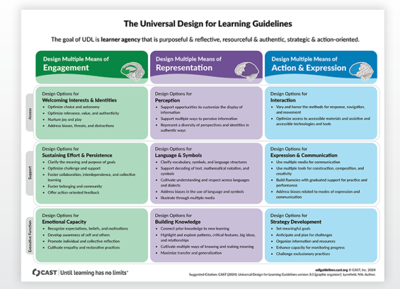
UDL Guidelines:

Slide 3
Multiple Means of Engagement
UDL consideration "Promoting Individual and Collective Reflection" was used to support students in achieving the learning goal of mastering fractions and decimals, which served as a culminating objective for the term.

Slide 4
Last Week of Math Class Activities
Post test given to students
Reflection
Kahoot
Group discussion

Slide 5
Last week of class
Students were given the same test (Pre-test)that was given the first week of class
  Provided students an opportunity to actively reflect on their growth and understanding over the course of the term
  Built confidence and provided a clear result of their new knowledge gained

Slide 6
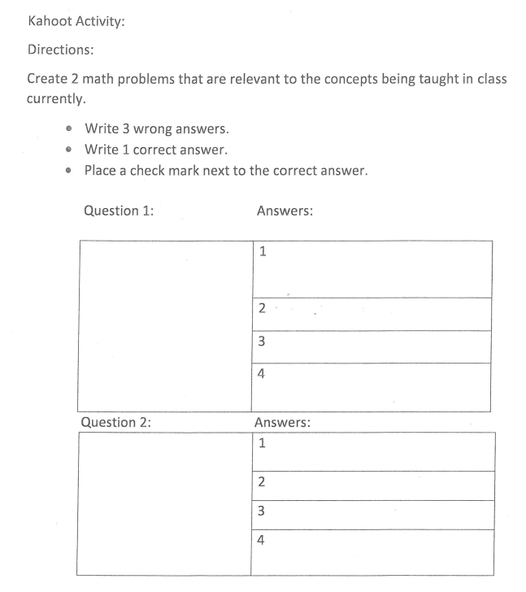
End of term Kahoot
Students created two Kahoot questions based on anything they learned over the eight weeks.
These questions were compiled into a class Kahoot activity, allowing students to celebrate their learning in a fun and interactive way.

Slide 7
Reflection Discussion
Students were asked to briefly reflect on their learning journey throughout the course. They were given the choice to write a response or share aloud with the class.
This provided choice and ownership over their reflection process.

Slide 8
Small group discussion
Discussed what they learned and what concepts they were still struggling with
Brainstormed how to act on this reflection
  Students identified areas where they still needed reinforcement
  Class generated strategies for ongoing support
    Using ChatGPT to clarify concepts
    Kahn Academy
    Visiting the tutoring center
    Accessing resources on Blackboard
    Attending office hours

Slide 9
Student responses
How did the Kahoot exercise and reviewing the pre test you did on the first day of class and then completing now help you learn the content better?
It reminded me of past lessons that are important
It showed me how much I've learned compared to the beginning of class
having our classmates create the kahoot was fun and challenging and looking back on the pre test and doing it again gave me confidence and was proud to see how much i’ve learned
It helped a lot
Thinking on the spot is a good way for me to learn and kahoots help, being able to come up with word problems gave me a better understanding of word problems so that did help and the review of the final helped me look at what I still need to study with
N/A
Please explain why the work was too easy, just right, or too hard.
The work is just right because it is so easy to learn and explained so well
I was actually learning the subject matter
i think it covered a little bit of everything we’ve learned in class so far
It was a challenge but i got to understand my work pretty quickly
It was just right because it involves using a white board or mental math and the questions were stuff we recently learned
fractions throw me off like ill get it sometimes but then when i try to come back and do it again i cant i be completely lost

Slide 10

Multiple Means of Representation
(“The what of learning”)
Presenting information in different ways to make it accessible. ​
Illustrate through multiple media
Clarify vocabulary, symbols and language structures
Support decoding of text, mathematical notation, and symbols

Slide 11
Learning Goals(Math):
MP1: Make sense of problems and persevere in solving them decoding and representing math symbolically.​
MP2: Reason abstractly and quantitatively moving between concrete (language) and abstract (symbols).​
MP4: Model with mathematics representing relationships using symbols, text, and visuals.​
MP6: Attend to precision using accurate mathematical language and structure.​
Standards:​
3.OA.6 and 3.OA.7

Slide 12
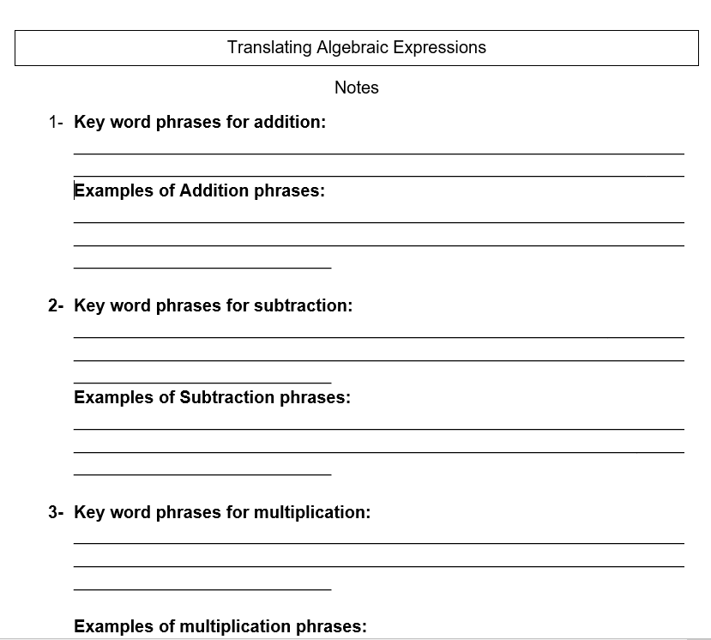
PowerPoint with helper notes

Slide 13
Activity
Students were given an algebraic equation or phrase and they needed to walk around the room to find their match.
Once they found their match they placed their matches on the table.
Example: "x/2 + 9" and "half a number increased by 9"
This activity was done 3 times, the third time everyone was given a phrase and an equation and had to find their match and then we shared.

Slide 14
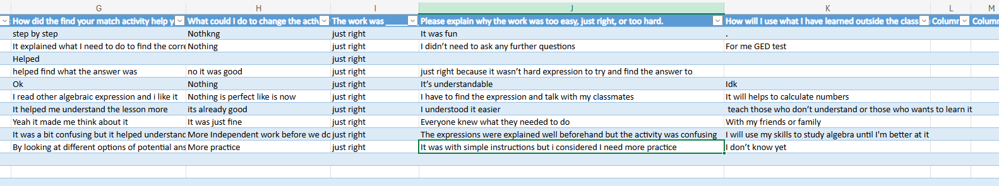
What did the students say?

Slide 15
Reflection
Students were engaged- variety of modalities were used
Knowledge was retained better than in previous semesters
Need to do a bit more practice before starting activity, discuss background knowledge
Students built self-awareness of the way they want to learn and works best for them as a learner
Students were able to make connections to the content and to others in class, building more of a community within the classroom

Slide 16
Multiple Means of Action and Expression

Slide 17
Goal was to:
Focus on Executive Functioning skills within the MM of Action and Expression
Provide tools for students to plan, monitor and achieve their goals
Support organization, task management, and self-regulation

Slide 18
Why ?
Allows for autonomy
provides multiple options for learning
Assists with reducing anxiety
provides accountability to the student

Slide 19
Goal Setting
In Adult Education, many learners at the higher levels (NRS levels 4-6) struggle not because of content but because of planning, attention, or task management barriers.

Slide 20
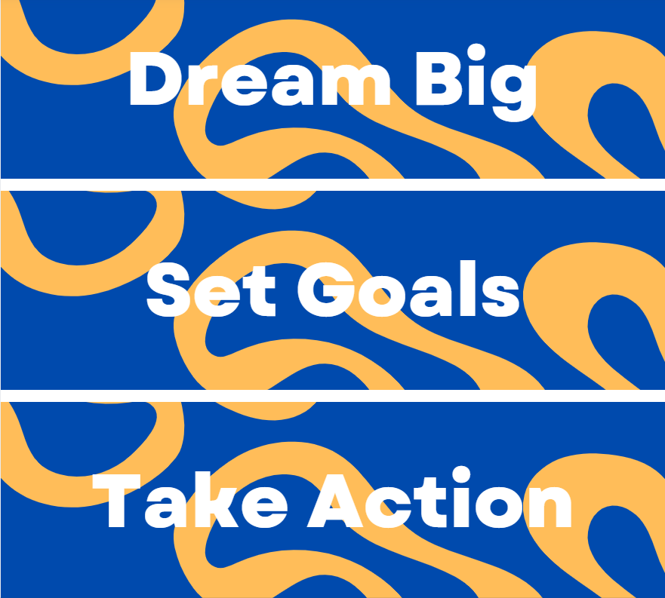

Slide 21
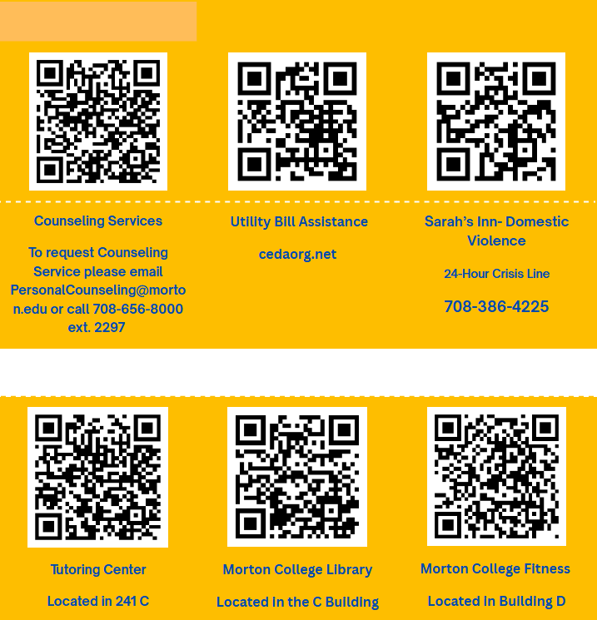
Resources to assist with your goals

Slide 22
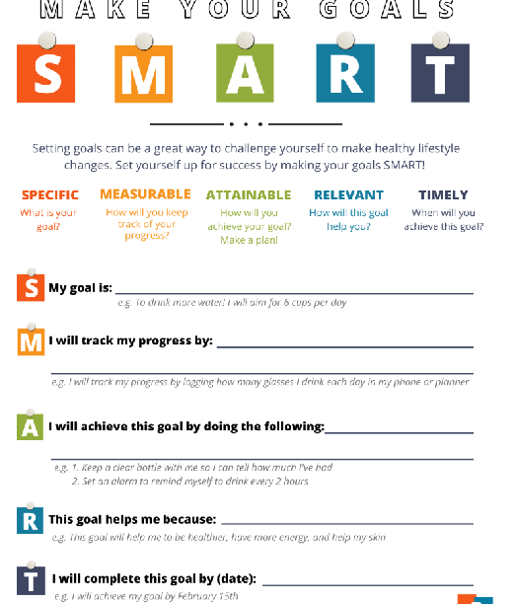
Students set a SMART Goal

Slide 23
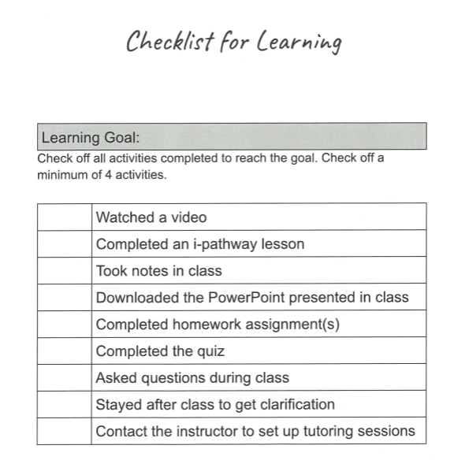
Students were provided with a checklist
(This provided a strategy for students to be successful and held the students accountable for their learning)

Slide 24
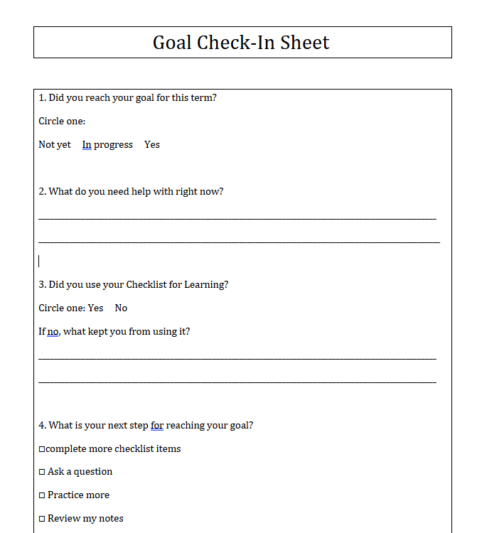
Check-ins

Slide 25
At the end of the term students...
reviewed their goal
Reviewed the checklist
Wrote a reflection

Slide 26
Writing an Essay
Incorporating the 3 UDL principles into 1 lesson

Slide 27
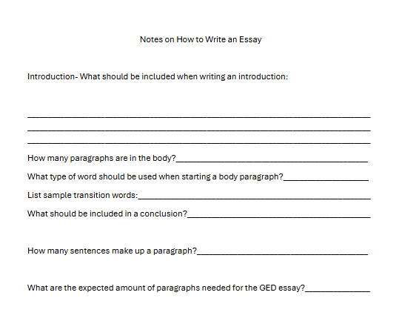
Lecture
Use PowerPoint with helper notes

Slide 28
Share the video from GED Testing Service
GED Testing Service Video: Essay Writing

Slide 29

Share an example of an essay
Sample Essay
GED Sample Essay
The following is an example of a high-scoring essay response to our free practice GED Essay Prompt. Below our GED sample essay is a brief analysis justifying its perfect score.

Slide 30
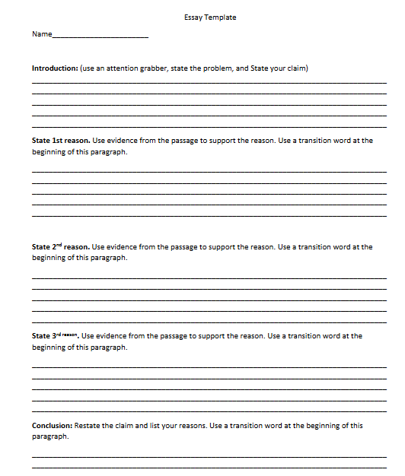
Essay template

Slide 31
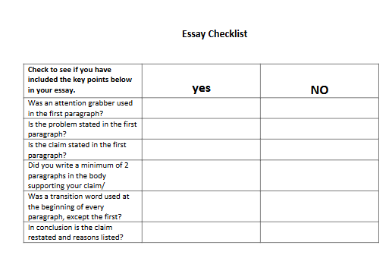
Checklist

Slide 32
UDL
Engagement
Scaffolded steps increase clarity (Sustaining effort & persistence)
Checklist encourages self-monitoring (Self-regulation)
Representation
PowerPoint
Helper notes
Video on essay writing
Example essay
Action & Expression
Essay template
Writing process
Checklist to support planning & revision (Executive functions)

Slide 33
Link to PowerPoint
VLC January.pptx

