Slide 1




Bridge and ICAPS Virtual Learning Community
Notes:
‹#›

Slide 2
Bridge and ICAPS Learning Community Purpose
Fulfill the mission of the Transitions Academy
Increase knowledge of documentation and compliance
Share information, ask questions, and learn from one another
Explore partnerships
Provide a safe place to share challenges and provide support
*If you need a PD certificate for this hour, please email us at sipdctrainer@gmail.com.

Slide 3
Healthcare Pipeline
Thank you to:
Patti Wragg and Julie Lieving from Kishwaukee College
Chantal Savage-Bryant from Danville Area Community College
Sara Escatel and Carrie Danekas from Illinois Valley Community College
Notes:
Morton, JJC-IBT Grants, JJC is IBT and ESL
Heartland -ESL Truck Driving
*Angela-just because funded by special grants, still need approval via jotform
Put into DAISI correctly with alternative funding either 4900 or 4910 codes, even though not adult dollars, can still plug in.

Slide 4

Kishwaukee College: Health Sciences Bridge and ICAPS Programs
Notes:
You know where to find us. We are happy to email, jump on a Zoom, whatever works best. Also, you will see us at the Forum on September 10-11! We will resume ICAPS Office Hours in September.

Slide 5
History of Bridge & ICAPS Development for Health Science Careers
2016- established Bridge to Healthcare course. For many years, we did not have ICAPS; adults would enter programs at the college, like CNA program and short term trainings, like phlebotomy, without credit for ICAPS.
2018 Bridge to Careers- allowed ESL levels 5 & 6 to participate in bridge programs. Bridge to Careers has flexibility to generalize pathways or focus on specific pathways.
2020 Established Phlebotomy and Pharmacy Tech short term ICAPS, Model 2, through IBT grant, to help students transition to post-secondary and/or earn credentials. (Must have HS diploma before credential is earned or evaluated transcripts to show education)
2023-24 Redesigned the Bridge to Healthcare (& other) curricula to reflect best practices and changes in the workforce and college/certificate programs. Yearly, we run bridge to healthcare in fall, two-8-wk sections & Health Science ICAPS in spring- due to limited staff
2025 additional ICAPS programs were added in Health Sciences track: Model 1-CNA/BNA and Basic EMT; Model 2 Short term trainings- Dental Assistant and Sterile Processing

Slide 6
ICAPS at Kishwaukee College
Adult Ed provides:
Teacher Support Course for Model 1 and Model 2 Health Science ICAPS
Continued prep for HS diploma/AMOC attainment
Some GED testing funds
Transition support, referrals to funding, and employment references
Career Tech/Instructional Staff and Deans:
Career training/course instructors in both Model 1 and Model 2 programs
Internship/Clinical experience for CNA & EMT programs at local facilities like nursing homes or hospitals and EMT labs & program hands on trainings
Externships for Model 2- Phlebotomy, Pharmacy Tech, and Dental Assistant short term trainings at local blood centers, hospitals, pharmacies, and dental offices
Some Foundation funding for ICAPS programs to offset expenses of tuition
Workforce/employment resources through Career Services Office

Slide 7
Important: Extra Activities
Include guest speakers for bridge classes:
Panel of professionals from providers in the surrounding communities and/or college: nursing student, paramedic/EMT, biolab/researcher, phlebotomist, dental assistant, pharmacy technician,and/or nursing instructor or others willing to share their career experiences
College Advising, WIOA, WIOA Youth,and Career Services providers
Health Sciences College Fairs-at KC- fall semester, to show all programs and spark interest- explanation of kinds of programs and requirements
Health Sciences Employer Fairs- Through the local One Stop or community organizations such as a Wellness Centers to help with employment opportunities for students
Field Trips to local health providers like County Health Department, YMCA, Northwestern Medicine Wellness Center, or NW Medical Center/Hospital

Slide 8
***Data
Data from FY 20-FY25
# Bridge participants: Careers-113 Health Sciences- 65 All Other Bridges-144 Total: 312
Others include: Academic Bridge; Information Technology; Manufacturing Tracks
# ICAPS completers for Health Science tracks since 2020:
Phlebotomy- 9 students (most established) 2 enrolled 2026
Sterile Processing-2 students (new program) 1 enrolled 2026
Certified Nursing Assistant- 2 students (new program) 1 interested 2026
Pharmacy Tech- 1 student completed (high math level required) 1 enrolled 2026
Dental Assistant is new spring 2025, no completers yet
EMT is also new spring 2025, no completers yet
________________________________________________________________________________
Other ICAPS:
Google IT ICAPS: 5 MS Application Specialist: 5 Manufacturing ICAPS: 3
New for 2026: CDL Bridge and ICAPS Run in Spring/Summer
FY 26-27 Developed Automotive-Diesel bridge/ICAPS; Welding ICAPS to go with Manufacturing Bridge

Slide 9
Advice
Research the needs for labor in local area- don’t build bridge/ICAPS that have no jobs available in your area
College/program support- if you don’t ask, you will never get the support; show how your adult learners are important to the college and community- data or anecdotal evidence
Find financial supports from donors/foundations/college, WIOA Adult or Youth, or local employers to offset expenses for program expenses or student tuition
Adult learners need to commit to the program- not everyone will do it, even if it is free to them and with support. Be sure to get a commitment in writing and they should pay a little out of pocket to have a vested interest in completing- even if it is just books or supplies
Ask for help from the experts in AE and other programs to develop a program that works for your needs in your area of employability
Short term credentials have a lot of power (MODEL 2)
  Students do not have to go to commit for 2 years to get credential/job placement
  Model 2 programs are usually more flexible, if you have them available
  There are other credentialing bodies besides a college program that may be available
  Ask your WIOA representative for some ideas for credentialing institutions that their funds may support that may not be linked to a college semester program
Don’t forget to label your programs in DAISI to get credit for the Bridge and ICAPS. Mark students completed when they earn their credential
Establishing teams/cohorts of students help to keep students engaged

Slide 10

Danville Area Community College

Slide 11
What Bridge and ICAPS do you offer in the Healthcare industry?
ICAPS in the Healthcare Industry:
Public Healthcare Billing Management (PHMB)
CNA
Pharmacy Technician
Phlebotomy
Direct Service Professional
Certified Medical Assistant
Notes:
Currently, Danville Area Community College offers a wide variety of Integrated Career and Academic Preparation System (ICAPS) programs in the healthcare field. Our longest-standing and most successful healthcare ICAPS offering is Public Healthcare Billing Management (PHMB), which launched in PY2024. This two-semester, six class program, prepares students for entry-level medical billing positions in outpatient settings, with a specific focus on public health departments and related billing procedures. In addition to technical billing skills, students learn the regulatory requirements necessary to establish and maintain a medical billing department within a small independent practice or public health agency.
In addition to PHMB, we offer several short-term, “learn-to-earn” healthcare ICAPS credentialing programs, including Certified Nursing Assistant (CNA), Pharmacy Technician, Phlebotomy, Direct Service Professional (DSP), and Certified Medical Assistant (CMA). These programs are designed to support rapid entry into the workforce while maintaining strong academic and career alignment.
The college-bearing credits earned through the Public Healthcare Billing Management Certificate are stackable and provide a clear pathway for students who are motivated to continue their education toward an Associate’s Degree in the field. Similarly, the CNA certification is intentionally structured to promote a seamless transition for students seeking to advance into nursing and other allied health professions.

Slide 12

What Bridge and ICAPS do you offer in the Healthcare industry?
Bridges in the Healthcare Industry:
Healthcare Bridge courses
Healthcare Context
Foundational Academic Skills-Reading, Math, Digital Literacy
Notes:
To further support student success, we offer Healthcare Bridge classes that serve as a supported on-ramp into healthcare careers. These bridge courses strengthen foundational academic skills—such as reading, math, and digital literacy—within a healthcare context. Rather than teaching skills in isolation, instruction is contextualized through medical terminology, workplace expectations and readiness, and patient-care scenarios.
As a result, students gain increased confidence, academic preparedness, and career clarity, leading to higher persistence, stronger performance in credential programs, and improved employment outcomes. Healthcare Bridge classes reduce barriers, shorten time to completion, and help adult learners move from “I might” to “I’m ready.”

Slide 13
What was the order of creation for your Bridges and ICAPS (which came first, second, etc.) ?
CNA
⇓
Strategic Redesign-CNA, ELEVATE Initiative
Notes:
Initially, prior to my appointment as Director, the Adult Education and Literacy program offered a single healthcare ICAPS pathway: Certified Nursing Assistant (CNA). While the program was solid, there was an opportunity to introduce additional rigor, innovation, and an expanded set of career options for adult learners.
As part of a strategic redesign, we developed the Public Healthcare Billing Management (PHMB) ICAPS, which marked the next phase of program evolution. Concurrently, we rebranded our ICAPS programming as the ELEVATE Initiative. This was an intentional decision - words matter - and “ELEVATE” more accurately captured the program’s purpose: to lift students academically, professionally, and economically.

Slide 14
Progress over time
What was the order of creation for your Bridges and ICAPS (which came first, second, etc.)?
AEL and PHMB Program Alignment
PY 2025
  Pharmacy Technician
  Phlebotomy
  Direct Service Professional
  Certified Medical Assistant
Notes:
The alignment between the AEL program and the PHMB ICAPS was seamless. The faculty member leading the program had earned her GED earlier in life, brought lived experience that deeply resonated with students, and also served as an AEL instructor. This unique combination allowed us to design a cohort-driven model that integrated GED preparation, Healthcare Bridge instruction, and hands-on instruction in three credit-bearing courses.
Students met four days per week, with GED and Bridge instruction offered on one day and college-level coursework delivered on the remaining days. This structure provided academic reinforcement while accelerating progress toward both secondary credentials and postsecondary completion.

Slide 15
What data can you share on student success in your Healthcare pipeline of training?
Certificates
PHBM Certificate >30 students
CNA 4 students
Pharmacy Technician 4 students
Phlebotomy Certification 3 students
CMA-1 enrolled
Employment and Continuing Education
Large percentage secure employment
65% enroll in DACC as traditional students
Notes:
To date, our Healthcare ELEVATE pipeline has demonstrated strong student success and positive postsecondary and employment outcomes. More than 30 students have earned the Public Healthcare Billing Management (PHMB) Certificate, representing our most established and successful healthcare ICAPS pathway.
In addition, four students have completed the Certified Nursing Assistant (CNA) program, four students have earned Pharmacy Technician certification, and three students have earned Phlebotomy certification. One student is currently enrolled in the Certified Medical Assistant (CMA) program, reflecting continued momentum and progression within the healthcare pathway.

Slide 16
Do you have plans to expand your pipeline of training in Healthcare?
Instead of rapid expansion, focus on strengthening and sustaining
Instructional Quality
Access
Community Partnerships
Enrollment
Skills, Confidence, and Support
Funding
Notes:
At this time, we believe our healthcare training pipeline offers a solid and diverse range of pathways that effectively meet the needs of our community and students. Rather than rapid expansion, our immediate focus is on strengthening and sustaining the programs currently in place.
Our priorities include deepening instructional quality, ensuring students have access to the academic, career, and wraparound supports necessary for success, and continuing to engage and strengthen community partnerships. We recognize that, given funding realities, these programs cannot be sustained in isolation; collaboration and braided funding are essential to long-term viability.
Additionally, we aim to increase student enrollment across existing healthcare (and other offered) pathways and intentionally equip learners with the confidence, skills, and support needed to take their next steps; whether that is entering the workforce or continuing their postsecondary education.
Finally, we are actively exploring additional funding streams to support growth and sustainability, as the ELEVATE healthcare pipeline is a critical asset to our community and an essential pathway for adult learners seeking economic mobility.

Slide 17
What advice do you have for others building their Healthcare pipeline?
*Lead with Data* *Design with Intention*
Develop strong internal and external partnerships.
Serve the whole student.
Build partnerships with the students themselves.
Notes:
For institutions building or expanding a healthcare pipeline, my strongest advice is to lead with data and design with intention. Begin by examining local labor market information and student outcome data to identify the specific healthcare pathways your community truly needs; rather than offering programs simply because they are popular or convenient.
Equally important is the development of strong internal and external partnerships. Secure institutional buy-in early, and collaborate closely with academic departments, student services, workforce agencies, and community partners. In particular, seek out like-minded community partners who share your mission and can support braided funding strategies, as no healthcare pipeline can be built or sustained successfully through a single funding source.
Program design must extend beyond academics alone. Adult learners often enter our doors carrying familial responsibilities, socioeconomic barriers, and limited confidence shaped by prior educational experiences. Effective healthcare pathways must address the whole student, ensuring that academic instruction is supported by career readiness, wraparound services, and intentional community partnerships capable of responding to real-life challenges.
Finally, build authentic partnerships with students themselves. Create a learning environment grounded in trust, grace, and open communication without compromising program expectations or rigor. When students feel supported, heard, and respected, they are far more likely to persist, succeed, and envision themselves as future healthcare professionals.

Slide 18
Illinois Valley Community College

Slide 19
BRIDGE & ICAPS in the
Healthcare Industry
Sara Escatel & Carrie Danekas
Illinois Valley Community College

Slide 20
Career Paths & Incentives
We did BRIDGE before ICAPS
ICAPS: CNA, PHLEBOTOMY
  Incentives: BRIDGE $500 scholarships paid for by the IVCC Foundation
  ICAPS – enrolled in GED & ICAPS
  Upon completion of their GED they get their First-Class-Free paid for by the IVCC Foundation or our workforce partner, Business Employment Skills Team

Slide 21
What is the order of our program?
We enroll students from Advanced ELA and GED. These students transition to BRIDGE to Careers and ICAPS. The end result is transitioning to college, certificate attainment and/or employment.

Slide 22
Training and employer partnerships in Healthcare
We have employers that partner with the ICAPS programs. The Nursing Department facilitates the partnerships with our local hospitals and nursing homes.
OSF allows students to come into their hospital for clinicals.
Liberty Village, Ottawa Pavilion and Pleasant View Lutheran Home allow students to come into their nursing home for clinicals.

Slide 23
How did you customize your BRIDGE Curriculum to align with ICAPS training?
Career Awareness Module
Self Awareness
  Learning Styles Inventory
Goals
  Vision Board
Employability Skills
  Soft skills/hard skills
  Emotional IQ
Exit Interview with Advisor to discuss college plans/career goals
Guest Speaker from Healthcare Profession: CNA/Nurse
Contextualized Reading Module
  Skim & Scan an article
  Note taking skills
Contextualized Writing Module
  Email etiquette

Slide 24
Curriculum Continued
  Contextualized Social Studies
  Maslow’s Hierarchy of Needs
  Introduction to Post Secondary Education
  Test taking strategies
  Career Development Module
    Types of Letters
  Career Awareness Module
    Learning Styles
    Technology Awareness and skills
    Emails with attachments
    Create passwords for computer logins
    Academic Success Module
    Time Management
    Use textbooks, workbooks, & resources from the courses for CNA & Phlebotomy

Slide 25
How did your training components change/evolve as you grew the pipeline of BRIDGES and ICAPS?
Utilize the ICCB BRIDGE Curriculum as a resource to teach the students
Emphasize key components in the curriculum as needed for each career pathway
Supplement the curriculum with additional resources found online or in print.

Slide 26
Data on student success in Healthcare pipeline of training
6 ICAPS Students in Healthcare: CNA, Phlebotomy
FY 25, 6 students passed & completed
3 students working in their Healthcare related fields

Slide 27
Do you have plans to extend your pipeline of training in Healthcare?
ICAPS Dental Assisting may be in the pipeline for the future. It’s an emerging career for our students at IVCC.
ICAPS Emergency Medical Technician is another pipeline for the future.

Slide 28
Advice to others building their Healthcare pipeline
Choose the right teacher
Choose high demand career pathways
Provide an orientation: testing, program expectations, enrollment, & interview (short term and long-term goals)
Provide comprehensive support services
Meet regularly with the students for support

Slide 29
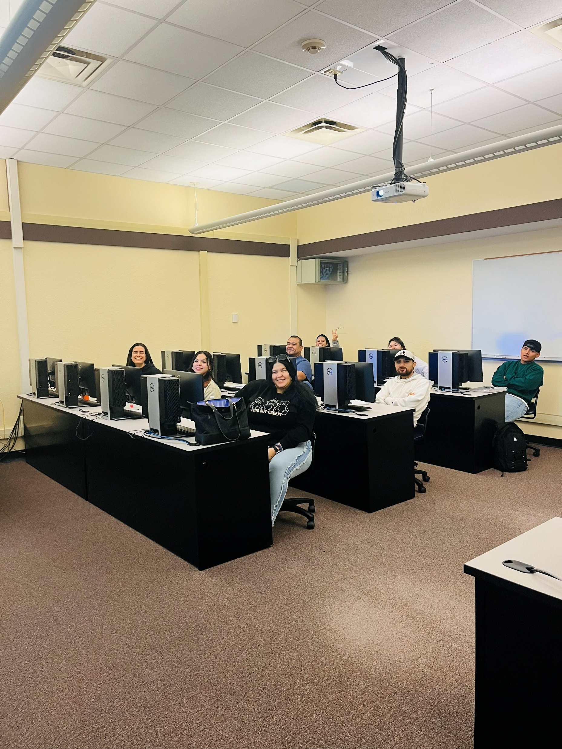
BRIDGE CLASS

Slide 30

Graduation Reception

Slide 31
Questions?
Thank you!

Slide 32
Future Bridge and ICAPS Virtual Learning Community Dates:
February 12
Let’s Chat
FY26 current ICAPS and Bridges lists are up!

