Slide 1
Calculating the Average: Average Salary

Slide 2

Career Decision
How important is the salary when making a decision about what career path you will choose?

Slide 3

What is an average?
The average is sometimes called the “mean.” This is the about how much is represented in a set or list of numbers.

Slide 4

Vocabulary
Practice!
Mean
Wage
Annual
Projected
ECE
CNA
Data
Sum
The average; about how much is in a set or list of numbers
Money earned (hourly or salary)
Per year
What is expected
Early Childhood Education
Certified Nursing Assistant
Information or numbers that are used for reference and analysis
The answer to an addition problem
https://wordwall.net/resource/103271202/average-salary-lesson-vocabulary

Slide 5
How do you find the average?
To find the average, you must follow 3 steps:
Gather the data you wish to average.
Add up the numbers.
Take the sum and divide by the total number of numerals in the data set. This is your average!

Slide 6
Gather the data you wish to average
Students in this class vary in age. Sonya is 19, Mark is 25, Ed is 28, Fatima is 21, Huang is 30, Sabina is 24, Sofia is 34, Carlos is 22, Ted is 36, and YoYo is 29.
We wish to find the average age in this class.

Slide 7
2. Add the numbers
Students in this class vary in age. Sonya is 19, Mark is 25, Ed is 28, Fatima is 21, Huang is 30, Sabina is 24, Sofia is 34, Carlos is 22, Ted is 36, and YoYo is 29.
19+25+28+21+30+24+34+22+36+29= 268
This is the sum

Slide 8
3. Take the sum and divide by the total number of numerals in the data set.
Students in this class vary in age. Sonya is 19, Mark is 25, Ed is 28, Fatima is 21, Huang is 30, Sabina is 24, Sofia is 34, Carlos is 22, Ted is 36, and YoYo is 29.
There are 10 people in the class. Divide 268 by 10
268 / 10 = 26.8 This is your average age

Slide 9
Average Salary Word Problems
Texas, Oklahoma, Arizona, and New Mexico are all Southwestern states. Truck drivers in Texas make an average of $48,234 per year. In Oklahoma, they make about $46,329 per year. In Arizona, they make $47,876 annually. In New Mexico, they make $45,987 per year. What is the average wage for truck drivers in those 4 Southwestern states?
In 2021, David made $31,285. In 2022, he made $33,471. In 2023, he lost his job and only made $25,437. In 2024, he got a better job and made $45,200. In 2025, he made $45,345. What is David’s average yearly wage for the past 4 years?
A packer who has worked at Acme Packing for 10 years makes $25 an hour. A worker who has worked there for 5 years makes $20 an hour. A new worker makes $17 an hour. What is the average hourly wage of all workers?
Adapted from World Relief Emerging Careers Class

Slide 10
Average Salary Word Problems
In September, Maria made $2,345. In October, she made $2,155. In November, she made $2,853. In December she took a vacation and only made $1,587. What is Maria’s average monthly wage for those months?
Childcare workers in Chicago make about $16 an hour. Substitute teachers make about $19 an hour. Nannies make about $20 an hour. Kindergarten teachers make about $29 an hour. What is the average wage for Early Childhood Education (ECE) jobs in Chicago?
Bill is a waiter. On Saturdays, he usually makes about $85 in tips. On Sundays, he makes $55 in tips. On Mondays he usually makes $25 in tips. On Tuesdays, he makes $30 in tips. On Thursdays, he makes $60 in tips. On Fridays, he makes $75 in tips. What is the average amount of tips he gets in one day?
Adapted from World Relief Emerging Careers Class

Slide 11
Average Salary Word Problems
Maya started her own business and made $2,015 in February. In March she made $2,890. In June she made $4,754. In July she made $5,659, and in August she made $5,230. What was her average income during the summer months?
Yanis works as a CNA and makes $39,872 a year. Stefano works as an X-Ray Technician and makes $77,600 annually. Marco is a Registered Nurse and makes 93,550. Ellison is a Physical Therapist and makes $101,020. What is the average salary for these friends all working in the healthcare industry?
A supervisor in a company in Sacramento, California makes $35 per hour. A supervisor at the same company in Minneapolis, Minnesota makes $31 per hour. Another supervisor from the same company in Phoenix, Arizona makes $33 per hour. What is the average hourly wage for supervisors in that company?
Alexi is researching jobs as a Dental Assistant. In New York, the average salary is $47,020. In New Jersey, the average salary is $48,070. In Pennsylvania, the average salary is $48,290. What is the average salary for these three east coast states?
Adapted from World Relief Emerging Careers Class

Slide 12
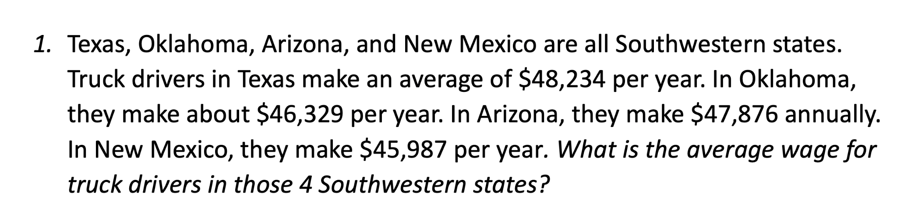


Slide 13
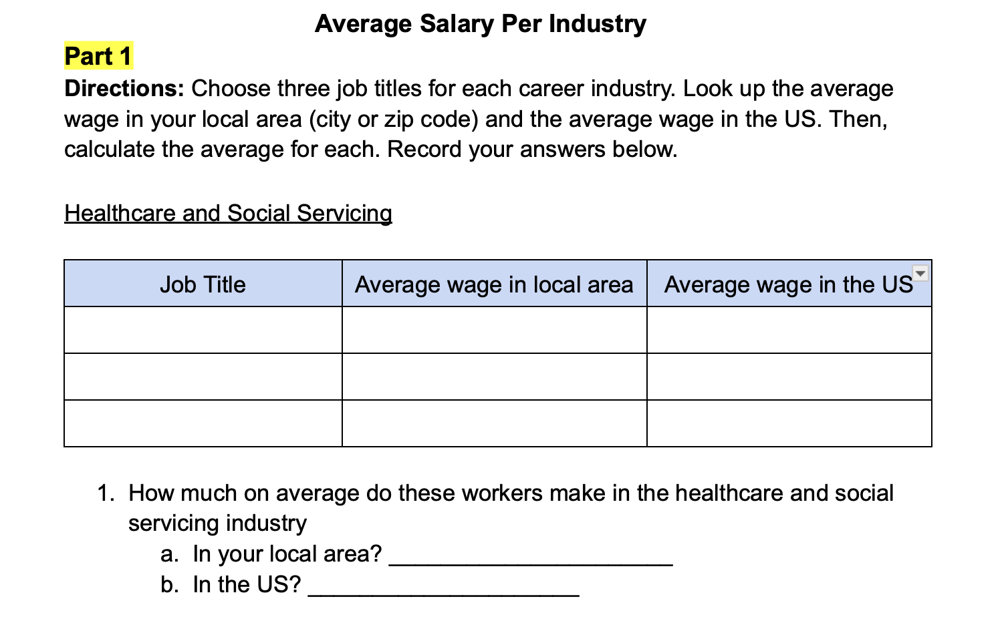

Slide 14
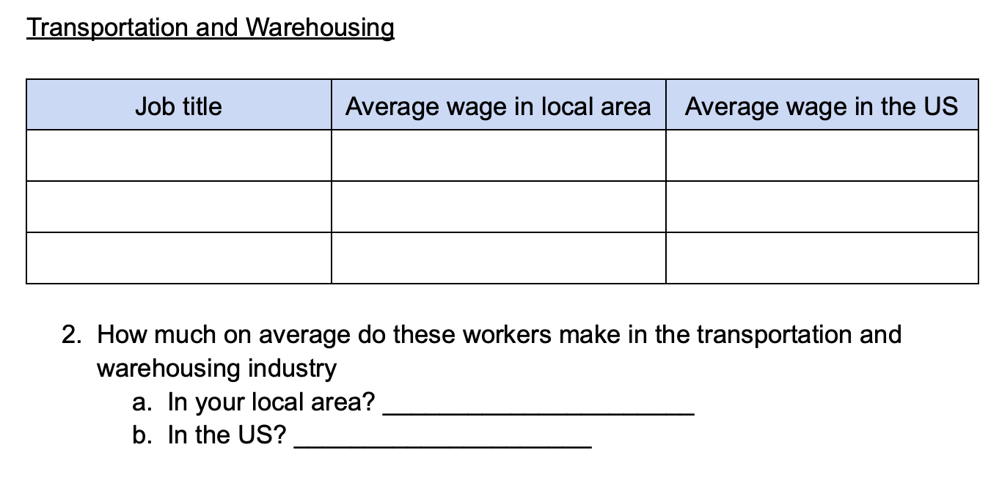

Slide 15
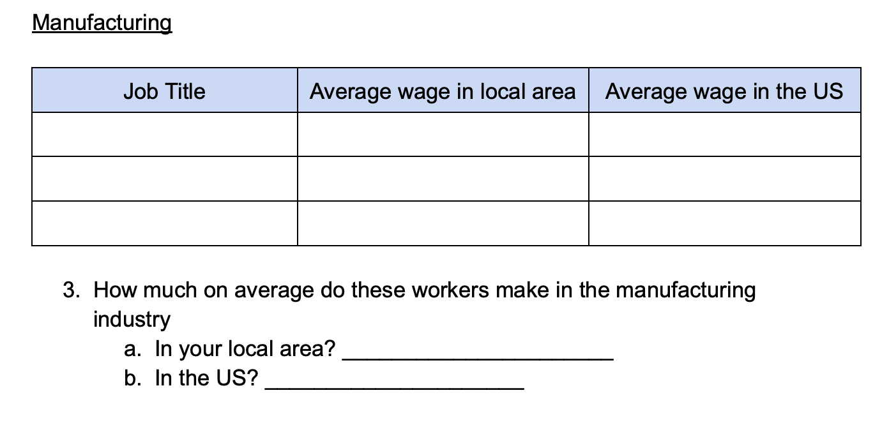

Slide 16
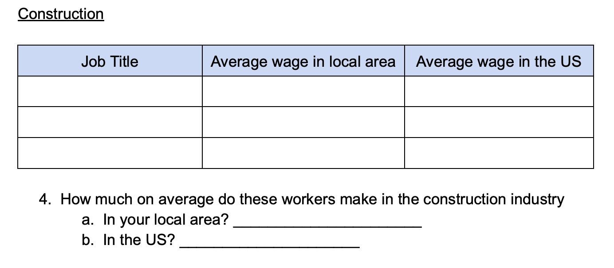

Slide 17
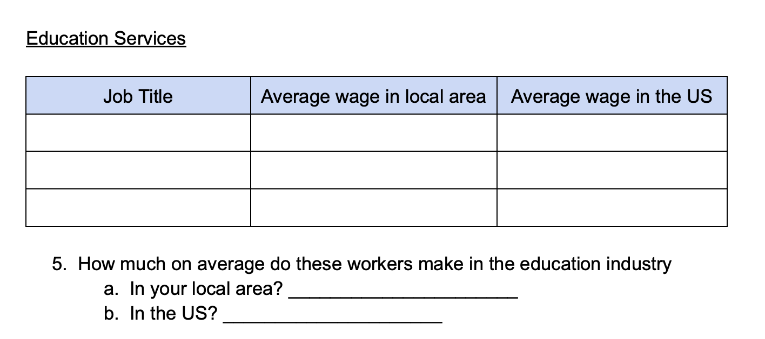

Slide 18
