Slide 1
EXPLORING CAREERS
Laura J. Bragg
Early School Leaver transition Program Advisor
Black Hawk College Optional Education

Slide 2
QUESTIONS TO ASK YOURSELF
What are my career interests?
Which careers do I want to explore?
What are my career goals?
Who’s doing what I want to do?
How do I start my career?
TED Talk: Scott Dinsmore
https://youtu.be/jpe-LKn-4gM

Slide 3
CAREER FACTORS
Interests
Values and Motivation
Skills and Qualifications
Location and Outlook
Personality
Education and
Training
Work
Environment

Slide 4
CAREER INTEREST INVENTORY
DOES:
Identify your likes, dislikes, interest areas
Find out about careers that are a good match for your
Help you decide if you need more training or experience in an area
DOES NOT:
Determine if a career will make you happy
Guarantee a job
Influence employment decisions
Have right or wrong answers
Require a certain amount of education to use

Slide 5
REALISTIC
1. FIX ELECTRICAL
THINGS

Slide 6
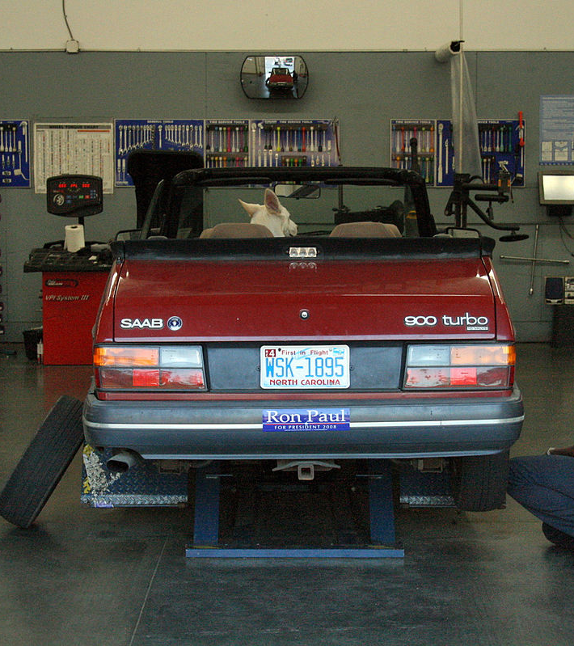
REALISTIC
2. REPAIR CARS

Slide 7
REALISTIC
3. BUILD THINGS
WITH WOOD

Slide 8
REALISTIC
4. DRIVE A TRUCK OR
TRACTOR

Slide 9
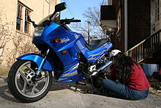
REALISTIC
5. WORK ON A
MOTORCYCLE

Slide 10
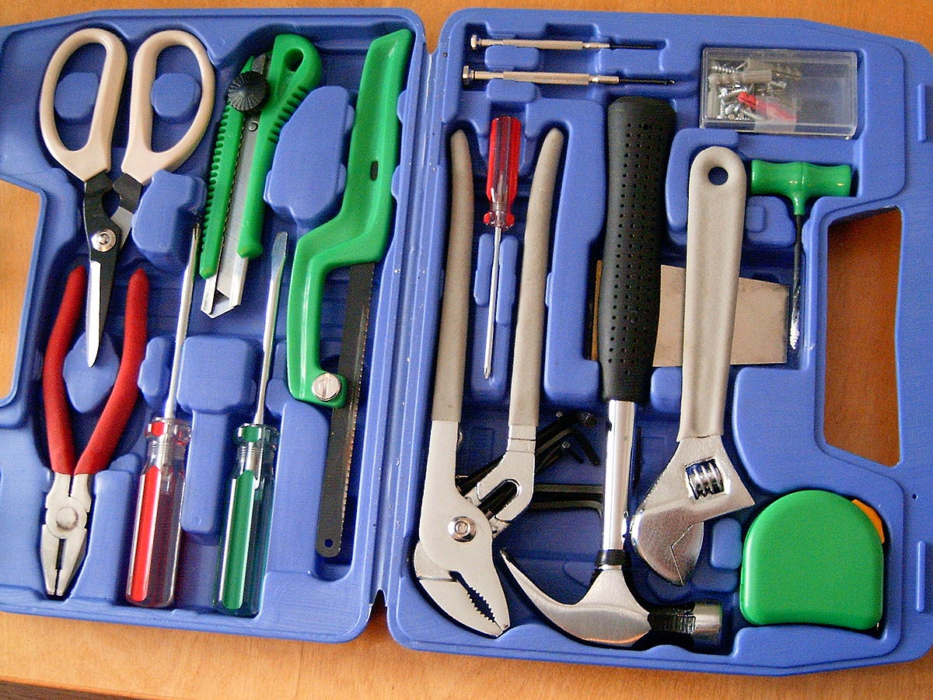
REALISTIC
6. USE MACHINE
TOOLS

Slide 11
INVESTIGATIVE
7. WORK IN A LAB

Slide 12
INVESTIGATIVE
8. READ SCIENTIFIC BOOKS OR MAGAZINES

Slide 13
INVESTIGATIVE
9. SOLVE MATH OR CHESS PUZZLES

Slide 14
INVESTIGATIVE
10. BUILD ROCKET
MODELS

Slide 15
INVESTIGATIVE
11. WORK WITH A
CHEMISTRY SET

Slide 16
ARTISTIC
12. SKETCH, DRAW, OR
PAINT

Slide 17
ARTISTIC
13. PLAY A MUSICAL
INSTRUMENT

Slide 18
ARTISTIC
14. DESIGN FURNITURE OR
BUILDINGS

Slide 19
ARTISTIC
15. CREATE PORTRAITS OR
PHOTOGRAPHS
This Photo by Unknown author is licensed under CC BY-NC-ND.

Slide 20
ARTISTIC
16. READ OR WRITE POETRY
This Photo by Unknown author is licensed under CC BY-NC-ND.

Slide 21
SOCIAL
17. TAKE CARE OF
CHILDREN

Slide 22
SOCIAL
18. GO TO SPORTS EVENTS

Slide 23
SOCIAL
19. HELP OTHERS WITH
PERSONAL PROBLEMS

Slide 24
SOCIAL
20. MAKE NEW FRIENDS

Slide 25
SOCIAL
21. WRITE LETTERS TO
FRIENDS

Slide 26
ENTERPRISING
22. SELL SOMETHING

Slide 27
ENTERPRISING
23. OPERATE YOUR OWN
BUSINESS

Slide 28
ENTERPRISING
24. SUPERVISE OTHERS

Slide 29
ENTERPRISING
25. GIVE TALKS

Slide 30
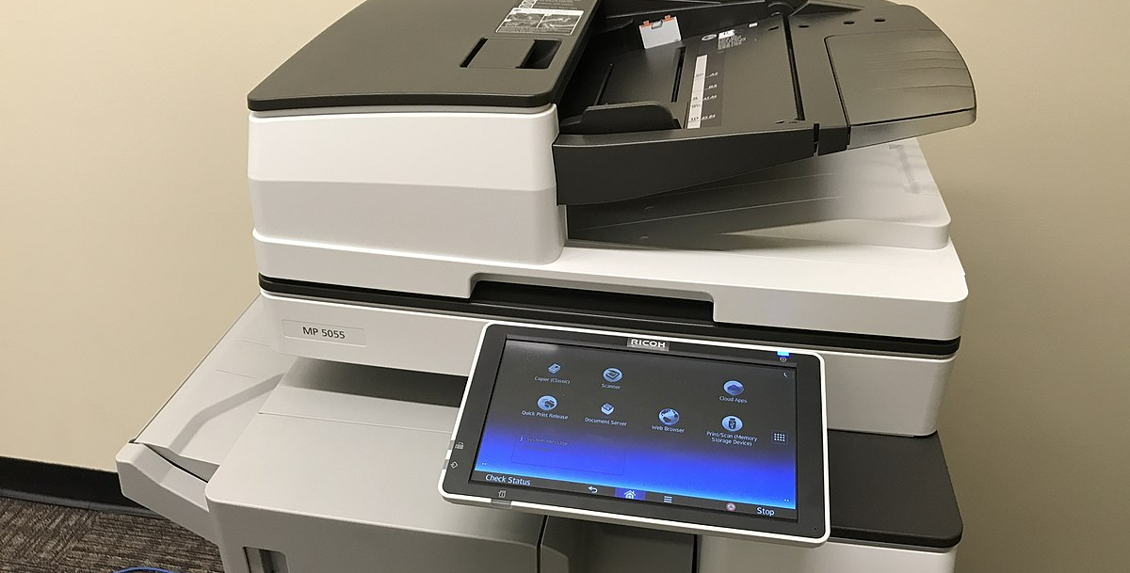
CONVENTIONAL
26. OPERATE
COMPUTERS OR
OFFICE MACHINES

Slide 31
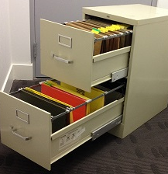
CONVENTIONAL
27. FILE LETTERS, REPORTS,
OR RECORDS

Slide 32
CONVENTIONAL
28. KEEP DETAILED
RECORDS OF
EXPENSES

Slide 33
CONVENTIONAL
29. KEEP YOUR DESK AND
ROOM NEAT

Slide 34
COVENTIONAL
30. ADD, SUBTRACT,
MULTIPLY, DIVIDE
NUMBERS

Slide 35
INTEREST CODES AND WHAT THEY MEAN
https://youtu.be/fyR6yJifLHI

Slide 36
REALISTIC
LIKE
LIKE TO MAKE THINGS WITH THEIR HANDS
HAVE
HAVE GOOD EYE AND HAND COORDINATION
PREFER
PREFER JOBS SUCH AS MECHANICS, CONSTRUCTION WORKERS, ETC.

Slide 37
INVESTIGATIVE
LIKE
LIKE TO DO RESEARCH, STUDY CIRCUMSTANCES AND EVENTS
HAVE
HAVE DESIRE TO WORK ALONE OR IN SMALL GROUPS
PREFER
PREFER JOBS AS BIOLOGISTS, ENGINEERS, RESEARCHERS, COMPUTER OPERATORS, DIETICIANS

Slide 38
ARTISTIC
LIKE
LIKE TO EXPRESS THEMSELVES BY THEIR ARTWORK. DON'T LIKE RIGID STRUCTURE
HAVE
HAVE, CREATIVITY, LIKE TO BE GUIDED BY THEIR FEELINGS
PREFER
PREFER JOBS AS ACTORS, HAIRDRESSERS, PHOTOGRAPHERS, TRANSLATORS, POETS, DANCE INSTRUCTORS, COMPOSERS, ETC.

Slide 39
SOCIAL
LIKE
LIKE TO BUILD RELATIONSHIPS WITH OTHERS AND HELP
HAVE
HAVE GOOD PEOPLE SKILLS
PREFER
PREFER JOBS AS NURSES, COUNSELORS, TEACHERS, COACHES, PLAYGROUND SUPERVISORS, PARAMEDICS,

Slide 40
ENTERPRISING
LIKE
LIKE TO EXPRESS THEMSELVES, POWER AND PRESTICE
HAVE
HAVE STRONG PERSUASION SKILLS
PREFER
PREFER JOBS AS REAL ESTATE AGENTS, SELLERS, PROMOTERS, SALES REPRESENTATIVES, HOTEL MANAGER,

Slide 41
CONVENTIONAL
DETAIL AND STRUCTURED
LIKE DETAIL AND STRUCTURED WORK
HAVE
HAVE NEED FOR ORDER
PREFER
PREFER JOBS LINKED TO THE BUSINESS WORLD SUCH AS OFFICE CLERKS, COMPUTER PROGRAMMER, SECRETARY, CASHIER, BOOKKEEPER, FILING CLERK,

Slide 42
10 HIGH IN DEMAND CAREERS
Nursing Assistant
Construction
Physical Therapy Aide
Medical Technologist
Health Services Administrator
Registered Nurse
Information Security Technologist
Average salary: $28,454/year
Average salary: $31,616/year
Average salary: $33,238/year
Average salary: $56,368/year
Average salary: $70,147/year
Average salary: $70,366/year
Average salary: $82,555/year

Slide 43
Questions?

