Slide 1

Communicating with Clarity:
Conflict Resolution Strategies for Success
Administrator Virtual Learning Community
Southern Illinois Professional Development Center
Wednesday, November 19^{th,} 2:00
While we wait for everyone to join:
  Please put your name and organization in the chat.

Slide 2

INTRODUCTION: Kristen Curtis-Krell
Over 30 years of experience leading and facilitating teams across education, workforce, and community sectors
Former TAACCCT Director at Santa Fe Community College, with expertise in adult education and workforce alignment
Founder of Curtis Consulting Services, specializing in collaborative leadership, communication, and team development

Slide 3
LEARNING OBJECTIVES
Discover the strengths and limitations of different conflict-handling styles using Alexander Hiam’s framework.
Reflect on your own approach to conflict and its impact on communication and workplace relationships.
Practice Compassionate Communication techniques from Marshall Rosenberg’s model to foster clarity, trust, and collaboration.

Slide 4
THE BUILDING BLOCKS OF EFFECTIVE COMMUNICATION
ACTIVE LISTENING: Truly hearing and understanding what the other person is saying without interrupting or planning your response. It involves paying attention, asking clarifying questions, and showing empathy so the speaker feels valued.
SHARING: Clearly and openly expressing your own thoughts, ideas, and feelings in a way that is respectful and easy for others to understand. Effective sharing balances honesty with consideration for the other person’s perspective.
FEEDBACK: Offering constructive responses that help clarify understanding and strengthen communication. Good feedback is specific, timely, and supportive—it highlights what’s working and suggests ways to improve, fostering trust and growth.
Notes:
3. Introduce Active Listening - slide

Slide 5
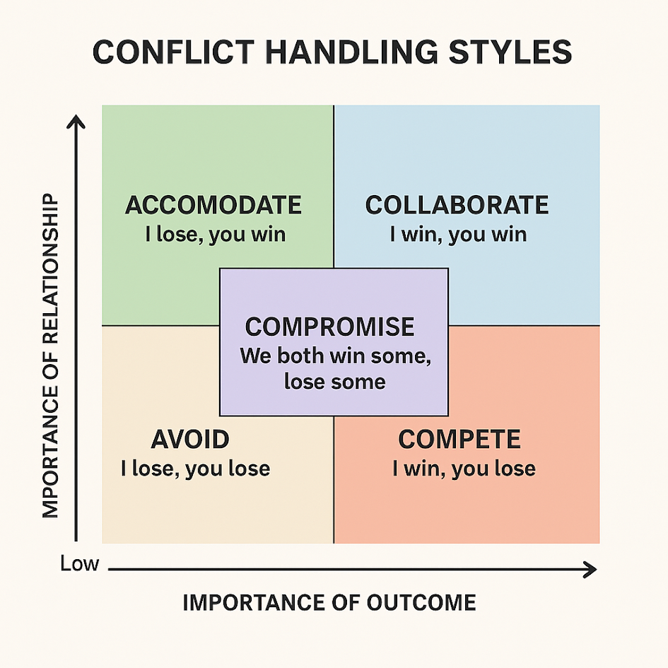
Alexander Hiam’s Conflict Handling Styles
Notes:
9:00-9:15| Dealing with Conflict:
Slides 11 - 17
Styles and Strategies
Facilitator Briefing (5 minutes):
Use Hiam’s conflict-handling styles (e.g., Avoiding, Accommodating, Competing, Compromising, Collaborating):

Slide 6
FIVE CONFLICT HANDLING STYLES
  Avoiding – Deliberately sidestepping or withdrawing from conflict rather than confronting it.
  Accommodating – Prioritizing the other person’s needs or desires over your own to maintain harmony.
  Competing – Asserting your position strongly to win the conflict, often at the other person’s expense.
  Compromising – Seeking a middle ground where each party gives up something to reach a solution.
  Collaborating – Working together to find a win-win solution that satisfies all parties’ needs.

Slide 7
Use the Mentimeter link in the chat to enter your response. What is your ‘goto’ conflict style (Avoiding, Accommodating, Competing, Compromising, Collaborating)?
Notes:
5 min

Slide 8
USING EFFECTIVE COMMUNICATION SKILLS FOR POSITIVE RESULTS
ACTIVE LISTENING: involves going beyond simply hearing the words that another person speaks. It's about actively processing and seeking to understand the meaning and intent behind them. It requires being a mindful and focused participant in the communication process.
Active listening techniques include:
  Being fully present in the conversation
  Showing interest by practicing good eye contact
  Listening to understand what is important to the other person rather than to respond
  Withholding judgment and advice
Notes:
3. Introduce Active Listening - slide

Slide 9

PARTNER SHARE
Using active listening, share with your team:
“HOW DOES ‘GO TO’ CONFLICT STYLE IMPACT YOUR ABILITY TO WORK WITH OTHERS?”
Notes:
5 min

Slide 10
TIPS FOR DEALING EFFECTIVELY WITH DIFFERENT CONFLICT HANDLING STYLES
  Avoiding – Tip: Give space initially but follow up when emotions are lower and resolution is more possible.
  Accommodating – Tip: Use this when the issue is minor, but be clear about your own boundaries to prevent resentment.
  Competing – Tip: Use in urgent situations, but pair with active listening to avoid escalating tension.
  Compromising – Tip: Focus on clear communication and shared goals to ensure the outcome feels fair.
  Collaborating – Tip: Invest time in understanding everyone’s interests and brainstorming creative solutions.
Notes:
3. Introduce Active Listening - slide

Slide 11
CREATING COLLABORATION
Clarify
Clarify Needs and Objectives
Encourage
Encourage Open Information Sharing
Explore
Explore Multiple Alternatives
Manage
Manage Emotions Constructively
Use
Use a Collaborative Problem-Solving Approach
Notes:
Clarify Needs and Objectives:
Ensure that each person shares their needs and goals openly to establish a common understanding. Share clearly what you need and want out of the situation.
Encourage Open Information Sharing:
Foster trust by expressing your intent to understand their perspective and by sharing information freely.
Explore Multiple Alternatives:
Offer a variety of creative options and stay open-minded. Emphasize that you're not fixed on any single solution but are committed to finding one that benefits everyone.
Manage Emotions Constructively:
Avoid collaboration when emotions are running high. Successful collaboration requires a calm, respectful, and trusting environment.
Use a Collaborative Problem-Solving Approach:
Work together to fully understand the problem, generate a range of possible solutions, and agree on implementing the best one.

Slide 12
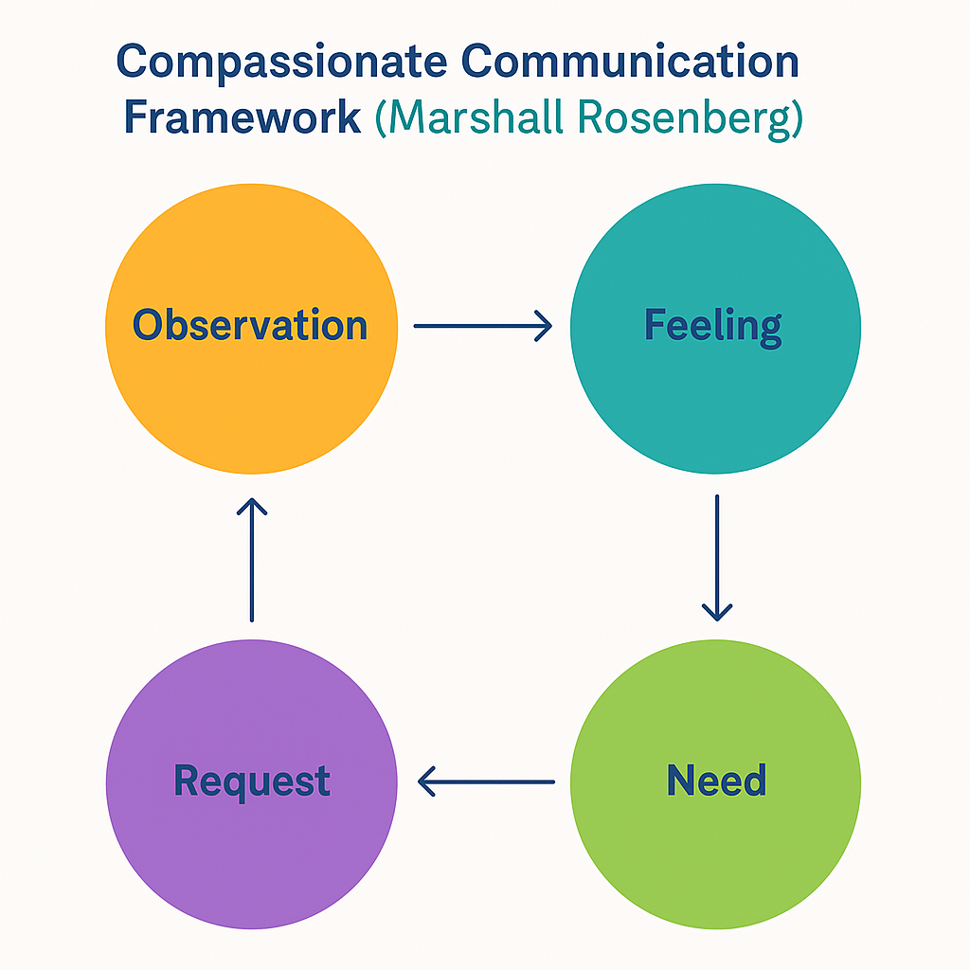
Notes:
Clarify Needs and Objectives:
Ensure that each person shares their needs and goals openly to establish a common understanding. Share clearly what you need and want out of the situation.
Encourage Open Information Sharing:
Foster trust by expressing your intent to understand their perspective and by sharing information freely.
Explore Multiple Alternatives:
Offer a variety of creative options and stay open-minded. Emphasize that you're not fixed on any single solution but are committed to finding one that benefits everyone.
Manage Emotions Constructively:
Avoid collaboration when emotions are running high. Successful collaboration requires a calm, respectful, and trusting environment.
Use a Collaborative Problem-Solving Approach:
Work together to fully understand the problem, generate a range of possible solutions, and agree on implementing the best one.

Slide 13
The Four Components of Non-Violent Communication
Observation – Describe what you see or hear without judgment.
“When I notice reports are turned in after the deadline…”
Feeling – Express how you feel about what you observed.
“…I feel anxious and frustrated…”
Need – Identify the underlying value or need.
“…because I need reliability and teamwork.”
Request – Make a specific, actionable request.
“Would you be willing to submit reports by Thursday next week?”
Notes:
Clarify Needs and Objectives:
Ensure that each person shares their needs and goals openly to establish a common understanding. Share clearly what you need and want out of the situation.
Encourage Open Information Sharing:
Foster trust by expressing your intent to understand their perspective and by sharing information freely.
Explore Multiple Alternatives:
Offer a variety of creative options and stay open-minded. Emphasize that you're not fixed on any single solution but are committed to finding one that benefits everyone.
Manage Emotions Constructively:
Avoid collaboration when emotions are running high. Successful collaboration requires a calm, respectful, and trusting environment.
Use a Collaborative Problem-Solving Approach:
Work together to fully understand the problem, generate a range of possible solutions, and agree on implementing the best one.

Slide 14
Transforming Language: Blame vs. Connection
Compassionate Response
Reactive Response
“You’re always late with your reports! You’re holding up the team.”
Observation: “I’ve noticed reports have been coming in late.”
Feeling: “I feel concerned and stressed…”
Need: “…because I value accountability and teamwork.”
Request: “Would you be open to discussing how we can stay on track?”
Notes:
“What differences do you notice between these two approaches?
How might the second one change the tone of the conversation?”

Slide 15
Turning Conflict into Connection – Small Group Activity
In small groups of 3–4 participants:
1. Choose a real or realistic workplace scenario (e.g., a colleague interrupting in meetings).
2. Reframe the situation using the 4 NVC steps: Observation → Feeling → Need → Request.
3. Share your reframed statement with the group.
4. Reflect together: What changed when you used this framework? What did you notice about tone and clarity?

Slide 16
An Overview: Giving and Receiving Feedback Effectively
Giving Feedback
Receiving Feedback
Be clear, specific, and focused on behavior—not character.
Describe the impact of actions on people, process, or outcomes.
Use curiosity-based language (e.g., “I noticed…”, “I’m wondering…”).
Deliver feedback close to the event, once emotions have cooled.
Collaboratively agree on next steps and follow-up.
Listen first to understand, not to defend.
Assume positive intent and look for the value in the message.
Ask clarifying questions to ensure shared understanding.
Summarize what you heard to confirm accuracy.
Reflect and choose what aligns with your values and goals.
Adapted from Center for Creative Leadership (CCL, 2025) & PMC Research Article (2017).
Notes:
Clarify Needs and Objectives:
Ensure that each person shares their needs and goals openly to establish a common understanding. Share clearly what you need and want out of the situation.
Encourage Open Information Sharing:
Foster trust by expressing your intent to understand their perspective and by sharing information freely.
Explore Multiple Alternatives:
Offer a variety of creative options and stay open-minded. Emphasize that you're not fixed on any single solution but are committed to finding one that benefits everyone.
Manage Emotions Constructively:
Avoid collaboration when emotions are running high. Successful collaboration requires a calm, respectful, and trusting environment.
Use a Collaborative Problem-Solving Approach:
Work together to fully understand the problem, generate a range of possible solutions, and agree on implementing the best one.

Slide 17
Use the Mentimeter link in the chat to share your response. What is one communication strategy you will bring back to your team?
Notes:
5 min

Slide 18
Thank you! Feel free to reach out!
Curtis Consulting Website: curtisconsultingservices.com
Kristen Curtis-Krell | 505-690-0139 | kristen@curtisconsultingservices.com
Follow-Up Resources
Nonviolent Communication by Marshall Rosenberg
The Five Conflict-Handling Styles by Alexander Hiam
Curtis Consulting Services: https://curtisconsultingservices.com

