Slide 1


DATA FOR PROGRAM IMPROVEMENT
DATA VLC 10/30
Mandy Dwyer, AEL Manager, Joliet Junior College
Marc Smierciak, Program Support and IE Instructor, PODER
2025

Slide 2
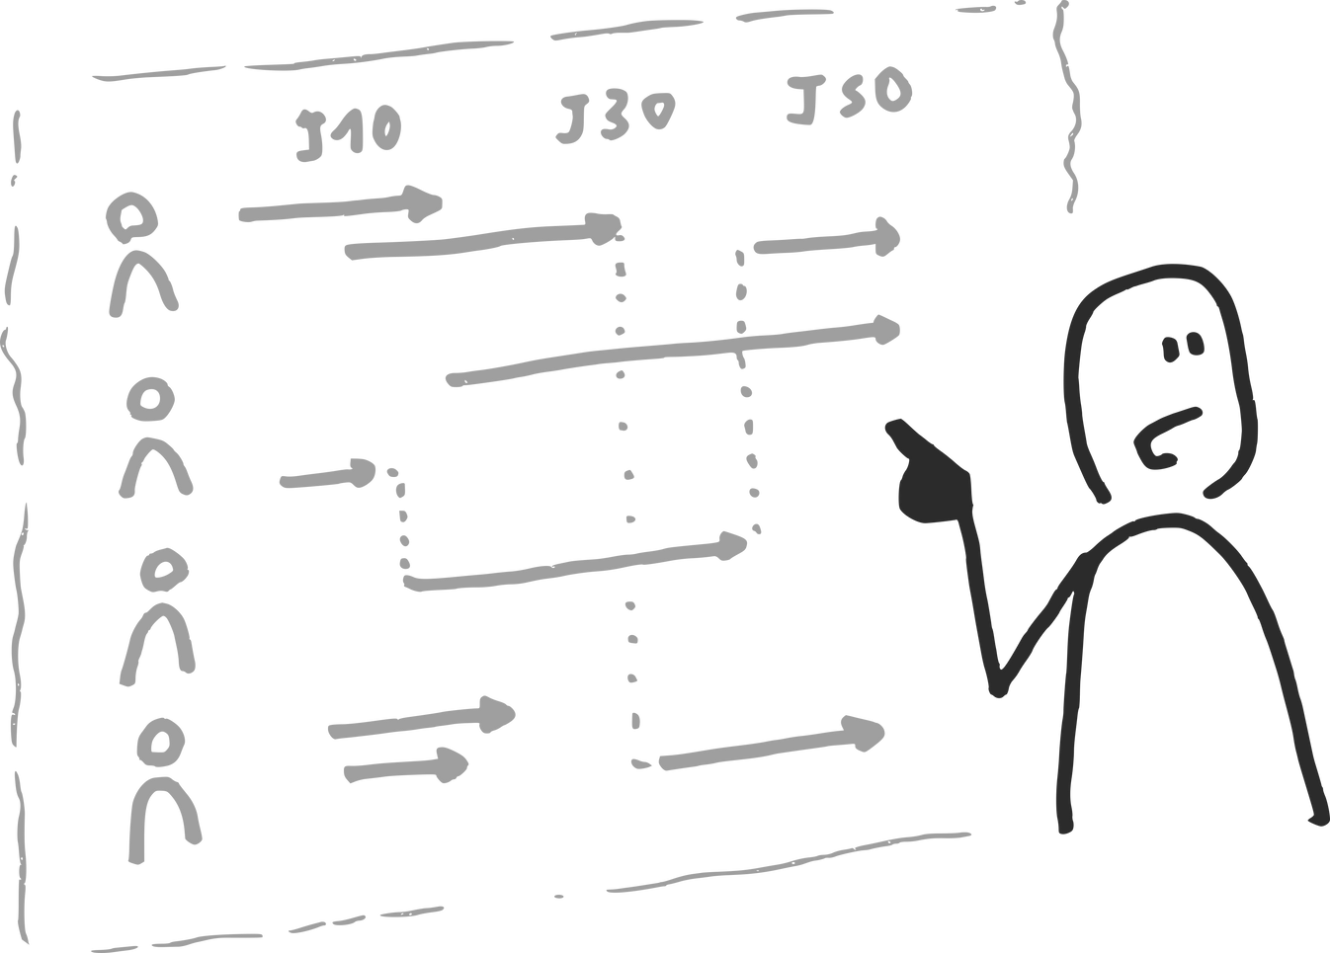
JJC and PODER will Share:
Program Data ISSUE
Key data Indicators, staff, and action
Actions implemented from Data
Ongoing Program mission impact?
30 Min.
Agenda:
15 Min.
PADLET Activity:
Think about: Your own Data ISSUE.
Monitor for: 1 Data practice you want to implement.
Plan: the Result you will see in the data.
What future ISSUE do we see in the horizon?
5 Min.
Share and discussion of Data practices and review suggestions from the field

Slide 3
Joliet Junior College
Context:
Community College-based, Adjunct Faculty, testing, enrollment, registration all administered within Adult Ed. Department.
Academic Programs:
ELA (800-1200 students yearly)
HSD (400-600 students yearly
HSCR (80-100 students yearly)
ICAPS (2-3 programs, 45-60 students yearly)
Web-based assessment post-COVID to date.
Key Staff:
Initial Assessment Discussion: Managers, + Instructional Coordinators, +Testing team, +Registration= TART (Testing and Registration Team) cross-purpose group
Implementation of Changes: Added Faculty information
Performance Data Shortfall
Data indicators
NRS POPS reporting showed:
Below State-required MSGs and Post-testing rates.
NOT A SMALL ISSUE!

Slide 4

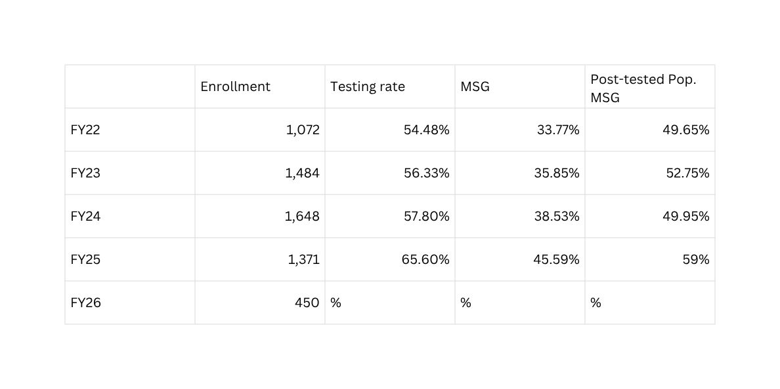
RESULTS FIRST:
7% NRS Increase
8% Post-test rate Increase

Slide 5
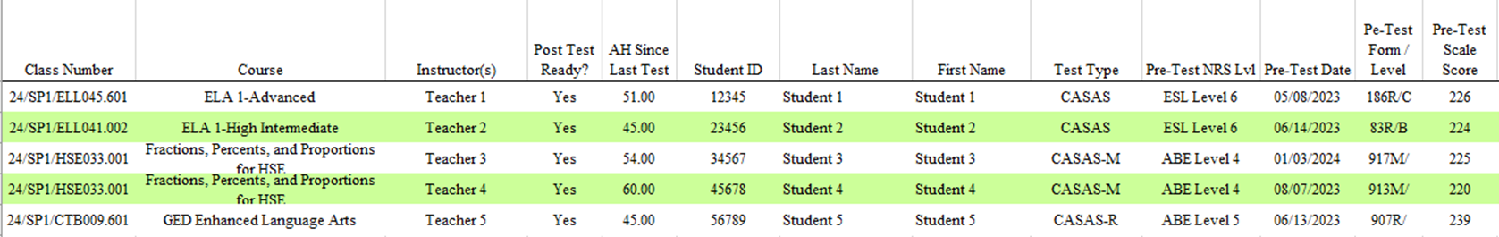
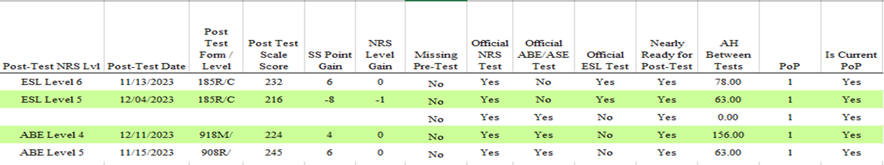
Post-testing Reporting
Understanding MSGs

Slide 6
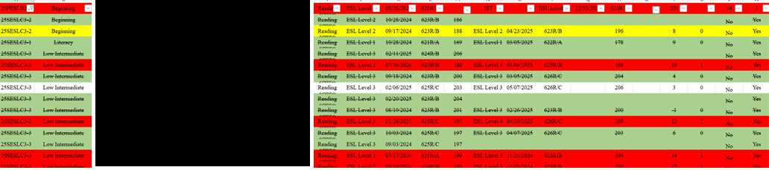
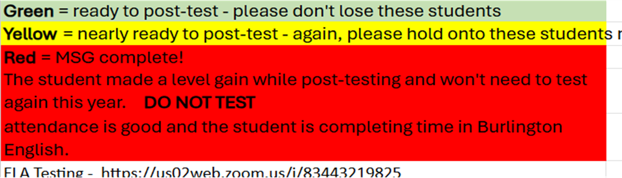
Data and Testing Changes
Manager: Weekly NRS Update
Coordinators: Weekly and twice weekly Post-testing report, teacher communication, testing team scheduling
Testing Team: Testing appointment and student outreach
Registration Staff: Planning, scheduling and data validation for enrollment
Teachers: Validating data, DAISI Testing vs. Testing Report, Teacher Progress Report (generated by Manager)

Slide 7
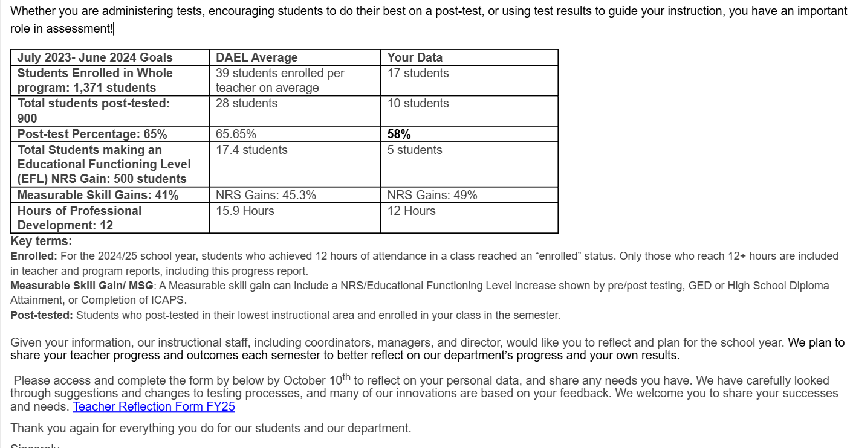
Measuring and Maintaining Progress
Twice Monthly TART Meetings:
  Class enrollment,
  Testing appointment availability
  Enrollment opening and closing, dates.
Coordinators and Support staff:
  Testing report updates, including ID Numbers
  ID Number-generated communication campaigns, text and email
Testing Team and Instructors:
  Reference Live Testing Report (shared from Coordinators).
  Text and schedule students as a class and as individuals

Slide 8

Background:
Community-based organization founded in Pilsen in 1997
Moved to West Lawn as Pilsen became gentrified
PODER HQ opened in January, 2023
Served 16k participants to date
We offer: Integrated English (IE, six levels), Career Exploration (CE) Bridge, Latinos in Finance/ICAPS training, Customer Service training (proposed 2nd ICAPS)

Slide 9
Historical DAIS-I data at a glance:
 | FY 2021 | FY 2022 | FY 2023 | FY 2024 | FY 2025
Enrollment | 152 | 327 | 389 | 452 | 519
MSG Rate | 9.21% | 31.19% | 36.55% | 48.37% | 48.95%
Post-test Rate | 14.47% | 43.12% | 56.30% | 65.04% | 73.60%
ICAPS Completions | N/A | N/A | N/A | N/A | 28

Slide 10
Current DAIS-I data, Q1 FY 2026:
Enrollment | 315 | With already robust enrollment, FY26 focus will be on performance
MSG Rate | 45.71% | Focusing on achieving stretch goal of 65%
Post-test Rate | 65% | Focusing on achieving stretch goal of 75-80%
ICAPS Completions | 13 | 13 additional ICAPS students enrolled in Q2

Slide 11
Changes we have made to improve DAIS-I data:
Tightened testing procedures;
  Ensuring 100% pre-tested to avoid errors
  Earlier identification of students eligible for post testing
  Weekly review of DAIS-I testing group reports
  Improved coordination between instructors and testing staff, both in person and online
Core DAIS-I Data Checklist;
  Accurate and complete enrollment data entry
  All ICAPS, Bridge, and credentials entered correctly

Slide 12
FY 2026 Challenges:
Retention in light of current situation
Employment data improvements, given our service area demographics
Adequate staffing and resources, given current funding challenges

Slide 13
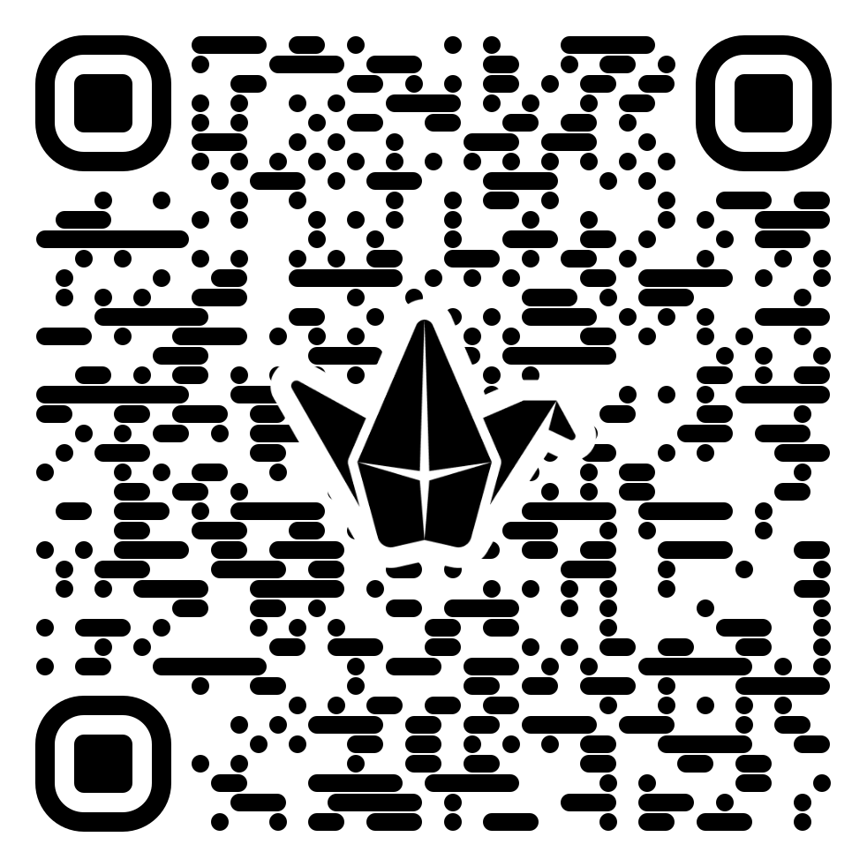

TOOLS AND RESOURCES:
Padlet Time!
https://padlet.com/ckramer55/taking-action-from-data-gq8i9nsqt0wbote9

Slide 14

THANK YOU!
2025

