Slide 1


ICCB Distance
Learning Institute
January 14, 2025

Slide 2


Thanks to our presenters
Rupa Sameer - ICCB
Reni Mitkova - Township #113
Amelia Hessling - Burlington English
Angela Gerberding - ICCB
Sarah Taylor - World Relief Aurora
Nancy Heuer-Evans - i-Pathways
Jennifer Schreier - Morton College
Kathy Olesen-Tracey - ICCB

Slide 3

01
ICCB Expectations for Distance Learning
02
Program Spotlight
03
Distance Learning with Burlington English
Agenda
04
Distance Learning in
Bridges & ICAPS
05
Program Spotlight
06
Distance Learning in i-Pathways
07
Q & A with ICCB

Slide 4

ICCB Guidance & Expectations
Encouragement for Distance Learning
Technology Integration and Digital Literacy
Assessment and Proxy Hours
Notes:
Rupa

Slide 5
Setting Up DL Classes in DAISI
Individualized Instruction
Class Types
Accurate
Data Entry
Notes:
Rupa

Slide 6
Benefits and Guidance
Accessibility
Flexibility
Higher Outcomes
Notes:
Rupa

Slide 7
Retention & Statewide Goals
Retention Strategies
Statewide Emphasis on Distance Learning
Alignment with Workforce Development
Notes:
Rupa

Slide 8

Program Spotlight
Township High School District 113
THSD113 Adult Education program offers ESL, ABE, ASE, IELCE, Bridge, Citizenship and HSE Preparation classes. Annual enrollment is about 500 students.
The majority of classes meet in a virtual format.
Notes:
Reni’s recording: https://youtu.be/EITxgbXO1s8?si=hhtBHaa22bCSjY7Q
Reni’s slides: https://docs.google.com/presentation/d/13vdoJXiu0rf_zuvrFUBMei4jX_J9NLUd/edit?usp=sharing&ouid=115347111597213422675&rtpof=true&sd=true
To post in chat, Best Practices from Reni: https://docs.google.com/document/d/1KHgr2SV9aViH-UXYoLfiEOkv4Bzbu_bi9VYAlQQi5pA/edit?usp=sharing

Slide 9
Empowering ELLS Through Distance Learning
with BurlingtonEnglish

Slide 10
Objectives
Understand the importance of meeting student needs in ELL programs.
Learn how BurlingtonEnglish can support distance learning and increase student engagement.
Explore strategies for capturing and reporting distance learning hours using BurlingtonEnglish.

Slide 11

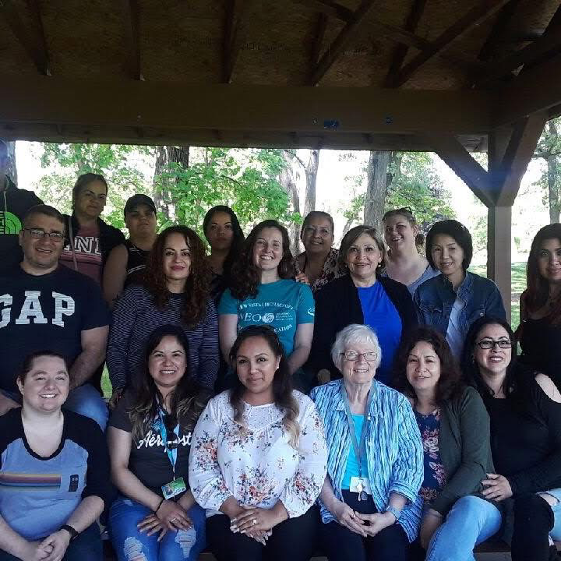
Hi, I’m Amelia.
15 years in Adult Education
ESL/ELA teacher, ABE/GED teacher, AE Coordinator, and Professional Development Facilitator for Indiana Adult Education
MA in Adult & Continuing Education
Passionate about supporting programs with BE!

Slide 12
Why is Distance Learning Important?

Slide 13

Notes:
Buy in: Think about a goal you had that you started towards but never reached. What got in your way?
Answers in chat
It’s safe to summarize that LIFE is usually what gets in the way. Students who start your ELL program always have a goal (bigger than “to learn English”) – it could be to feel a part of a community, to get a better job, advocate for their family at the doctors, or speak with their children’s teachers. These goals are what keeps your students coming.
But like you, our students are adults, sometimes – life gets in the way of these goals… even the really important ones.
Another barrier can be TIME. How much time does a student have before life throws a curveball at them and they need to stop coming to classes?
We must remember that we’re teaching humans first: their humanity and the fact that LIFE happens to us all are important factors when considering the services we prioritize and offer.
When it comes to language acquisition, the more time studying and being immersed in the language, the quicker students will reach their goals.
Whether your program offers 1 four-hour class a week, 2 two-hour classes, or classes four days a week… when it comes to language, Distance Learning is one way you can maximize your students’ time in English and help them reach their goals (and MSGs) faster.
When students feel their needs are being met, they are more likely to stay in classes even when life happens.
Today, I’m going to share with you how BurlingtonEnglish can support your ELL classes and help your program to increase Distance Learning hours.

Slide 14
Audience Poll
1. Does your program use BurlingtonEnglish?
✅ Yes
❌ No
❓ I'm not sure
2. Does your program currently collect any distance learning hours for your ELLs?
✅ Yes
❌ No
❓ I'm not sure
Tell me in the chat!

Slide 15


Slide 16
Let’s Chat.
How can distance learning benefit your ELL students? How can it benefit your program?
Notes:
Amelia Elicit responses from the audience.
Highlight the correlation between active student participation and successful language acquisition.
Briefly share a compelling statistic or anecdote illustrating the positive impact of increased student engagement in distance learning environments.
Dive into BurlingtonEnglish specific data from Texas

Slide 17
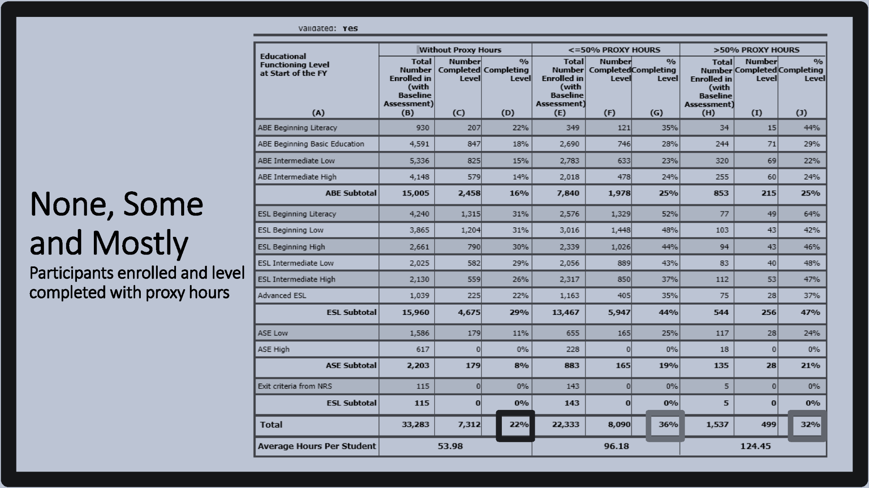
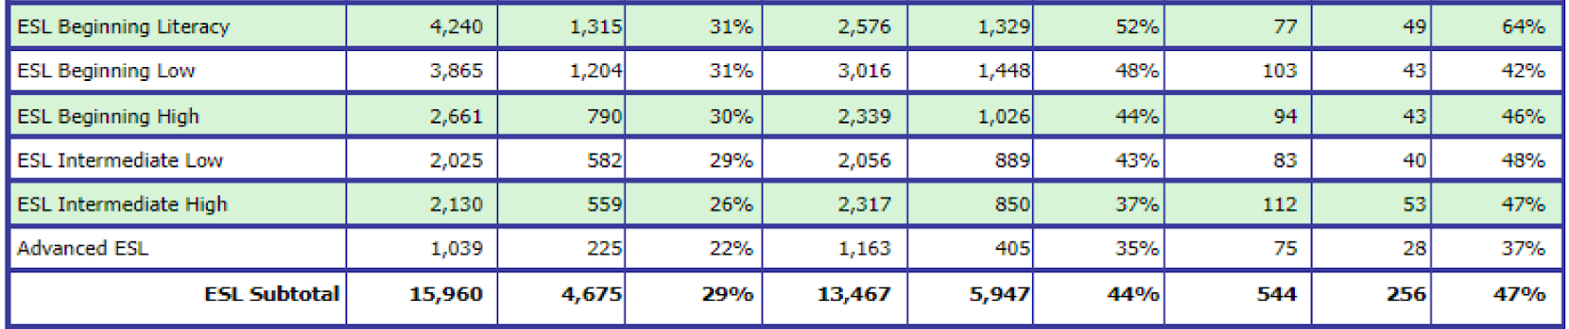
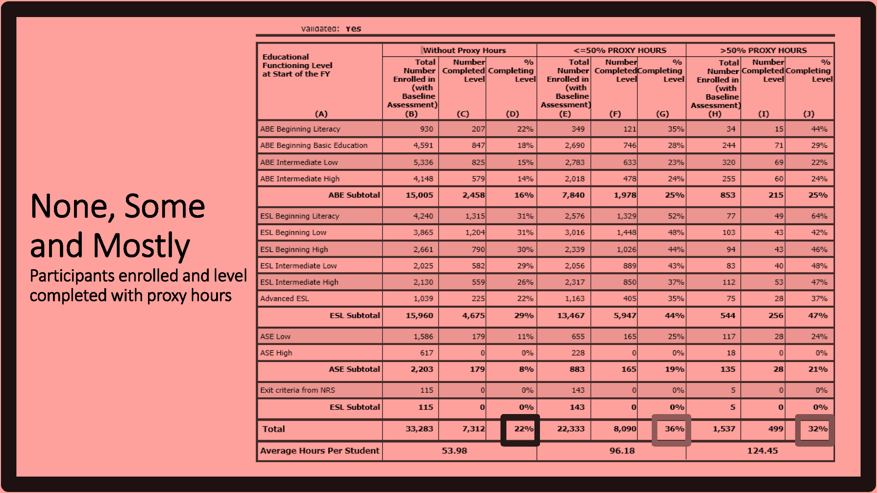
From the TCALL, Texas Workforce Commission, and Texas A&M University
COABE 2023 presentation
with Lori Slaton, Dr. Debra Hargrove, and Dr. Kurt Czupryn
Notes:
Amelia
Let’s take a closer look at the ESL numbers.

Slide 18
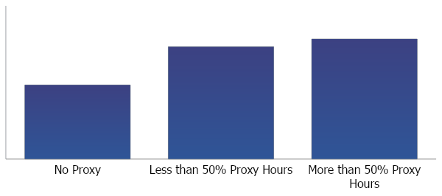
Percentage of Texas ESL Students who Achieved a Level Gain
47%
44%
29%
Notes:
Amelia
(arrow will appear WITHOUT clicking)
As the proxy hours increase, the percentage of students achieving a level gain goes up (MSGs).

Slide 19
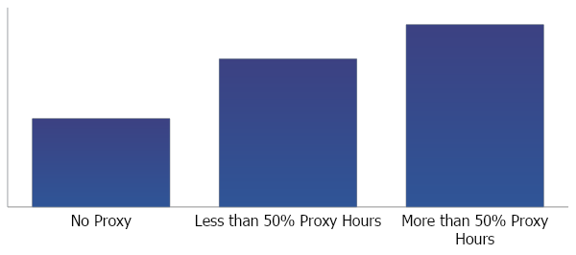
Percentage of TX Beginning Literacy ESL Students who Achieved a Level Gain
64%
52%
31%
Notes:
Amelia arrow will appear WITHOUT clicking)
These results hold true at the level of Beginning literacy students – in fact there was an even greater increase in level gains.

Slide 20

Level Gains
(MSGs)
Proxy Hours
Notes:
Remember: “Teaching human beings” – leads to better data (which ICCB wants) and student retention (meeting students needs)

Slide 21
Capturing Distance Learning Hours
Notes:
Okay, so you’re convinced. Distance Learning is a powerful tool to reach students’ by keeping them engaged and working towards their goals. Now how do you get started?

Slide 22

This Photo by Unknown Author is licensed under CC BY-SA-NC
Notes:
Misconceptions about DL: Not an either/or situation

Slide 23
Distance Learning can look like….
Face-to-face + asynchronous “traditional face-to-face”
Synchronous online “web platform” + asynchronous
Asynchronous only “At-Distance”
🔑 Set students up for success with an asynchronous component to all classes
Notes:
Misconceptions about DL: Not an either/or situation
Face-to-face + asynchronous “traditional face-to-face”
Synchronous online “web platform” + asynchronous
Asynchronous only “At-Distance”
Key to Distance Learning: setting students up for success with an asynchronous component to all classes

Slide 24
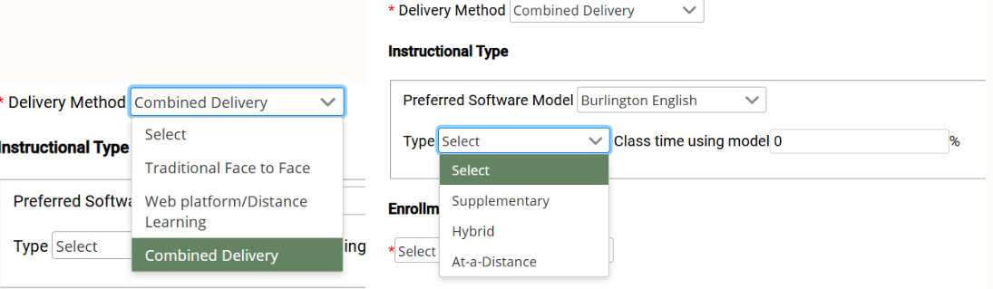
Class Set Up
Notes:
Not sure how to set these up? Check out the Daisi 2.0 guide – section on “Class Set Up”
Put in chat: https://www2.iccb.org/daisi/classes/#Add_Classes
Option 1: Combined Delivery > Hybrid > 50%
Note: Programs are concerned with setting up classes with this expectation b/c students often won’t do the independent work 🡪 Great segue into the importance of contextualized blended learning to increase students’ completion of distance learning
Option 2: At-a-Distance (individual grid for each student – asynchronous only)
This setup would be used for students who are working at a distance only (no synchronous time)
Note from Rupa: Remember setting up At-a-Distance class only will only be an individualized enrollment. On the other hand, program can elect to use a hybrid format, of which they should choose what percentage of the time the software will be use.

Slide 25
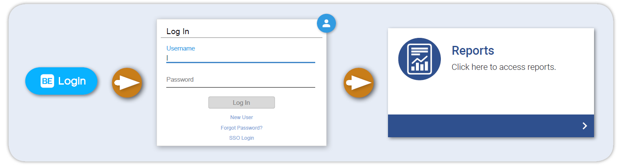
Let’s talk reports.
Notes:
Already using Burlington? Need to capture those DL hours?

Slide 26
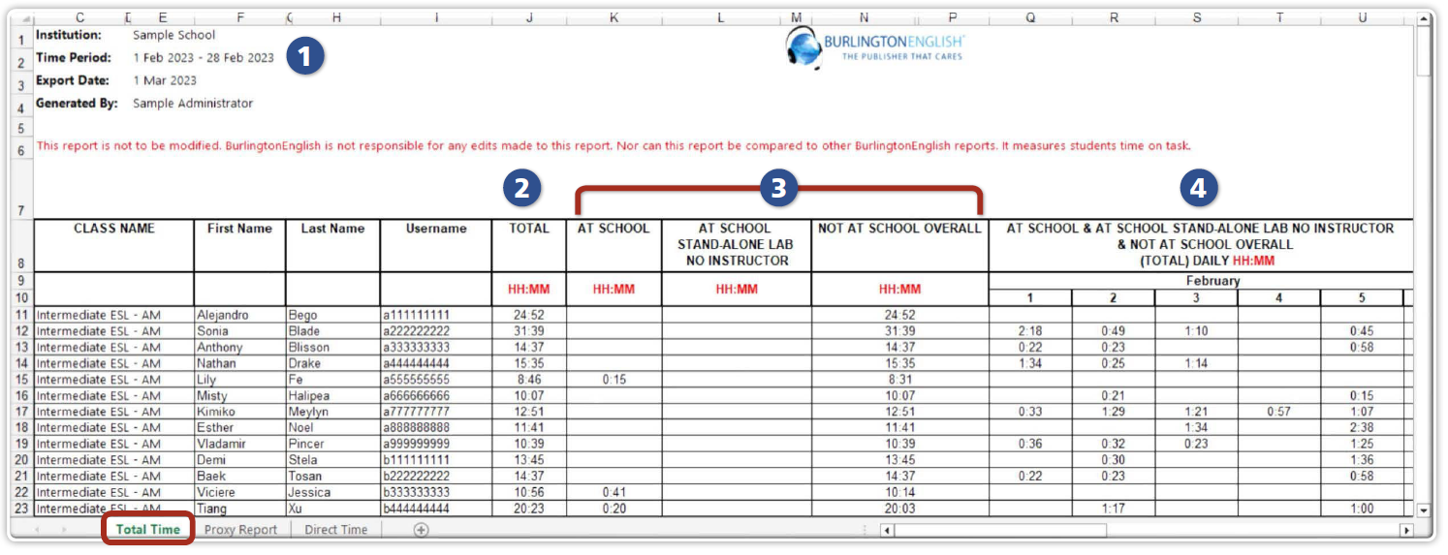
The Proxy Report
Notes:
Sheet 1: Total Time
1 Shows the selected time period for the report.
2 Shows the total time each student has spent working in BurlingtonEnglish in that time period.
3 Shows the time each student has spent working in BurlingtonEnglish at each location in that time period.
4 Shows the total time each student has spent working in BurlingtonEnglish for each day of the selected time period.
Notes for Sheets 2 and 3
Sheet 2: Proxy Report does not include At School time.
Sheet 3: Direct Time only includes At School time.

Slide 27
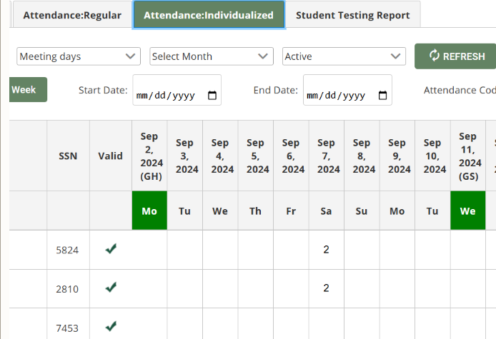
Teachers make the magic happen.
Notes:
Once the class is set up, teachers will have two attendance tabs - one for class attendance and one for DL hours. If the teacher isn’t capturing this data, then BE & ICCB can’t help!
Note on Proxy Report Hours: ICCB has confirmed it is ok for programs to consolidate DL time for the week rather than entering lots of little times.

Slide 28

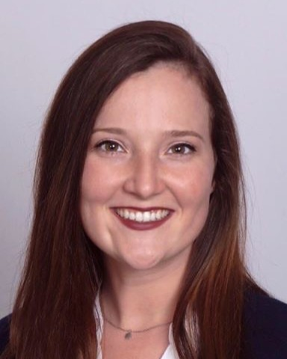
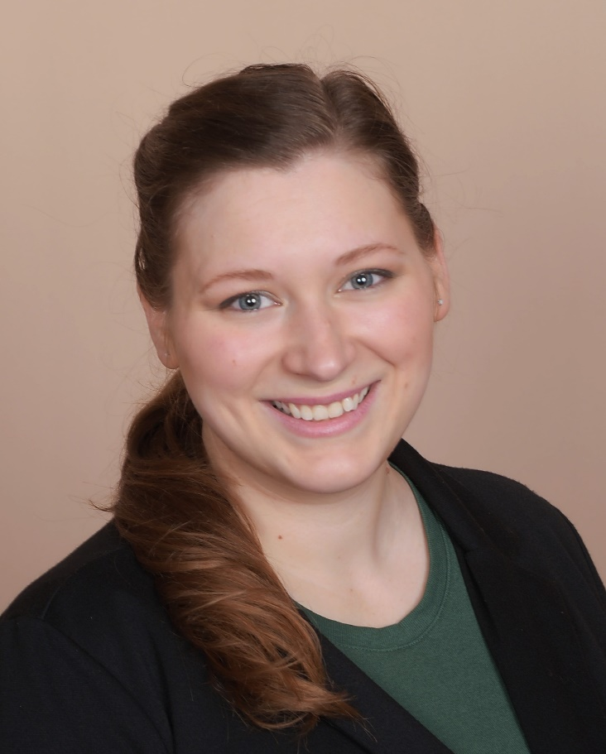
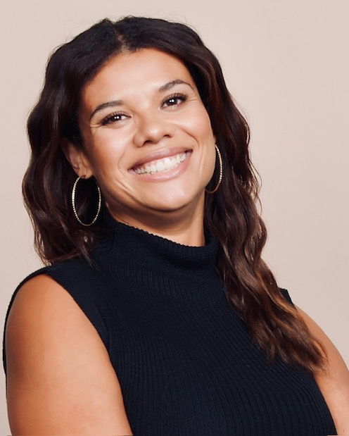
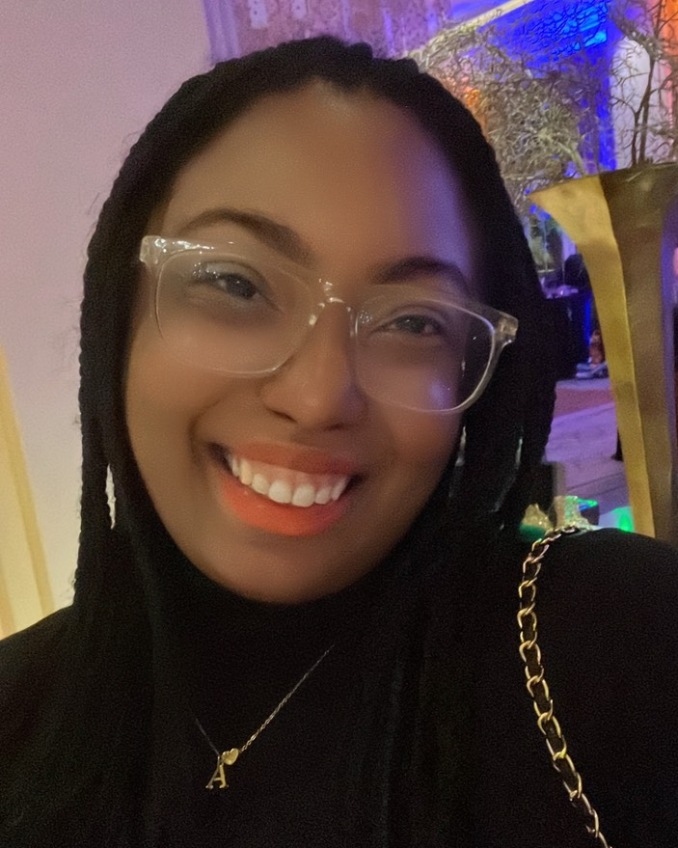
Amelia Hessling
Sr. Customer Manager
Amelia.H@BurlingtonEnglish.com
(312) 292-1473
Lane Steiner
Customer Manager
Lane.S@BurlingtonEnglish.com
(773) 882-5011
Mara Stibitz
Teacher Trainer
Mara.S@BurlingtonEnglish.com
(312) 805-0247
Autumn Perry
Teacher Trainer
Autumn.P@BurlingtonEnglish.com
(708) 500-4592
Notes:
My team and I would love to discuss your Distance Learning options with BurlingtonEnglish more in-depth and to support you in capturing your students' distance learning hours. Contact me at (312) 292-1473 or amelia.h@burlingtonenglish.com to discuss your program-specific needs and preparing for DL success in 2025!

Slide 29

Have more questions?
Join me next Tuesday, January 21st at 2 pm for Q&A with the ICCB!

Slide 30
DISTANCE LEARNING IN BRIDGES & ICAPS
Angela Gerberding
Director for Work-Based Learning, ICCB

Slide 31
What does distance learning look like in Bridges & ICAPS?
During COVID, lots of programs explored what could be done at a distance.
Zoom classes
Recorded videos of lessons
Students video recording themselves practicing skills with family members (taking blood pressure, taking temperatures, prepping for a blood draw, etc.)
Identifying anatomy on drawings – think ESL terminology
Identifying vehicle parts on drawings – think inside a CDL cab

Slide 32
What ‘stuck’? What else is being tried?
Thanks to the push to try new teaching strategies, programs have stepped up and shared ideas.
Some things that stuck:
1.Online curriculum options – Burlington
English, i-Pathways, Pathful Explore,
NRPOL, IXL, etc.
2.Hybrid classes – 1 or 2 days in-person with
1 day virtual, either required or optional

Slide 33
Bridge specific efforts:
One program uses activities from Career Solutions Publishers that allow students to explore careers of their choice - Hands On Academics for Careers. There are lots of careers to choose from, alongside modules from their Job Ready Career Skills Platform. It has vignette-based activities that teach workplace skills and etiquette. These modules can be used synchronously in a group, or they can be assigned asynchronously for individual use.
from Shawnee Community College

Slide 34
Bridge specific efforts:
Another program uses Pathful Explore for students to engage in career activities and workforce/industry vocabulary for specific careers on lab days. They might also use Burlington English Career Modules for ELA students who are at NRS 5 and 6 for vocabulary practice.
from Kishwaukee College

Slide 35
ICAPS specific efforts:
One program provides Zoom hours as synchronous online support and in person hours at least once per week for support classes.
Students who still need to complete their final GED® tests will use i-Pathways.org to prepare for the specific subject tests.
from Kishwaukee College

Slide 36
ICAPS specific efforts:
Another program provides basic skills, focusing on how best to support the learning objectives of the content course. This usually involves reviewing reading skills, vocabulary, or basic math skills.
They also stick to basic skills curriculum, with the exception of the Entrepreneurship, where they sometimes make use of the MYOBI materials offered free from Santa Clara University, or our Edmentum Courseware Entrepreneurship modules, depending on what support the student needs.
from Shawnee Community College

Slide 37
Where are ideas shared?
ICAPS Office Hour
Last Monday of each month @ 2:00 pm
Bridge & ICAPS Virtual Learning Communities
Bridge VLC: 3rd Thursday @ 2:00 pm
ICAPS VLC: 2nd Thursday @ 2:00 pm
Notes:
ICAPS Office Hour: https://siue.zoom.us/meeting/register/tJUocumtqDgrG9HqT278SRaW0oWJKWAo7y8K#/registration
Bridge VLC: https://siue.zoom.us/meeting/register/tJMtcu6grz0rGtOMWzty_ffFli6akDqKLP9l#/registration
ICAPS VLC: https://siue.zoom.us/meeting/register/tJUqc-mtqDouE9PAPsXB4_vZbghGD4hQdQoC#/registration

Slide 38
PROGRAM SPOTLIGHT
World Relief - Aurora
Notes:
Sarah’s recording: https://us02web.zoom.us/rec/share/cXfRIxA-OchY2aZPWv4DQ7-v-_SzgfQ1TYInyD24jI0pk220brmpjECRvCISvRfD.rj6P-H31LEbPmpPb

Slide 39
DISTANCE LEARNING i-PATHWAYS
Nancy Heuer-Evans, i-Pathways Curriculum Coordinator
Jennifer Schreier, Morton College Adult Education Faculty
ICAPS & i-Pathways:
The I’s Have It
Collaboration and Innovation

Slide 40
i-Pathways and ICAPS Basics
3 ways i-Pathways pairs with ICAPS
Aligned with State Standards
Includes Workforce Preparation materials
Facilitates Distance Learning components

Slide 41
Distance Learning Deployment
Synchronous
Asynchronous
Hybrid
HyFlex
Sampling

Slide 42
Examples in Action: Morton College
#1.) ICAPS Support Course
#2.) Bridge to Career Pathways
#3.) Added Distance asynchronous instruction (runs in the summer)

Slide 43
Best Practices
Mandatory weekly check-ins for independent instruction
Follow guide on survey for best use of time
Buy One, Get One (re: GED tests)
Evaluate how many lessons per week make sense
Sampling with Math

Slide 44
Barriers and Solutions
Distance Learning is NOT the easy way out for teachers OR students
Access
Resistance
Technology

Slide 45
Questions / Sharing
Stories?
Advice?
Cautionary tales?
Contact Nancy with i-Pathways questions
nevans@cait.org

Slide 46

Q & A with ICCB
Notes:
Q and A with ICCB on Tuesday, January 21st @ 2:00 pm
Registration: https://siue.zoom.us/meeting/register/tJItcuiupz4pGdU5iGWsbHU6DlXvY2KRlBvM

Slide 47
Thank You

