Slide 1

Serving Adult Students with Disabilities in ABE/GED Programs: Q&A
Jenifer Montag, Ed.D., CRC
Assistant Director,
National Center for College Students with Disabilities (NCCSD)
jenifer@ahead.org
Notes:
NOTE:
To change the image on this slide, select the picture and delete it. Then click the Pictures icon in the placeholder to insert your own image.

Slide 2
Today’s Conversations
General categories of questions asked
  Process & Procedures
    ELL Learners with disabilities
    Documentation
    Administration
    Documentation
  Specific Disabilities
  Vocational Rehabilitation
  GED Issues
  Resources

Slide 3
Process & Procedures
What should we do if we think our student could benefit from services?
When students are not able to get all the accommodations they believe they should have, how do you handle that discussion and make sure the student understands some things are out of our control?
What would you recommend for a student with approved accommodations who doesn’t want to use them during testing?
What would be a good way for front-line staff to assist individuals with very limited English proficiency when they walk in the facility?
How can we support students with undiagnosed disabilities and when should we consider referring them to specialized services?
How can we accommodate a student with an emotional support animal when the campus policy only allows service animals on campus?

Slide 4

Starting the Process
Where located? Part of larger agency?
ADA Coordinator or DS Professional
Campus responsibility / Campus Administration
State program and state program responsibility (MOUs)
Discuss and determine campus process for ABE/GED students
  Create campus procedure manual
  Who will determine person has disability?
  Documentation requirements
  Who will determine appropriate accommodations campus programming?
  Stipulate outside procedures (GED / HiSET) as separate
Connect with DS office for legal info / policy changes
Public notice (to request and grievance process)
**Jails/Prisons/Youth Centers**

Slide 5
Helping Students
Part of the process is helping students
  Connect with person who can facilitate accommodations
  Identify community resources they may need
    VR / WIOA / Job Center
    Disability specific resources
    Non-academic resources (food / housing / transportation / medical / mental health)
    ELL community resources
    Documentation resources
  Understand separation of GED / HiSET accommodation process
  Develop self-advocacy/self-determination
    Informed decision making
  Resource Fair for campus and be sure ABE students are invited and encouraged to attend
  Ask to be invited to campus disability office in-services or trainings

Slide 6
English Language Learners
ELL does not equal disability…but ELL Learners can have disabilities
Appropriate documentation challenge
Cultural challenges
Identify resources (culturally appropriate)
Evaluations may need to be completed in native language (LD)
Some individuals may have had evaluation in home country – may need to help student find qualified translator
UDL techniques might be helpful

Slide 7
Questions about Specific Disabilities
What types of disabilities will we learn about?
Many students with disabilities I support are looking for mental health support but our institution tends to refer out A LOT. This referral process is lengthy and causes students to feel unsupported. What can I do?
Best supports for ADHD/Autism
What supports would you recommend for a student whose mental health diagnoses prevents them from participating in in-person classes, but who probably would benefit from structured social interactions?
Supporting students with limited vision
How do we address medical deserts for students who need services due to their disability to better their quality of education?

Slide 8
Specific Disabilities
No “list” in any of the laws – physical or mental impairment that substantially limits one or more activities of daily living (people can have multiple disabilities at one time as well)
Commonly seen disabilities on college campuses:
  Hearing – Deaf/deaf/hard of hearing
  Vision – Blind / low vision
  Speech – stutter / aphasia
  Learning Disabilities – dyslexia, dyscalculia, processing
  Mental Health – depression, generalized anxiety disorder, PTSD, bipolar disorder
  ADHD – inattentive / hyperactive (some other conditions can appear as ADHD, but are not ADHD – evaluation is important to identify)
  Physical / Mobility – use wheelchair, walker, scooter, cane, crutches “mobility devices or tools”
  Chronic Health – diabetes, epilepsy, multiple sclerosis

Slide 9
Types of Accommodations
Individually determined on a case-by-case basis. To reduce or remove the barrier experienced because of the disability in the environment.
FM/ALD
ASL Interpreters
Real-time captioning
Seating – tables – classroom setting
Magnifiers / large print
Braille
Audio text
Modification of policy can be a reasonable accommodation

Slide 10






Pictures of D/HH/B/LV Accommodations

Slide 11
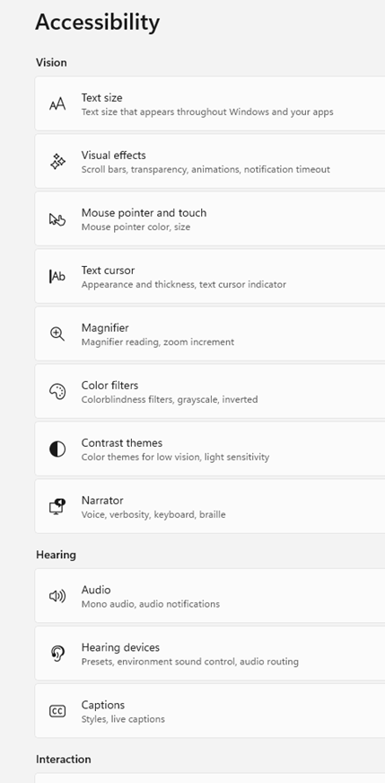



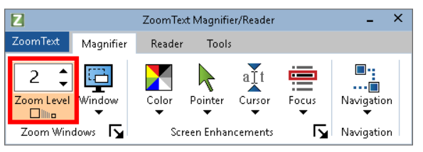


Pictures of Audio Text Accommodations

Slide 12


Additional Types of Accommodations

Slide 13
Lack of Resources
Community organizations
  Coalition?
  County health department
  Mental health services / addiction recovery programs
  NAMI
  Public University Graduate Programs in Psychology, Social Work, Vocational Rehabilitation, or Counseling
  Vocational Rehabilitation Services (VR)
Community Foundation Grants
Institutional or state?
  Advocate for more resources – bring students into this – their voices will be heard (COABE)

Slide 14
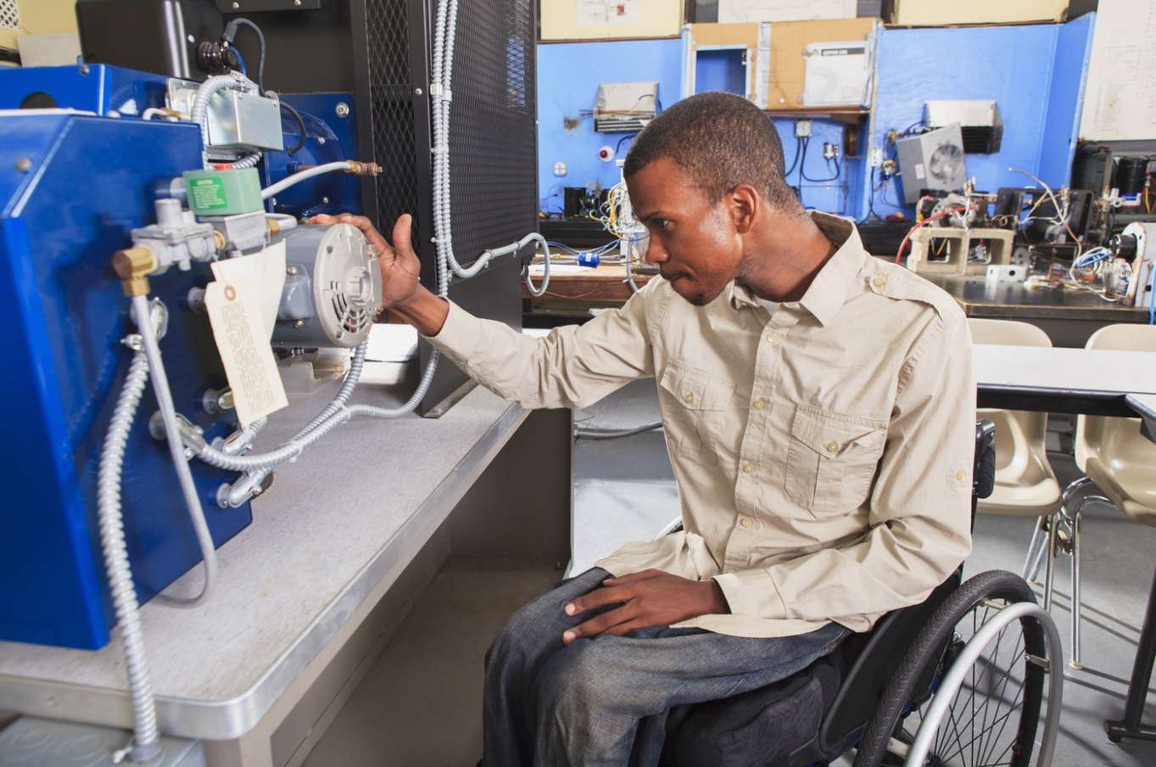
Vocational Rehabilitation Services (VR)
State agency tasked with helping disabled people get and maintain employment.
Works with other state agencies (Job Services, WIOA)
Help student understand VR as option
(**may require citizenship to access)
May help with evaluations if student has no documentation
May help with assistive technology
May help with accommodation negotiation with employer or apprenticeship site
Pre-ETS for IEP holders under 21 still in high school
***Order of Selection

Slide 15

GED Challenges
3rd Party controls their exam
Stipulate accommodation request process
Documentation requirements (high bar)
Follow GED process
Inform students early in their program
Refer to area resources (VR? Evaluators?)
Practice tests (with/without accommodation)
Change to HiSET?

Slide 16
Resources
State VR listing at JAN
JAN Job Accommodation Network
AHEAD (Association on Higher Education and Disability)
NCCSD
Great Lakes ADA Center
Centers for Independent Living
  Core Services:
    Individual / Systems Advocacy
    Peer Support
    Independent Living Skills Training
    Information and Referrals
    Transition Services
ADDitude
LDA
NFB (National Federation of the Blind)
Hadley School (blind and low vision classes)
National Deaf Center
Mental Health First Aid
NAMI
NAMI Resources Listing
Veterans Crisis Line

