Slide 1




ICAPS Learning Community
Notes:
‹#›

Slide 2
ICAPS Learning Community Purpose
Fulfill the mission of the Transitions Academy
Share information, ask questions, and learn from one another
Engage both AE and CTE training partners
Provide a safe place to share challenges and provide support
*If you need a PD certificate for this hour, please email us at sipdctrainer@gmail.com.

Slide 3
Distance Learning Considerations
Thank you to
Margaret Segersten and Becky Wade of ROE #33
Patti Wragg of Kishwaukee Community College
for sharing today!

Slide 4




Regional Office of Education #33
Bridge & ICAPS
Dr. Margaret Segersten
Adult Education Director
Becky Wade
Bridge & Transition
Services Coordinator
Your Path to a Brighter Future.
3/13/2025

Slide 5
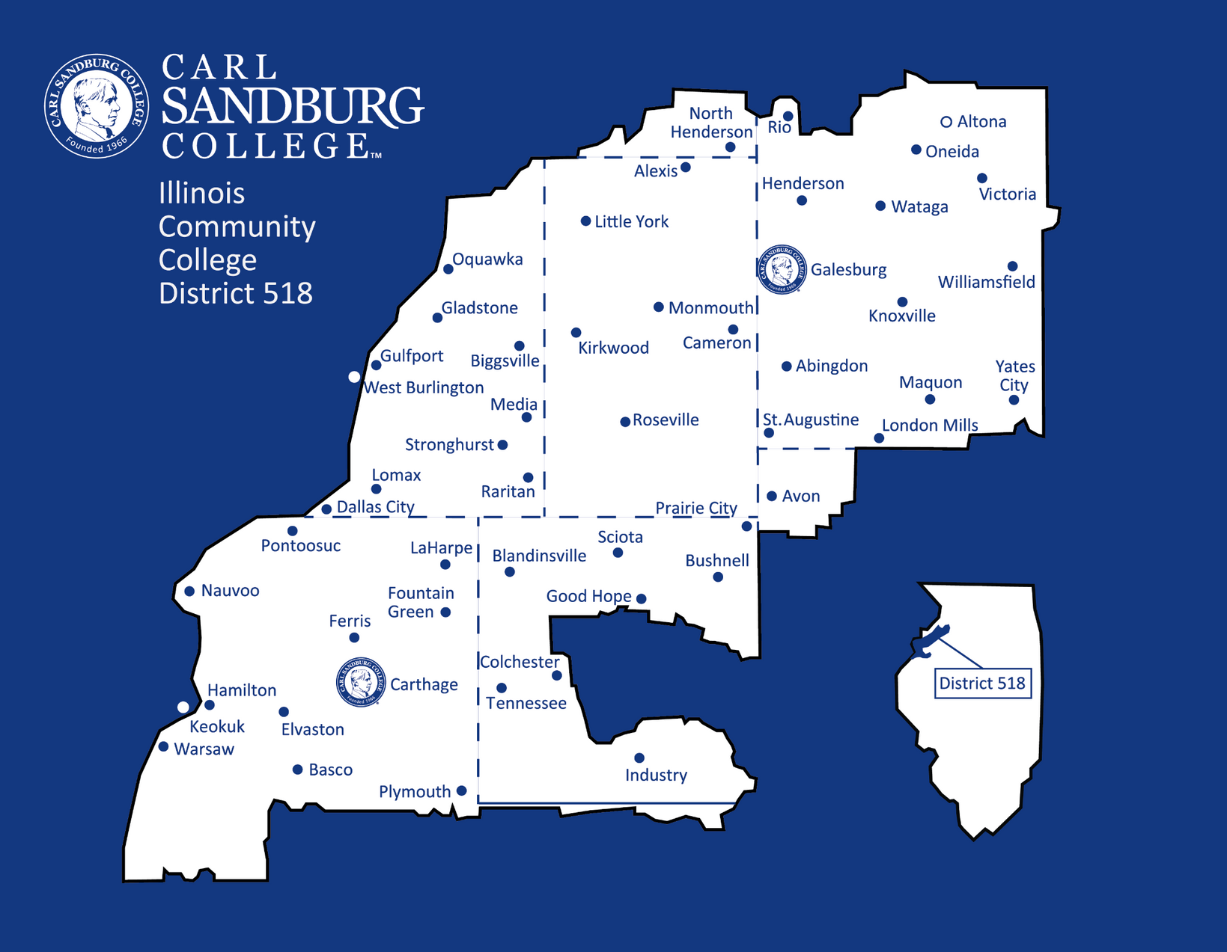

Slide 6
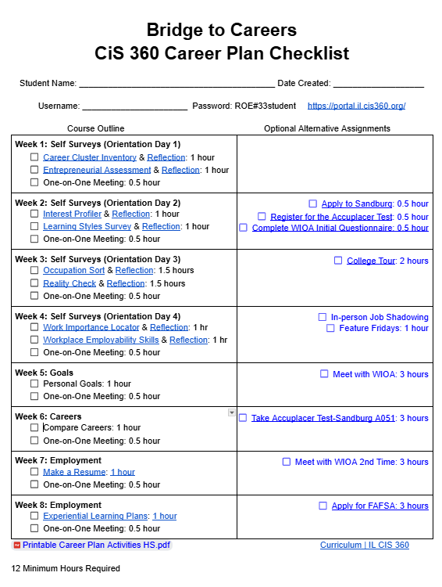

Bridge to Careers
  Students have the option to complete their Bridge in class or online
  Students can go at their own pace or follow along with the class's pace
  All HSE students take this Bridge
  It’s Free
  Students learn more about themselves
  Explore Careers, Education, and Employment
  Create Personal Goals
  Compare Careers
  Build a Resume

Slide 7



Current ICAPS Offerings:
  Automotive Technology
  Basic Computer (IT)
  Certified Nursing Assistant (CNA)
  Computer Numerical Control (CNC)
  Computer Support (IT)
  Paraprofessional (Model 2)
  Phlebotomy
  Entrepreneur (Model 2) - Coming soon!
  Pre-Medical Assisting – TBD

Slide 8


Why Hybrid ICAPS?
  Students working second shift
  HSE and ELL Classes have online options
  Breaks down barriers for students
  Students can live up to 90 miles away from an in person ICAPS Support Class
  Implementing a blended classroom structure boosts engagement and accelerates student progress

Slide 9



Students Benefit From:
  Having the option of being in person or online during every ICAPS support class
  ICAPS instructors work with their ICAPS students to accommodate their needs for ICAPS support times
  Hybrid ICAPS Orientation
  Receiving the help and skills they need to succeed
  Convenience while strengthening essential skills for success
  Gaining skills by becoming adaptive and technically proficient to enhance their academic performance and career prospects

Slide 10
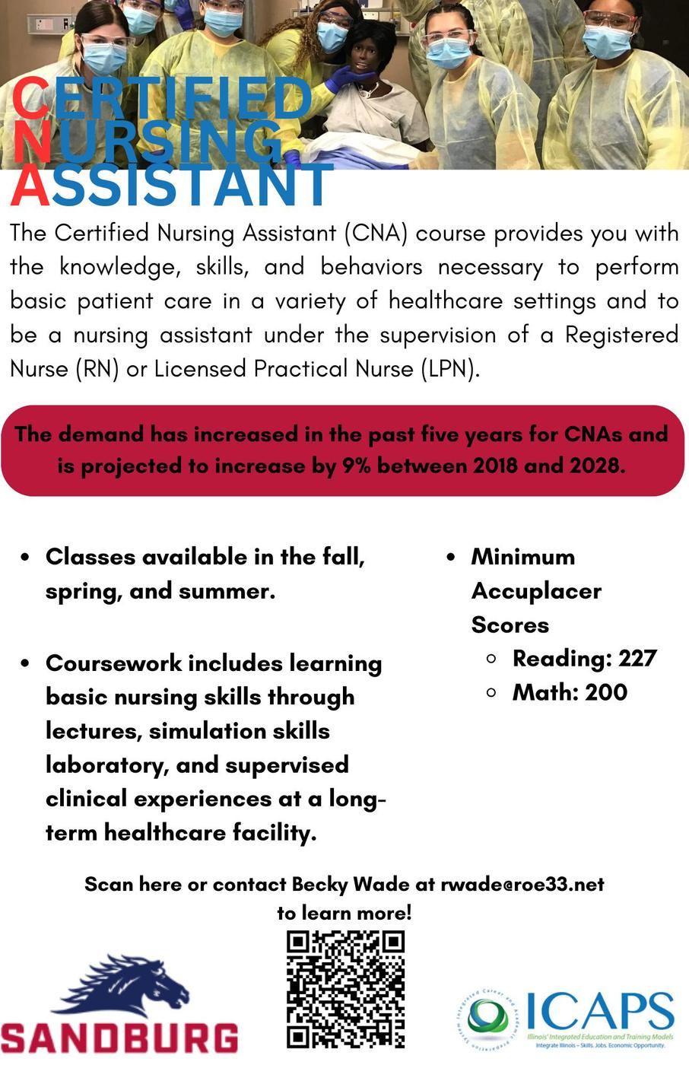
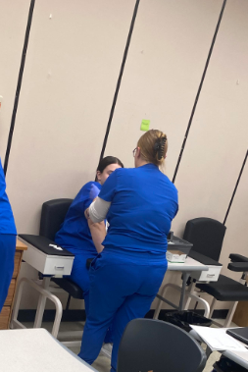
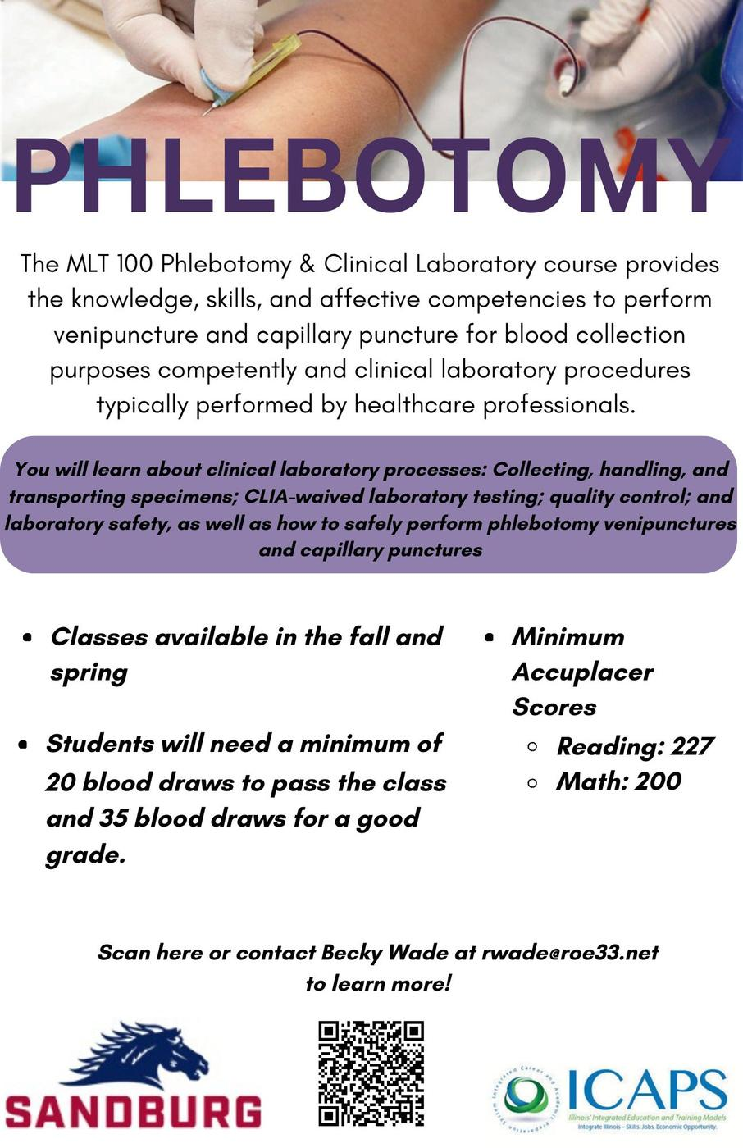
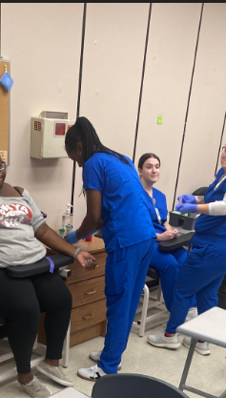
Current
Spring ICAPS

Slide 11


Current
Spring ICAPS

Slide 12
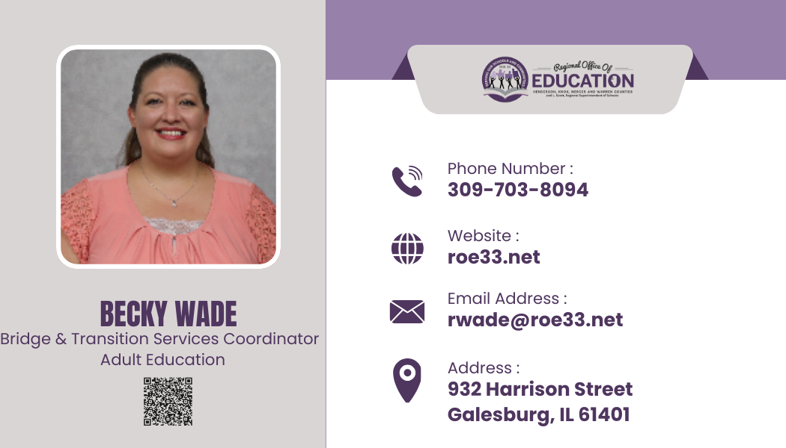
Contact Your ICAPS Representative Today!

Slide 13

Kishwaukee College
Bridge & ICAPS
Patti Wragg
Director Adult Education & Transitions Programs
3-13-2025

Slide 14
Kishwaukee College ICAPS Programs
ICAPS Model One
ICAPS Model Two
  College Credit Programs
  Basic Nursing Assistant (CNA prep)
  Basic Emergency Medical Technician
  Google IT Support Specialist
  Application Specialist (OS)
  Production Technician will be
  redesigned due to program changes
  to include Welding and Automotive
  FY 25/26
Industry Recognized Non-credit
Phlebotomy Technician
Pharmacy Technician
Sterile Processing (new in FY 25)
Dental Assistant (new in FY 25)
Truck Driver (CDL) New in FY 25/26

Slide 15
Why use Hybrid/Synchronous Learning?
Bridge courses prepare students for both workforce & ICAPS ir post-secondary education, so try to emulate what they will experience in college and work.
Many ICAPS courses are hybrid model and some could be asynchronous
  Help students understand online class models (synchronous/asynchronous)
  Builds technical skills
  Accountability and participation are key elements of a hybrid/online class
    Prepares adults for work and college level classes
  Practice turning in work online
  Flexibility for students and teachers (teach from home or office, day or eve)
  Recording classes for absences through Zoom

Slide 16
Hybrid Bridge & ICAPS Courses
Curricula options:
  Use i-pathways for traditional students pursuing their IL High School diploma
  Assign specific lessons in the areas most needed for GED® completion
  Burlington English for ESL 5/6 in bridge/ICAPS
  Practice career specific vocabulary and pronunciation
  Soft Skills- multi-level
  Use ICCB Bridge Curricula available online (newly updated)
  AMOC (Alternative Method of Credentialing) along with i-pathways for those who qualify for high school transcript evaluation

Slide 17
Hybrid Bridge & ICAPS Courses
  Career Preparation options:
  Pathful Explore for all students ELA NRS 5/6 and ABE4 and ASE 5/6 (May cost if not used at your institution)
  Career Exploration
  Career Information- specific jobs
  Virtual Job Shadowing
  Resume Building
  Employment 101 through IL WorkNet Centers for all students- earn certificates
    ExploreCareers
  Independent work is necessary in these platforms for students to be successful in their bridge programs and prepare for workforce and/or ICAPS programs

Slide 18
ICAPS Hybrid Support Courses
Hybrid learning gives students flexibility in schedules….
Assign all lessons for GED® completion ahead of time to help with time management and set dates for GED® testing
If asynchronous class (like Google IT or Sterile Processing)- be sure teacher is in touch with the CT/Short Term Instructor to consistently meet about students and curricula needs
If asynchronous ICAPS, offer the support course as remote/synchronous learning options at times best for students
Help students utilize their instructor’s office hours for content help

Slide 19
Patti Wragg
Director Adult Education & Transition Programs
Kishwaukee College
Malta, IL 60150
Contact Information:
815-825-9386
pwragg@kish.edu

Slide 20
Future ICAPS Learning Community Dates:
April 11

Slide 21
ICAPS Learning Community
Notes:
‹#›

