Slide 1
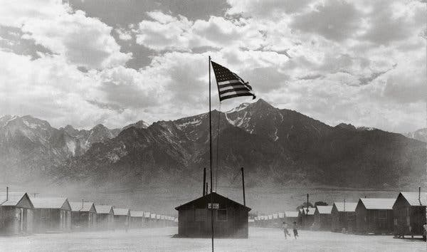
Japanese Internment Camp Vocabulary

Slide 2
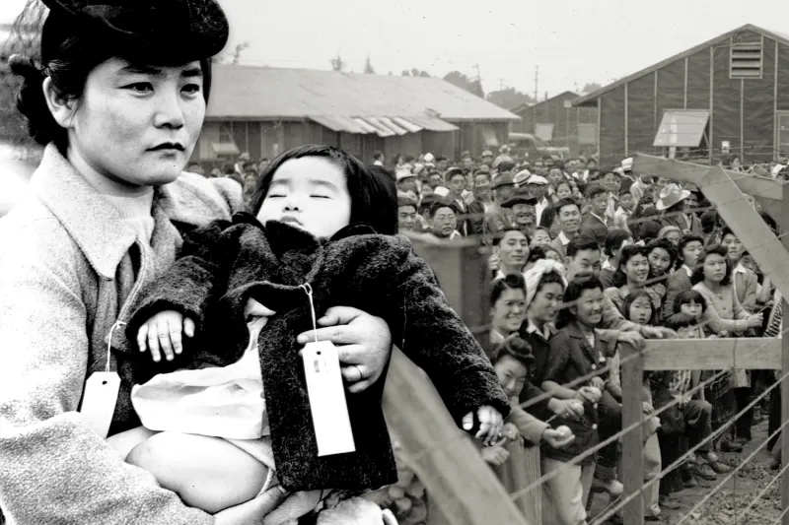
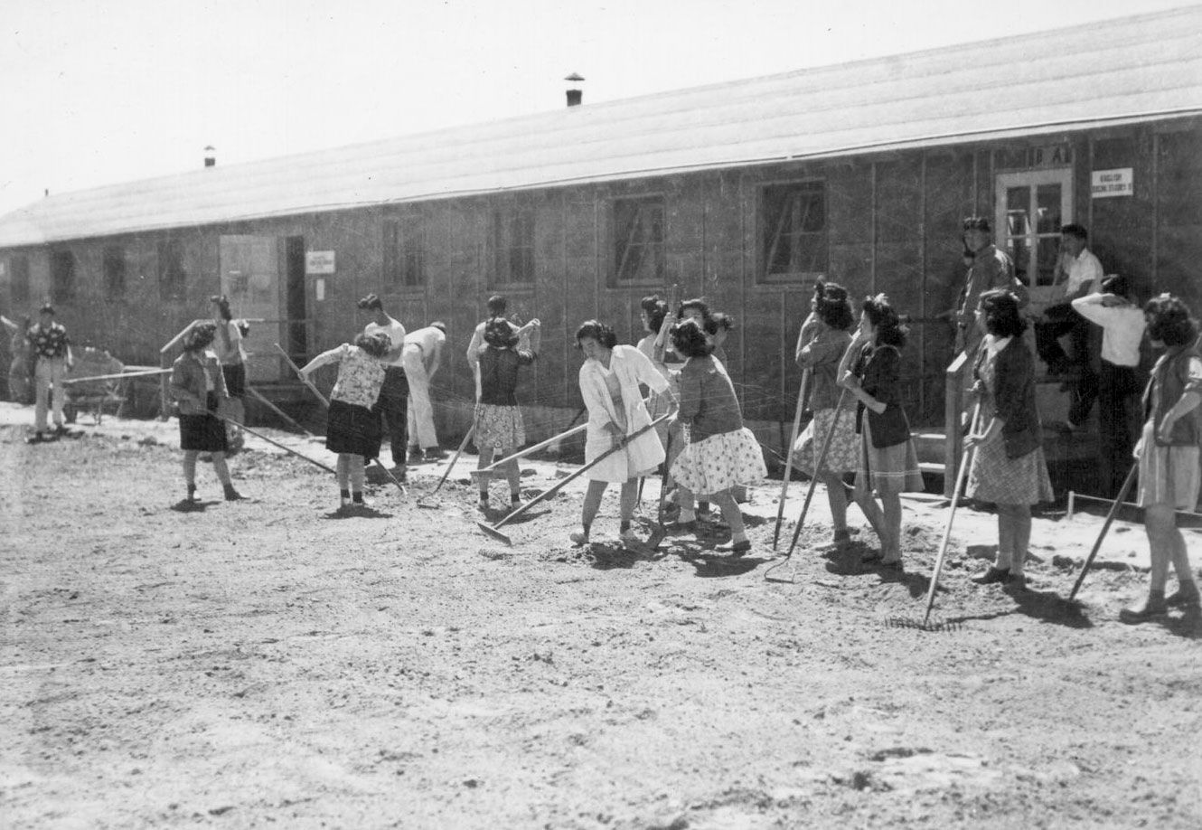
Internment Camp
A place where people are confined, usually without hearings and under harsh conditions

Slide 3
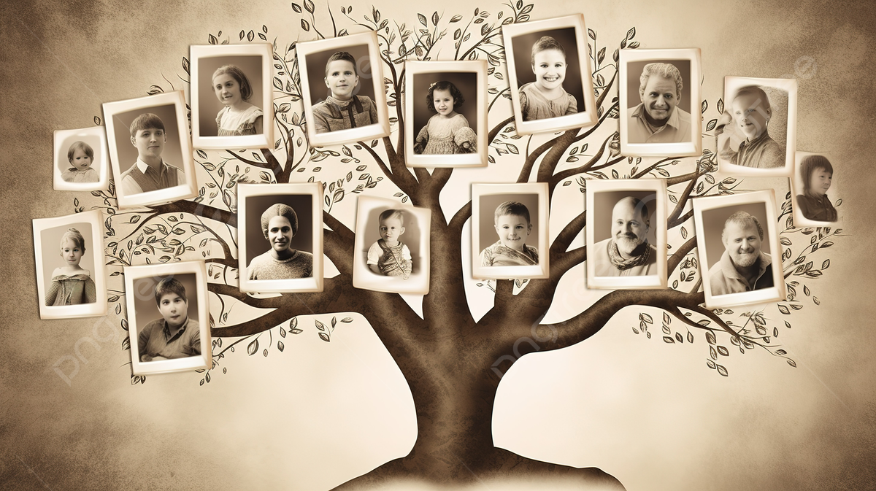
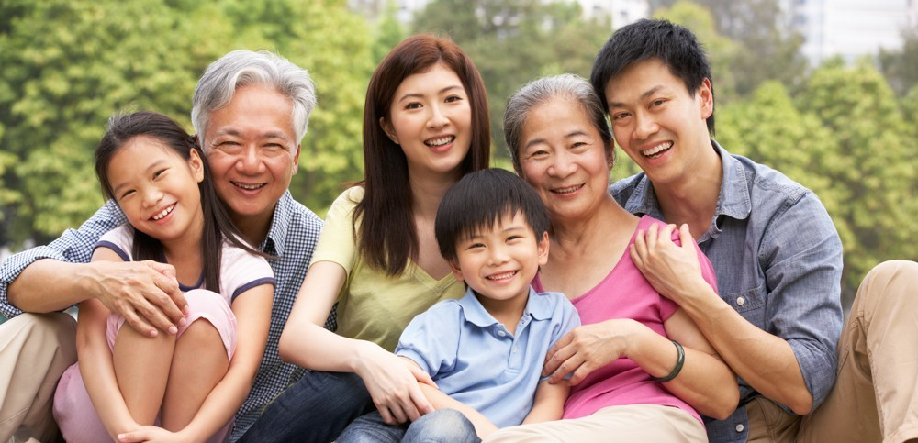
Ancestry
one's family or ethnic descent

Slide 4


Democracy
a system of government by the whole population or all the eligible members of a state, typically through elected representatives

Slide 5


Advocate
a person who publicly supports or recommends a particular cause or policy

Slide 6


Representation
The way in which cultures, identities, and social practices are portrayed in various forms of media

Slide 7
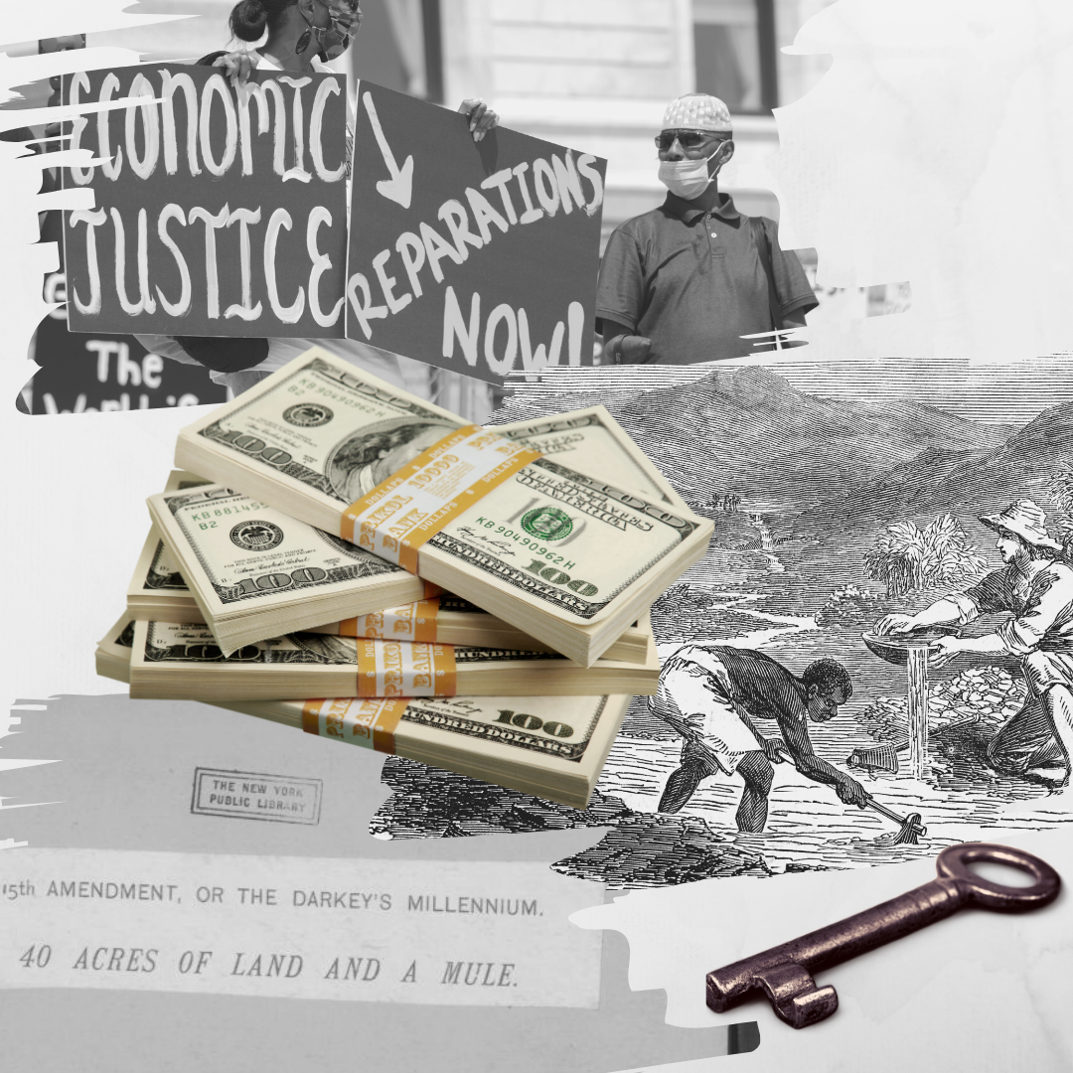
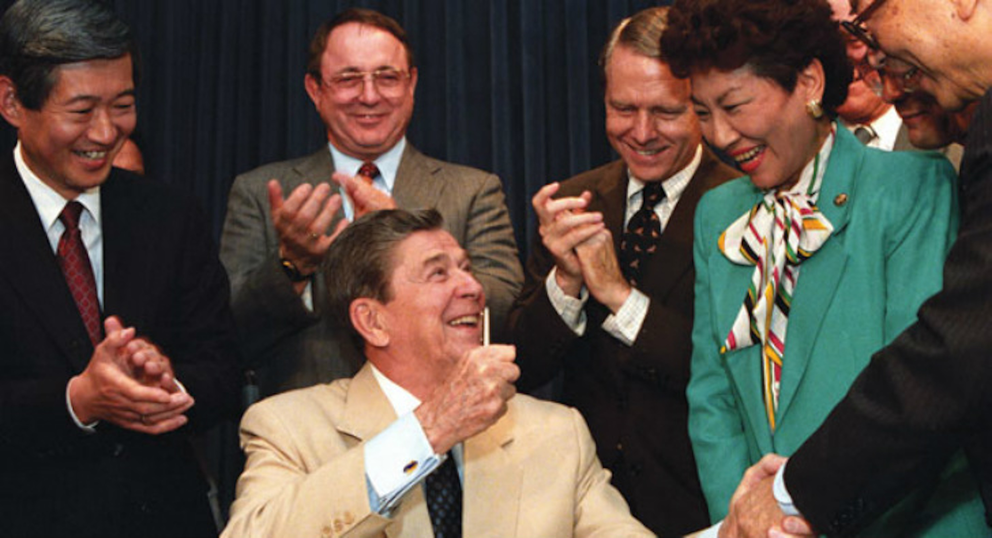
Reparation
The making of amends for a wrong one has done, by paying money to or otherwise helping those who have been wronged

