Slide 1
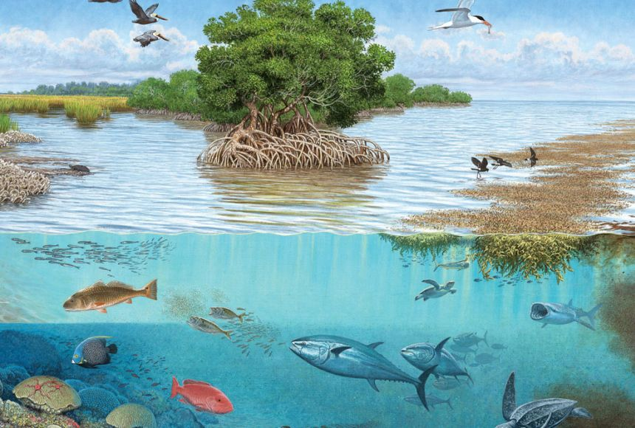
Ecosystem Vocabulary

Slide 2
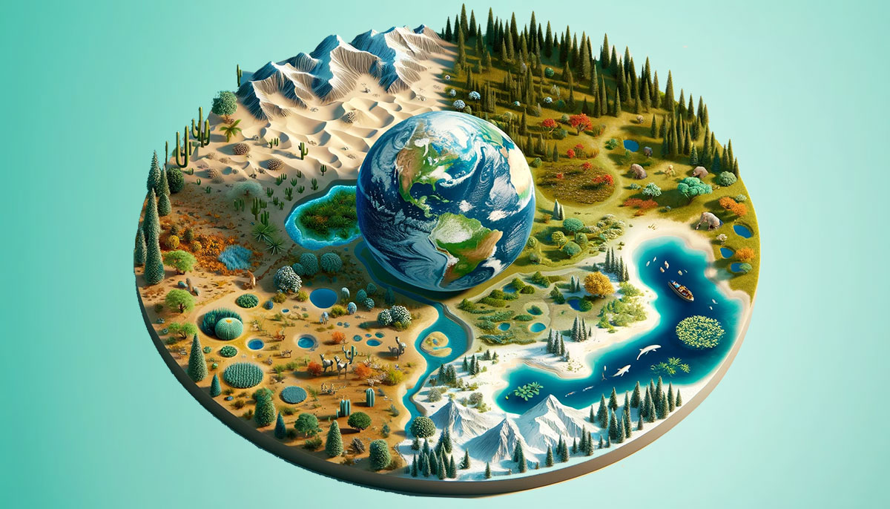
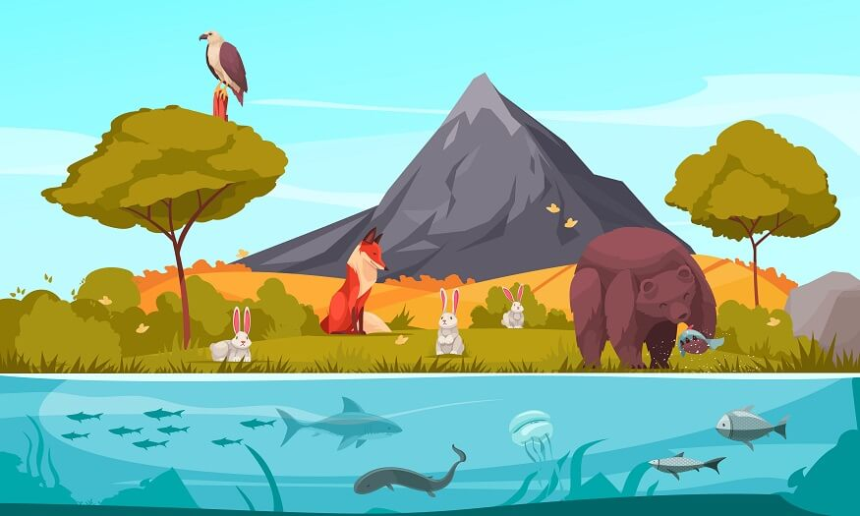
Ecosystem
An area in which living and nonliving things interact

Slide 3
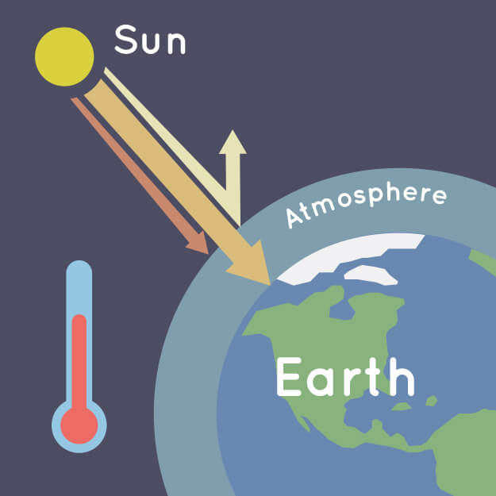
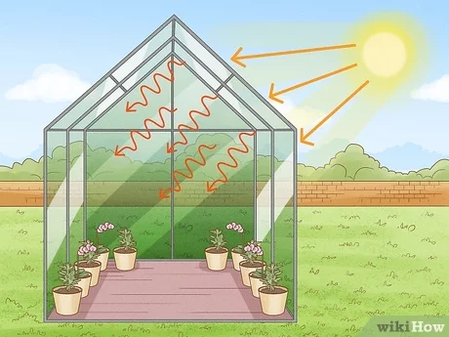
Greenhouse effect
The process through which heat is trapped near the Earth’s surface by gases

Slide 4
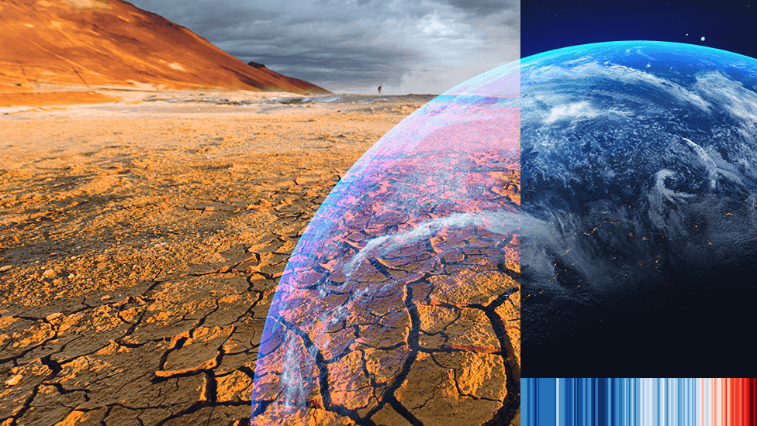
Climate change
Long-term shifts in temperature and weather patterns

Slide 5
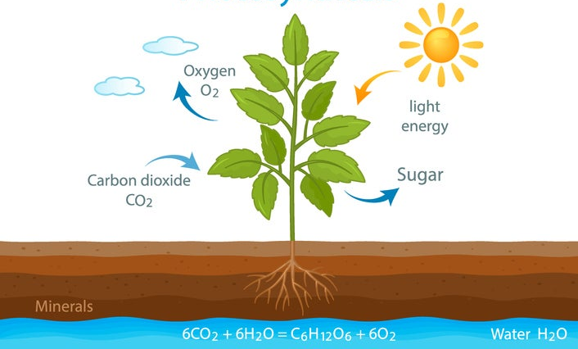
Photosynthesis
The process through which plants make food
(Using water, carbon dioxide and energy from sunlight to make food)

Slide 6
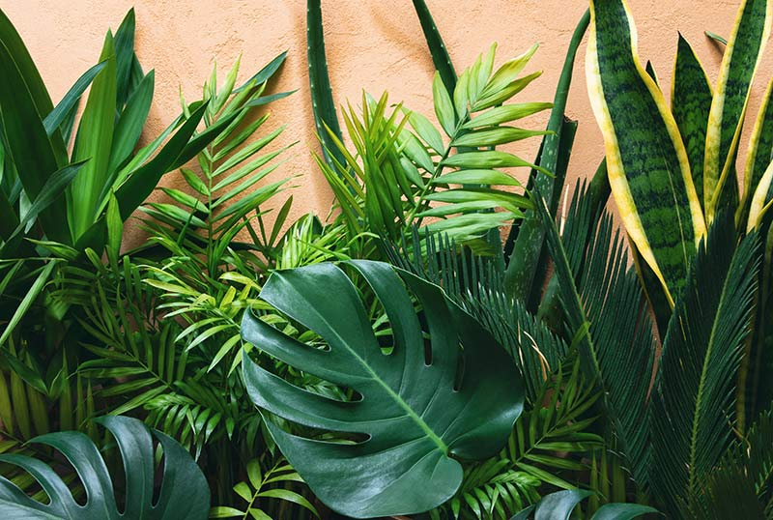
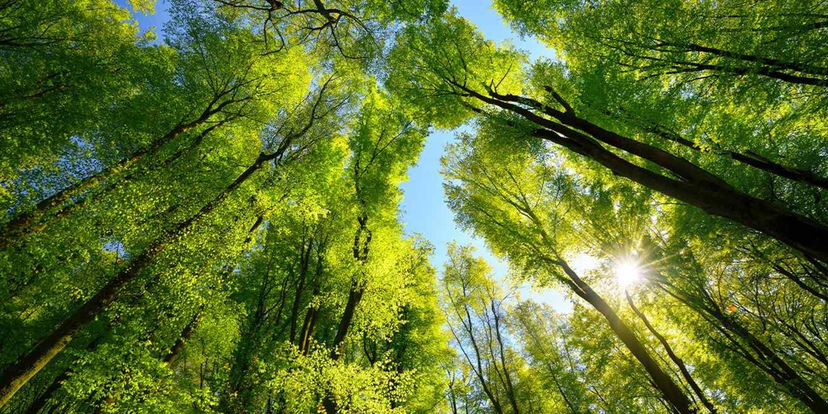
Producer
An organism that makes its own food

Slide 7
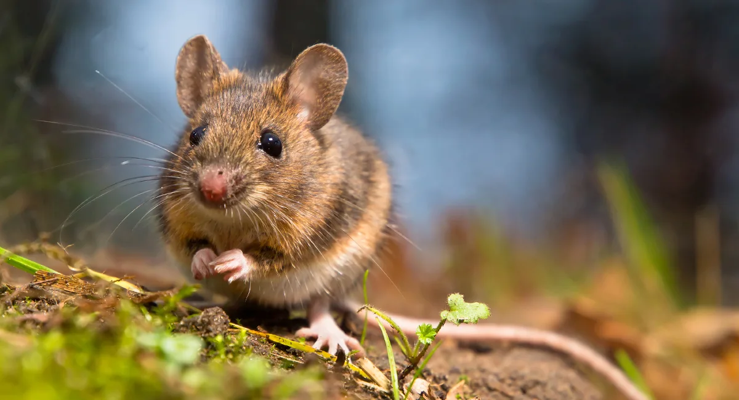
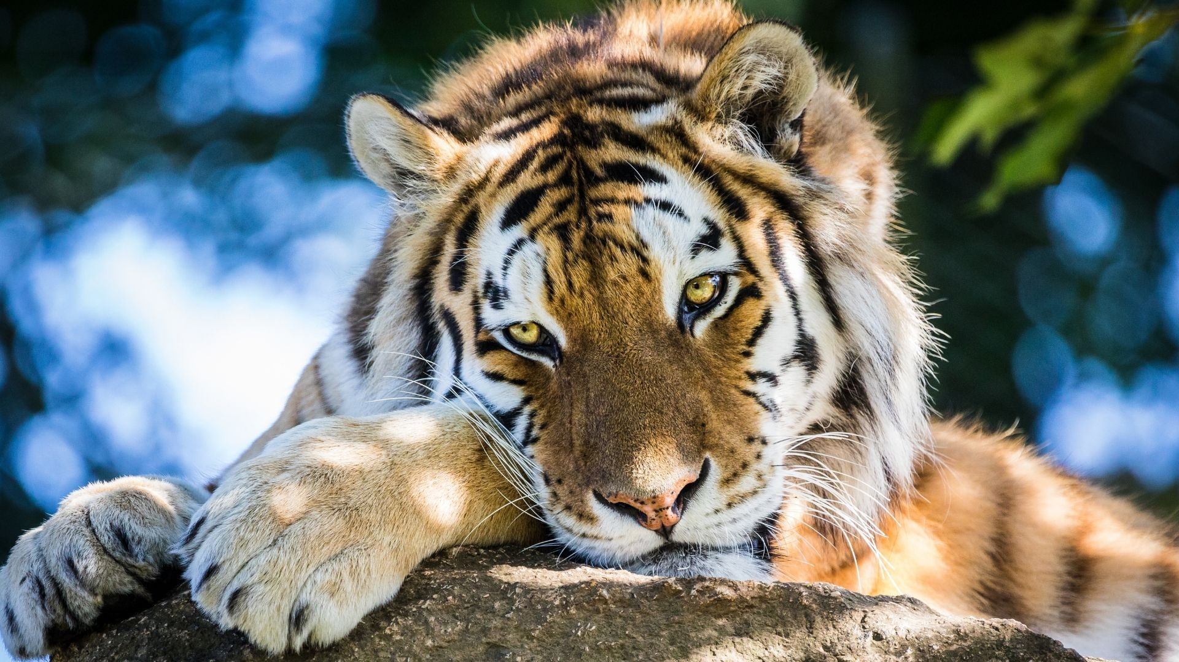
Consumer
An organism that cannot make its own food;
it must eat plants or animals for food

Slide 8
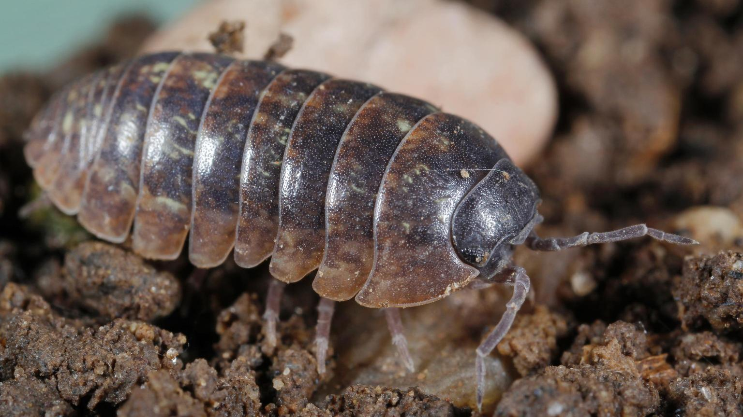
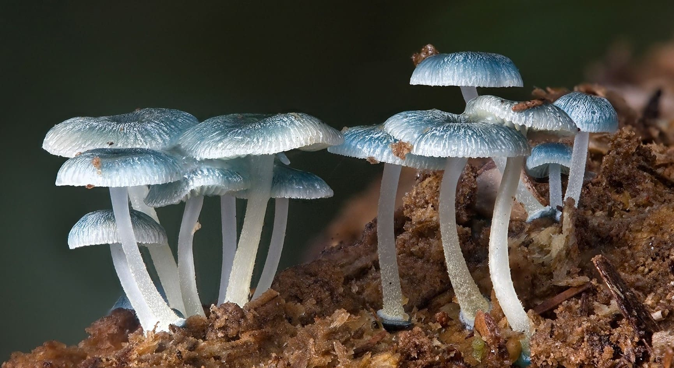
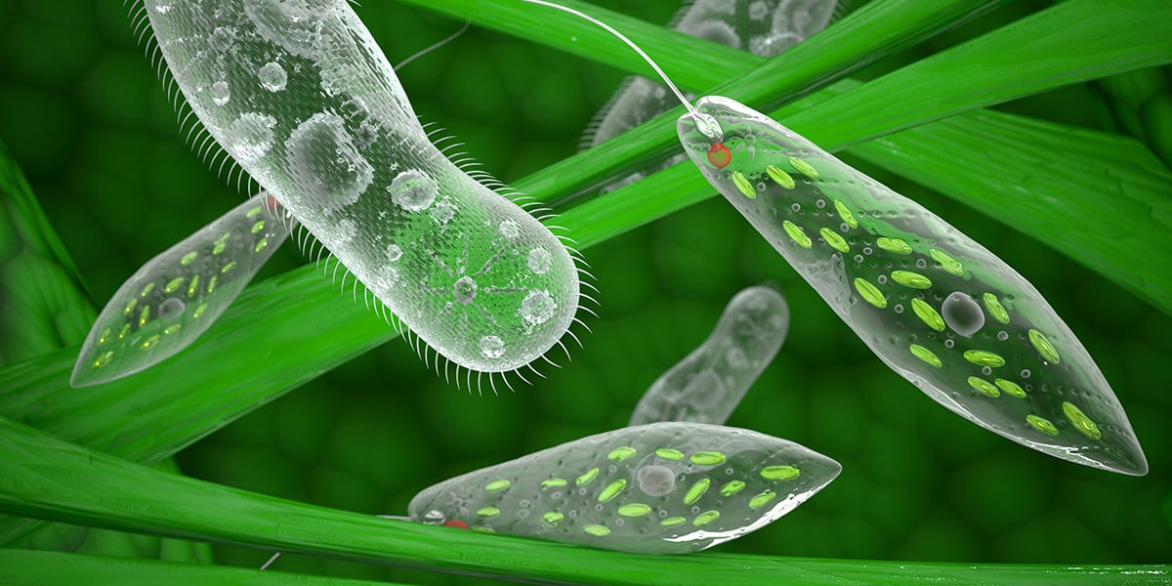
Decomposer
A living thing that break down dead plants and animals

Slide 9
Ecosystem Vocabulary Practice
What is the word?

Slide 10
Climate change
Long-term shifts in temperature and weather patterns

Slide 11
Photosynthesis
The process through which plants make food
(Using water, carbon dioxide and energy from sunlight to make food)

Slide 12
Producer
An organism that makes its own food

Slide 13
Ecosystem
An area in which living and nonliving things interact

Slide 14
Decomposer
A living thing that break down dead plants and animals

Slide 15
Greenhouse effect
The process through which heat is trapped near the Earth’s surface by gases

Slide 16
Consumer
An organism that cannot make its own food;
it must eat plants or animals for food

