Slide 1
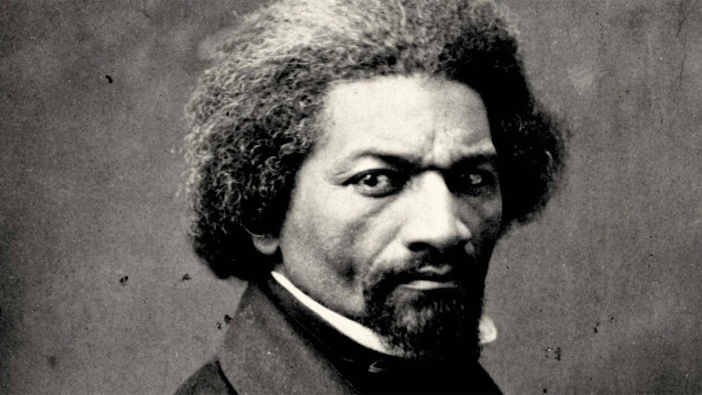
Frederick Douglass Vocabulary

Slide 2
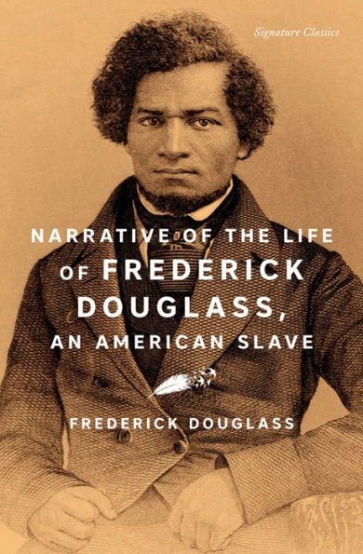
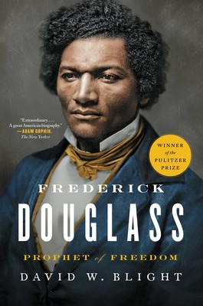
Primary Source vs. Secondary Source
Primary Source - a document or artifact that provides first-hand evidence about a topic of study
Secondary Source - a document, image, or object that analyzes, interprets, or summarizes information from primary sources

Slide 3
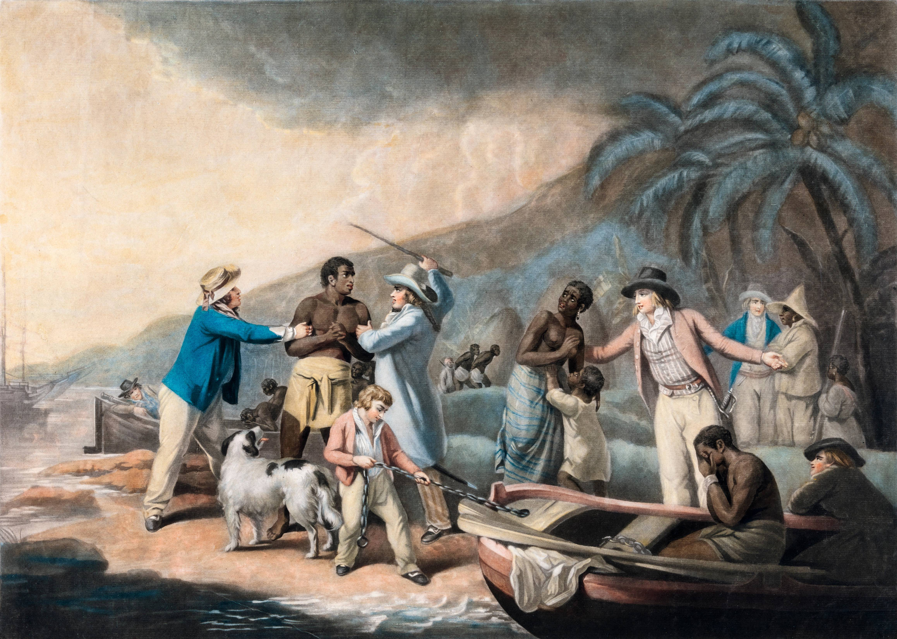
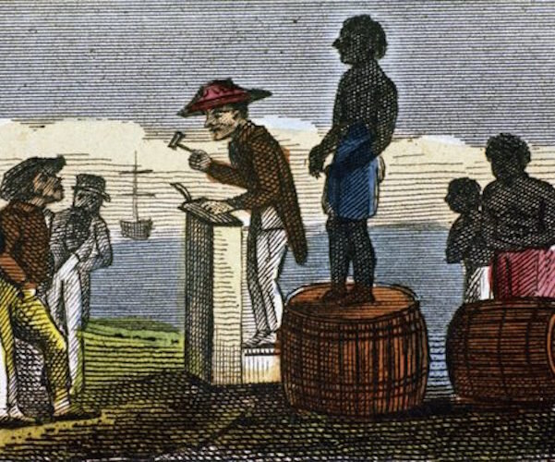
Enslavement
the act of taking or holding someone as a slave

Slide 4
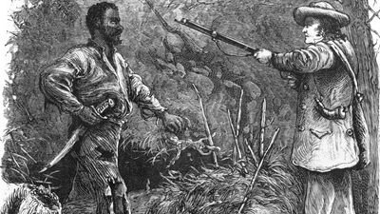
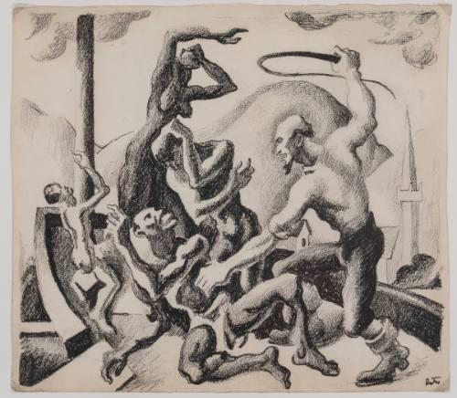
Master
a man who has people working for him, especially servants or slaves

Slide 5
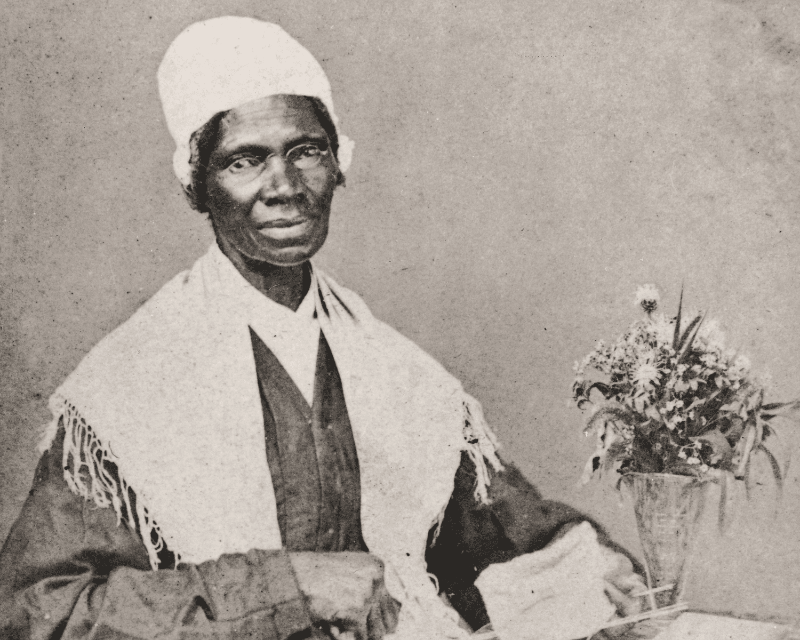

Abolitionist/Abolish
Abolitionist - a person who wants to stop slavery
Abolish – to formally end or stop something

Slide 6
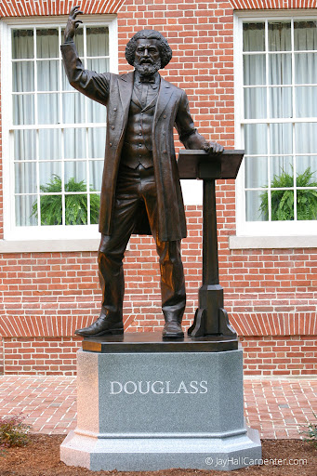
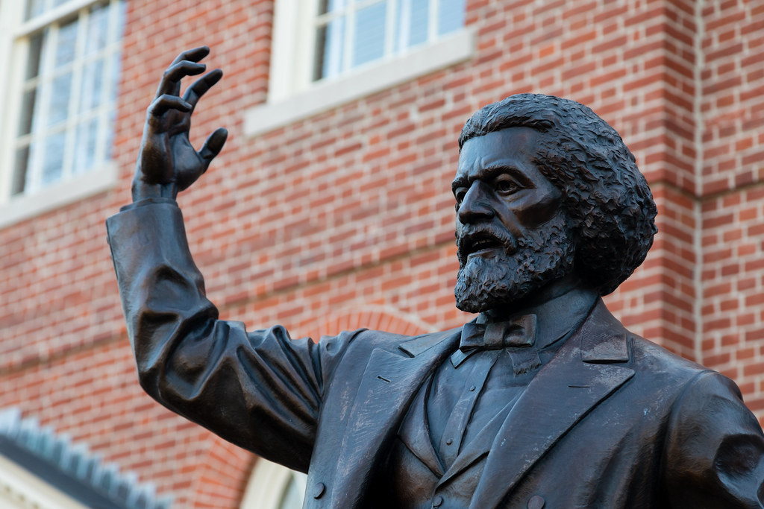
Orator
a public speaker, especially one who is eloquent or skilled

