Slide 1

How to Tell if a Source is Reliable

Slide 2

1. Who is the author?
Is an author listed?
If so, what are the author’s qualifications?
Is the author qualified to be writing on this topic?

Slide 3
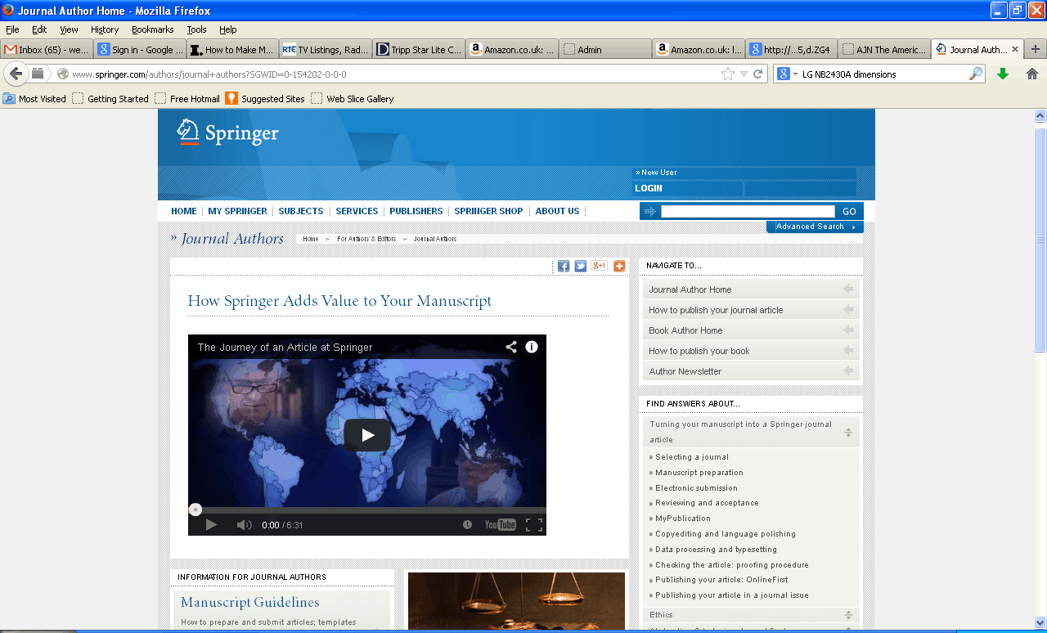
2. Who is the publisher?
Can you identify who published the material?
Is the publisher reputable?
Is there contact information listed for the publisher ?

Slide 4

3. If it is a website, what is the domain?
Websites with .com, .net or .org can be purchased by anyone.
.gov is for government websites
.edu is for colleges and universities

Slide 5
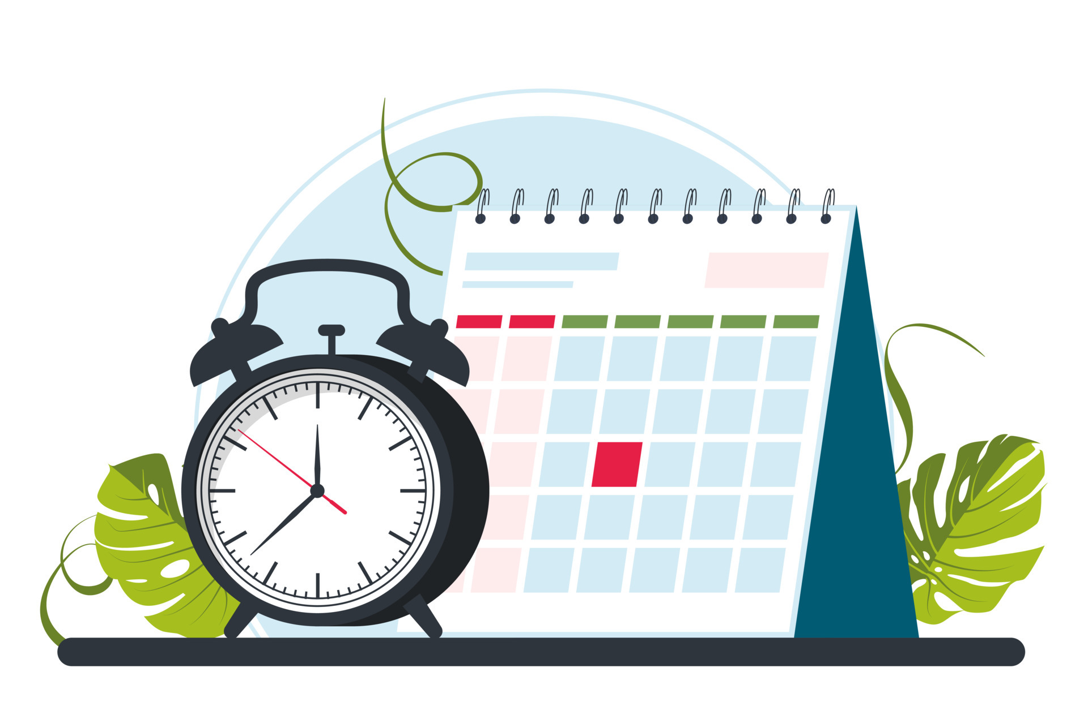
4. What is the date?
Is the date listed?
If so, is the information current or out of date?

Slide 6

5. What is the purpose?
Does the publisher have a mission statement?
Is the source trying to get you to buy something?
Is the information presented as fact or opinion?
Is there a bias?

Slide 7
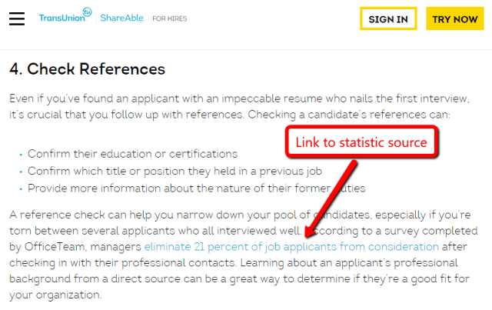
6. Is information supported?
Are there quotes and statistics?
Reputable sources will cite sources where information comes from
Are there working links to other websites?

Slide 8

7. Is it professional?
Are there spelling and grammar errors?
Is the material well-designed?
Is there anything on the website that you know is untrue or too unbelievable?

