Slide 1
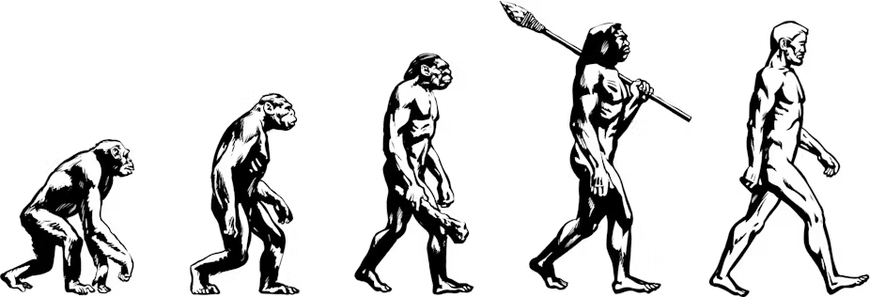
Evolution Vocabulary

Slide 2
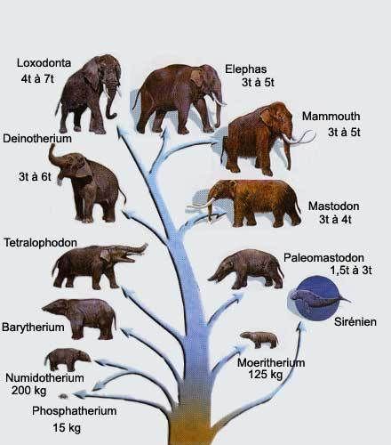
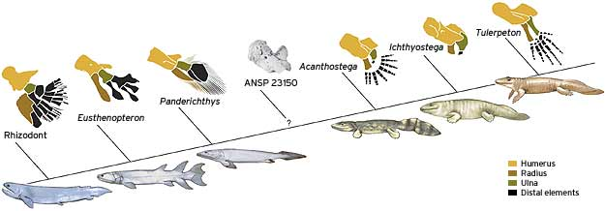
Evolution
The gradual change of a species over time

Slide 3
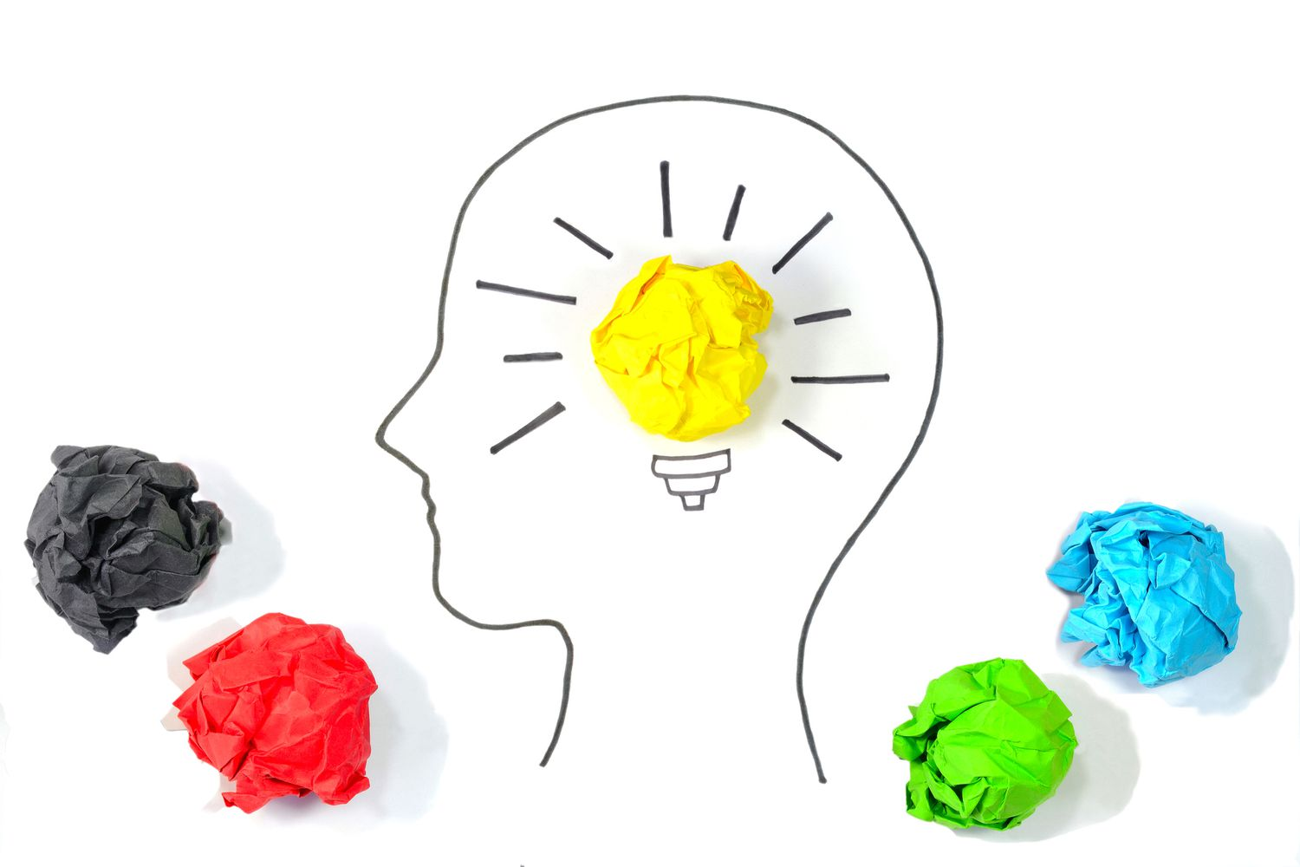
Theory
A well-supported explanation for observations made in the natural world

Slide 4
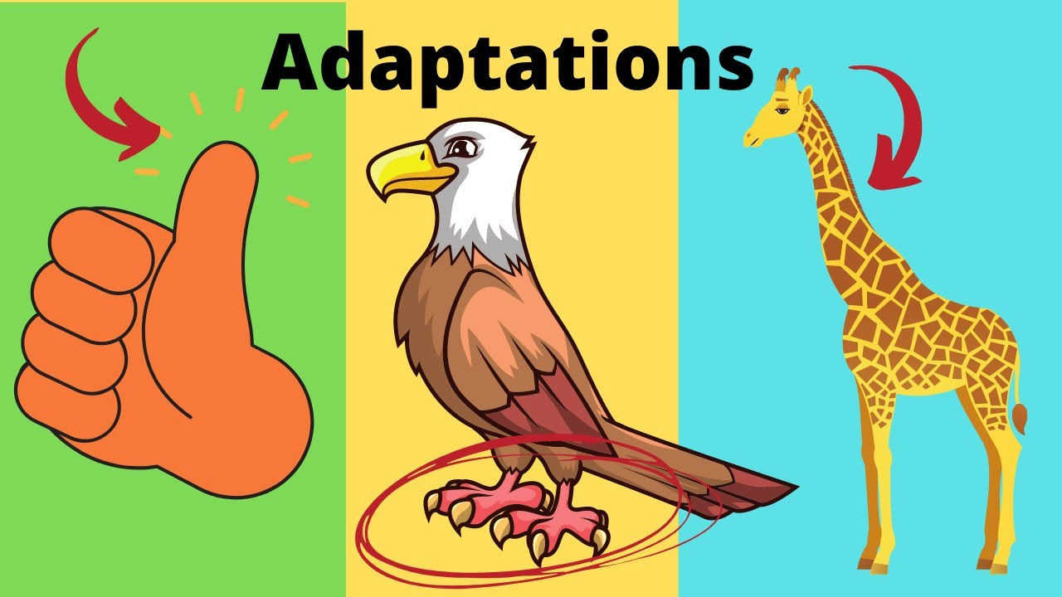
Adaptation
A trait that makes an organism better able to survive in its environment

Slide 5
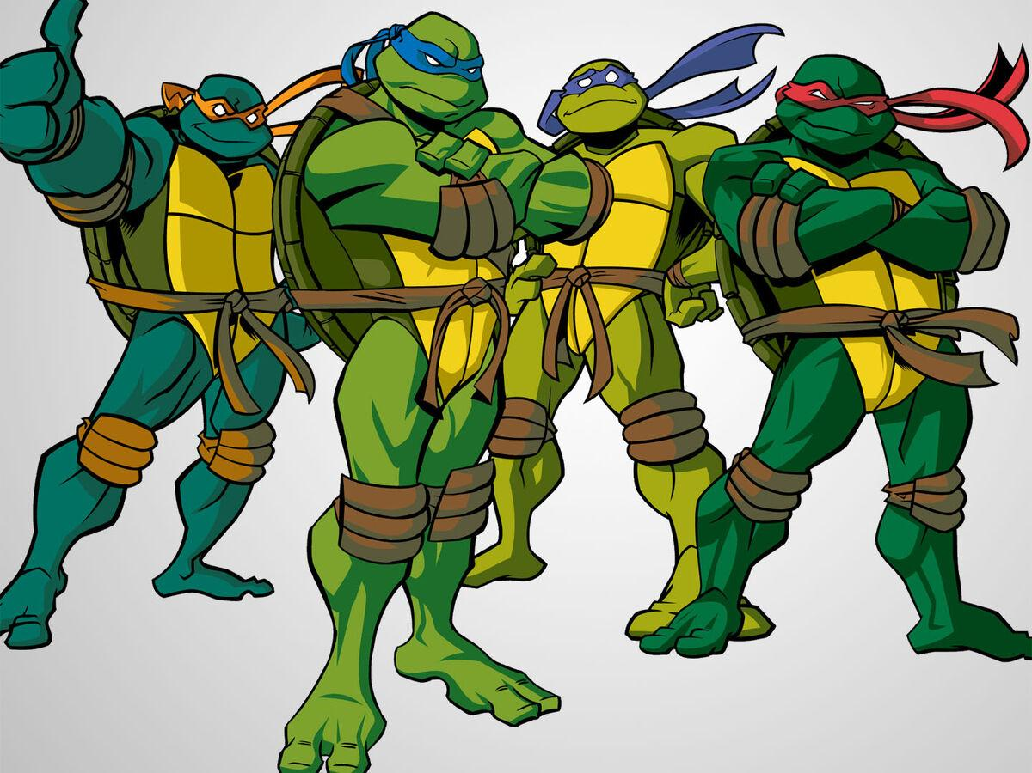
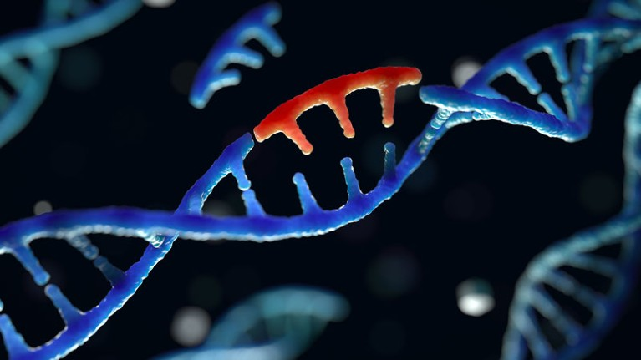
Mutation
A change in genetic material

Slide 6
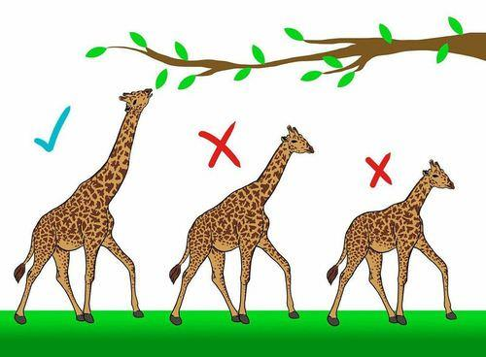
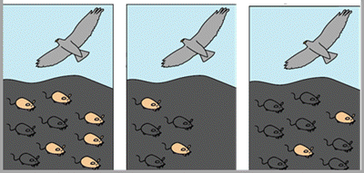
Natural Selection
Organisms best suited to their environments are most likely to survive and reproduce

Slide 7
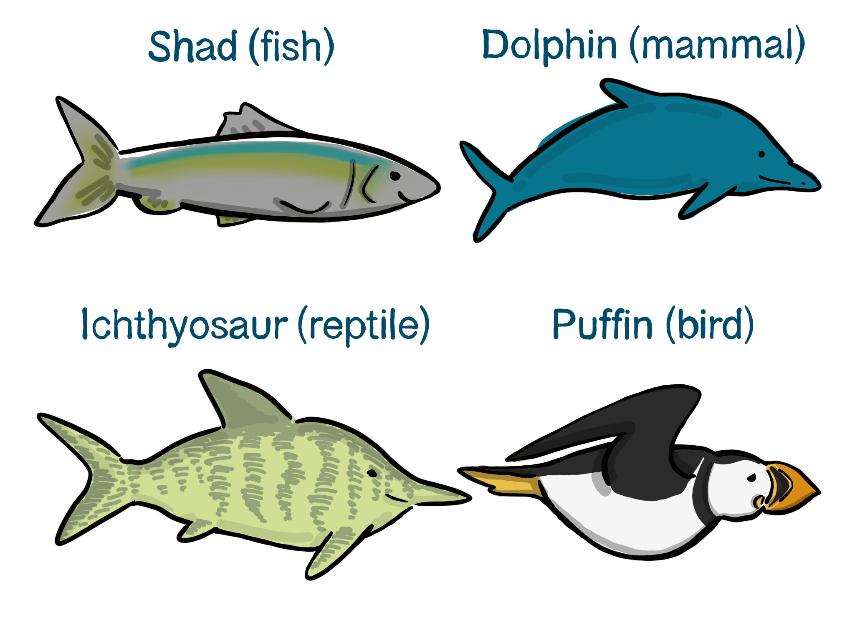
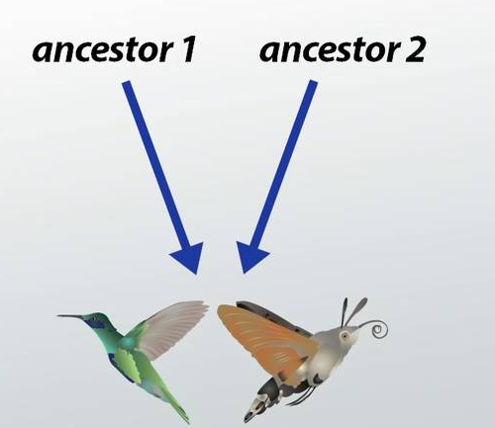
Convergence
When not closely related species develop the similar traits independently

Slide 8
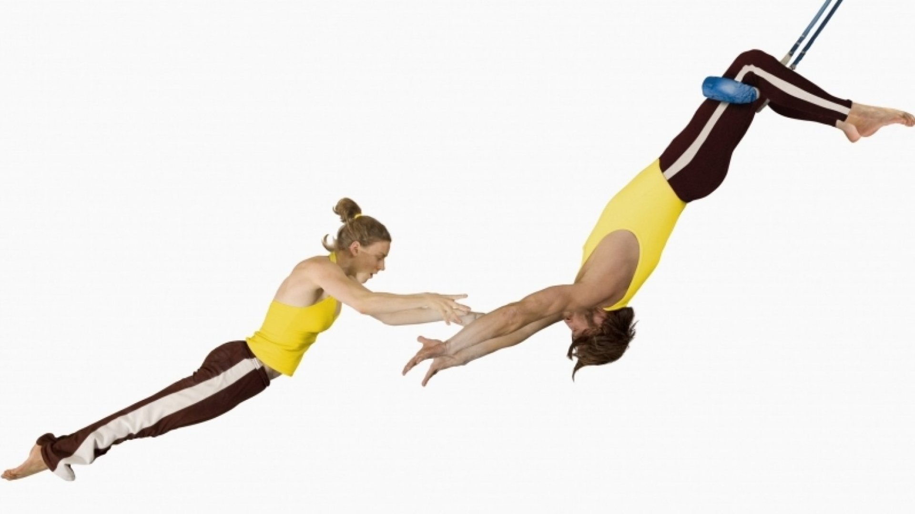
Reliable
consistently good in quality or performance; able to be trusted

Slide 9
Evolution Vocabulary Practice
What is the word?

Slide 10
Adaptation
A trait that makes an organism better able to survive in its environment

Slide 11
Evolution
The gradual change of a species over time

Slide 12
Convergence
When not closely related species develop the similar traits independently

Slide 13
Natural Selection
Organisms best suited to their environments are most likely to survive and reproduce

Slide 14
Mutation
A change in genetic material

Slide 15
Theory
A well-supported explanation for observations made in the natural world

Slide 16
Evolution
The gradual change of a species over time

Slide 17
Convergence
When not closely related species develop the similar traits independently

Slide 18
Mutation
A change in genetic material

Slide 19
Theory
A well-supported explanation for observations made in the natural world

Slide 20
Natural Selection
Organisms best suited to their environments are most likely to survive and reproduce

