Slide 1
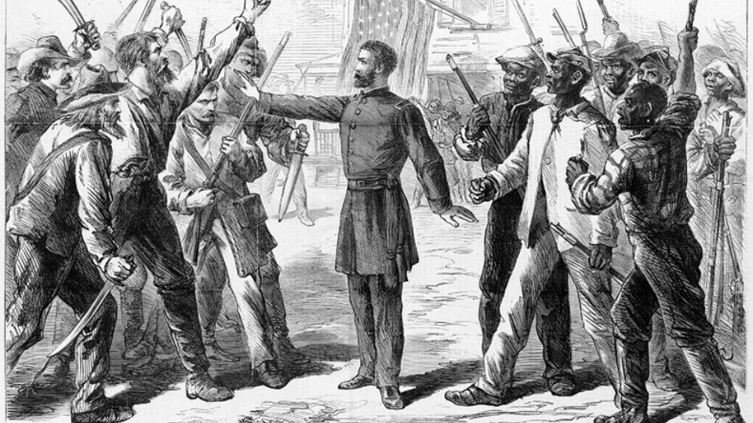
Reconstruction Vocabulary

Slide 2
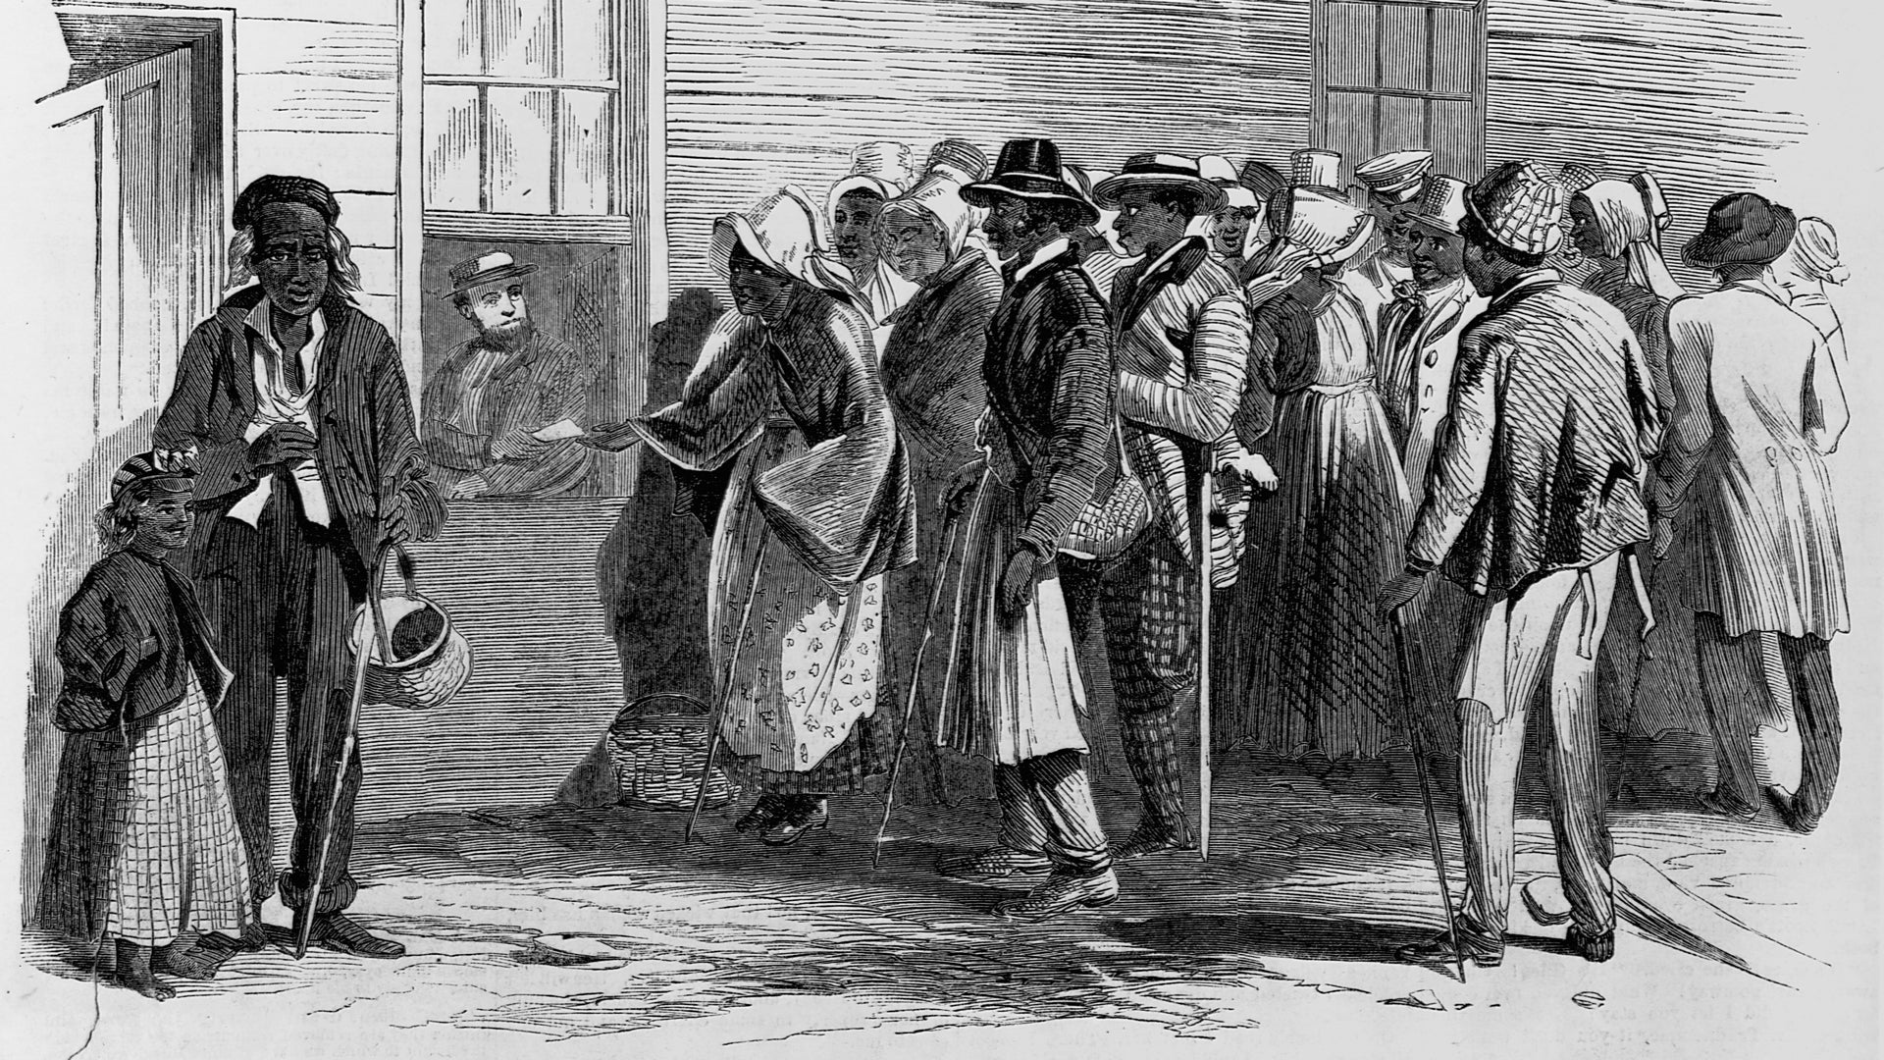
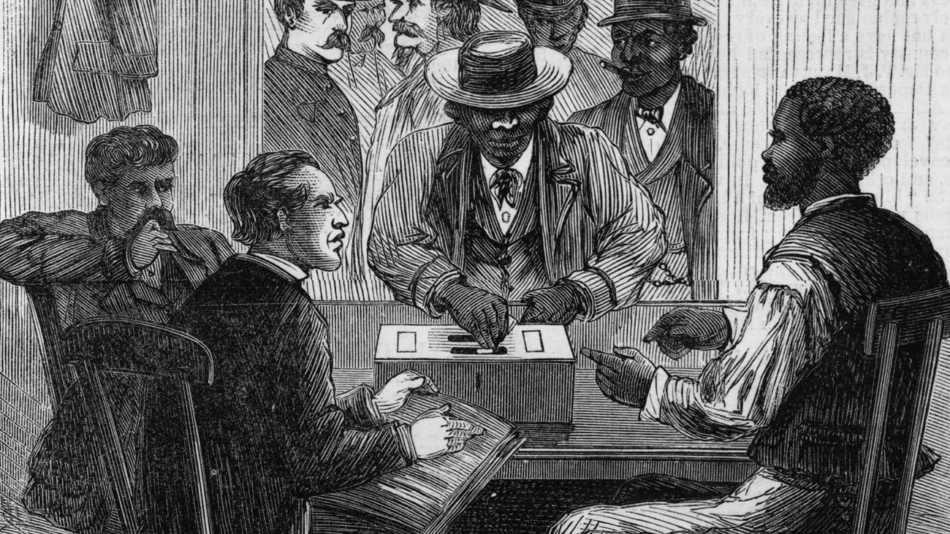
Reconstruction
The period following the American Civil War (1865-1877) when the federal government aimed to rebuild the Southern states and integrate formerly enslaved African Americans into society

Slide 3
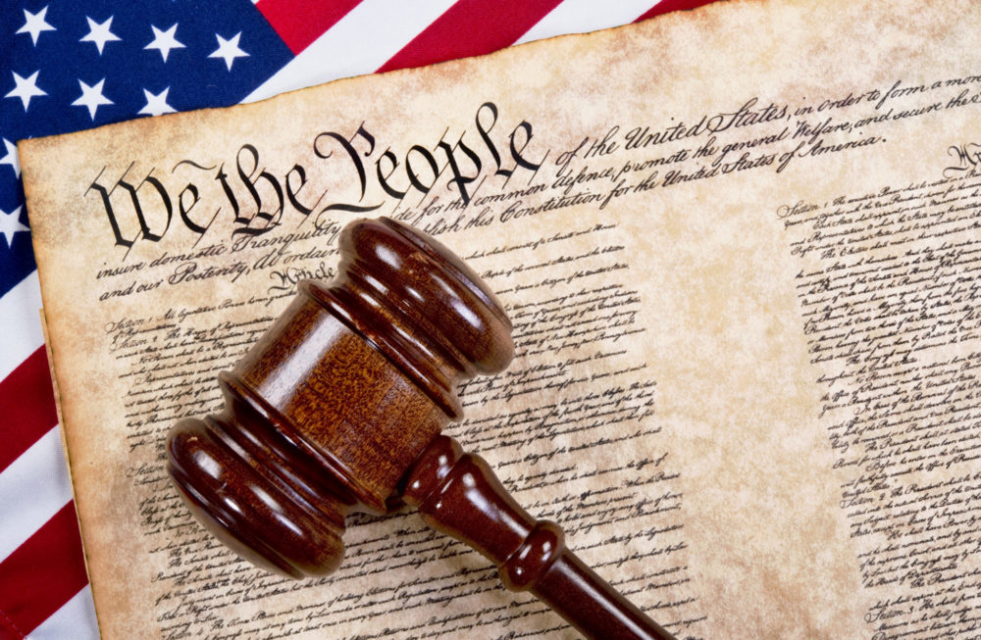
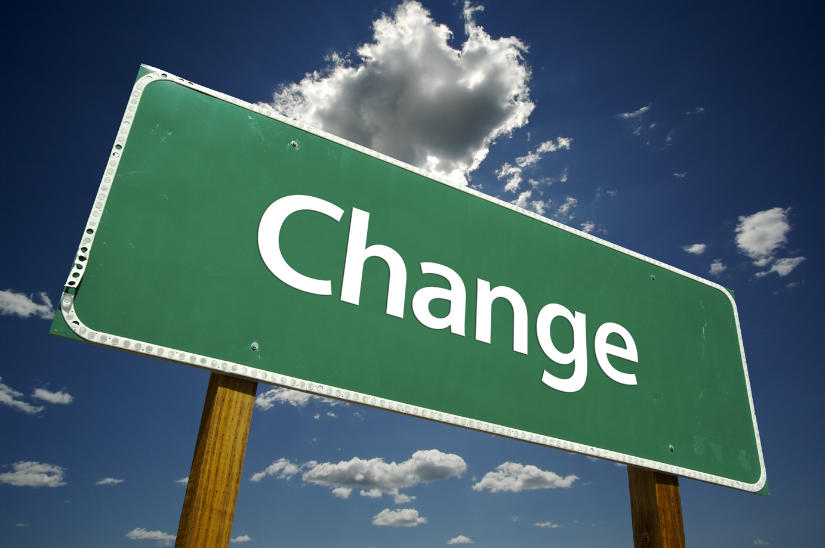
Amendment
A change or addition to the US Constitution

Slide 4


Ratify
The process of giving official approval to a law, treaty, or other legal document

Slide 5
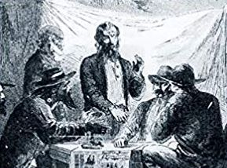
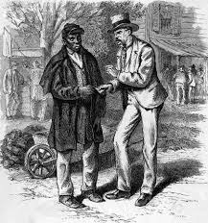
Scalawag
A white Southerner who supported the Republican Party and the Reconstruction governments after the American Civil War

Slide 6
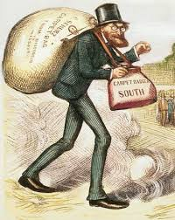
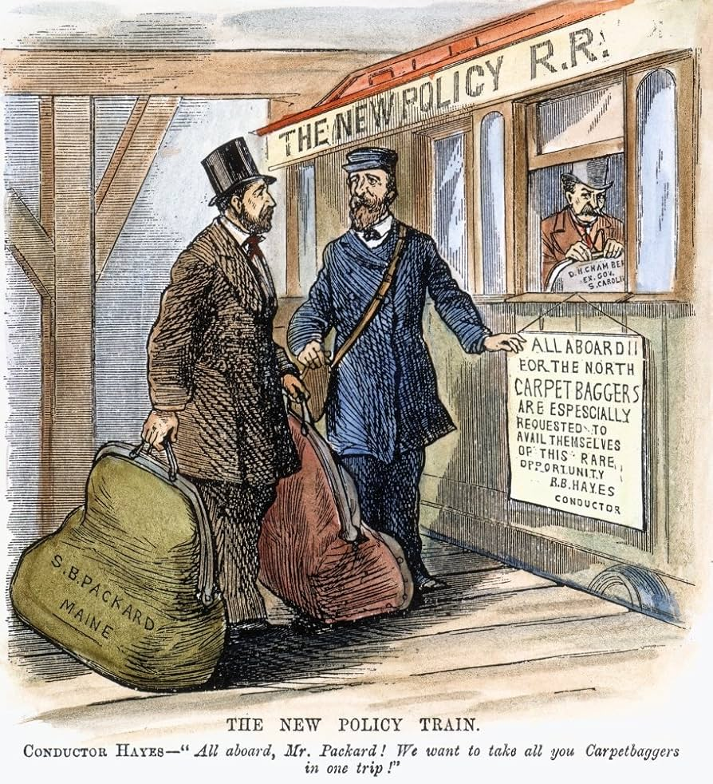
Carpetbagger
A carpetbagger is a northerner who moved to the south during Reconstruction for economic, social, and sometimes political opportunities

Slide 7
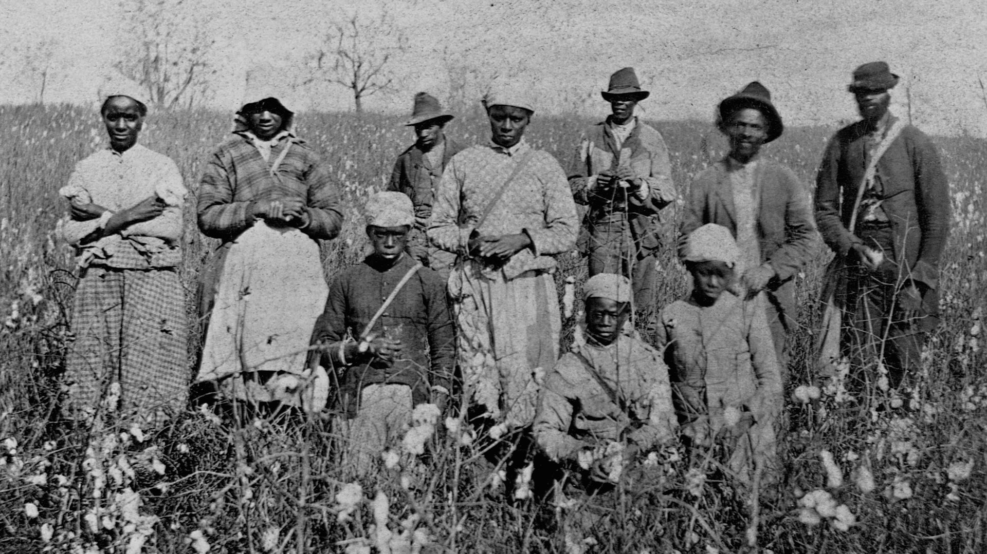
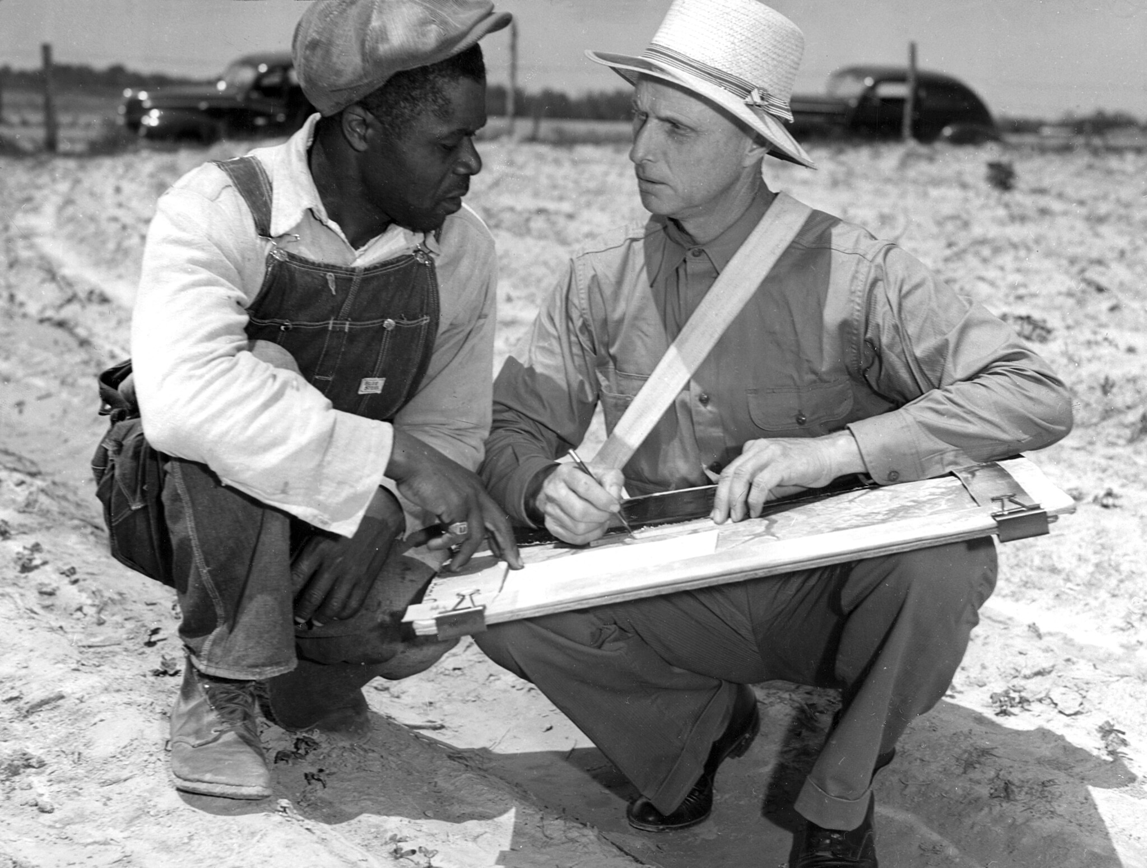
Sharecropping
An agricultural system where a farmer works a landowner's land in exchange for a portion of the crop harvested

