Slide 1
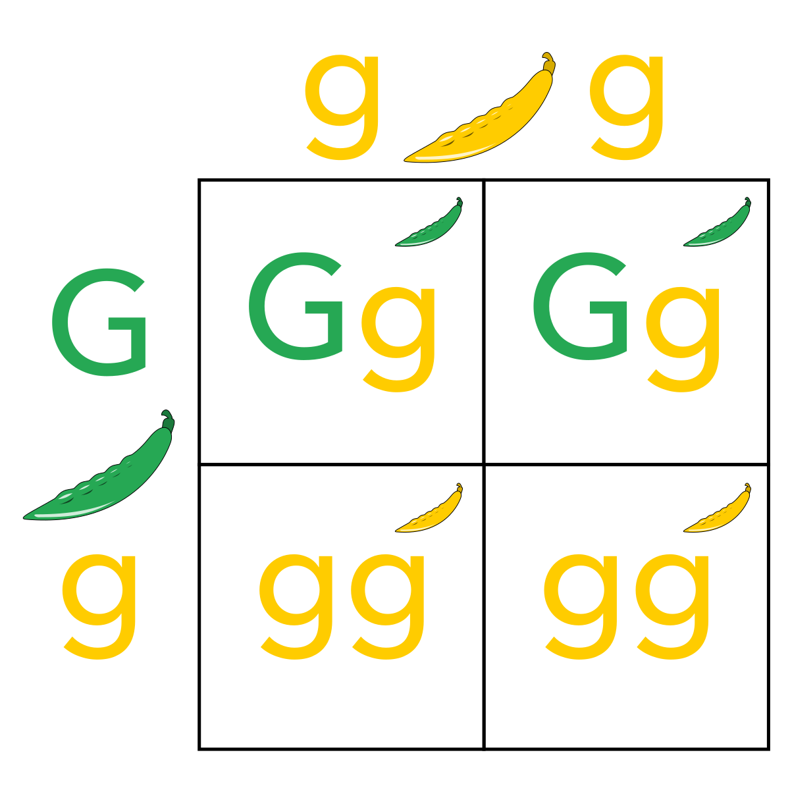
Punnett Squares

Slide 2
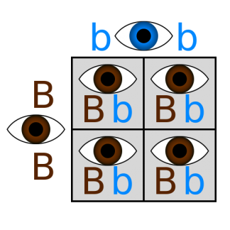
What is a Punnett Square?
A Punnett Square is a diagram that shows the possible combinations of traits among the offspring of two parents.

Slide 3


Genes can be dominant or recessive
Dominant genes show the trait the whenever the gene is present
Dominant genes are represented by a CAPITAL letter
Recessive genes do not always show the trait when the gene is present
Recessive genes are represented by a lower case letter

Slide 4

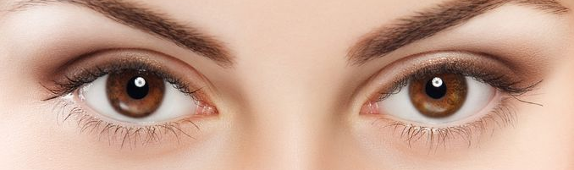

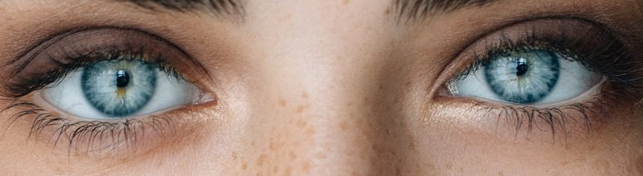
Example – Eye Color
The gene for brown eyes is dominant.
It is represented by B.
The gene for blue eyes is recessive.
It is represented by b.

Slide 5

A person may inherit 2 genes for certain traits
One gene comes from the person’s mother
One gene comes from the person’s father

Slide 6
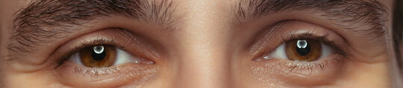
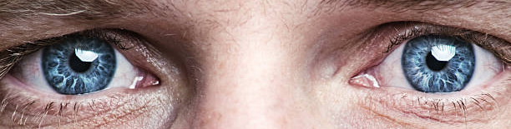
3 Eye Color Possibilities (Genotypes)
BB
Bb
bb
Inherited B gene from one parent
Inherited B gene from one parent
Inherited b gene from one parent
Inherited B gene from other parent
Inherited b gene from other parent
Inherited b gene from other parent
Eyes are brown (phenotype), but person is carrying the blue-eyed gene (and can pass it down to offspring)
Eyes are brown (phenotype)
Eyes are blue (phenotype)
Homozygous dominant
Homozygous recessive
Heterozygous dominant

Slide 7
Homozygous
Heterozygous
Both of the genes are the same
The two genes are different
BB
Bb
bb

Slide 8
Genotype
Phenotype
The genes that a person has
The genes that a person expresses
Bb
Bb
Brown eye gene
Blue eye gene
This person has brown eyes

Slide 9
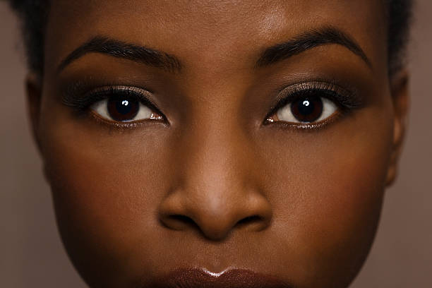

What if these two people have a baby?
BB
bb
What color eyes will their baby have?
A Punnett Square will help us find out!

Slide 10
B
B
Bb
Bb
b
100% of the children will have brown eyes, but they will carry a blue eye gene
Bb
Bb
b

Slide 11
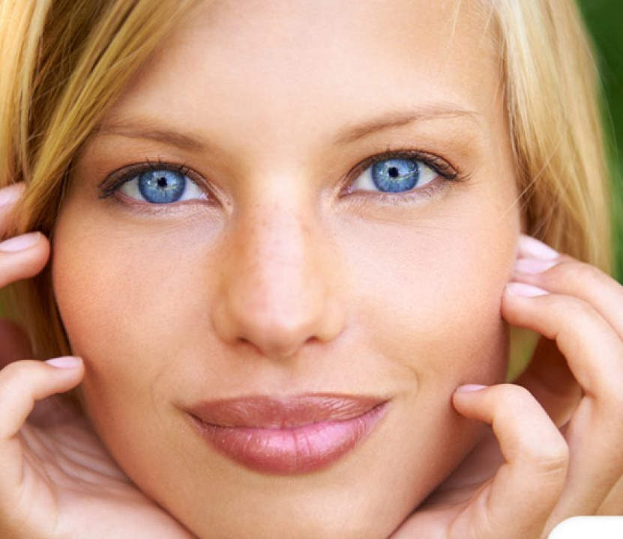
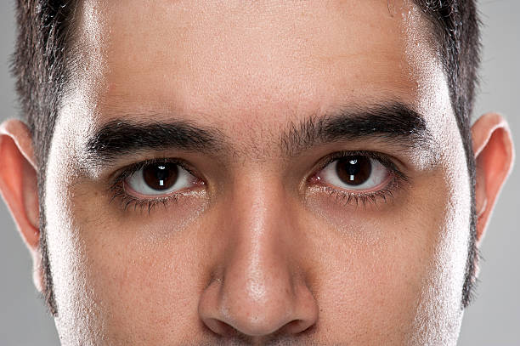
What if these two people have a baby?
bb
Bb
What color eyes will their baby have?

Slide 12
b
b
Bb
Bb
50% of the children will have brown eyes, and 50% of their children will have blue eyes.
B
bb
bb
b

Slide 13
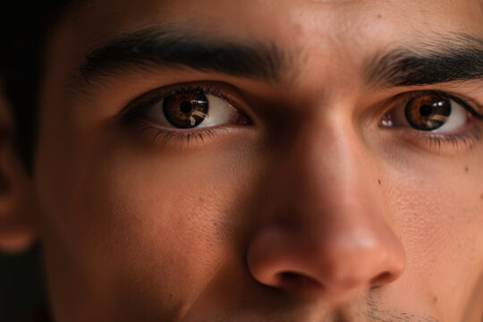
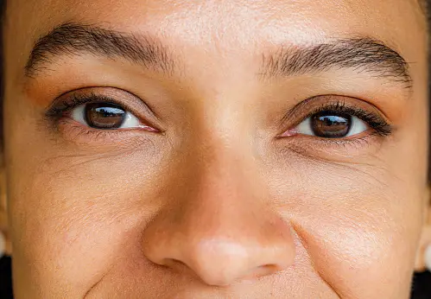
What if these two people have a baby?
Bb
Bb
What color eyes will their baby have?

Slide 14
B
b
BB
Bb
B
75% of their children will have brown eyes, 25% will have blue eyes
Bb
bb
b

Slide 15
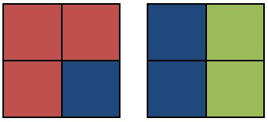

The Punnett Square represents probability.
100% chance of one trait, 0% chance of other trait
75% chance of one trait, 25% chance of other trait
50% chance of one trait, 50% chance of other trait

