Slide 1
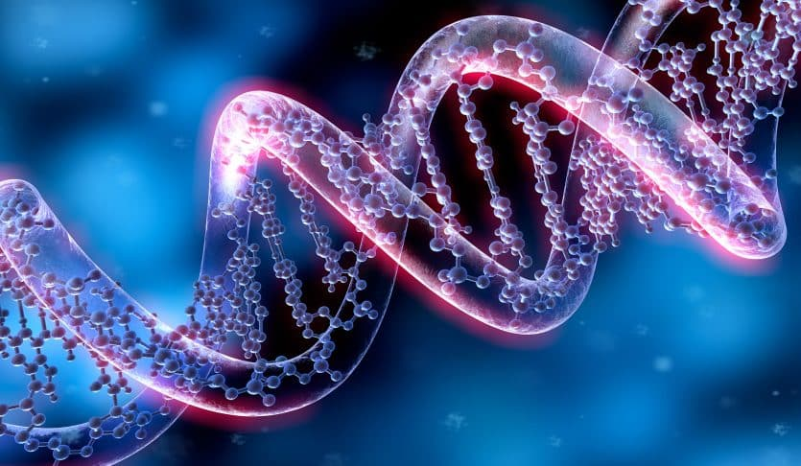
Genetics Vocabulary

Slide 2
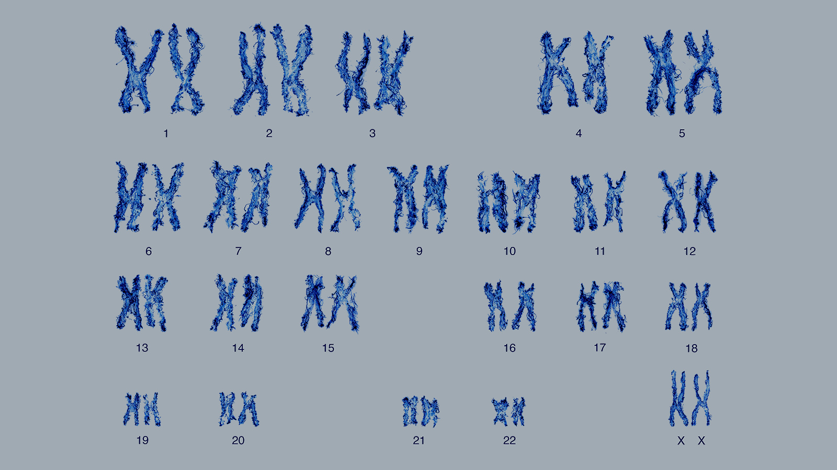
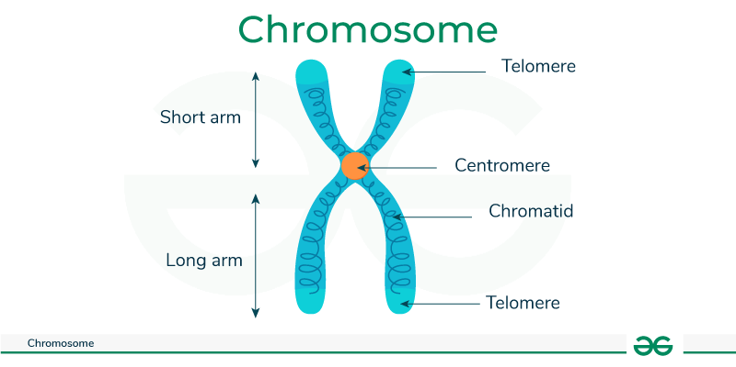
Chromosome
A threadlike structure found in the nucleus of most living things that carries genetic information (genes)

Slide 3
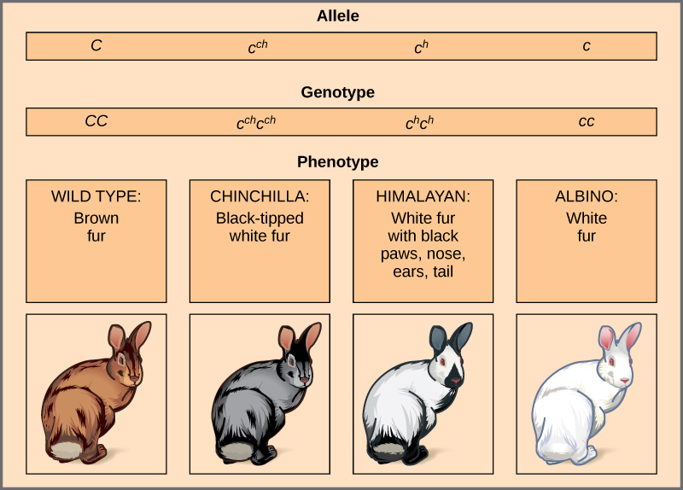
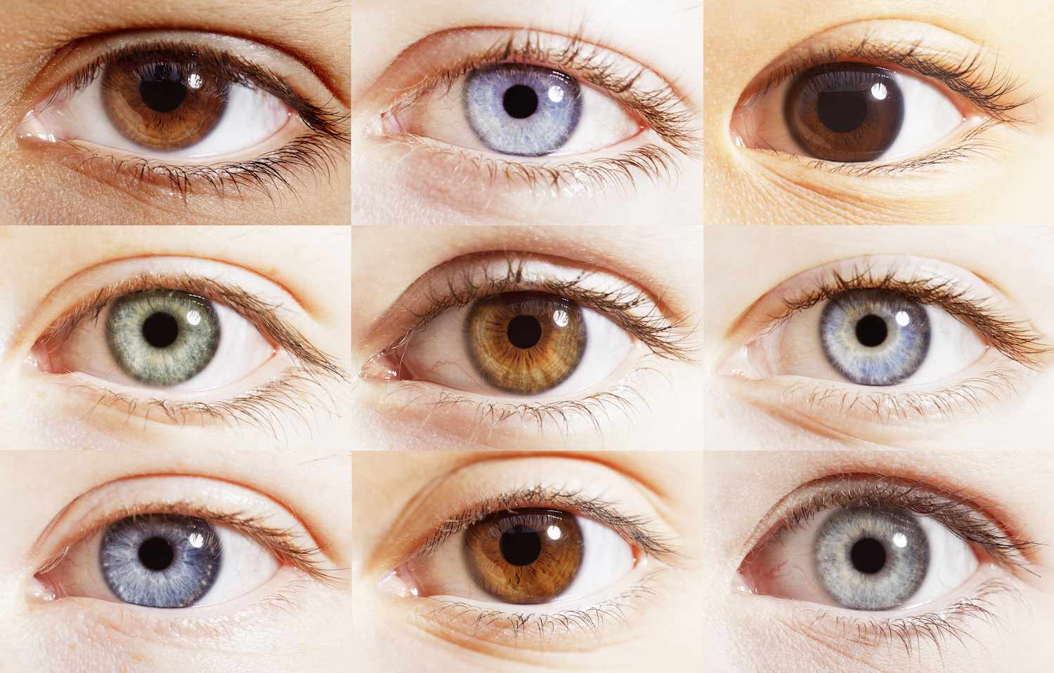
Allele
One of the alternate forms of a gene
(options of genes)

Slide 4
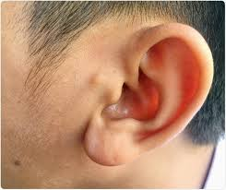
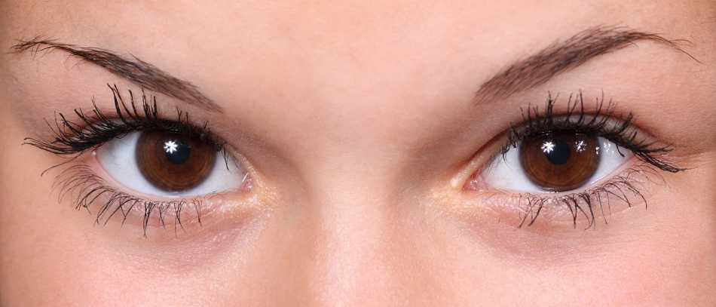
Dominant
A gene that carries a trait that always shows
Represented by a capital letter

Slide 5
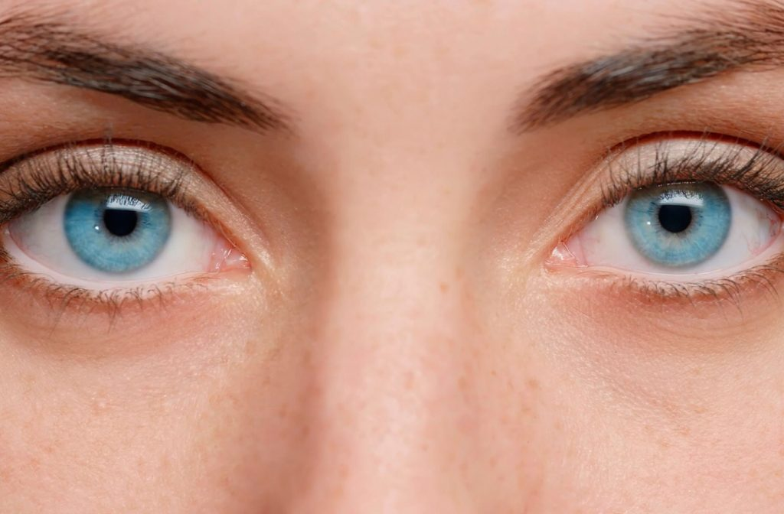
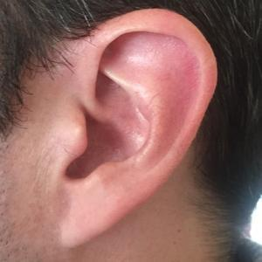
Recessive
A gene that carries a trait that does not always show
Represented by a lower case letter

Slide 6
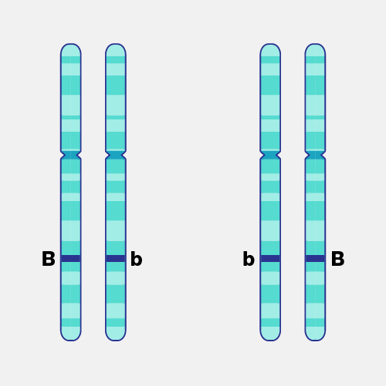
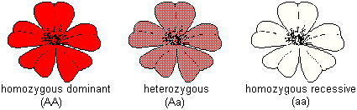
Heterozygous
Having two different versions of the same gene

Slide 7
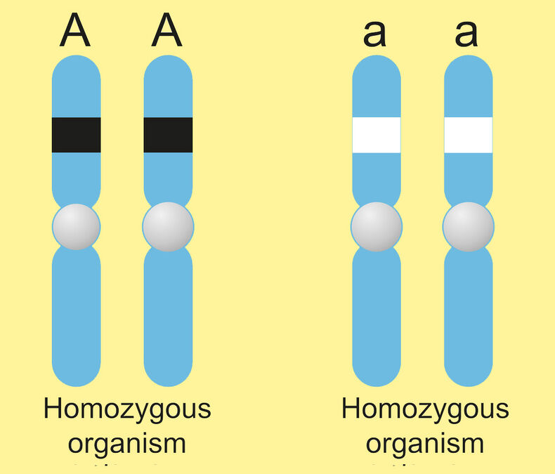
Homozygous
Having two of the same versions of the same gene

Slide 8
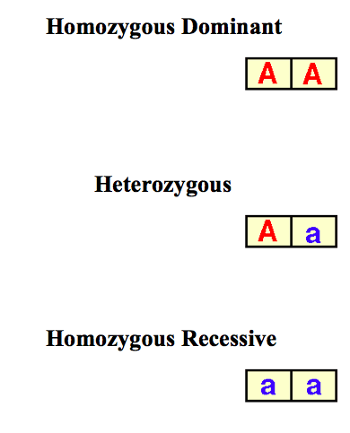
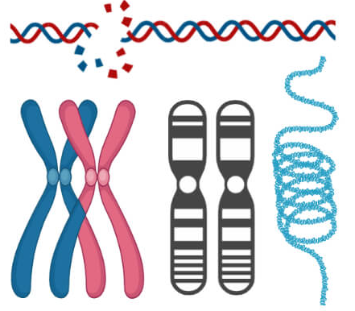
Genotype
The genetic makeup of a living thing;
the alleles that a living thing has

Slide 9
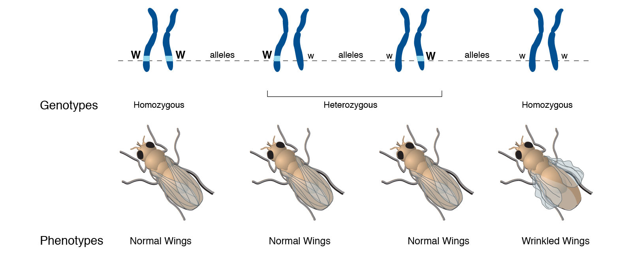
Phenotype
The observable physical properties of a living thing
(what the living thing looks like)

Slide 10
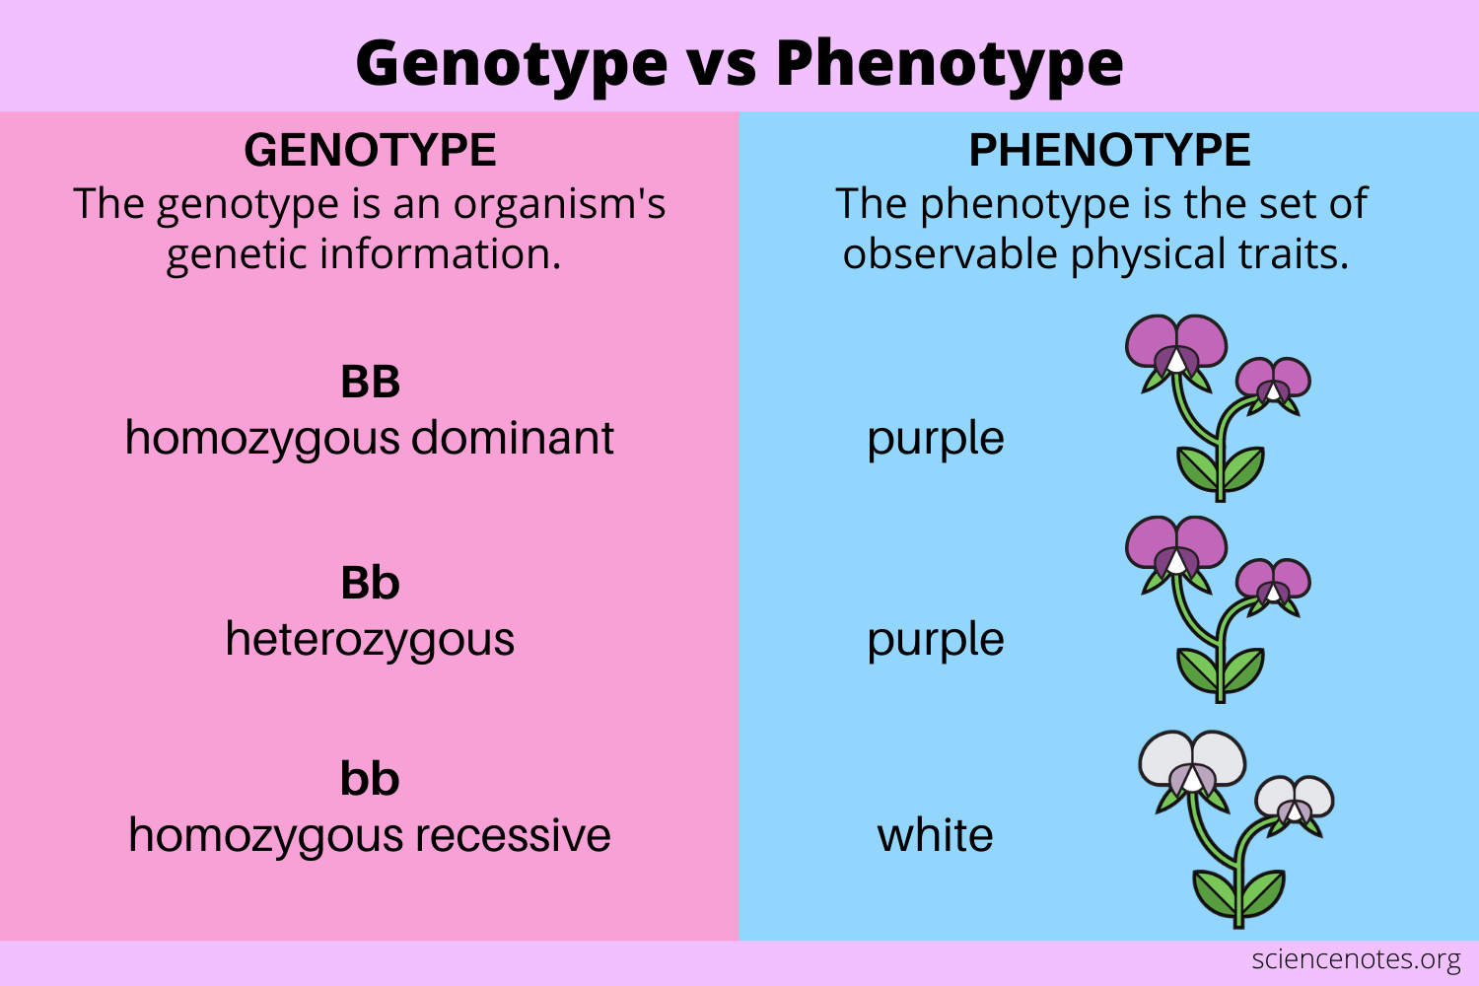

Slide 11

What is the word?

Slide 12
Genotype
The genetic makeup of a living thing;
the alleles that a living thing has

Slide 13
Recessive
A gene that carries a trait that does not always show
Represented by a lower case letter

Slide 14
Heterozygous
Having two different versions of the same gene

Slide 15
Phenotype
The observable physical properties of a living thing
(what the living thing looks like)

Slide 16
Allele
One of the alternate forms of a gene
(options of genes)

Slide 17
Chromosome
A threadlike structure found in the nucleus of most living things that carries genetic information (genes)

Slide 18
Dominant
A gene that carries a trait that always shows
Represented by a capital letter

Slide 19
Homozygous
Having two of the same versions of the same gene

