Slide 1
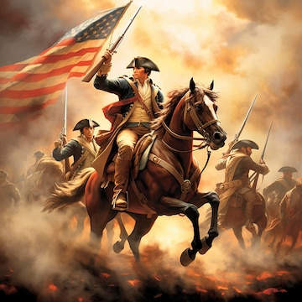
American Revolution
Vocabulary

Slide 2
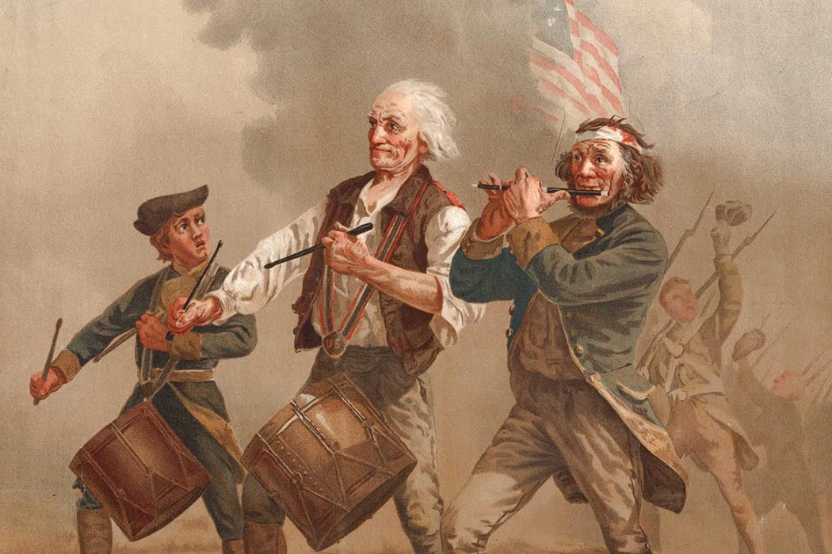
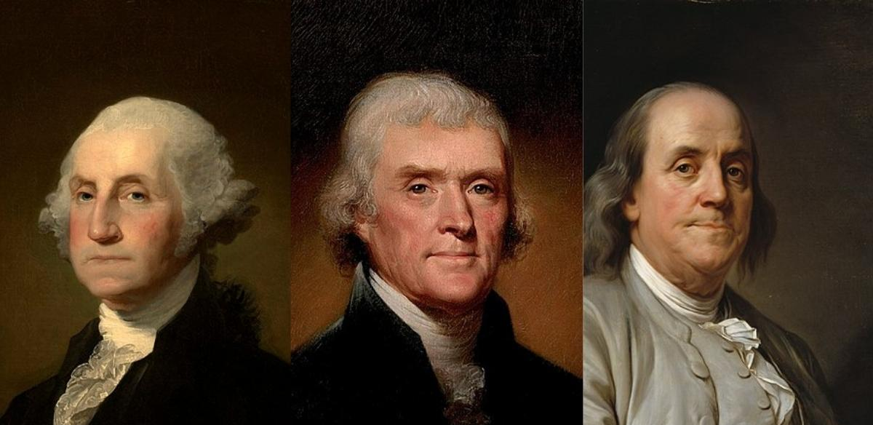
Patriot
a colonist who supported the war for independence from Britain and opposed British rule

Slide 3
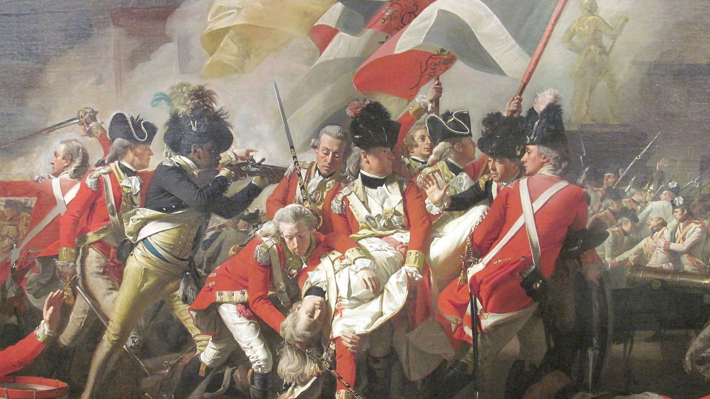
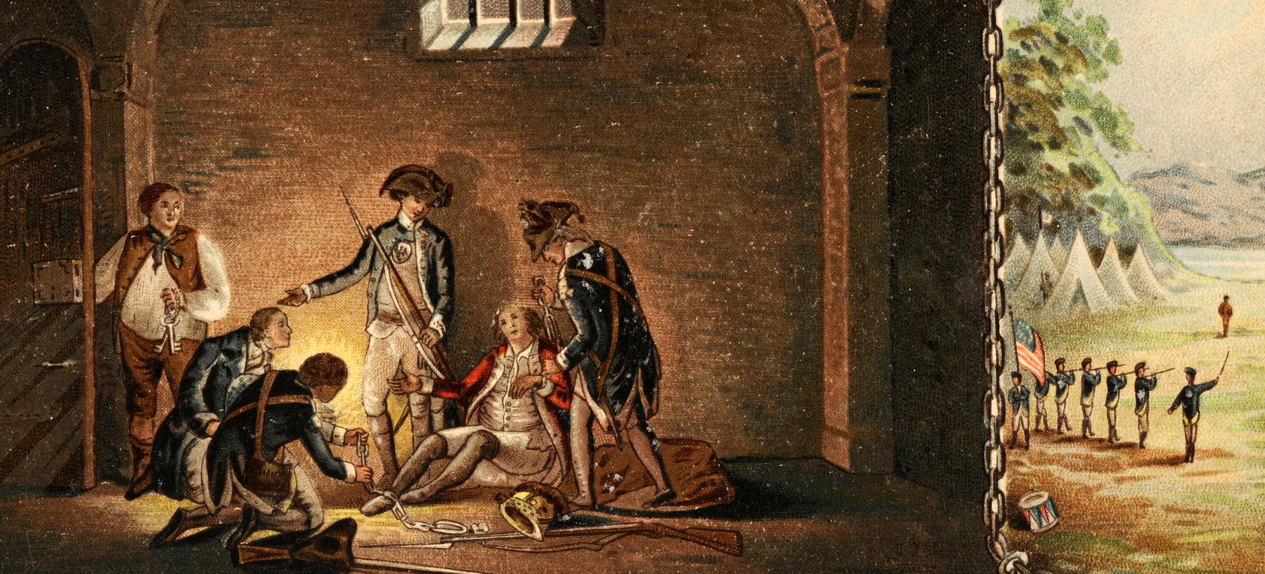
Loyalist/Tory
a colonist who remained loyal to the British crown and opposed the American Revolution

Slide 4
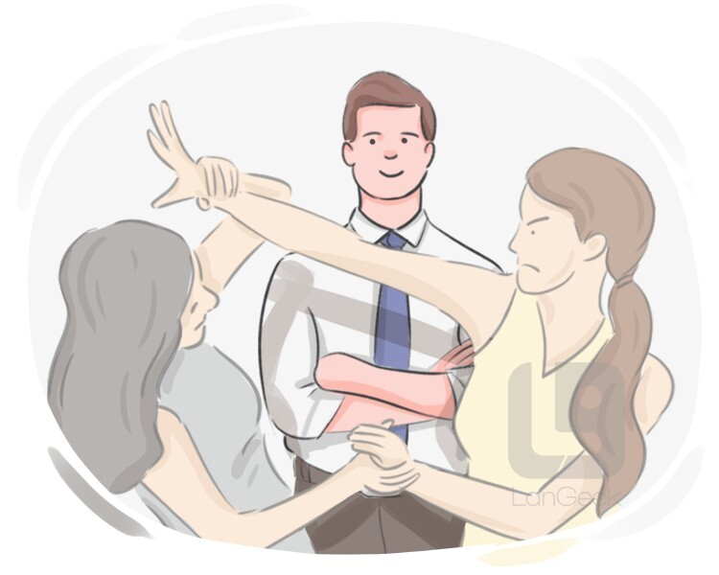

Neutral
not helping or supporting either side in a conflict

Slide 5
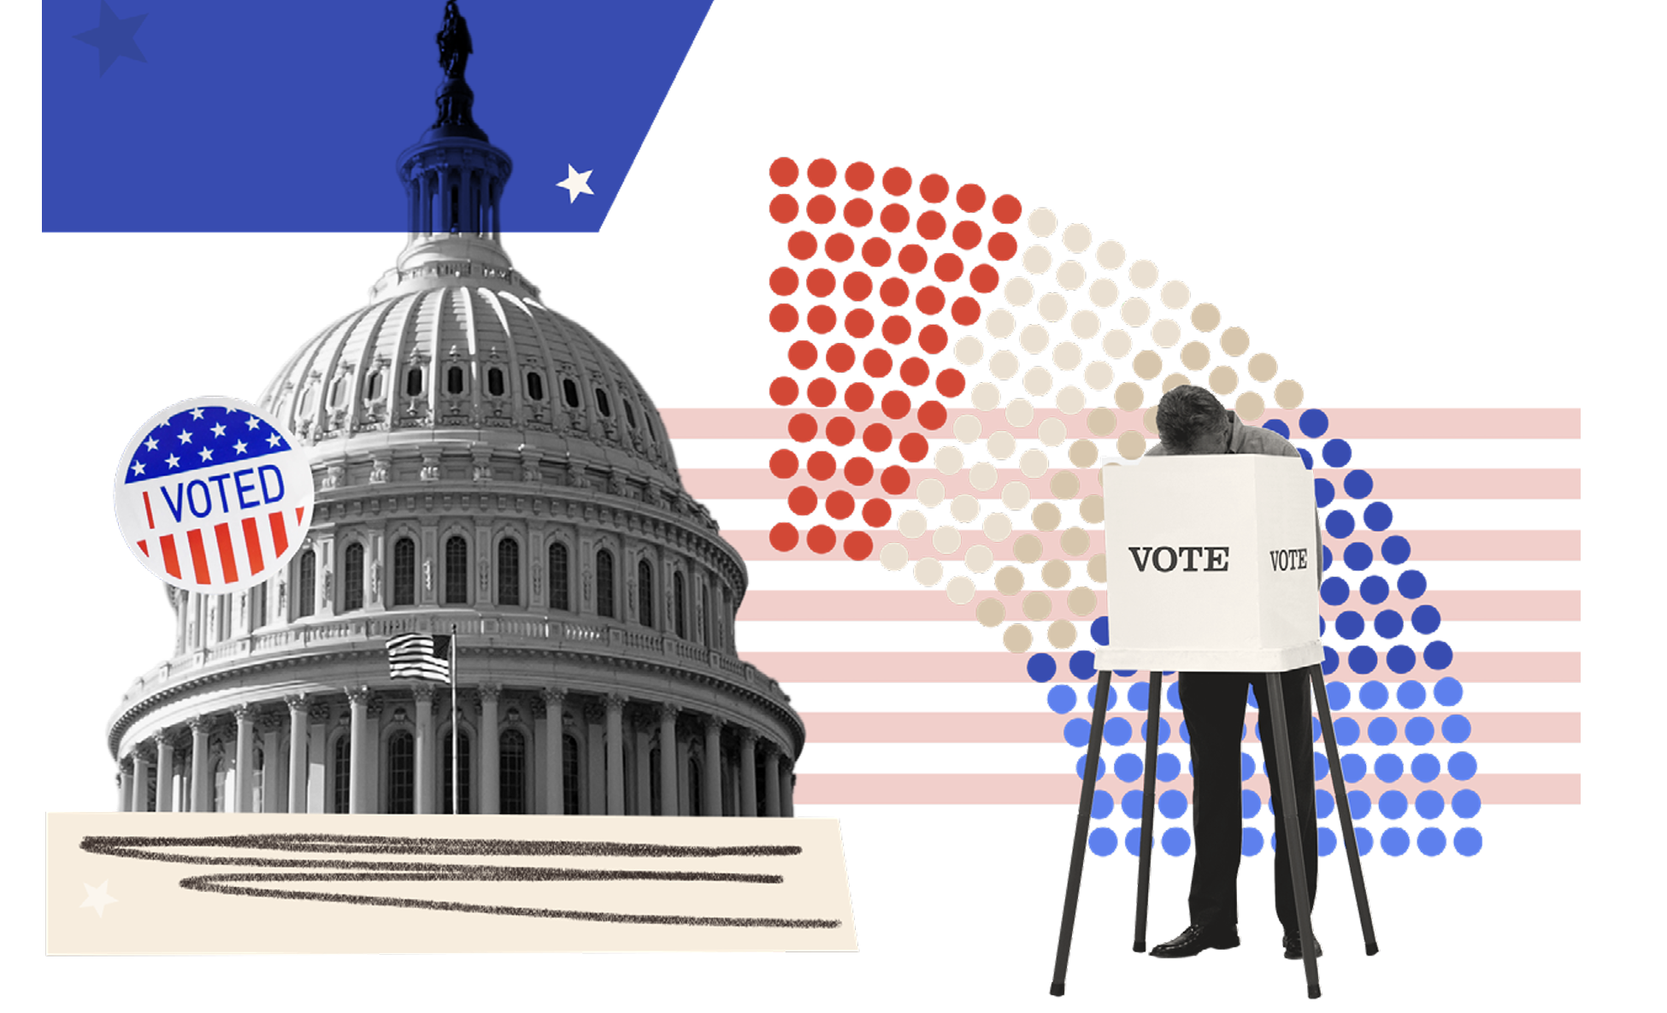
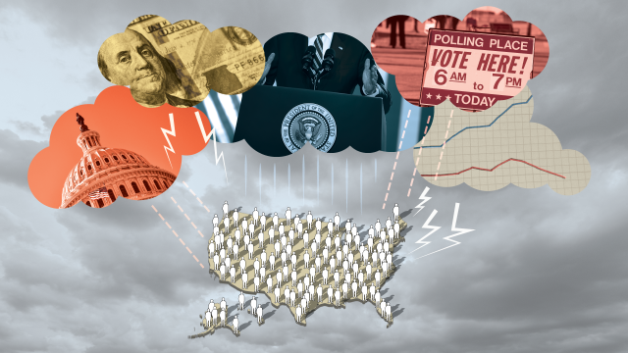
Representation
the activity of making citizens' voices, opinions, and perspectives “present” in public policy making processes

Slide 6
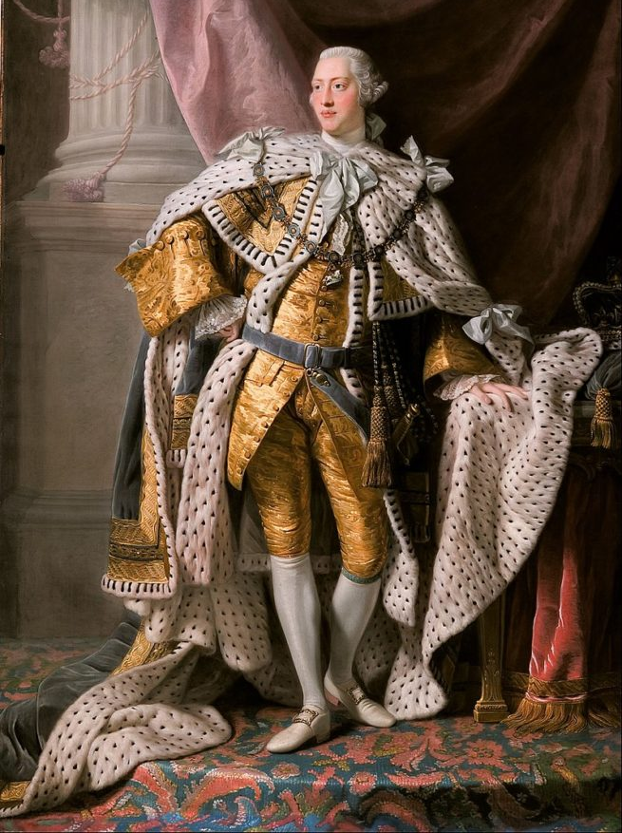
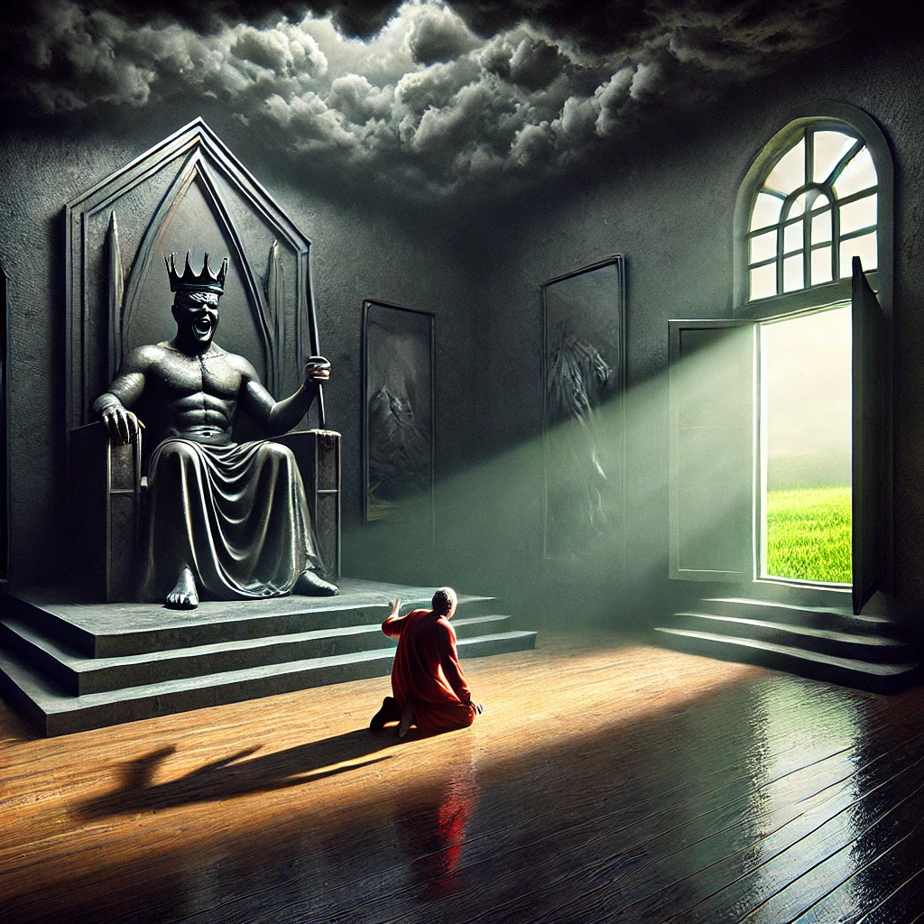
Tyrant
a ruler who has unlimited power over other people, and uses it unfairly and cruelly

Slide 7
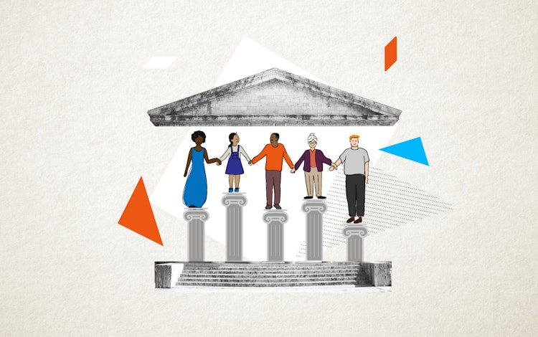
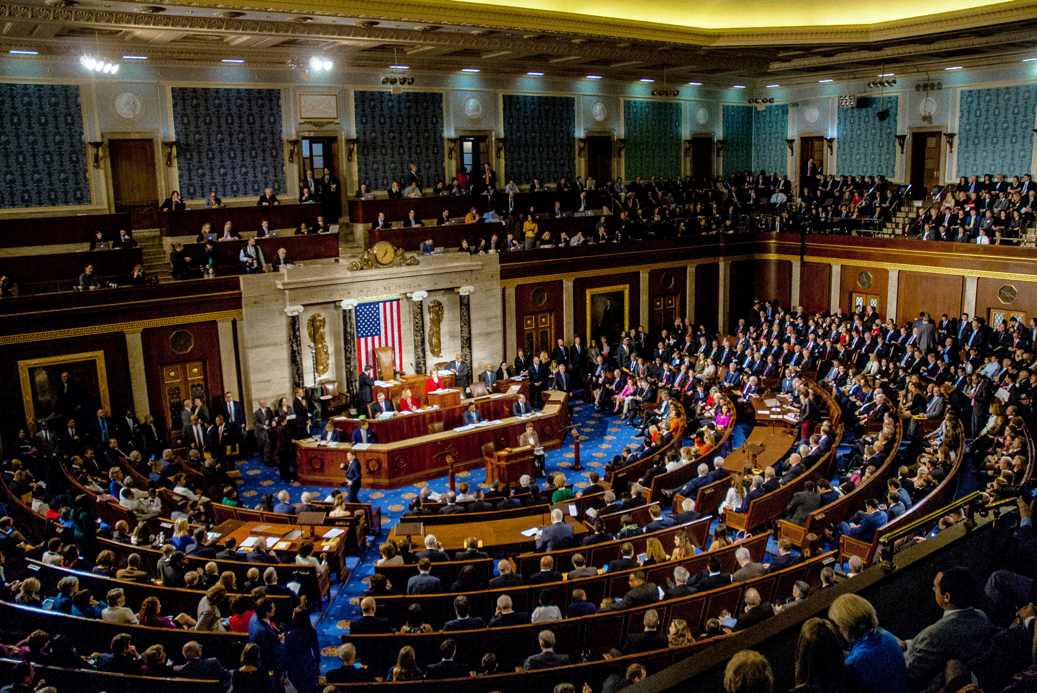
Democratic
a system of government in which power is held by elected representatives who are freely voted for by the people, or held directly by the people themselves

Slide 8
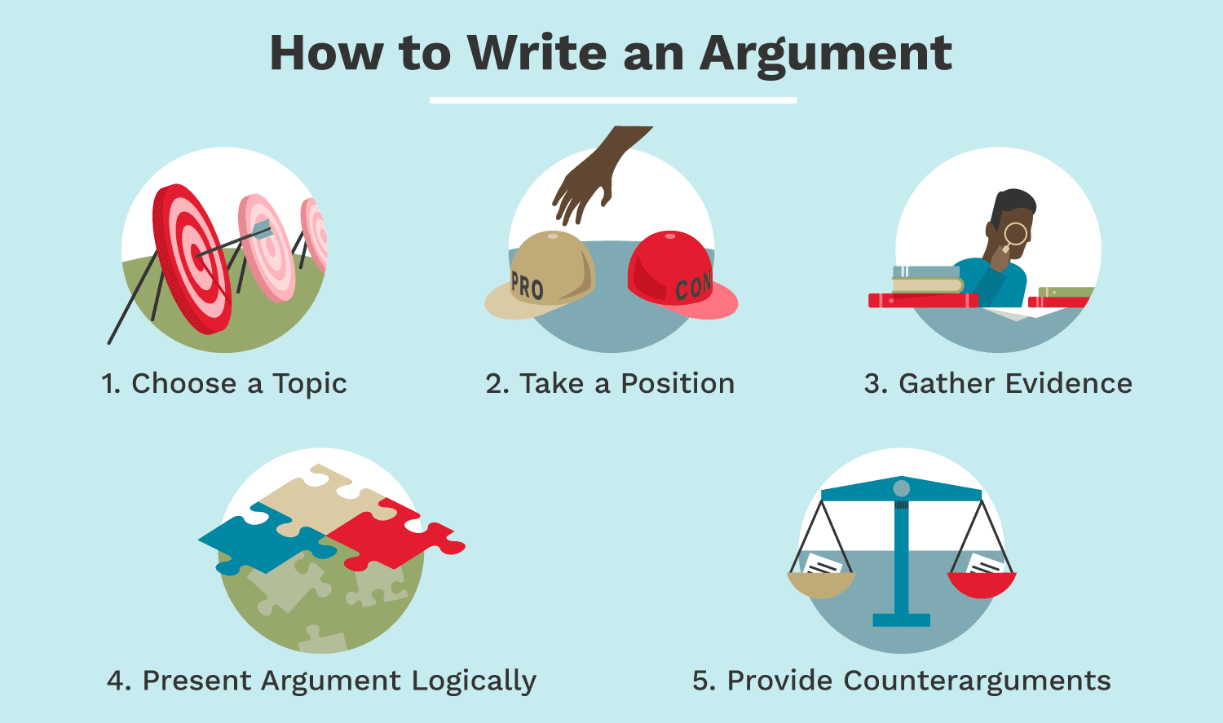

Argument
the main claim or position the writer is trying to prove, supported by evidence and reasoning, aiming to persuade the reader to accept their point of view on a particular topic;

