Slide 1
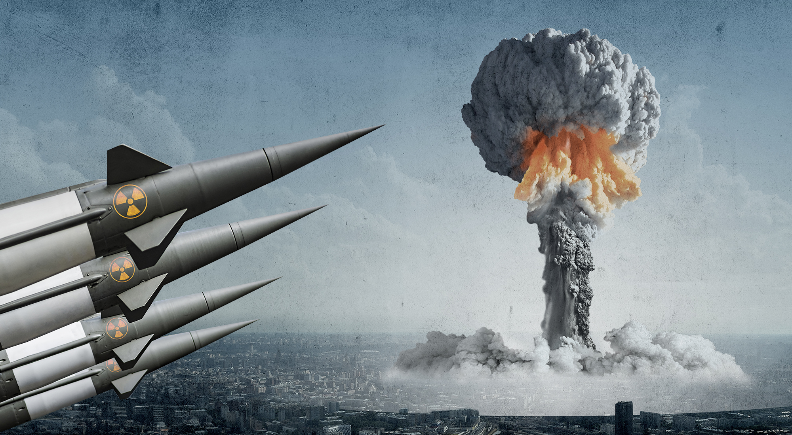
Nuclear Weapon
Vocabulary

Slide 2
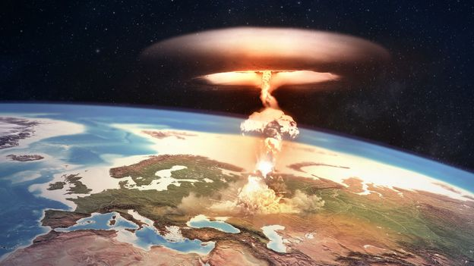
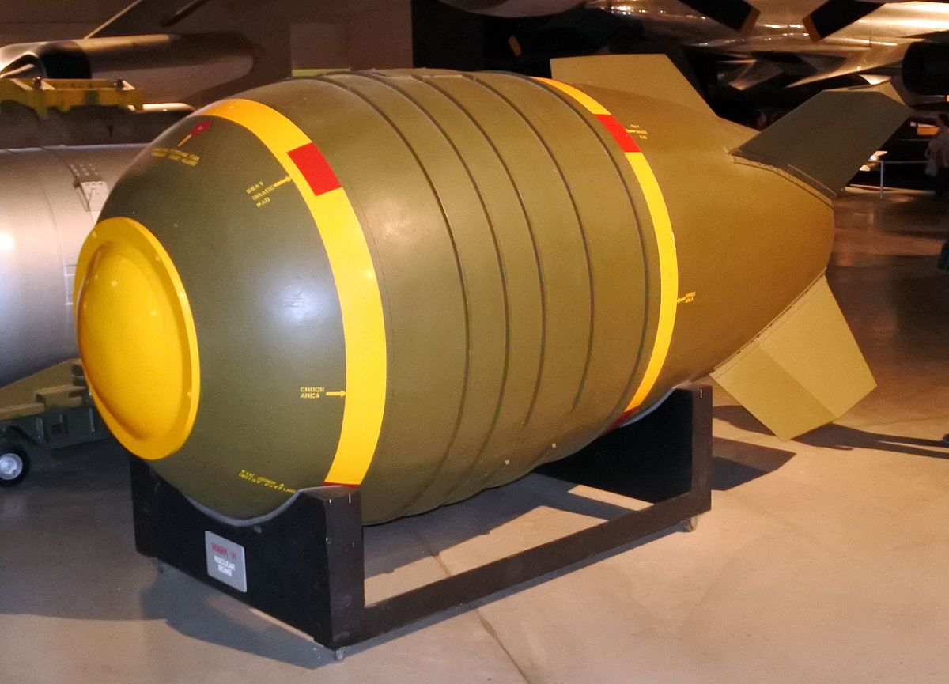
Nuclear Weapon
A device that releases a large amount of energy through nuclear reactions, causing a nuclear explosion

Slide 3

Ban
To forbid something from being or happening

Slide 4
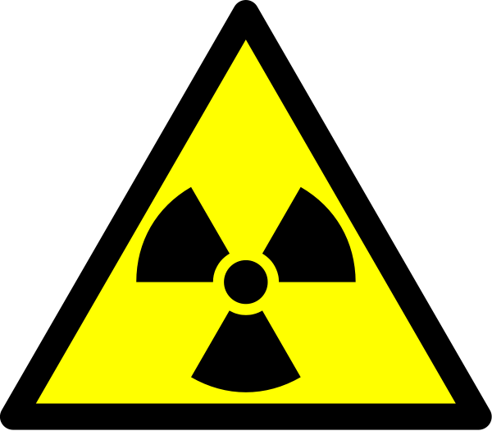
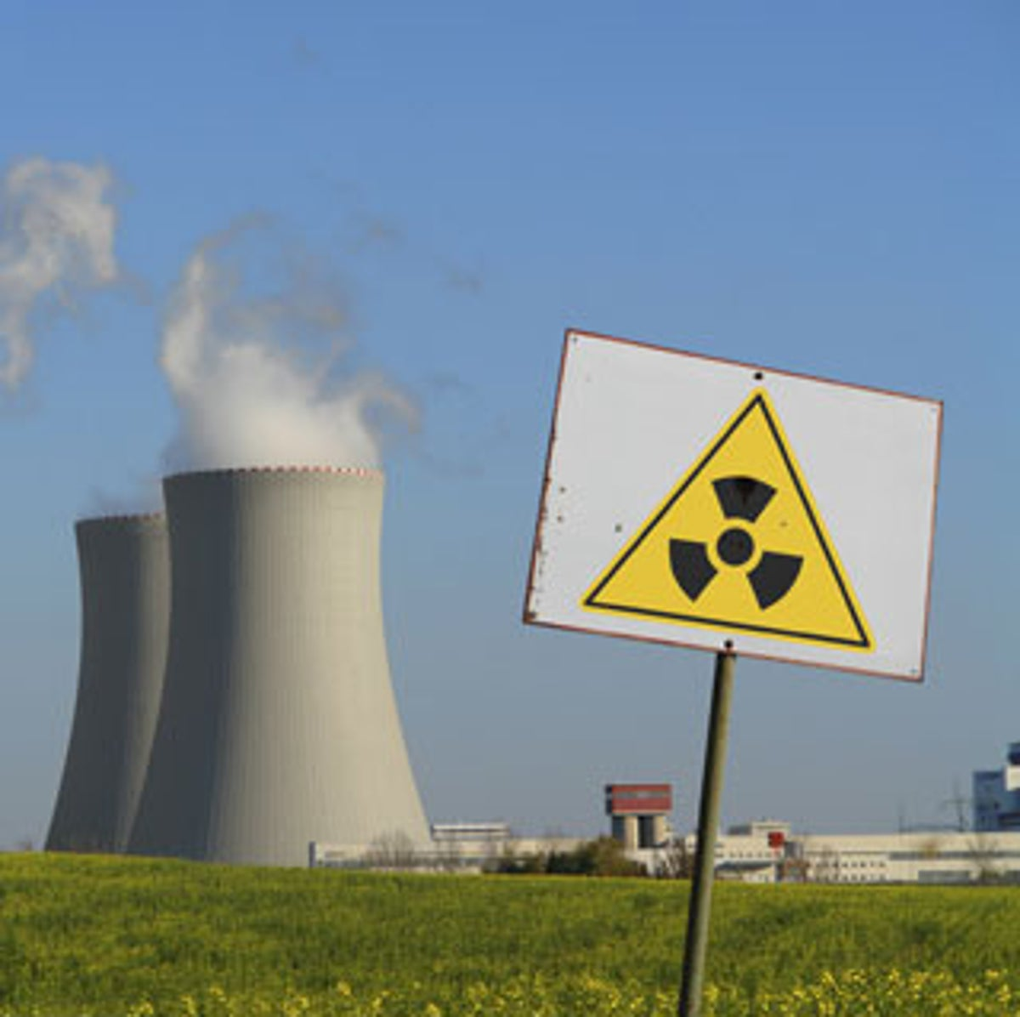
Radioactive
Having or producing powerful and dangerous energy that comes from the breaking up of atoms

Slide 5
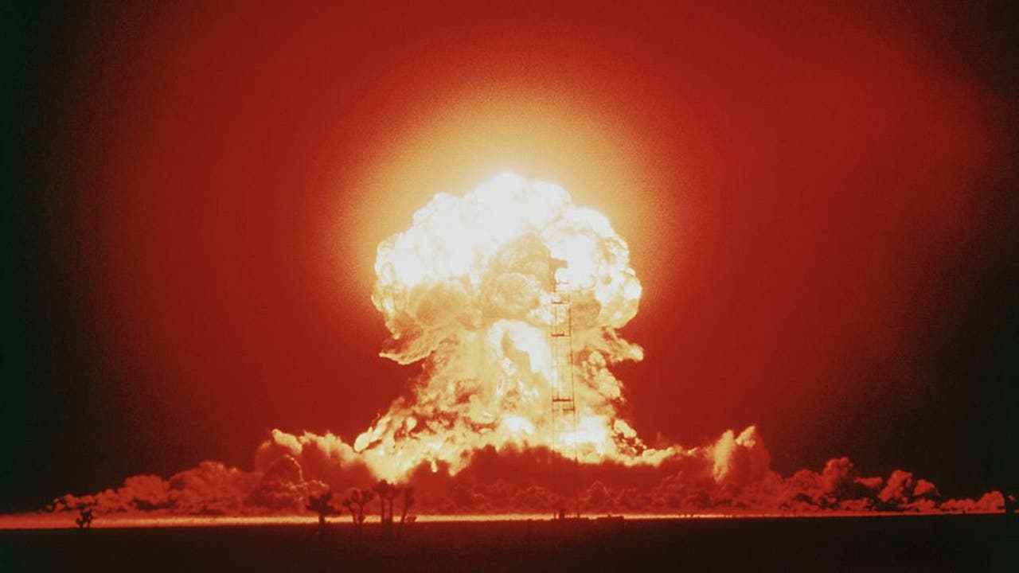
Fallout
The cloud of radioactive material that falls from the sky after a nuclear blast

Slide 6
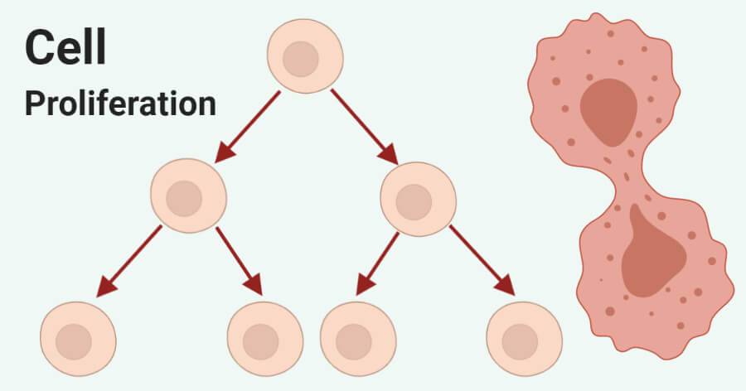
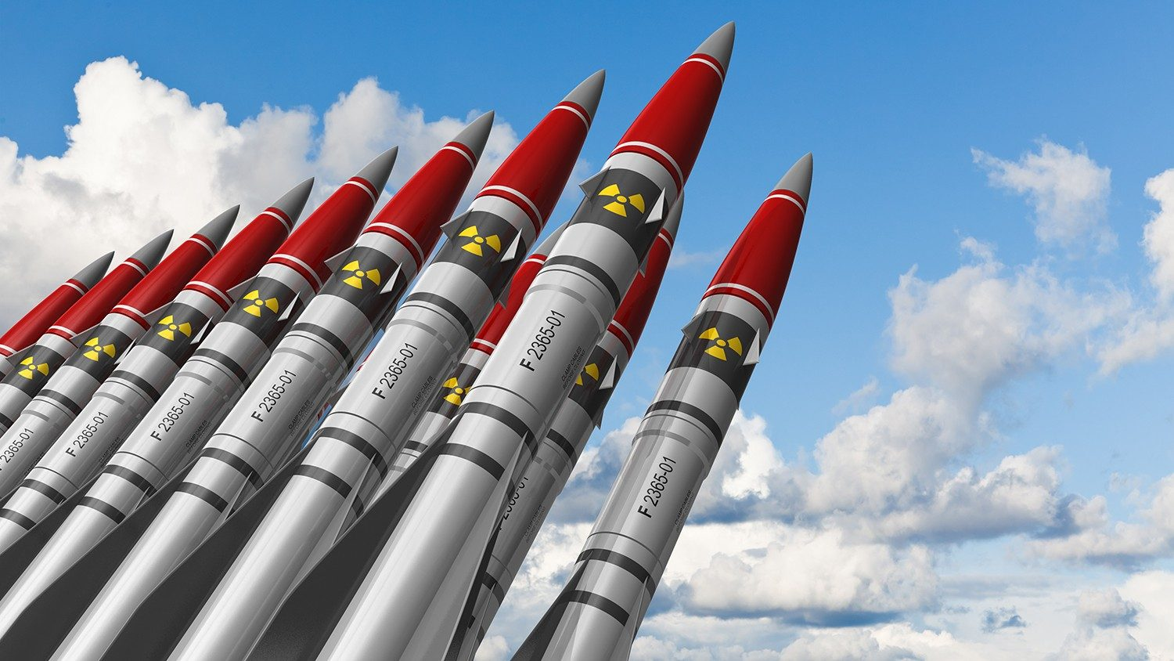
Proliferation
Rapid increase in numbers

Slide 7
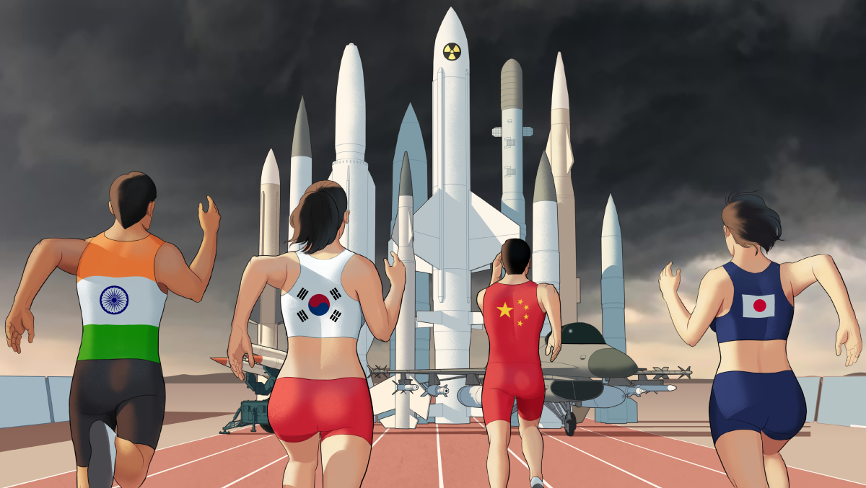
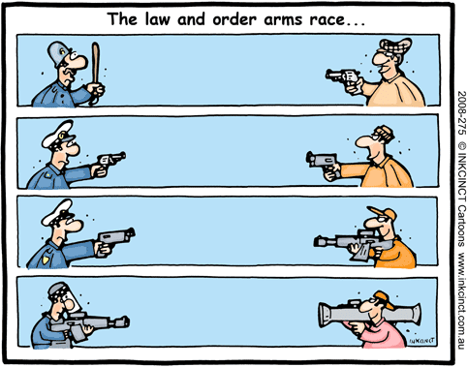
Arms Race
When two or more countries increase the size and quality of military resources to gain military and political superiority over one another

