Slide 1
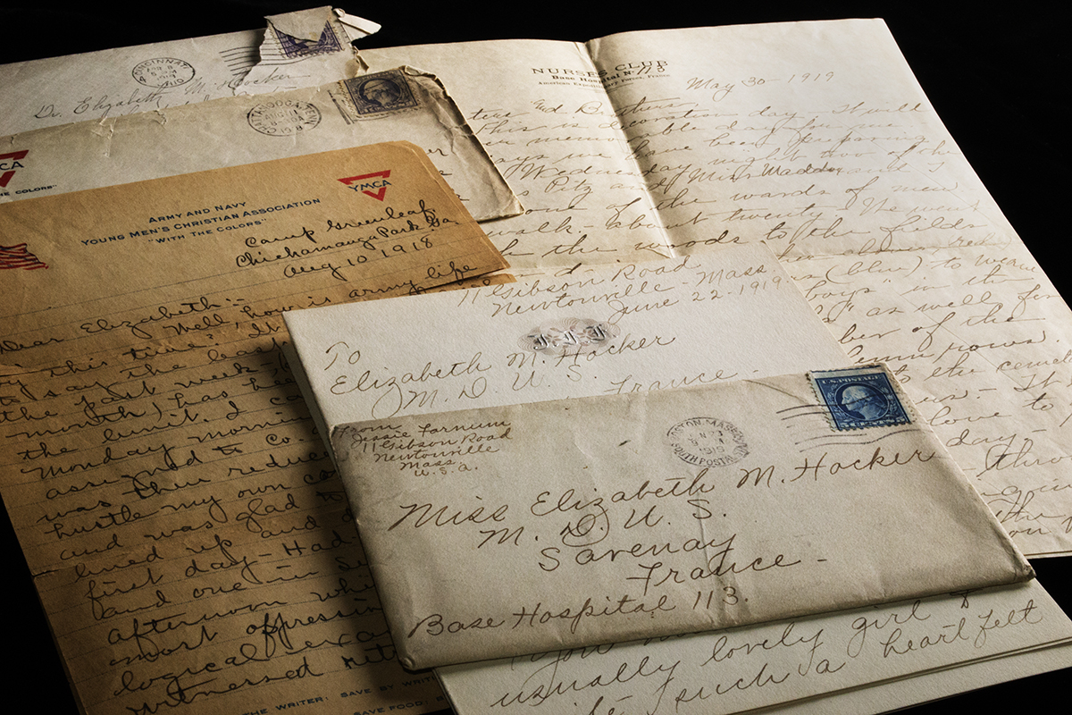
Primary Sources and Secondary Sources

Slide 2






What do we mean by “source”?
A way to get information about a topic

Slide 3
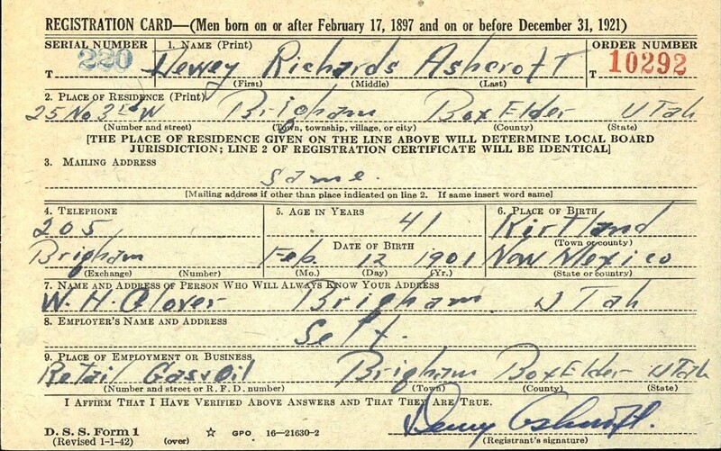
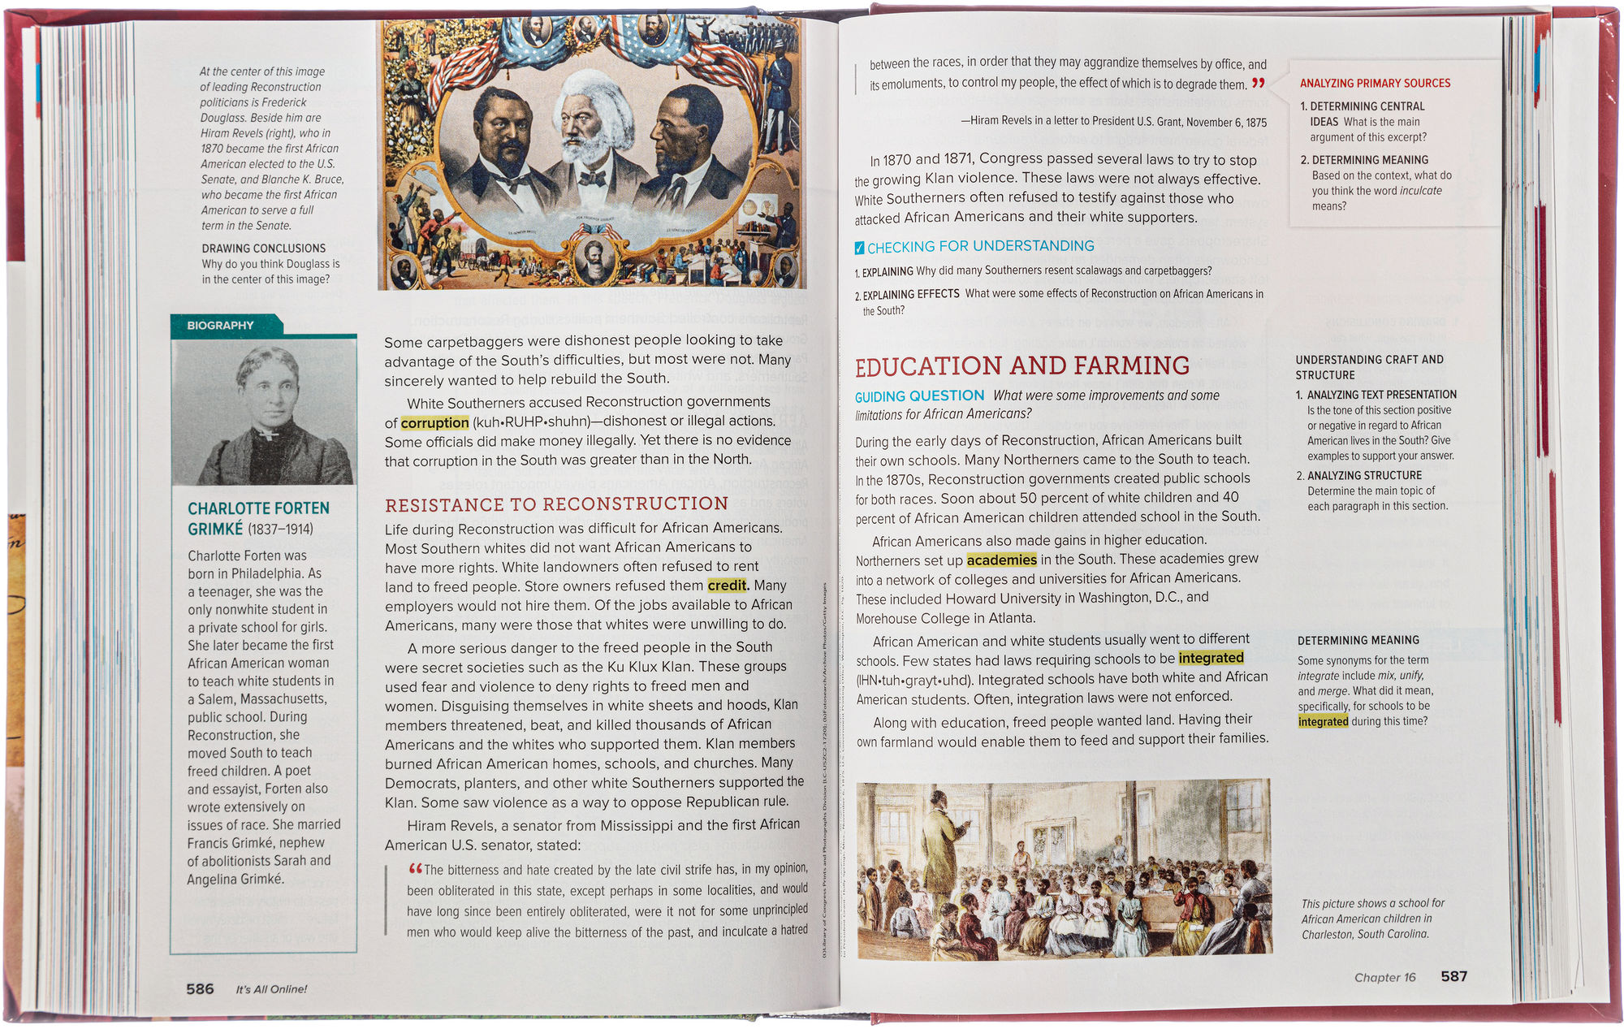
Primary Sources
Secondary Sources
What: Anything that describes or analyzes information from primary sources.
What: History, original records or objects
Created by: Participants and observers
Created by: Someone not present at the event
When: At the time the event occurred
When: Usually much later after the event

Slide 4
Examples of
Primary Sources
Examples of Secondary Sources
Diaries
Original documents
Autobiographies
Interviews and speeches
Laws
Government documents and reports
Creative artworks and books
Newspaper articles
Journal articles
Textbooks
Dictionaries and encyclopedias
Books that interpret or analyze
Political commentary
Biographies
Criticism of literature, art works or music

Slide 5

Turn and Talk
Discuss with a person near you what are the differences between primary and secondary sources.
Provide examples of each type of source.

Slide 6

Critical Thinking Question
What are the advantages of primary sources?
What are the advantages of secondary sources?

Slide 7

Task: Is it a primary or secondary source?

Slide 8
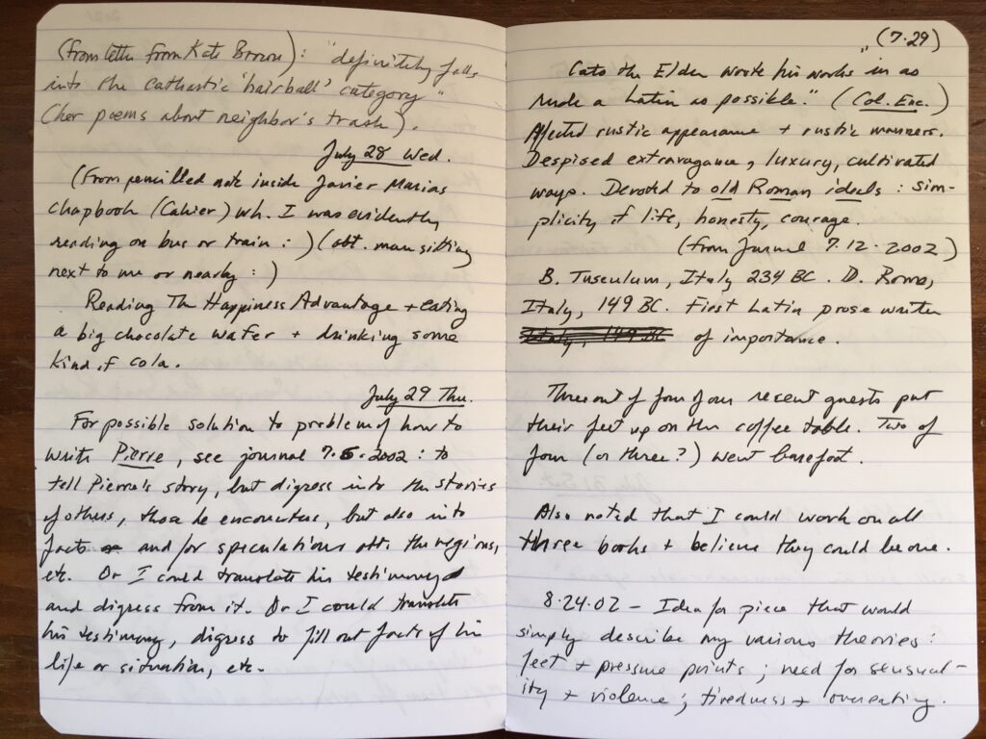
Primary Source

Slide 9
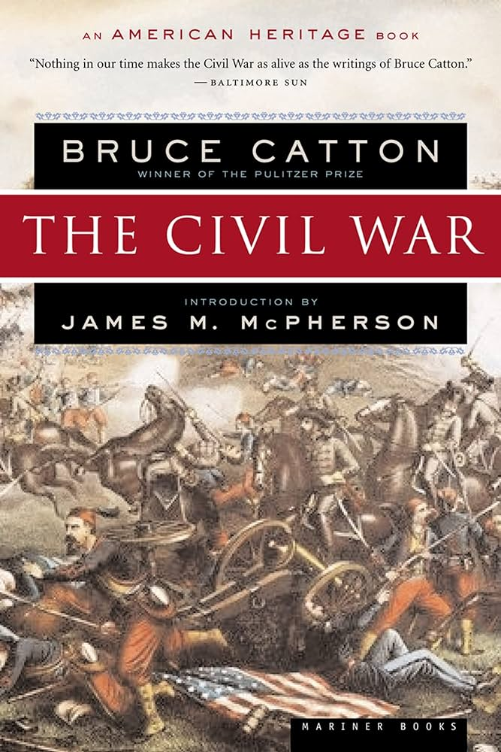
Secondary Source

Slide 10
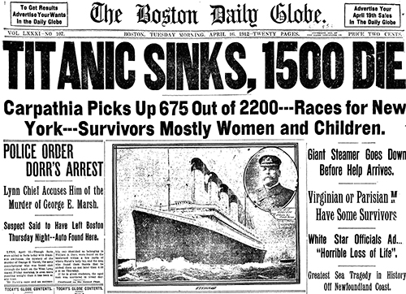
Primary Source

Slide 11

Secondary Source

Slide 12

Primary Source

Slide 13
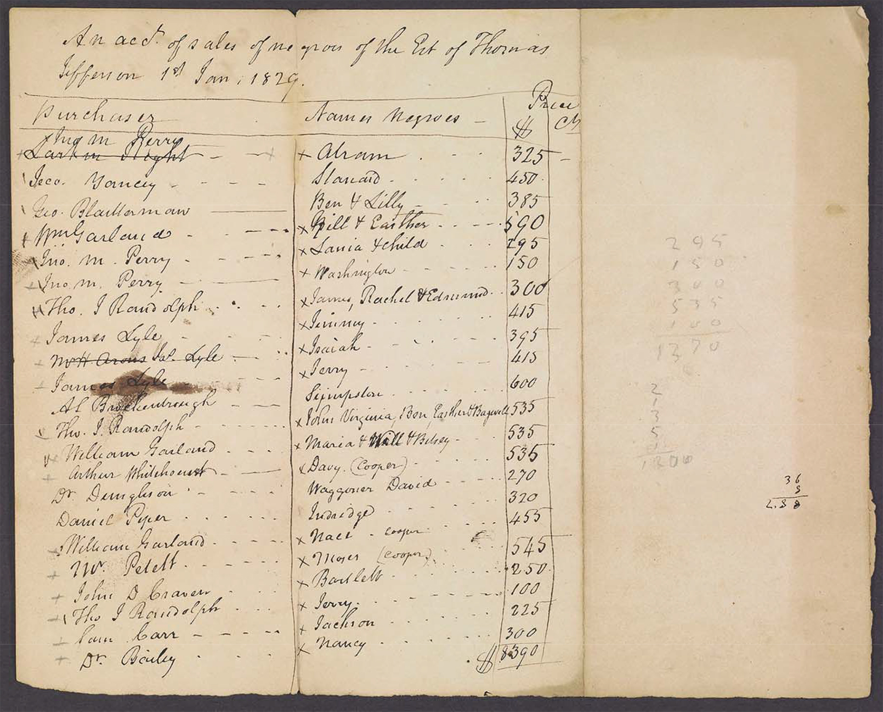
Primary Source

Slide 14
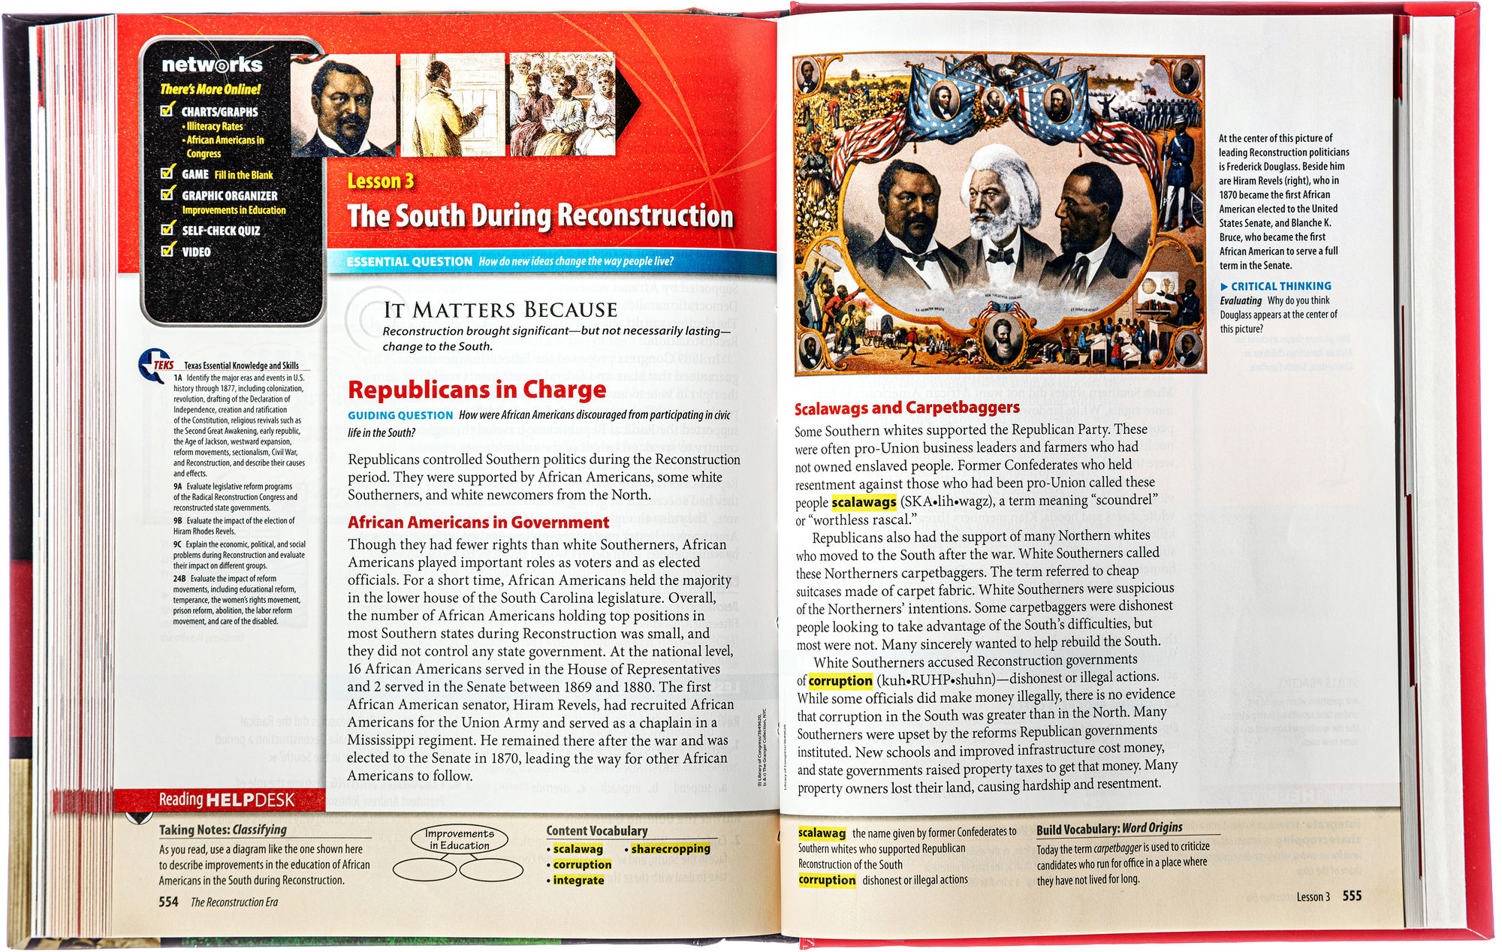
Secondary Source

Slide 15
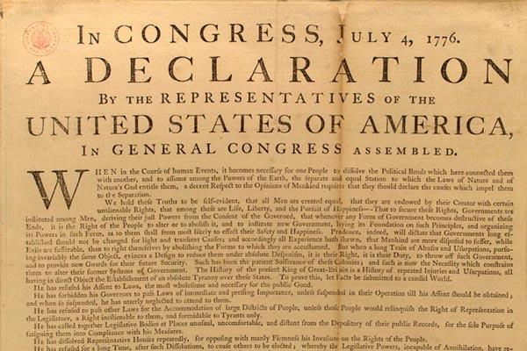
Primary Source

Slide 16

Primary Source

Slide 17
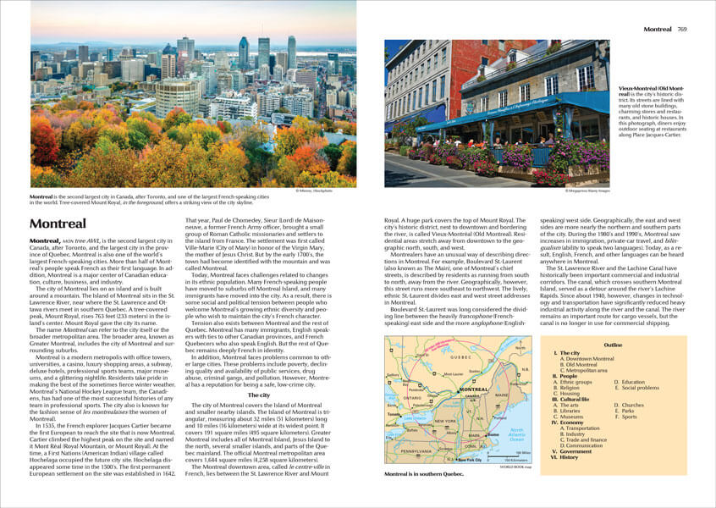
Secondary Source

Slide 18

Primary Source

Slide 19
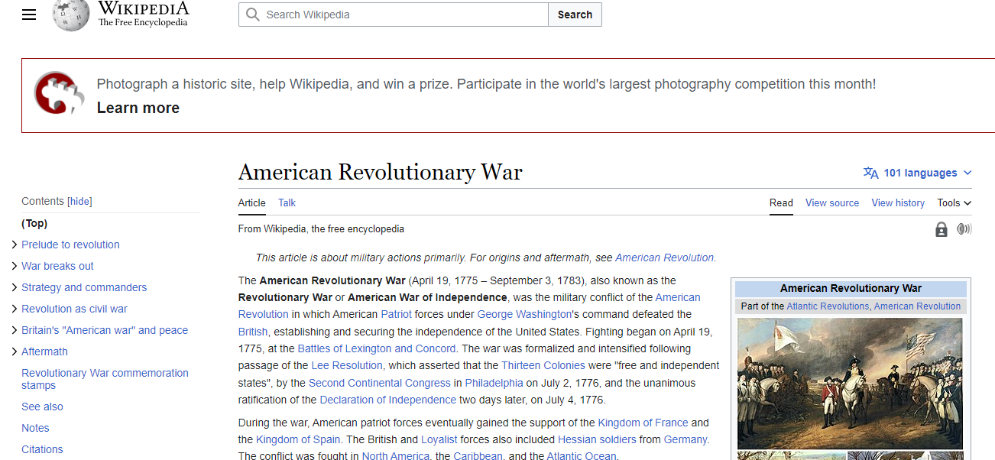
Secondary Source

Slide 20
The End

