Slide 1

HiSET Accomodations
ICCB Webinar - September 24, 2024

Slide 2
Agenda
Overview of Accommodations
Common Accommodations
Accommodations that Do or Do Not Require Preapproval
Accommodations Process
Resources
Contact Information
Notes:
During this brief presentation, I will highlight several points on our agenda today. I will provide an overview of accommodations and will touch on the most common accommodations. I will also review a list of accommodations that do need approvals and that do not require approvals. Then, I will explain the accommodations process from the initial request through the time when the exam is scheduled. And, finally, you will have the accommodations contact information should you need to reach out to for any questions, concerns, or kudos.

Slide 3
HiSET Accommodations
Accommodations are available for test takers with diagnosed disabilities that include, but are not limited to:
Attention deficit/hyperactivity disorder
Psychological or psychiatric disorders
Learning and other cognitive disabilities
Physical disorders/chronic health disabilities
Intellectual disabilities
Hearing and visual impairments
https://hiset.org/hiset-test-accommodations/
Notes:
In regards to accommodations, please note that PSI will make reasonable modifications to its examination procedures or provide auxiliary aides or services for test takers with documented disabilities. Such diagnosed disabilities can include, but are not limited to:
ADD or ADHD
Psychological or psychiatric disorders such as anxiety or PTSD
Learning and other cognitive disabilities like dyslexia
Physical disorders/chronic health disabilities - being visually impaired, having diabetes or asthma
Intellectual disabilities and
Hearing and visual impairments
On the referenced website HiSET.org, specifically under the Accommodations tab, you will find this list as well as the next list we will review which are accommodations that are available without an approval and those that require an approval.

Slide 4
Some Accommodations Do Not Need Pre-Approval
Transparent overlays
Scratch paper (provided by the test center and collected by test center staff at end of testing session)
Earplugs (not attached to any electronic device)*
Plain, unmarked straightedge to assist with keeping place while reading
Handheld non-electronic magnifying device (without memory or camera)*
Seat cushion/back pillow, or footstool (item will be inspected before and after testing)
Prescription medication (ppackaging will be inspected by test center staff; see website for more info)
Service animals*
Medical devices (e.g., asthma inhaler, hearing aid, pacemaker, insulin pump on vibrate or silent, oxygen tank, TENS stimulator)*
Highlighter or black felt pen for essays and scratch work only
Notes:
These are some accommodations the do NOT need pre-approval. For the sake of time, I will not read them all as this information is on the HiSET website. I will note those marked with an asterisk are known as pre-approved comfort aids - earplugs, handheld non-electronic magnifying device, service animals, and medical devices.

Slide 5
Accommodations Requiring Approval
Test takers must request pre-approval for most accommodations before scheduling their test appointments. This list includes some, but not all, of the available accommodations.
Extended time*
Separate room*
Reader
Large print*
Screen magnification*
Calculator/talking calculator
Scribe or keyboard entry aide
Additional supervised break time*
Sign language-interpreted instructions for test takers who are deaf or hard of hearing
Notes:
In this next slide, we have listed accommodations that require approval in which the test taker must initiate the request process. Some of the most common accommodation requests, I've marked with an asterisk. They are:
Extended time
Separate room aka private room
Large print, screen magnification
Additional supervised break time
There are 2 more common approvals not listed
A human reader (in which a private room will also need to be requested so as not to distract other test takers whilst the reader reads the exam out loud)
JAWS reader which is computer screen reader program or a text-to-speech program. For these accommodations a private room will also need to be requested so as not to distract other testers)

Slide 6
The Accommodations Process
Notes:
You may be asking … What is the accommodations request process? I'm happy to review the steps with you.

Slide 7

HiSET Accommodations Process
Review the HiSET Test Taker Bulletin and our Accommodation Web site
Reach out to the PSI Exam Accommodations team for support
Determine needed accommodations
Applicants will receive an email with specific registration instructions for approved accommodations
PSI Exam Accommodations staff will coordinate with the appropriate test center and the test taker to schedule their test with the approved accommodation(s)
Create a myHiSET account
Use the online HiSET Testing Accommodations Request form
Gather supporting documentation
Be sure to include your and/or your advocate’s contact information
Submit completed request ASAP
Applicants are encouraged to apply early
PSI Exam Accommodations may need more documentation before approval
Notes:
One of the first steps the candidate will need to do is review the TT bulletin along with the accommodation website which is full of vital details regarding the request and documents required for submission. Prior to sending the request, the candidate will need to ensure their HiSET account has been created. Next, the candidate will submit the request using the PSI Accommodations Request Form (keep in mind this is an online form). When the request and documentation is received, the accommodations team will review before approval. (Side note: there could be a chance additional documentation is required.) Once approved, an Exam Accommodations representative will coordinate the scheduling of the test taker at their preferred testing location with their approved accommodations.
There are 2 key points to remember in this process that are not outlined here in this slide.
#1 - Accommodations request cannot be submitted by phone as documentation is required and #2 requests are approved in accordance with PSI’s policies and procedures

Slide 8
Typical Documentation
Test takers must submit proper documentation
Verification from the medical authority or learning institution that rendered the diagnosis must be submitted to PSI on letterhead or stationery of the authority or specialist and include all the following:
  Test taker’s name
  Description of disability and limitations related to testing
  Recommended accommodation/modification
  Name, title and telephone number of the medical authority or specialist
  Original signature of the medical authority or specialist
In some cases, a letter from an adult educator working closely with the test taker will be considered
Failure to submit required documentation will delay the approval process
Notes:
In mentioning files to be uploading in the submission request, here is the breakdown of the proper documentation that will need to added to the accommodations request. A letter of verification, to include the test taker's name, details of the disability and limitations, recommendation, contact information of authority or specialist, and signature are required. Please note if anything is missing, that will hinder the process and delay the test taker's request from being reviewed.

Slide 9
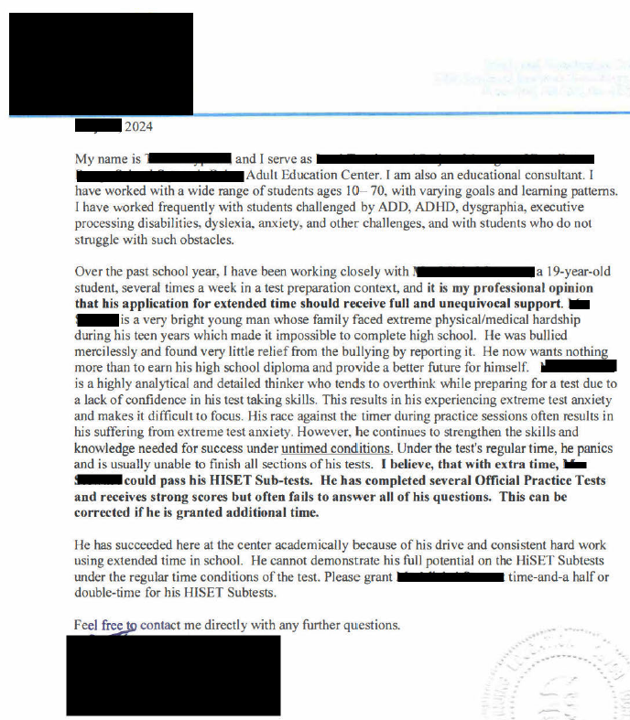
Example of an Educator Letter
Submit on official letterhead
Include title and experience
Indicate accommodation requested
Include any additional information
Provide full contact information

Slide 10
Example of an Educator Letter
Submit on official letterhead
Include title and experience
  “I serve as a lead instructor at the adult education center and am also an educational consultant” ….”I have worked with a wide range of students ages 10-70 with varying goals and learning patterns” …. “frequently with students challenged by ADD, ADHD, dyslexia, anxiety and other challenges”
Indicate accommodation requested
  “application for extended time should receive full and unequivocal support” …. “please grant student time-and-a-half or double-time for his HiSET subtests”
Include any additional information
  “is a highly analytical and detailed thinker who tends to overthink while preparing due to lack of confidence” …. “experiencing extreme test anxiety and makes it difficult to focus” …. “with extra time student could pass his HiSET sub-tests” …. “has completed several official practice tests and receives strong scores but often fails to answer all his questions” …. “can be corrected if he is granted additional time”
Provide full contact information

Slide 11
Accommodations Approvals
Once documentation has been received and reviewed, the test taker will receive an email notification
  Approval emails includes instructions to contact our accommodation team for scheduling
  If not initially approved, the email will request more info is required to approve the request
Accommodations approvals (or requests for more info) will go directly to the email specified in the request form
Notes:
Upon approving the accommodations, an accommodations specialist will email the requestor with specific directions to contact the PSI Exam Accommodations team for scheduling.

Slide 12
Accommodations Scheduling
PSI Exam Accommodations staff will coordinate directly with the preferred test center and the test taker/advocate to schedule the exam(s)
  Test takers should NOT self-schedule exams unless advised by the Exam Accommodations team
  Test takers can reply directly back to the email for assistance or contact the accommodations team via phone
  Notes are added to the test taker’s file during scheduling indicating their approved accommodations
  Once the test-taker is scheduled, the test center will be notified via an email memo of the candidate’s scheduled date, time, and approved accommodations.
Notes:
The PSI exam accommodations team will work with all parties – the test taker, the test site, the advocate, the administrator - to schedule the exam. Test takers should NOT go online to self-schedule as their accommodations may not be fulfilled timely and appropriately. Should the test taker have questions, email or call the team for assistance. The accommodations team will notate the accounts accordingly with any communication between the test taker, test site, and advocate. And once the exam date is confirm, the accommodations team will email a memo to the test center to include details of the candidate's exam date, time, and approved accommodations. And the last step will be for the test taker to show up on exam day early with valid ID, confident and ready to sit for their test.

Slide 13
Resources to Support Students

Slide 14

HiSET Practice Tests
Free, Paid and Official Practice Tests
Free (FPT) and answer sheets can be downloaded directly from the HiSET website
  The new FPT 8 is currently available at HiSET.org
Paid (PPT) can be purchased through the PSI Online Store
Official (OPT) can only be purchased by State agencies or Adult Education programs
  One full length paid, and one full length official practice test will be available shortly
Practice Tests and Materials: HiSET Practice Tests

Slide 15

HiSET Website Resources
Use the For Test Centers & Adult Educators Resources drop down list for specific Computer and Paper-based test administration resources including:
Procedure docs
How-to flyers
Training materials

Slide 16
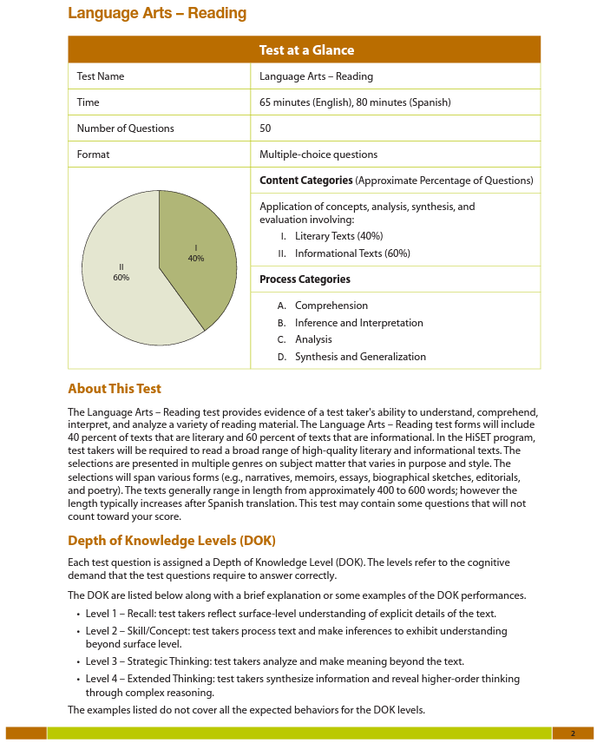
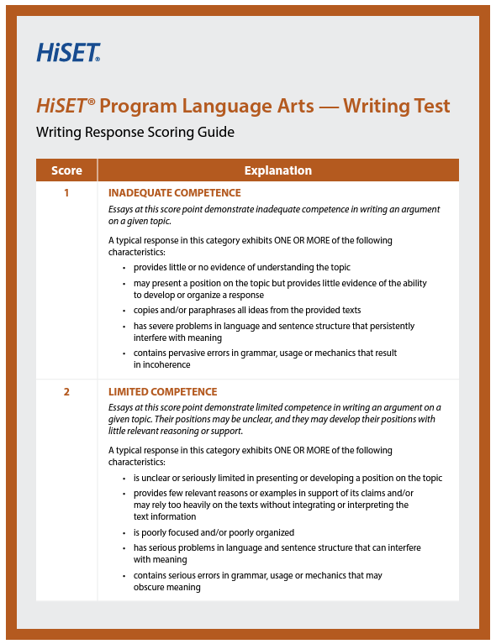


Key Educator Resources
HiSET Test at a Glance (TAAG)
HiSET Study Companion
Are You Ready to Take the HiSET Exam?
Scored Sample Writing Responses
Writing Response Scoring Guide
Official Math Formula Sheet
HiSET Test Taker Bulletin
Benefits of Taking the HiSET
Find these and more resources at
Test Taker Support Resources and Test Takers Downloadable Resources

Slide 17

HiSET Test at a Glance (TAAG)
What is on the test: Content Categories
How it’s assessed: Process Categories
Why it’s assessed: CCRS Descriptors
English TAAG: https://hiset.org/s/pdf/HiSET_Test_at_a_Glance.pdf
Spanish TAAG:
https://hiset.org/s/pdf/taag_es.pdf

Slide 18
Contact Information and Social Media

Slide 19
HiSET Support for Test Takers
Test Taker Services for general test taker inquiries
1-855-MyHiSET
Monday through Friday 8:30 a.m. – 7:00 p.m. Pacific time
Saturday and Sunday: 10:00 a.m. – 6:30 p.m. Pacific time
HiSETsupport@psionline.com
PSI Exam Accommodations for accommodations requests and scheduling
1-800-367-1565 ext. 6750
Monday – Friday 8:00 am – 5:00 pm CT
eaalerts@psionline.com
Notes:
The Accommodations Team is comprised of incoming & outbound call center agents, as well as coordinators who assist with off the phone tasks meaning responding to emailed inquiries, reviewing accommodation submissions, sending memos to the test centers, and other tasks. Please note that our overall PSI goal is to make the test takers experience as easy as possible, so that way they don't have to stress about any delays or any hiccups in order to do so, we are open to your concerns, feedback and suggestions. With that said, here is the contact information for test taker inquiries and also the contact information to reach out to the PSI Exam Accommodations department to include our hours of operation.

Slide 20
Social Media
HiSETexam
We help promote adult education programs, HSE graduates, and HSE events through our social media.
HiSET
HiSETexam
Notes:
HiSET Facebook:
@HiSETexam
https://www.facebook.com/HiSETexam
HiSET Twitter:
@HiSETexam
https://twitter.com/HiSETexam

Slide 21

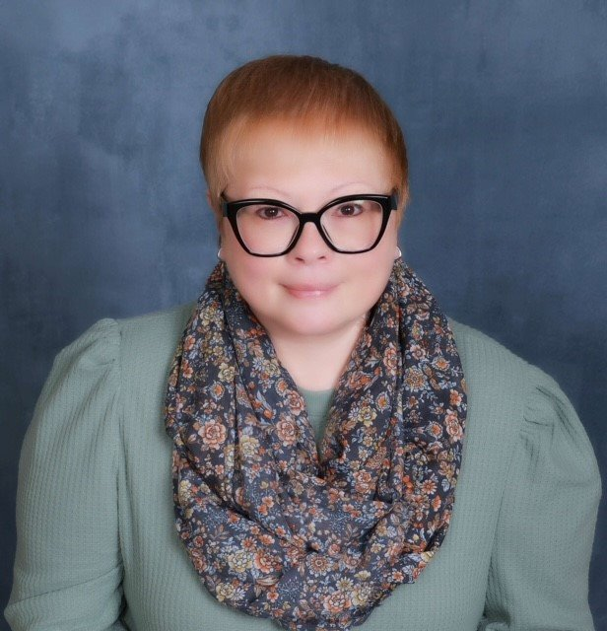
Thank you!
Rebecca Reed
HiSET Program Manager
Stephanie Bauer
HiSET Client Manager
Learn more at
hiset.org
Notes:
This completes my presentation. Thank you for your time. I appreciate everyone's attention. And, I hope you all have a wonderful day, afternoon, or evening.

Slide 22


