Slide 1
Welcome to the IELCE VLC!! Britt Garton Pisto Director for IELCE with ICCB with guests: Stephen Alderson Dean of Adult Education, Instituto del progreso latino laura guerrero assistant dean of adult education, instituto del progreso latino

Slide 2
Agenda survey of those in attendance Ielce components ielce resource Guests, Stephen & laura discuss: Instituto del progreso latino’s work with new arrivals and IELCE programming questions general resources

Slide 3
Four COMPONENTS
Continuum of students in IELCE Programming.

Slide 4
IELCE RESOURCES MAKING SURE YOUR IELCE STUDENT IS COUNTED !
DAISI Cheat Sheet for IELCE Funding
Example Found in iLEARN

Slide 5
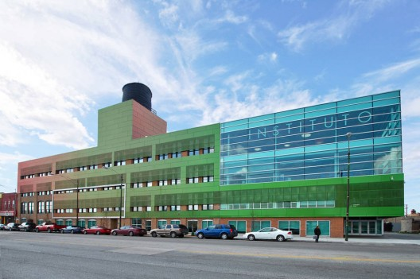
IEL-CE Program and Experience with Recent Arrivals - Instituto
Stephen Alderson, Dean of Adult Education;
Laura Guerrero Assistant Dean of Adult Education

Slide 6
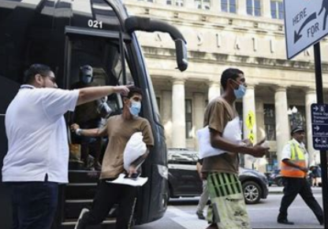
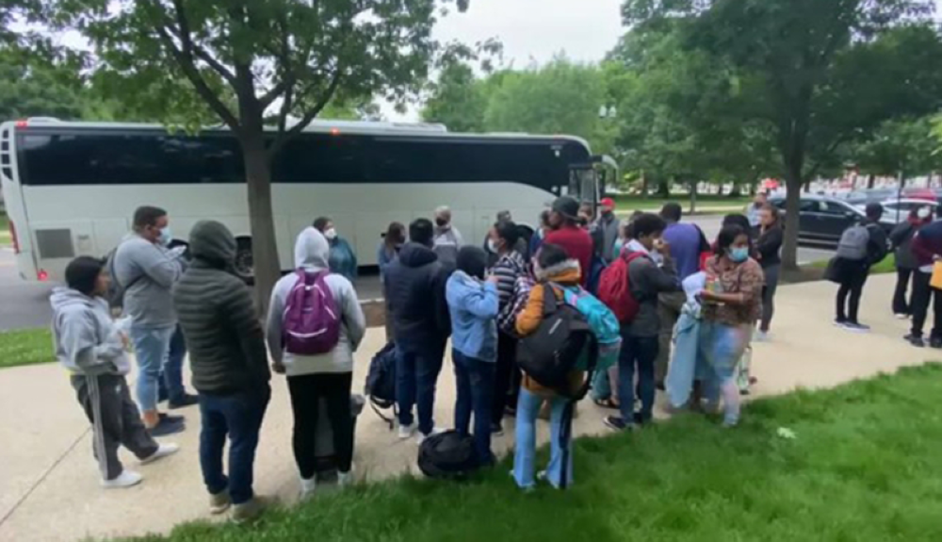
Experience with New Arrivals

Slide 7
Statistics in Chicago

Slide 8
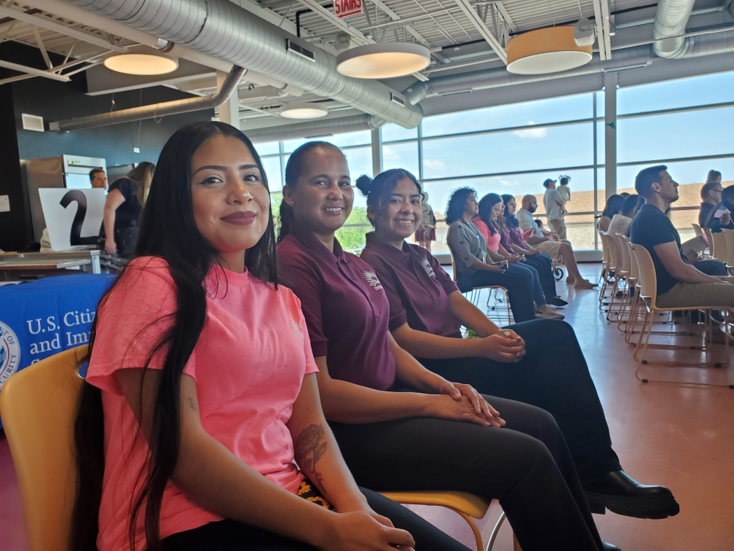
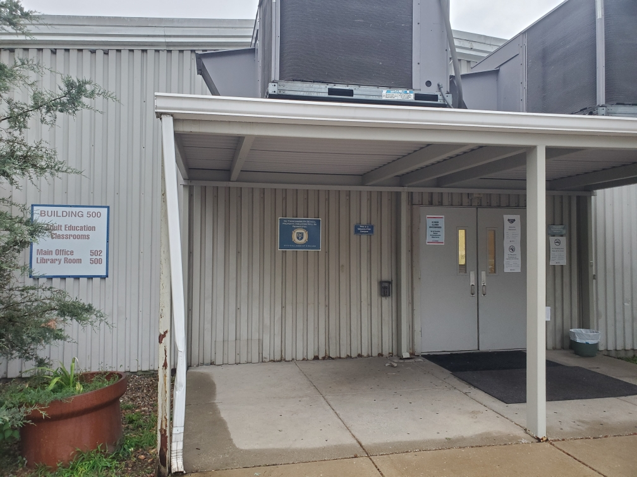
Community Navigators
Daley and Piotrowski Park Shelters.
Ex students & Community Volunteers, New Citizens. Daley College Shelter

Slide 9
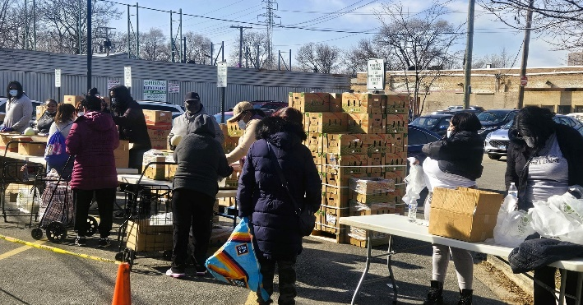
Food distribution to the Community

Slide 10
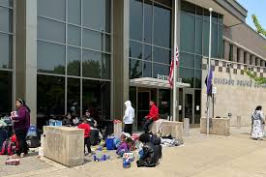
Community Navigators outside a Police Station

Slide 11
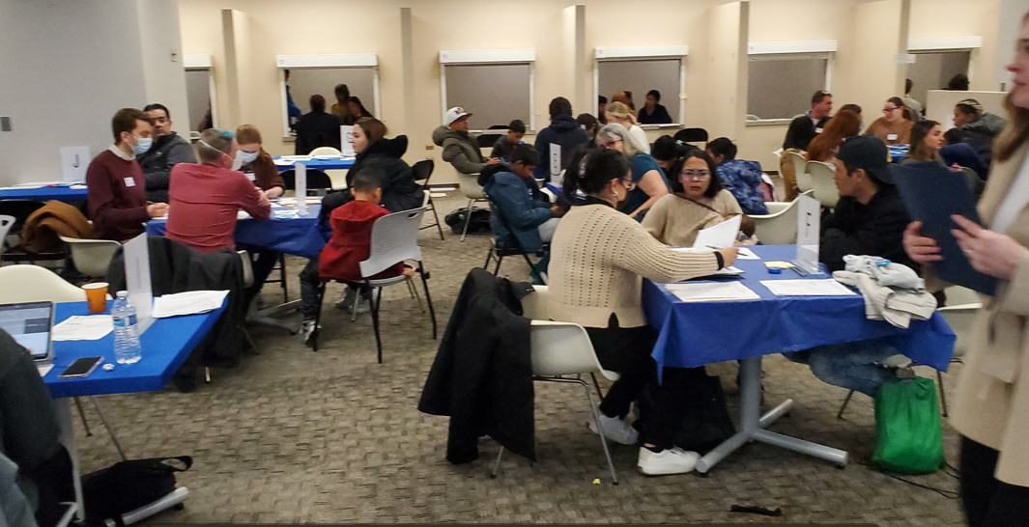
CENTRALIZED WORKSHOP FOR TPS
Truman College Nov 8 – Metcalf Bldg Dec 8

Slide 12
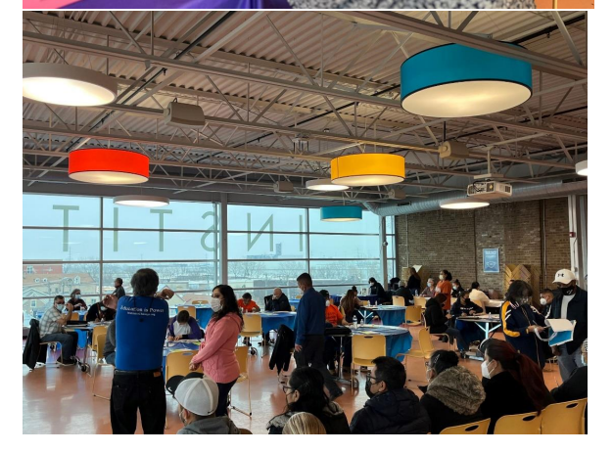
Legal Screenings and related ILS services for Venezuelan Refugees
INITIAL SCREENING 26 Individuals
SECOND WORKSHOP JAN 14 – w/ 34 additional screenings.
Career Pathways personnel & KAB provided City Key to >90 participants.
IDPL Community Navigators helped to interview and fill out forms.

Slide 13
ICCB TITLE II Career Pathways Navigator. Gabe Perez.

Slide 14
SBA (Southern Border Arrivals).
Newly Arrived Immigrants – Instituto Contacts
Case Workers at Shelters
Immigration Legal Services
ESL & Family Literacy
Community Navigators.

Slide 15
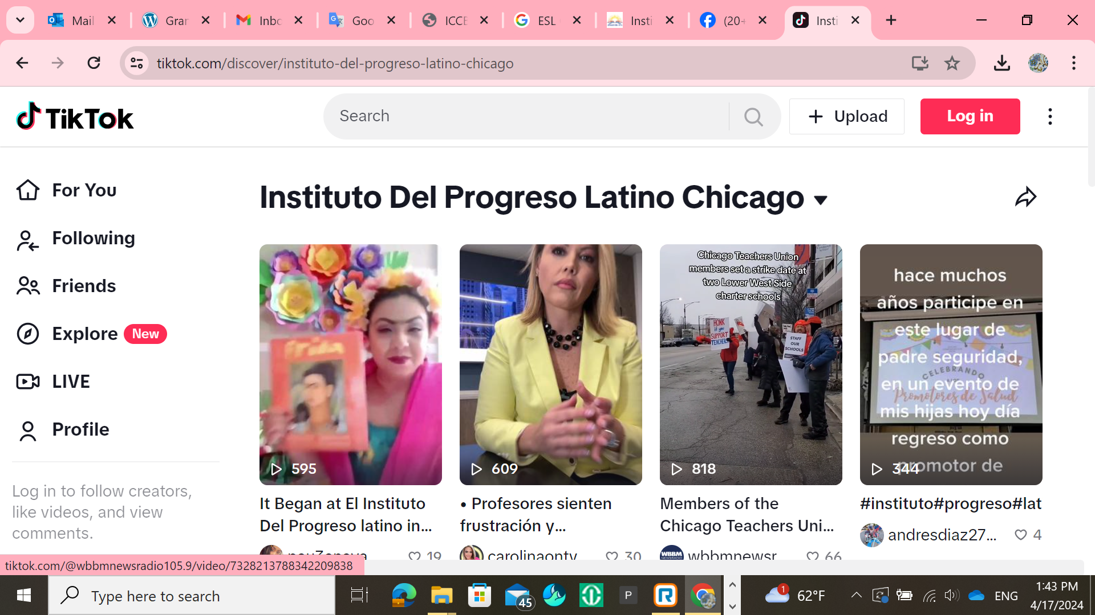
The use of Social Media of SBA (Recent Immigrants) to look for information and Communication.
Instituto del Progreso Latino Social Media Applications:

Slide 16
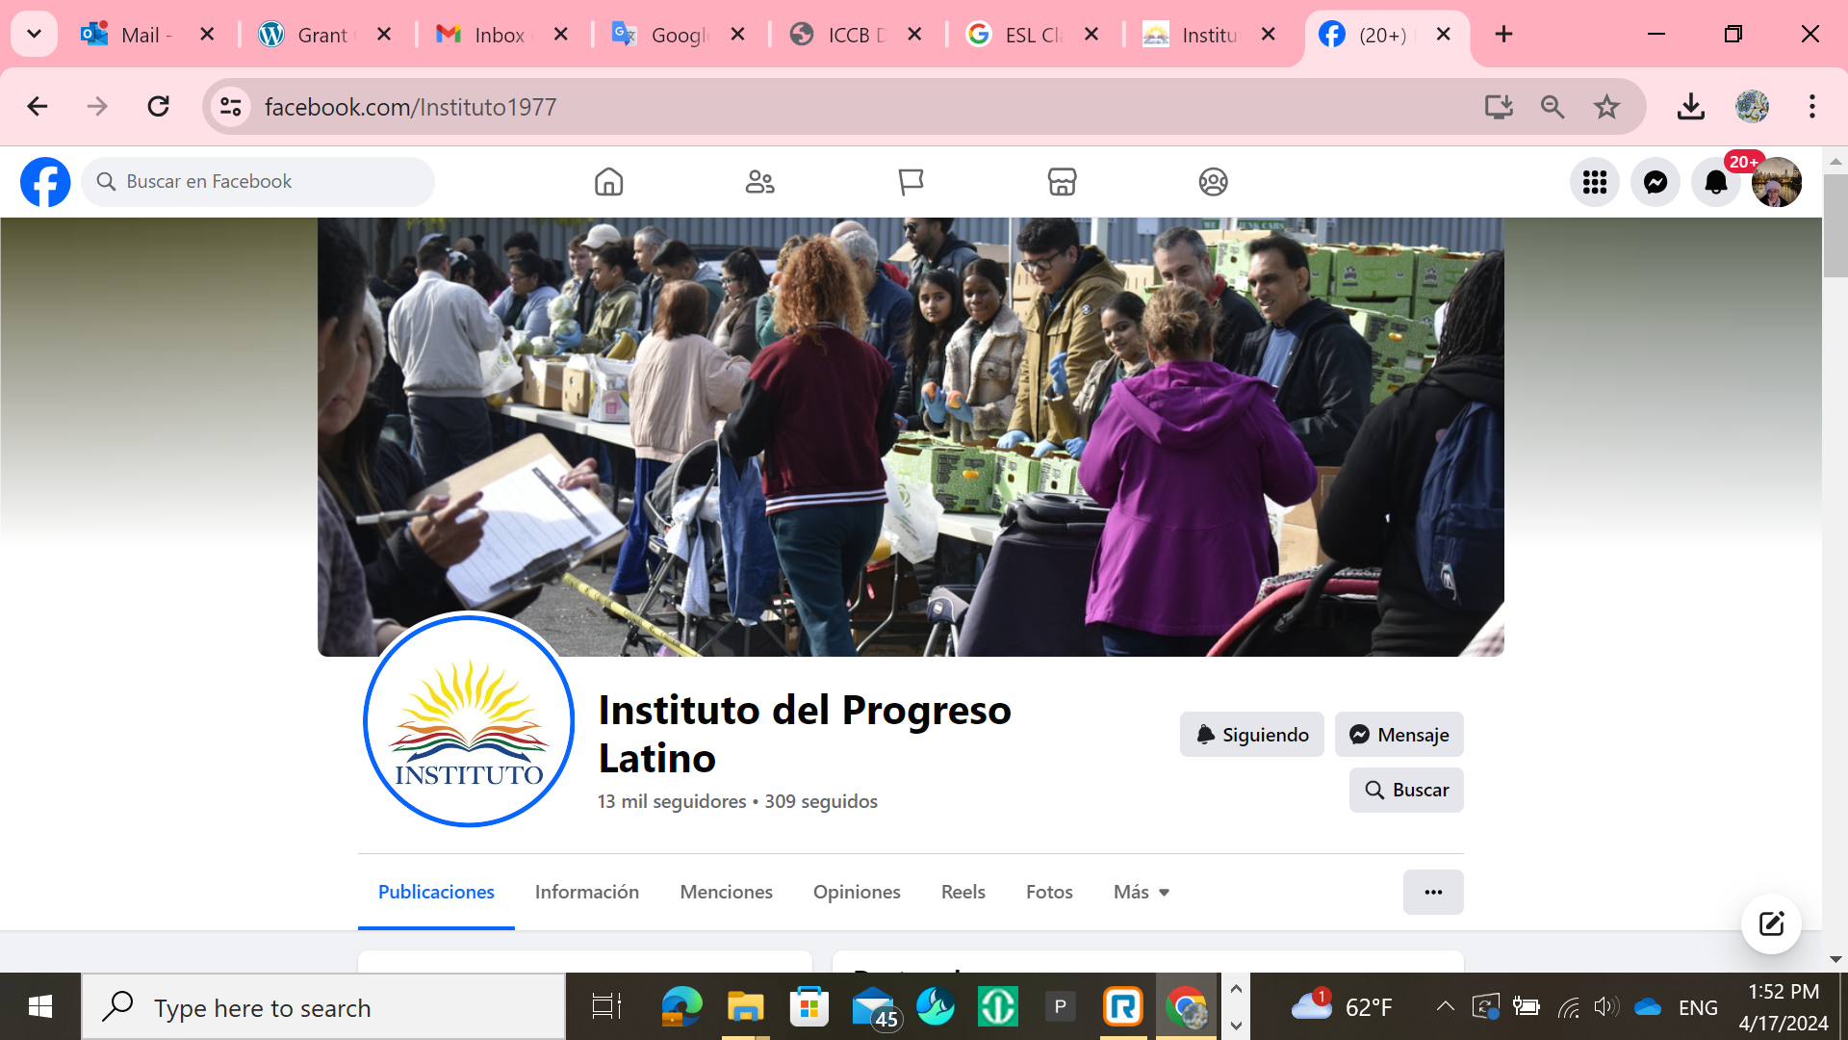

Slide 17
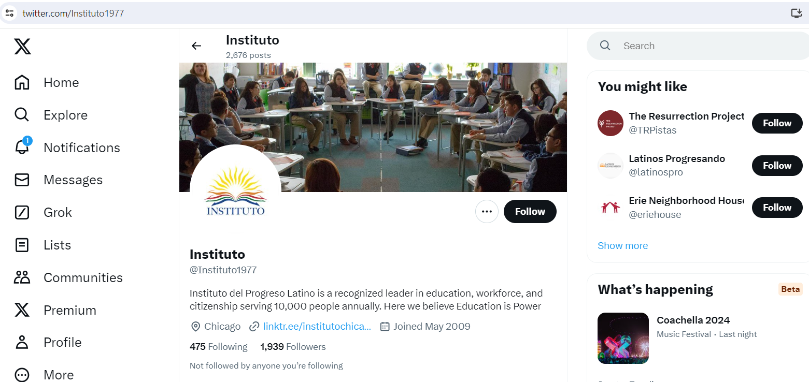

Slide 18
IEL – CE PROGRAMMING AT INSTITUTO.
-IEL-CE Competencies by level:
-400 NRS Levels 2 & 3 – Community Resources, Democratic Process and some employment Competencies.
-50 NRS Levels 3 & 4 – Employment and Career Exploration competencies, and the school system.
-20 Bridge and ICAPS II – Public Health System competencies; Employment and Community competencies.

Slide 19
IEL – CE PROGRAMMING AT INSTITUTO.
-BURLINGTON ENGLISH Digital Platform. Promotes the use of all Illinois Civics Competencies in Levels 2 to 4, and Carreras en Salud (Bridge Program and ICAPs courses).

Slide 20
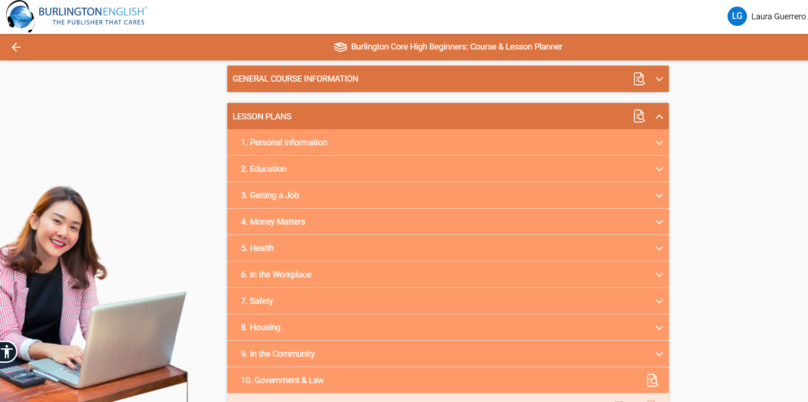
Burlington English

Slide 21
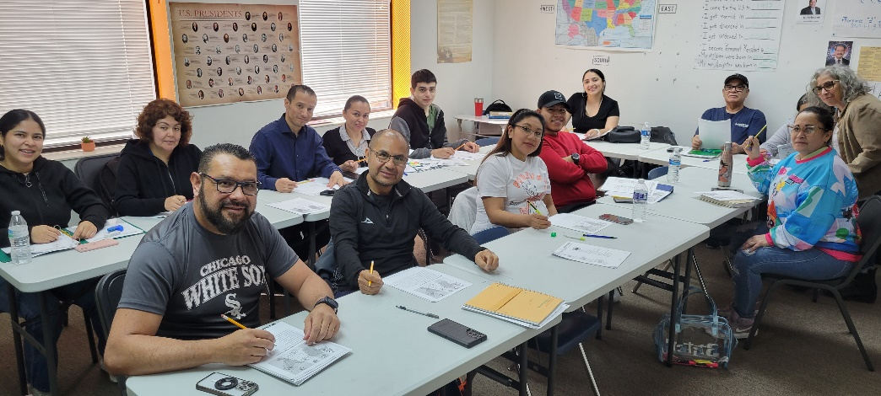

Slide 22
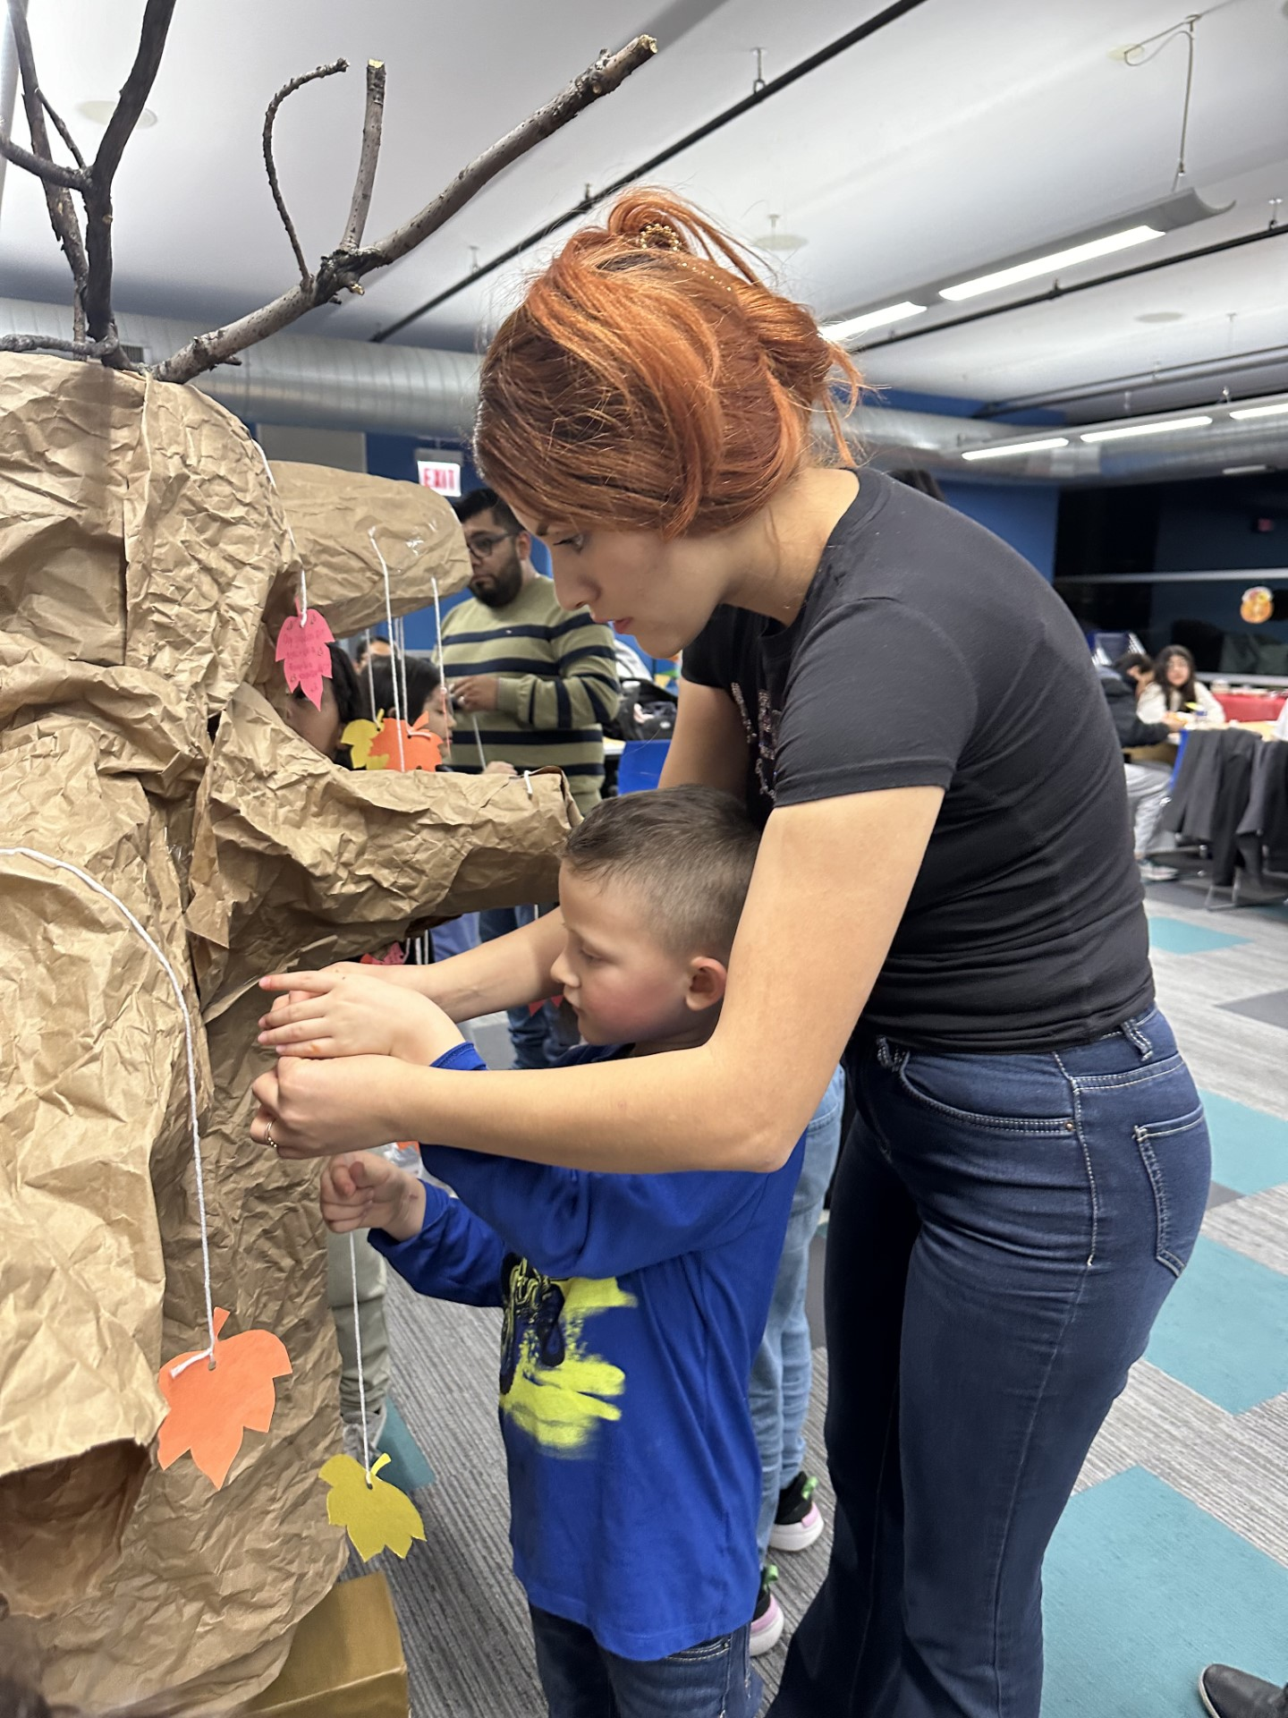
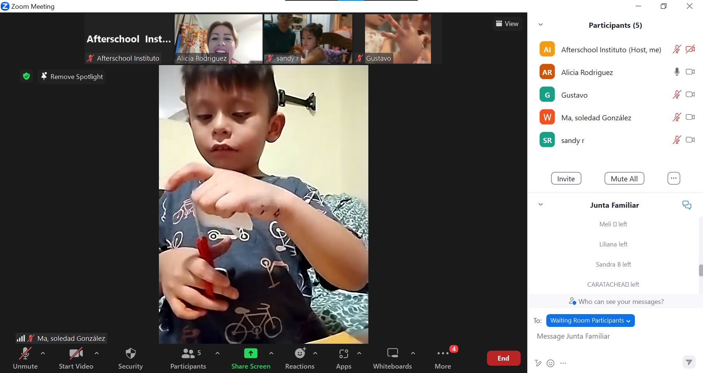
FAMILY LITERACY PROGRAM AND YOUTH LEADERSHIP AND STEM PROGRAMS
-3 TO 8 YEARS OLD.
-Students’ children.
-Students from 2nd to 8th grades.
-Partnership with Irma Ruiz Elementary School.
-From 3 to 7 pm.

Slide 23
Contact Information
Stephen Alderson Dean of Adult Education steve@idpl.org
Laura A. Guerrero Assistant Dean of Adult Education
l.guerrero2@idpl.org

