Slide 1
INTRO TO FRACTIONS
Lesson 3: Comparing Fractions
STUDENT GUIDE

Slide 2
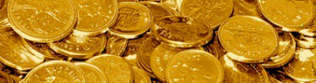
Slide deck contents
RED
PINK
ORANGE
YELLOW
GREEN
BLUE
INDIGO
PURPLE
GOLD
Review comparing unit fractions
none
Goals | Objectives | “I can…” statements
Lesson: Adding fractions in different units
Discussions: Reasoning about fractions | Activity: Human number-line
Small group/partner tasks: Experimenting with fraction sets
Discussion | Learning checks (QR codes)
Post-Learning Activities (Links)
A&W’s comeback

Slide 3
Overview of lesson 3: What am I going to learn?
Content Objectives - I will be able to…
_____________ fractions, using reasoning and equivalent fractions (if necessary).
Order fractions on a _____________ _______ to compare values, finding and using equivalent fractions if necessary.
Recognize ___________________ ___________ of simple fractions (using virtual modeling tools, hands-on manipulatives, number lines, or pattern reasoning)
Notes:
What is “reasoning,” in the context of the first objective?
___________________________________________________
___________________________________________________

Slide 4
VOCABULARY
equivalent fraction:
____________________________________________________________
____________________________________________________________
fractional notation
____________________________________________________________
____________________________________________________________
simplify
____________________________________________________________
____________________________________________________________
simplified fraction
____________________________________________________________
____________________________________________________________

Slide 5
Recall: Comparing unit fractions
compare
to state whether a number is smaller, larger, or equal to another
What fractions are these, and how would you compare them?
½ ¼
Notes:
FILL-IN-THE-BLANKS:
When comparing two unit fractions, the fraction with the ________________ denominator will be the larger fraction.
To compare is to state whether a number is ______________________, _______________________, or _________________________ another.

Slide 6
OBJECTIVES:
#1: Students will be able to compare fractions, using reasoning and equivalent fractions.
“I-Can…” StatementS:
I can compare fractions.

Slide 7
discuss: How to compare fractions
How might you compare these fraction sets without modeling?
4/5, 2/5, 5/5
3/3 , 3/6 , 3/9
2/6 , 3/6 , 5/6
2/6 , 2/3 , 2/9
2/3 , 3/6, 3/9
2/3 , 4/6 , 6/9
Notes:
What questions can we ask ourselves about fractions that we have to compare?
_____________________________________________________________________
_____________________________________________________________________
_____________________________________________________________________

Slide 8
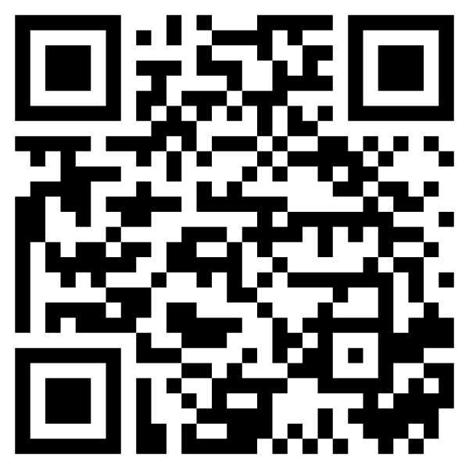
Fraction Set 1
2/6 , 2/3 , 2/9
3/3 , 3/6 , 3/9
MLC
Notes:
Directions: First, discuss with your partner[s] answers to the following questions. Using the blank lines below, record at least one response from a partner, along with their reasoning. Then, model the first two groups of fractions to see if the results support your theories.
1. What is one thing you will guess about how the fractions would compare?
(“I believe/think/guess that…”)
______________________________________________________________________________
______________________________________________________________________________
______________________________________________________________________________
2. Why will you guess that?
(“Because I know/remember/can see that….”)
______________________________________________________________________________
______________________________________________________________________________
______________________________________________________________________________

Slide 9
Fraction Set 1
2/3 , 4/6 , 6/9
Notes:
Directions [cont’d]: First, discuss with your partner[s] answers to the following questions. Using the blank lines below, record at least one response from a partner, along with their reasoning. Then, model the first two groups of fractions to see if the results support your theories.
3. How was the third set different from the first two?
___________________________________________________________________________
___________________________________________________________________________
What thoughts or ideas are you starting to have as you compare what is changing and staying the same?
___________________________________________________________________________
___________________________________________________________________________
___________________________________________________________________________
___________________________________________________________________________

Slide 10
Fraction Set 2
2/6 , 3/6 , 5/6
4/5 , 3/6 , 5/5
MLC
Notes:
Directions: First, discuss with your partner[s] answers to the following questions. Using the blank lines below, record at least one response from a partner, along with their reasoning. Then, model the two groups of fractions to see if the results support your theories.
1. What is one thing you will guess about how the fractions would compare?
(“I believe/think/guess that…”)
______________________________________________________________________________
______________________________________________________________________________
______________________________________________________________________________
2. Why will you guess that?
(“Because I know/remember/can see that….”)
______________________________________________________________________________
______________________________________________________________________________
______________________________________________________________________________

Slide 11
Fraction Set 2
2/3 , 3/6 , 3/9
Notes:
Directions [cont’d]: First, discuss with your partner[s] answers to the following questions. Using the blank lines below, record at least one response from a partner, along with their reasoning. Then, model the first two groups of fractions to see if the results support your theories.
3. How was the third set different from the first two?
___________________________________________________________________________
___________________________________________________________________________
What thoughts or ideas are you starting to have as you compare what is changing and staying the same?
___________________________________________________________________________
___________________________________________________________________________
___________________________________________________________________________
___________________________________________________________________________

Slide 12
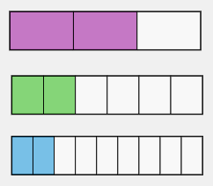
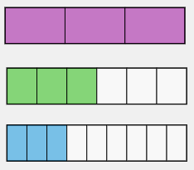
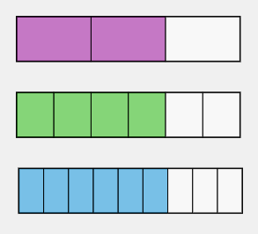
Discuss: How to discuss (your own or another’s) reasoning
What was changing in each set?
What stayed the same?
What thoughts or ideas were you starting to have as you compared what was changing and remaining?
⅔
2/6
2/9
3/3
3/6
3/9
⅔
4/6
6/9
2/9 < 2/6 < 2/6
3/3 > 3/6 > 3/9
2/3 > 4/6 > 6/9
What was one thing you guessed about how the fractions would compare?
What led you to make that guess?
What was different about the last fraction set? How was it like the first two?
How did these differences change or add to your perspective or your ideas?
Did this experiment agree or disagree with your original hypothesis?
Notes:
Notes:
____________________________________________________________________________
____________________________________________________________________________
____________________________________________________________________________
____________________________________________________________________________
____________________________________________________________________________
____________________________________________________________________________

Slide 13
Learn: We can compare fractions using reasoning
NEW CONCLUSION:
When comparing two fractions with the ____________________, the fraction with the higher denominator is the ___________ fraction.
REVIEW GAME
Notes:
Notes:
____________________________________________________________________________
____________________________________________________________________________
____________________________________________________________________________
____________________________________________________________________________
____________________________________________________________________________
____________________________________________________________________________

Slide 14
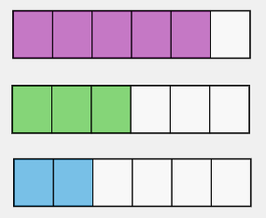
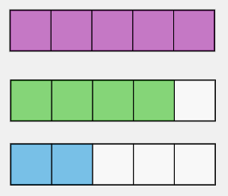
Discuss: How to discuss (your own or another’s) reasoning
What was changing in each set?
What stayed the same?
What thoughts or ideas were you starting to have as you compared what was changing and remaining?
5/6
3/6
2/6
5/5
4/5
2/5
2/3
3/6
3/9
2/6 < 3/6 < 5/6
2/5 < 4/5 < 5/5
2/3 > 3/6 > 3/9
What was one thing you guessed about how the fractions would compare?
What led you to make that guess?
What was different about the last fraction set? How was it like the first two?
How did these differences change or add to your perspective or your ideas?
Did this experiment agree or disagree with your original hypothesis?
Notes:
Notes:
____________________________________________________________________________
____________________________________________________________________________
____________________________________________________________________________
____________________________________________________________________________
____________________________________________________________________________
____________________________________________________________________________

Slide 15
Learn: We can compare fractions using reasoning
NEW CONCLUSION:
When comparing two fractions with the ____________________, the fraction with the higher numerator is the __________ fraction.
REVIEW GAME
Notes:
Notes:
____________________________________________________________________________
____________________________________________________________________________
____________________________________________________________________________
____________________________________________________________________________
____________________________________________________________________________
____________________________________________________________________________

Slide 16
Discuss: How to critique (your own or another’s) reasoning
Initial hunch:
Reasons for thinking this:
Supporting evidence from experiment:
Opposing evidence from experiment:
Factor[s] not initially considered:
State the Rule: When comparing fractions, ___________________________.
A fraction is smaller than another if its denominator is larger.
When modeling unit fractions, fractional units got smaller as the number of parts increased.
The results of the first two sets of fractions supported my guess.
The results of the last set opposed my guess.
The value of the fractions’ numerators being the same. I hadn’t considered how the numerator would make a difference in the size of the fraction.
Notes:
Notes:
____________________________________________________________________________
____________________________________________________________________________
____________________________________________________________________________
____________________________________________________________________________
____________________________________________________________________________
____________________________________________________________________________

Slide 17
Paired Task: Studying fraction sets
How does Fraction Set 3 compare?
Use modeling tools to prove or disprove your theory:
2/3 , 4/6 , 6/9
1/2 , 2/4 , ???
???, ???, ???
MLC
Notes:
DIRECTIONS: Answer the following questions to find the pattern in the first group of fractions. Then complete the second group of fractions to follow that pattern. Finally, make a third group of fractions that fits the rules established by the first two.
What is changing?
___________________________________________________________________________
___________________________________________________________________________
What is staying the same?
___________________________________________________________________________
___________________________________________________________________________

Slide 18
Group work: We can compare fractions
Group work: We may find equivalent fractions
equivalent fraction
a fraction that expresses the same value as another, written in different fractional notation
What did you notice about these fractions?
2/3
4/6
6/9
Notes:
Notes:
____________________________________________________________________________
____________________________________________________________________________
____________________________________________________________________________
____________________________________________________________________________
____________________________________________________________________________
____________________________________________________________________________

Slide 19
OBJECTIVES:
#1: Students will be able to compare fractions, using reasoning and equivalent fractions.
#1: Students will be able to compare fractions, using reasoning and equivalent fractions.
“I-Can…” StatementS:
I can compare fractions.
I can substitute equivalent fractions.

Slide 20
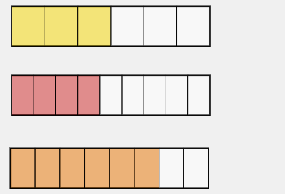
Paired task: Substituting equivalent fractions
Equivalent fractions:
3/6
4/9
6/8
2/3
4/6
6/9
How might you use equivalent fractions to compare two fractions?
3/6
2/3
4/6
6/8
2/3
6/9
4/9
2/3
4/6
6/9
Notes:
Notes:
____________________________________________________________________________
____________________________________________________________________________
____________________________________________________________________________
____________________________________________________________________________
____________________________________________________________________________
____________________________________________________________________________

Slide 21
OBJECTIVES:
#3: Students will be able to recognize equivalent fractions of simple fractions.
#1: Students will be able to compare fractions, using equivalent fractions.
“I-Can…” Statement:
I can find, create, and use equivalent fractions.

Slide 22
find/Create task: Create equivalent fractions
Group 1 SLIDE
Group 2 Slide
Group 3 Slide
Group 4 Slide

Slide 23
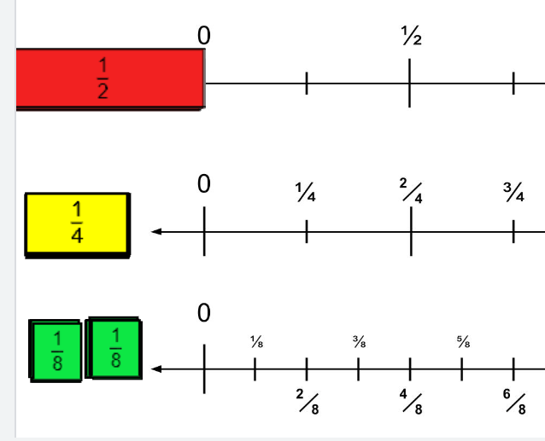
Group 1 task: Create equivalent fractions
Back to list Slide
INTERACTIVE:
Jamboard [place link for class JB]
Make equivalents for:
1/2
8/8
1/4
Notes:
Notes:
____________________________________________________________________________
____________________________________________________________________________
____________________________________________________________________________
____________________________________________________________________________
____________________________________________________________________________
____________________________________________________________________________

Slide 24
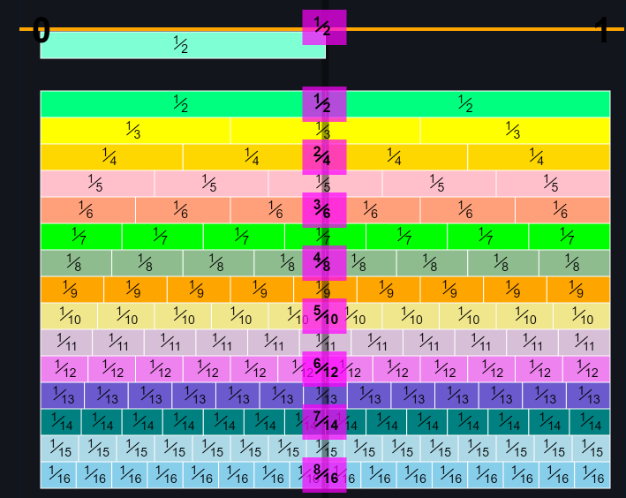
Group 2 task: Create equivalent fractions
Back to list Slide
DISPLAY:
MathsisFun Number Line
Make equivalents for:
1/2
6/8
2/3
Notes:
Notes:
____________________________________________________________________________
____________________________________________________________________________
____________________________________________________________________________
____________________________________________________________________________
____________________________________________________________________________
____________________________________________________________________________

Slide 25
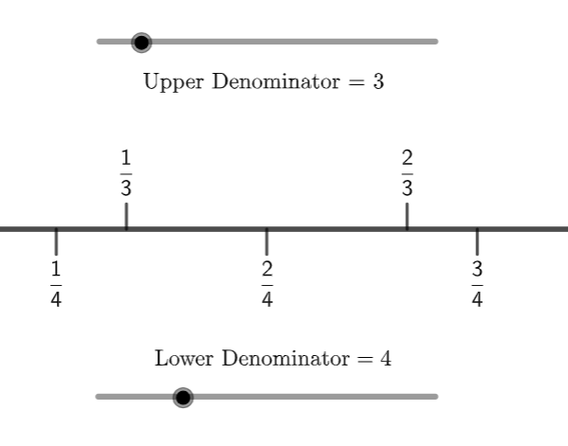
Group 3 task: Create equivalent fractions
Back to list Slide
USE:
Geogebra Two-sided number Line
Make equivalents between:
Halves + fourths
Thirds + sixths
Fifths + tenths
Two fractional units of your choice
Notes:
Notes:
____________________________________________________________________________
____________________________________________________________________________
____________________________________________________________________________
____________________________________________________________________________
____________________________________________________________________________
____________________________________________________________________________

Slide 26
Group 4 task: Create equivalent fractions
Back to list Slide
DISPLAY:
MathsisFun Number Line
Make equivalents among:
Halves + fourths + eighths
Fourths + eighths + sixteenths
Thirds + sixths
BONUS: Which fraction can you make the most equivalents for?
Notes:
Notes:
____________________________________________________________________________
____________________________________________________________________________
____________________________________________________________________________
____________________________________________________________________________
____________________________________________________________________________
____________________________________________________________________________

Slide 27
OBJECTIVES:
#3: Students will be able to recognize equivalent fractions of simple fractions (using …. pattern reasoning).
“I-Can…” Statement:
I can find and create equivalent fractions using what I know about

Slide 28
Learn: We can create equivalent fractions
Fractional Notation
a fraction expressed as a numerator and a denominator with a fraction line between the numbers (written as “a/b”)
How do the partitions differ from one fraction to the next?
2/3
4/6
6/9
What kind of relationship do we see in their their numbers (how a number is written)?
simplify = to substitute an expression with the equivalent expression that is the easiest to understand
Notes:
Notes:
____________________________________________________________________________
____________________________________________________________________________
____________________________________________________________________________
____________________________________________________________________________
____________________________________________________________________________
____________________________________________________________________________

Slide 29
Think: How is this value being expressed?
We see the fraction model change. Where do we see change?
What stays the same?
What do you think about the operations we see at the end?
Notes:
Notes:
____________________________________________________________________________
____________________________________________________________________________
____________________________________________________________________________
____________________________________________________________________________
____________________________________________________________________________
____________________________________________________________________________

Slide 30
OBJECTIVES:
Students will be able to…
1. Compare fractions, finding and using equivalent fractions if necessary.
2. Order fractions on a number line to compare values, finding and using equivalent fractions if necessary.
3. Find/Create equivalent fractions of simple fractions (using virtual modeling tools, hands-on manipulatives, number lines, or pattern reasoning)
4. Explain my own understanding of a fraction’s size using these terms: equivalent fraction, equal, fractional notation, simplify, simplified fraction, compare, like fractions, same numerator, same denominator

Slide 31
Activity: I Have / Who Has?
Creating a human number line
The card with a star in its upper left corner begins the call sequence.
First caller hangs their card on the number line and says “I have _______; who has _________?” filling in the blanks with what is on their card.
The person who is called will then say “I have ____.” But, before placing their card on the line, the class must discuss and guess where that fraction will go on the line.
After class discusses and some guesses have been made, the student with the called card can reveal their card.
The class works together to help that student place the card on the number line.
That player then calls for the next card in the sequence.
Steps 3-6 repeat until all cards have been called.
Notes:
Notes:
____________________________________________________________________________
____________________________________________________________________________
____________________________________________________________________________
____________________________________________________________________________
____________________________________________________________________________
____________________________________________________________________________

Slide 32
Connect the lesson: Reading a measuring tape
Notes:
Notes:
____________________________________________________________________________
____________________________________________________________________________
____________________________________________________________________________
____________________________________________________________________________
____________________________________________________________________________
____________________________________________________________________________

Slide 33
Post-Lesson Learning Checks
How to do it: Choose an activity to complete by yourself, with a classmate, or with a group of classmates.
ACTIVITY TYPE AND SETTING | ACTIVITY NAME + DIRECTIONS
DISCUSSION Medium- to large-sized group (5+ people) | Which One Doesn’t Belong? Look at the fractions and choose the one you think doesn’t belong. How would you argue that you’re right?
LEARNING CHECKS Individual or with a buddy | Monster Fractions (many variations) Ordering four fractions (w/ different denominators + numerators) Finding equivalent fractions
GAMES Small group (2-4 people) | SHOW OR TELL - Vocabulary game CONNECT FRACTIONS (LEVEL 2) - Adding-fractions game
INDEPENDENT ACTIVITIES | Decode a measuring tape Create your own number line

Slide 34
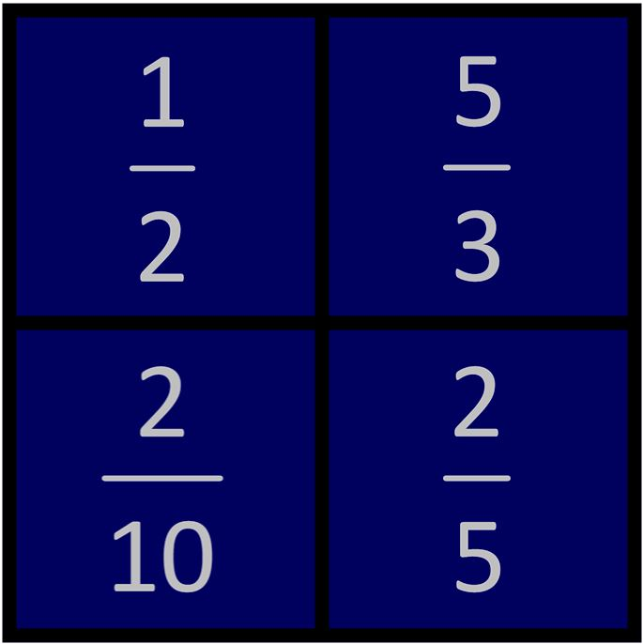
Discussion: Which one doesn’t belong?
Notes:
DISCUSSION NOTES:
____________________________________________________________________________
____________________________________________________________________________
____________________________________________________________________________
____________________________________________________________________________
____________________________________________________________________________
____________________________________________________________________________

Slide 35
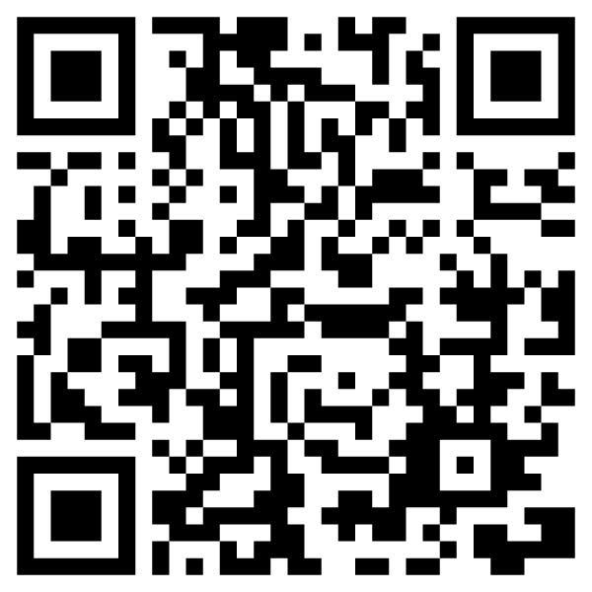
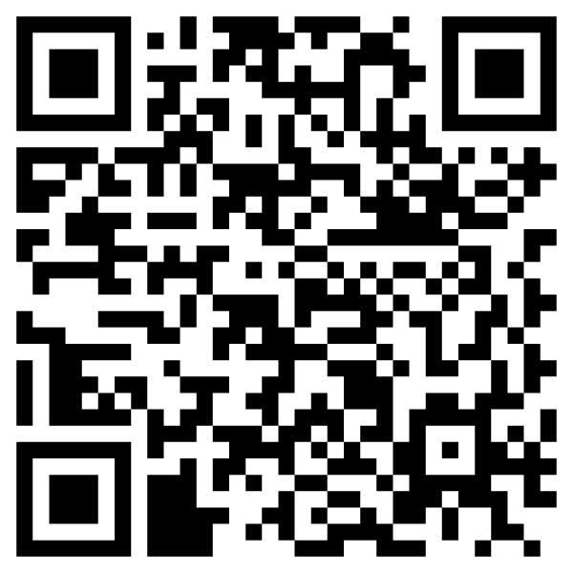
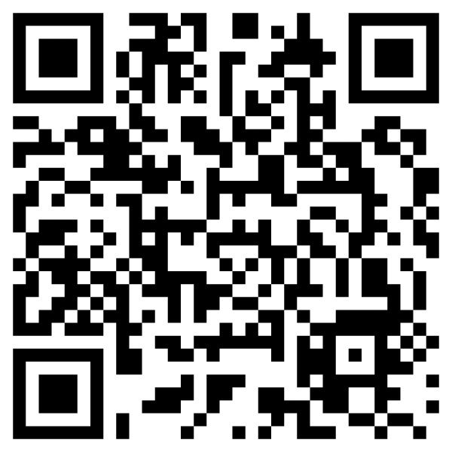
LEARNING CHECKS
Monster Fractions
(many focuses)
Ordering 4 fractions
(different denominators + numerators)
Equivalent fractions
(on a number line)
Notes:
REVIEW YOUR PROGRESS:
I did well with these activities: ___________________________________________________________
I need more practice with: ______________________________________________________________

Slide 36
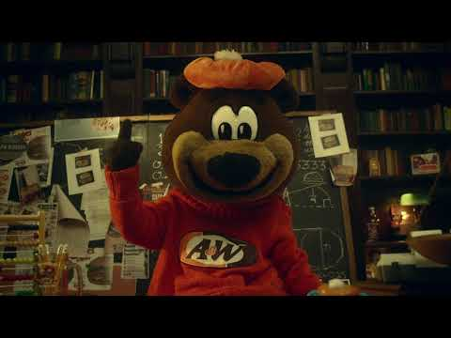
The Reveal: How A&W came back from marketing flop using math
Notes:
How did A&W use math to come back from their epic marketing failure?
____________________________________________________________
____________________________________________________________
____________________________________________________________

