Slide 1
INTRO TO FRACTIONS
Lesson 2: Composing Fractions
STUDENT’S NOTE-TAKING GUIDE

Slide 2
Lesson 2 Content Standards
IL ABE/ASE Math Standards
2.NF.1 Understand a fraction 1/𝑏 as the quantity formed by 1 part when a whole is partitioned into b equal parts; understand a fraction 𝑎/𝑏 as the quantity formed by a parts of size 1/𝑏.
2.NF.2 Understand a fraction as a number on the number line; represent fractions on a number line diagram.
a. Represent a fraction 1/𝑏 on a number line diagram by defining the interval from 0 to 1 as the whole and partitioning it into b equal parts. Recognize that each part has size 1/𝑏 and that the endpoint of the part based at 0 locates the number 1/𝑏 on the number line. b. Represent a fraction 𝑎/𝑏 on a number line diagram by marking off a lengths 1/𝑏 from 0. Recognize that the resulting interval has size 𝑎/𝑏 and that its endpoint locates the number 1/𝑏 on the number line.
2.NF.3 Explain equivalence of fractions in special cases, and compare fractions by reasoning about their size. c. Express whole numbers as fractions, and recognize fractions that are equivalent to whole numbers.
3.NF.3 Understand a fraction 𝑎/𝑏 with a > 1 as a sum of fractions 1/𝑏: a. Understand addition and subtraction of fractions as joining and separating parts referring to the same whole. b. Decompose a fraction into a sum of fractions with the same denominator in more than one way, recording each decomposition by an equation. Justify decompositions by using a visual fraction model.
Targeted SMPs: 5, 7, 8

Slide 3
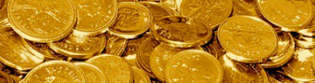
Slide deck contents
RED
PINK
ORANGE
YELLOW
GREEN
BLUE
INDIGO
PURPLE
GOLD
Recall: Composing Units
Videos & Practice
Goals & Objectives
Lesson: Unit Fractions Compose Whole + Non-whole Numbers
Discussion: Adding with tiles + on number lines
Buddy Tasks: Creating expressions + number lines
Independent Task: Fraction Feud
Post-Test: Targeted Exercises
Challenge: Composing expressions

Slide 4
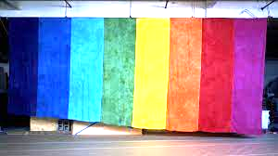
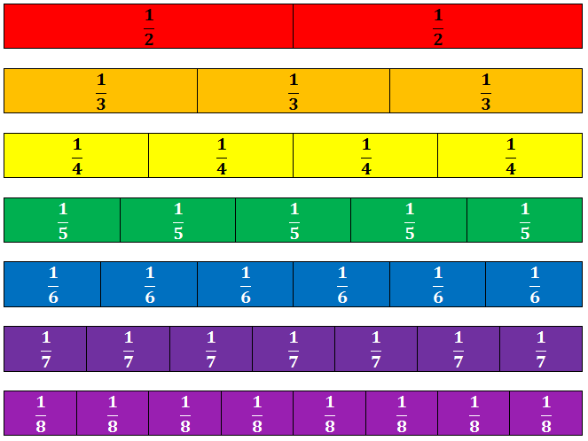
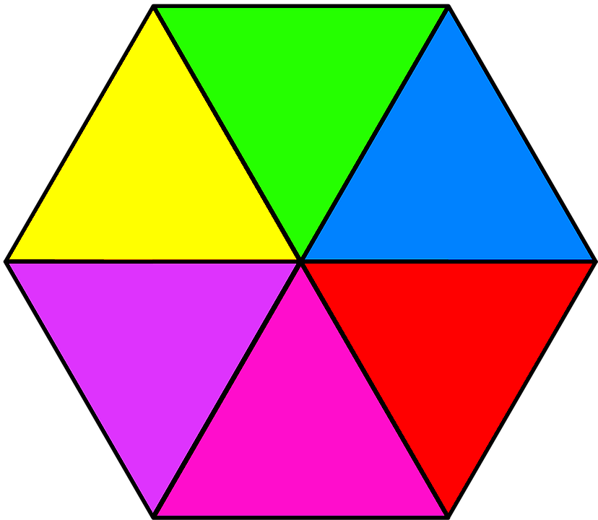
INTRO TO FRACTIONS
Lesson 2:
Composing Fractions
course name
class name
date

Slide 5
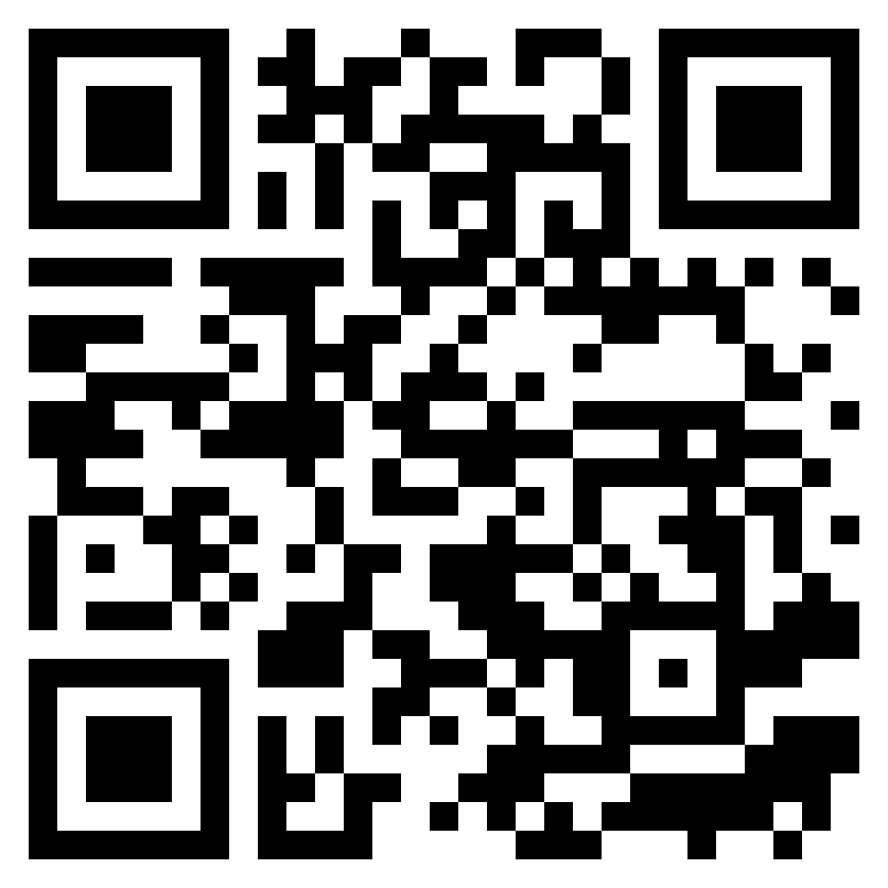
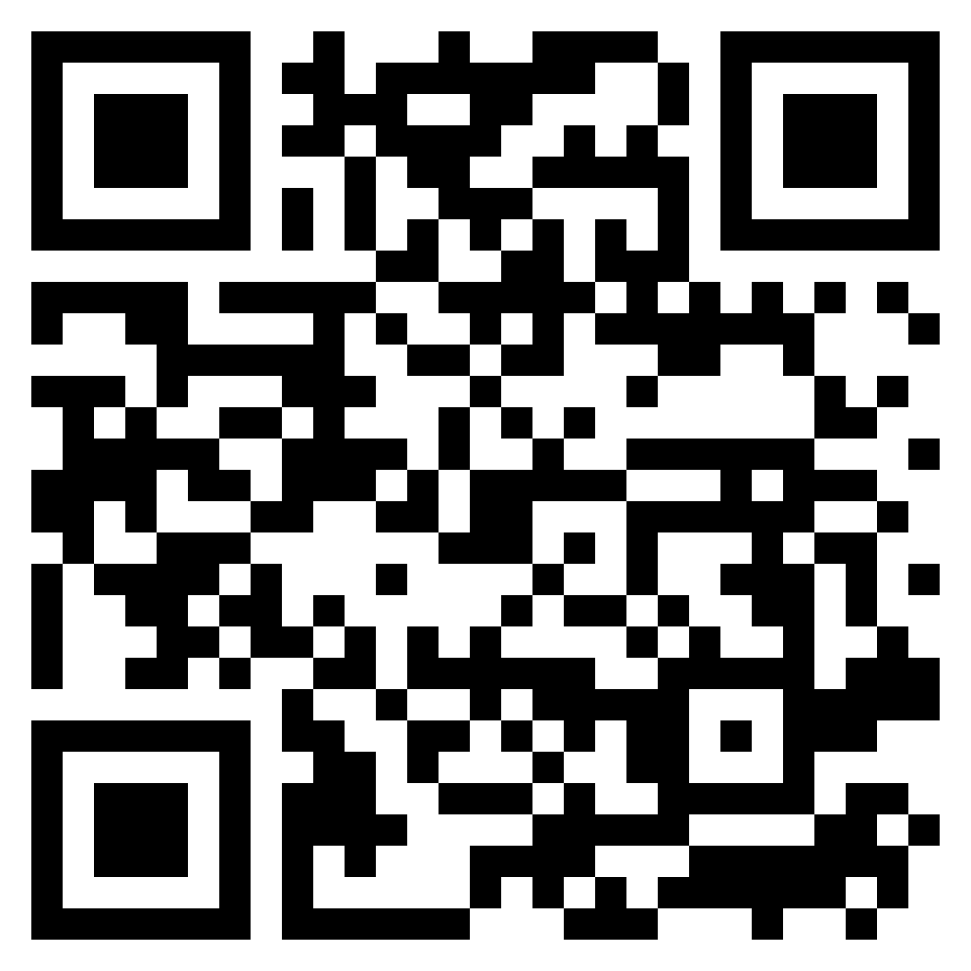
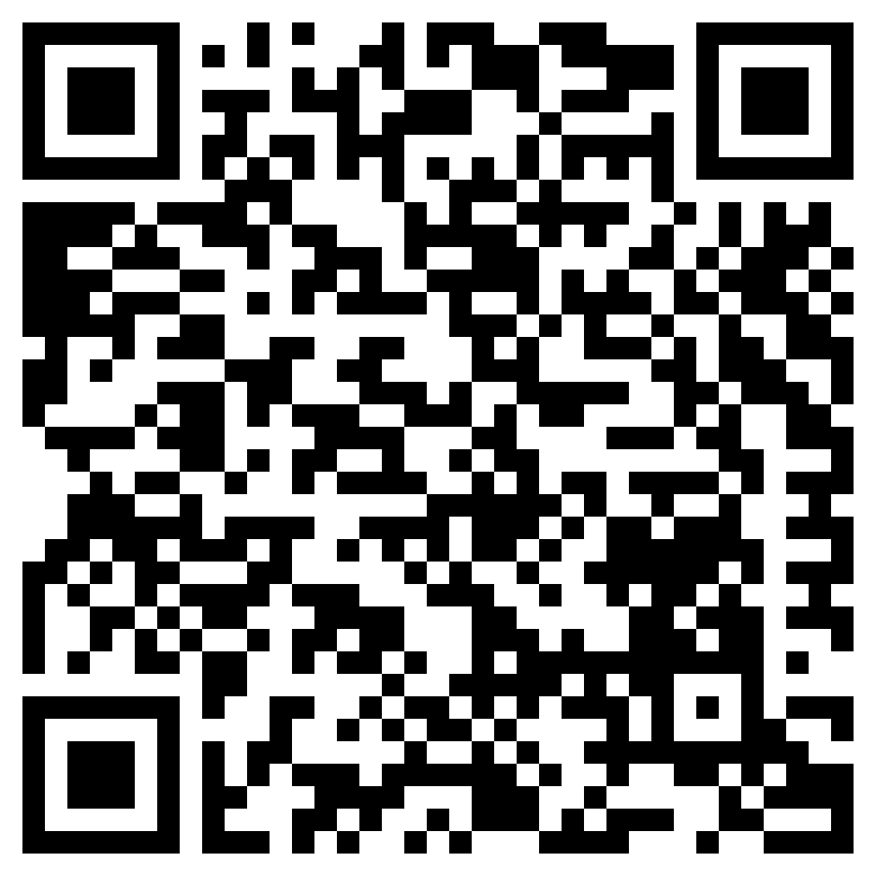
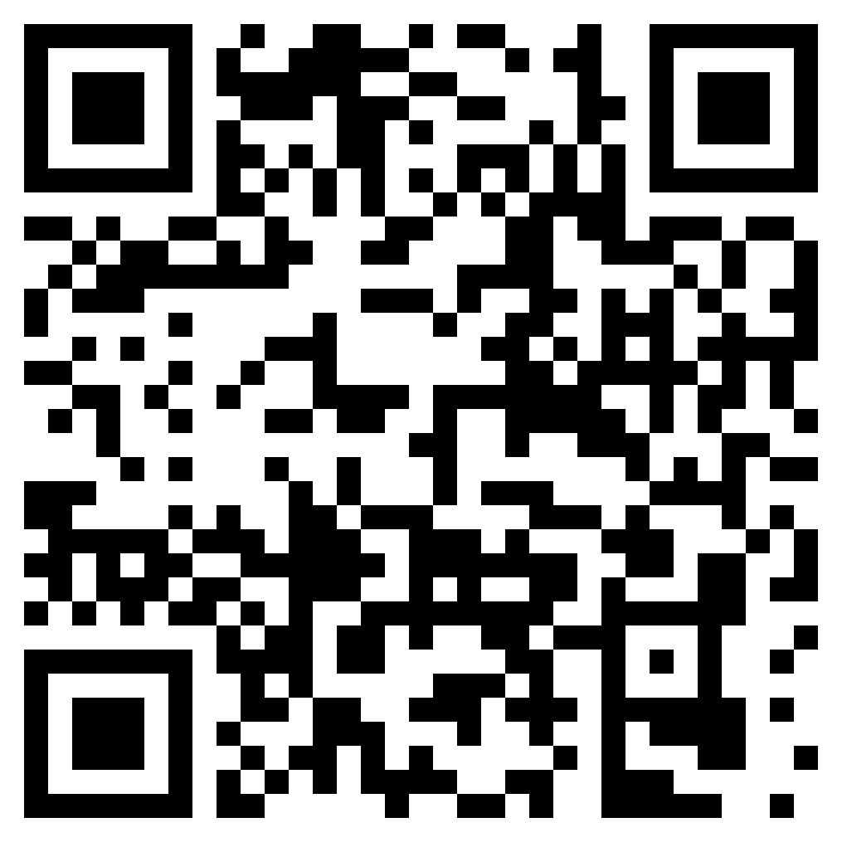
Prerequisite learning: Comparing values, shapes, place value
Before starting this lesson, students should be able to…
Find whole numbers on a number line
Decode a visual fraction model
Count fluently up to 20, from any number 0-19
SKILL / KNOWLEDGE | Use a number line Find a whole number on a number line |  | Know that fractions can be modeled with partitioned shapes |  | Count and add to 20
LESSON | Watch: Finding number line values |  | Watch: Fractions are parts
PRACTICE | Do: Find Integers on a Number line activity |  | Do: Name the Fraction activity
Review these concepts if necessary
Notes:
Complete these independent mini-lessons if you need to!

Slide 6
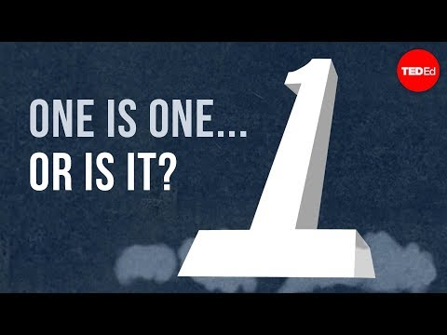
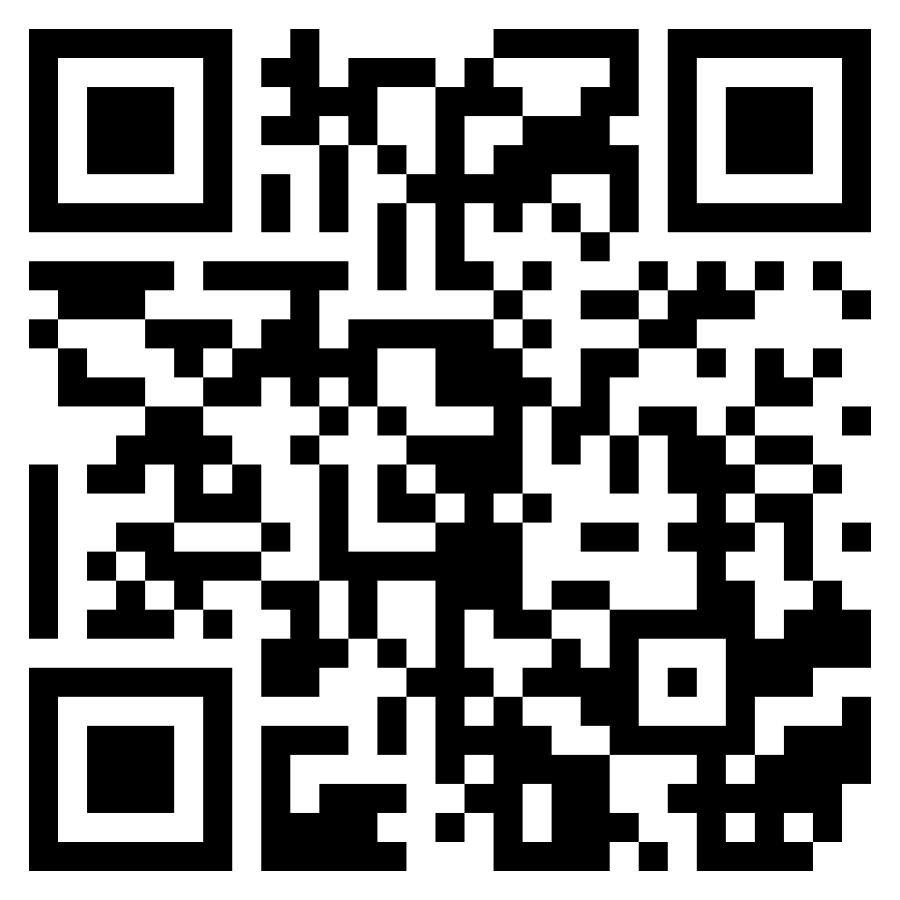
Recall: Composing units
Notes:
VOCAB
partition: the process of dividing something into smaller _______
compose: the process of ___________ together to make a new unit

Slide 7
Recall: Composing units
1 + 1 + 1 + 1 + 1 + 1 + 1 + 1 + 1 + 1 = 10
Ten (10) ones becomes a ten-rod (bundling)
Or…
A ten-rod can become ten units (unbundling)
=
=
Notes:
FILL-IN-THE-BLANKS
Another name for composing (used in the context of blocks and tenrods) is __________.
Other names for partitioning are ________________ and decomposing.

Slide 8
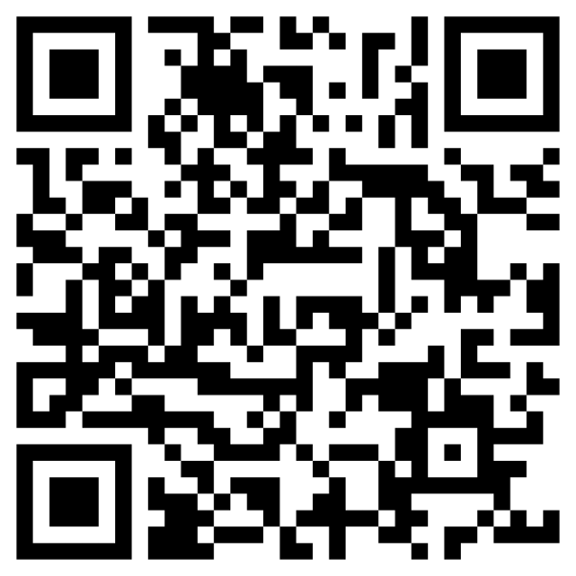
Notice: What’s happening? What do you notice?
Video
Notes:
How does this relate to what we are recalling about composing and decomposing/partitioning?
_________________________________________________________________________________________
_________________________________________________________________________________________

Slide 9
INTRO: Composing / decomposing with fractions
composed
decomposed
¼ + ¼ + ¼ + ¼
Notes:
FILL-IN-THE-BLANKS
Composing is the process of ______________________________________________, whereas decomposing numbers is ____________________________ and viewing them next to each other. Think of the difference as puzzle pieces. A whole puzzle is ___________________ of hundreds or thousands of pieces. When ____________________, each piece is viewed as its own part.

Slide 10
Overview of lesson 2: What am I going to learn?
Language Objectives - I will be able to…
Content Objectives - I will be able to…
Partition a whole number or fraction into a sum of like fractions, including repeated unit fractions
Combine unit fractions in expressions to create like fractions
Show that adding simple* unit fractions creates bigger fractions
By counting and composing fraction tiles
By labeling and counting on number lines
Discuss and describe addition of fractions using vocabulary terms: partition, compose, decompose, sum, like fractions, expression, equal
Know the objectives
Notes:
Notes:
For this lesson, simple fractions have denominators of 1 to 10.
You have previously used fraction-modeling software and pen/paper to partition circles and rectangles. This lesson will build off of those models to include online and hands-on tools, specifically fraction tiles/bars and number lines.

Slide 11
Goals of this lesson…
Tasks of this lesson…
Overview of lesson 2: What will learning look like?
Recognize that all fractions are sums of unit fractions
Understand that rational numbers can be expressed as fractions
Understand that there are many ways to break apart numbers
Explore fractions using models: physical/digital fraction bars and number lines
Paired practice creating expressions
Create measuring strips
End goals for this lesson

Slide 12
OBJECTIVES:
#1: Students will be able to partition a whole number or a fraction into a sum of like fractions, including only unit fractions.
#2: Students will be able to create like fractions by adding unit fractions.
“I-Can…” Statements:
I can partition a number into a sum of unit fractions.
I can create like fractions.
Focus on objectives, ask questions

Slide 13
Learn: Fractions are sums of unit fractions
1 student + 1 student =
1 inch + 1 inch =
1 hundred + 1 hundred =
1 part + 1 part =
1/4 + 1/4 =
___________
___________
___________
___________
___________
VOCABULARY:
Fractions that have the same fractional unit are called like fractions.
Notes:
VOCAB
like fractions: fractions that are in the same fractional unit, fractions that have the same denominator
FILL-IN-THE-BLANKS
Adding fractions sounds like adding other numbers with units:
One student plus one student is two students.
One inch and one inch is ____ inches.
One hundred plus one hundred is ___________________.
One-fourth plus one-fourth is ___________________.
Remember! A fraction’s denominator is the name of the fraction’s unit (i.e.: fractional units) and the numerator is the number. We don’t add names; we add numbers!

Slide 14
Learn: Fractions are sums of unit fractions
Conceptual expressions
Written expressions
¼
+ ¼
+ ¼
Notes:
VOCAB
expression: any number OR numbers with operations connecting them
FILL-IN-THE-BLANKS
Adding fractions sounds like adding other numbers with units:
Explain “We see here three expressions that represent the same value: three-fourths. In each expression, we could say we are partitioning (or decomposing) a whole unit into four equal parts and adding together three of those parts. Notice that the second expression is showing the unit fractions that compose the expression of ¾. When partitioning a fraction into a sum of its unit fractions, remember that you are only taking apart that top number, the numerator. If we add 1 three times, we get three. Likewise, if we add one-fourth three times, we get three fourths.”
Check for understanding before moving on.

Slide 15
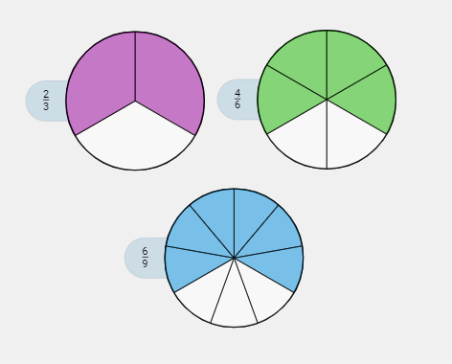
Try: To express fractions as sums of unit fractions
How could you express a sum of unit fractions that is depicted by each model?
⅓ + ⅓
⅙ + ⅙ + ⅙ + ⅙
1/9 + 1/9 + 1/9 + 1/9 + 1/9 + 1/9
1) Determine the fractional unit, based on how the fraction is partitioned.
2) Count the number of parts shaded.
3) Create a sum of unit fractions to represent the shaded parts of the circles.
Talk through the steps, take notes
Notes:
Explain to students that they are going to practice what we’ve learned by decomposing these fractions to sums of unit fractions.
Think aloud how to interpret the 2/3 circle: “For the first circle, I see we have thirds, and two of those thirds are filled in. This circle represents 2/3 and its expression can be broken down (or decomposed) into 1/3 + 1/3.” Click to reveal expression.
Direct students to talk you through creating expressions for the 4/6 and 6/9, revealing other circles and expressions as they’re covered:
2nd click: 2nd expression appears, third fraction appears
3rd click: 3rd expression appears

Slide 16
Try: To express fractions as sum of unit fractions
Learning Check!
Write expressions
Notes:
Explain to students that they are going to be presented with three area models, for which they will write the fraction represented and a sum of unit fractions for each.
Click for reveal.

Slide 17
Try: To express fractions as sum of unit fractions
Write expressions

Slide 18
Try: To express fractions as sum of unit fractions
Write expressions

Slide 19
ChecK Your Answers
Answers:
1/2; ½
3/6; ⅙ + ⅙ + ⅙
2/3; ⅓ + ⅓
4/6; ⅙ + ⅙ + ⅙ + ⅙
1/3; ⅓
2/6; ⅙ + ⅙
Self-assess, ask questions

Slide 20
Learn: To express the parts of a shape as a sum of fractions.
How many equal parts does this Rainbow Pride flag have? What is the fractional unit?
What is an expression that shows the sum of each part?
+
+
+
+
+
Discuss flag’s composition
Notes:
Explain to students that most flags are created with colors whose proportions can be represented with fractions; this is especially true with LGBTQ+-oriented flags, or Pride Flags, but is also true of many national flags.
Use the Pride flag as an example to walk students through decomposing a whole unit into a sum of repeated unit fractions.
Remind students the first step is to identify the fractional unit.
Ask “How do we identify the fractional unit?” (Count how many equal parts the whole has been partitioned into)
1st Click: Reveals first questions.
Repeat questions. (Six parts, sixths)
2nd Click: Reveals last question.
Repeat/clarify question. Let students give some answers and input.
3rd Click: Expression appears, followed by color bands
Ask, “How can we know that this expression completely summarizes the parts of the flag? In other words, when doing this on your own, how can you check your work to be sure you’ve covering all of the parts?” Students might count 6 parts or remember that 6 sixths is a whole.

Slide 21
Practice: Expressing the parts of a shape as a sum of fractions.
Ukraine
Armenia
Mauritius
__ + __
__ + __ + __
__ + __ + __+ __
Work in pairs to create expressions
Notes:
DIRECTIONS:
Work with a partner to recreate the three flags shown in class. Then, create an expression of the sum of fractions for each flag. Use pencil to outline the colors and either shade in the parts (with highlighter, colored pens/pencils, etc.) or label the colors of each part.

Slide 22
Practice: Expressing the parts of a shape as a sum of fractions.
Bhutan
Austria
Uganda
__ + __
__ + __ + __
__ + __ + __ + __ + __ + __
Work in pairs to create expressions
Notes:
Combine fractional units of the same color for these expressions if possible.
Explain “You may notice how the colors on some flags are repeated, but the parts are easy to distinguish because they are partitioned into amounts that are equal to the others parts of the flag. So, Austria’s flag is 2/3 red, but we can easily see it as 1/3 and 1/3 because it has a white stripe in the middle that is also 1/3. Our eyes are trained now to see three equal parts and think, ‘Those are thirds.’ ”

Slide 23
Practice: Expressing the parts of a shape as a sum of fractions.
Notes:
Work with a neighbor to discuss potential expressions representing the shaded parts of these shapes. Write some expressions to share with the class.

Slide 24
OBJECTIVES:
#3a Students will be able to show that adding simple unit fractions creates bigger fractions, by counting and composing fraction tiles.
“I-Can…” Statements:
I can use fraction tiles to show that unit fractions compose bigger fractions.
Focus on objectives, ask questions

Slide 25
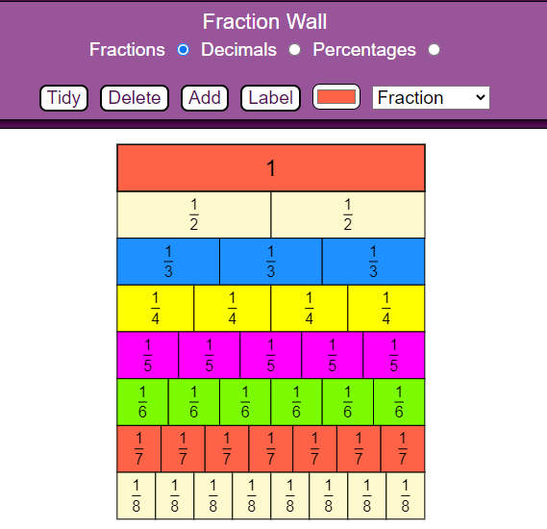
Try: Exploring and working with fraction tiles
OFFLINE:
fraction tiles (paper of plastic)
ONLINE: Fraction Wall
Notes:
FILL-IN-THE-BLANK
Fraction tiles/fraction bars help us add and compare unit fractions:
I can see how many individual unit fractions ________________ one whole.
I can _____________ unit fractions to one another.
I can compare fractions to common benchmark fractions, like ½ and ¼ and ¾
I know that each row equals one ________.

Slide 26
Check in: Objectives 1 & 2
¼ | ¾
1. Can you point out which of the fractions above is a unit fraction?
2. Can you state how many of the unit fractions compose the non-unit fraction?
3. Do you understand how fraction bars show us how unit fractions compose bigger fractions?
4. In the flag activity, did you understand the expressions we created that expressed the sum of fractions?
5. Did your expressions for this part of the lesson contain like fractions and have addition operations (+) in them?
Notes:
SELF-ASSESS
Give yourself a point for every statement that’s true for you
1. I can point out which of the fractions above is a unit fraction.
2. I can also say how many of the unit fractions would add together to create the non-unit fraction.
3. I can describe how fraction bars show us how unit fractions compose bigger fractions.
4. I understood the expressions I and my partner created for the flags in the flag activity.
5. My sum expressions have had like fractions and addition operations (+) in them.
My understanding is a ____ out of . 5 .

Slide 27
OBJECTIVES:
#3b Students will be able to show that adding simple unit fractions creates bigger fractions, by labeling and counting on number lines.
“I-Can…” Statements:
I can use number lines to show that unit fractions compose bigger fractions.
Focus on objectives, ask questions

Slide 28
REcall: Using a number line
What do you remember about using a number line?
Given points.
The intervals/segments.
0 4
Moving right to add and left to subtract.
Moving across intervals to add.
0 + 1 + 1 + 1 = 3

Slide 29
Learn: To partition number lines like shapes
How do we get thirds?
…sixths?
Notes:
We partition number lines into equal parts just like we do with shapes. Follow in-class demonstration, adding a box and partitions to create a number line that shows thirds. Then, create sixths.
Note: Students working remotely can use the box and partition lines provided to the left of the slide.

Slide 30
LEARN: To locate fractions as points on a number line
Two parts = halves
Placing the fraction ½ on the number line looks like this:

Slide 31
LEARN: To count and label points on a number line
Six parts = sixths
Where would we place the point 4/6?
Notes:
DIRECTIONS: Use a point to indicate where 4/6 is on the bottom number line.

Slide 32
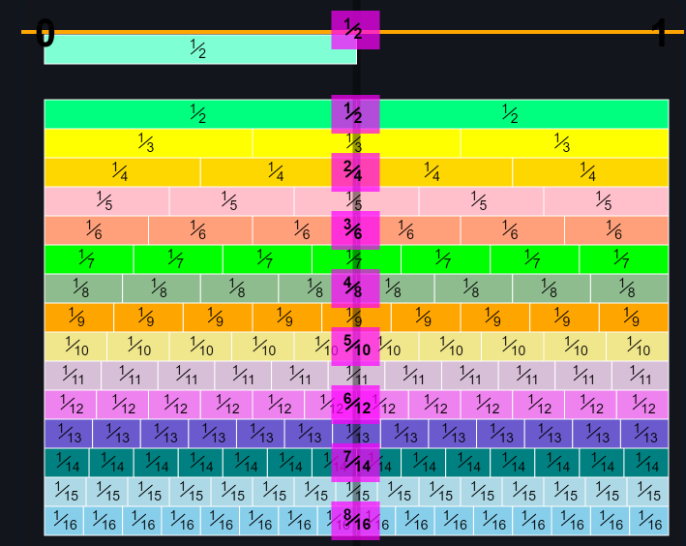
Explore: Using number line diagrams to add unit fractions
INTERACTIVE:
MLC’s Number line app
DISPLAY:
MathsisFun Number Line
Notes:
Notes on fraction tiles:
Tiles are added to each other to create new fractions.
The right edge of each tile is where the “point” on the number line would fall that represents the total of those tiles
We add units from left to right as we count with fractional units, just like with whole numbers.

Slide 33
Create: Number line diagrams by adding unit fractions
MAKE A COPY
Notes:
Get, or make, a copy of the Jamboard provided. Work with a partner to create original number lines.

Slide 34
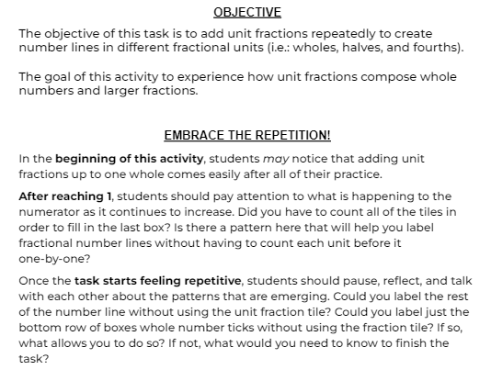

Slide 35
Notes:
Exploration slide provided in attached Google Slides file, to help students use their number lines and focus on what the numbers in their lines mean.
Note: students will have to cut out at least one set of number line strips in order to complete some of these tasks.

Slide 36
Discuss: Number line diagrams by adding unit fractions
Think of patterns you saw, vocabulary words we’ve learned, or anything else we’ve discussed so far that came up during this task:
What did you notice RIGHT AWAY?
What did you notice AFTER A WHILE?
What did your partner help you to see?
DID THIS TASK MAKE YOU SAY, “I WONDER IF/HOW ___________________________________” (ABOUT NUMBER LINES)?
Notes:
Share what you noticed…
… right away.
… after a while.
… once your partner pointed it out.

Slide 37
Check for understanding: Using a number line
Can you express a fraction using a number line diagram?
Can you count in different fractional units using a number line diagram?
Can you say what unit this fraction line is segmented into?
Can you label its tick marks?
Rate your own understanding. Thumbs up?
Notes:
Do you have more thumbs UP (answered yes) or DOWN (answered no)?
👍 👎 Can you count in different fractional units using a number line?
👍 👎 Can you say what unit this fraction line is segmented into?
👍 👎 Can you label its tick marks?

Slide 38
Discuss: How is this like adding fractions on a number line?
Notes:
Tick marks that differ in size indicate different _______________ _________, just as the tick marks on the number lines did. The larger tick here between the whole numbers marks the ____________. We see that there are ten-tenths between 2 and 3 cm as well as two-halves. The centimeter can be partitioned into __________ millimeters. A millimeter is one- _________ of a centimeter.

Slide 39
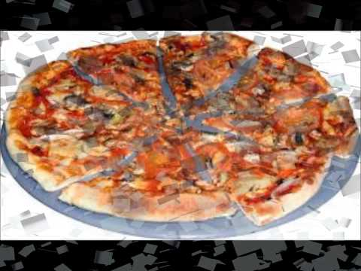
Review: Fraction Feud
Notes:
Images + timestamps:
0:08 bread slices
0:15 quarter-pounder sandwich
0:21 Google cake
0:28 February calendar
0:34 chocolate bar
0:41 cards
0:47 clock tower
0:55 eggs
1:01 ferris wheel
1:07 flower
1:13 gas prices
1:20 mile markers
1:27 kittens
1:33 styrofoam plate
1:40 measuring cups
1:46 measuring spoons
1:53 flag
1:59 piggy bank
2:06 moon
2:12 orange slices
2:19 paper plane
2:25 piano keys
2:31 pizza
2:39 Platform 9 ¾
2:46 dog and puppies
2:51 tires
2:58 Skittles
3:04 stairs
3:11 sushi
3:18 toilet paper
3:23 towels
3:32 diced vegetables
3:38 glass of water
3:43 watermelon

Slide 40
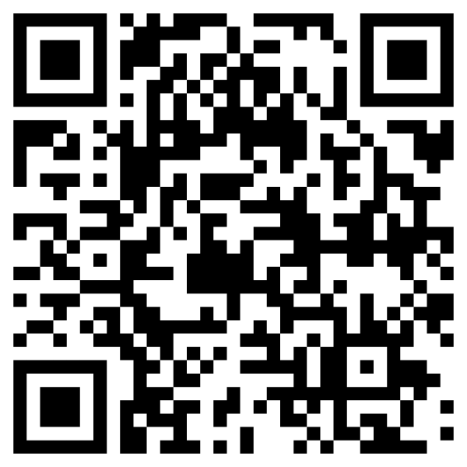
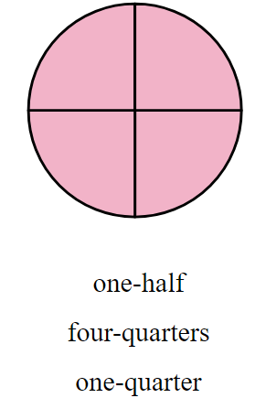
Independent work: Adding Unit Fractions
Objective statement #2: I can add unit fractions to create bigger fractions.
How to do it: Each link/QR code will take you to a different set of problems. Answer questions until you feel that you have mastered the concept. If you struggle at first, keep trying until you get 3 in a row correct.
QR | HYPER-LINK | PREVIEW | STANDARD
 | NAMING FRACTIONS https://www.commoncoresheets.com/naming-fractions/483/oat |  | 2.NF.1 2.NF.3
Notes:
NAMING FRACTIONS
Total # of problems attempted: ____
# Correct on 1st try: ____
# Correct on 2nd try: ____
Which problems challenged me the most? Draw or write them below:
ADDING PARTS
Total # of problems attempted: ____
# Correct on 1st try: ____
# Correct on 2nd try: ____
Which shapes challenged me the most? Draw or write them below:
ADDING UNIT FRACTIONS
Total # of problems attempted: ____
# Correct on 1st try: ____
# Correct on 2nd try: ____
Which shapes challenged me the most? Draw or write them below:

Slide 41
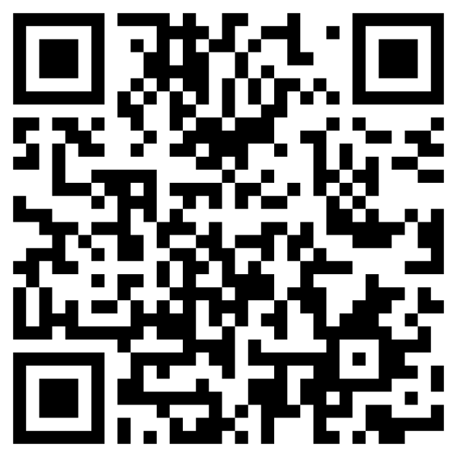
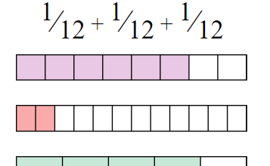
Independent work: Adding Unit Fractions
Objective statement #2: I can add unit fractions to create bigger fractions.
How to do it: Each link/QR code will take you to a different set of problems. Answer questions until you feel that you have mastered the concept. If you struggle at first, keep trying until you get 3 in a row correct.
QR | HYPER-LINK | PREVIEW | STANDARD
 | ADDING PARTS PARTS OF A WHOLE https://www.commoncoresheets.com/adding-parts-of-a-whole/410/oat |  | 2.NF.1
Notes:
ADDING PARTS OF A WHOLE
Total # of problems attempted: ____
# Correct on 1st try: ____
# Correct on 2nd try: ____
Which problems challenged me the most? Draw or write them below:
ADDING PARTS
Total # of problems attempted: ____
# Correct on 1st try: ____
# Correct on 2nd try: ____
Which shapes challenged me the most? Draw or write them below:

Slide 42
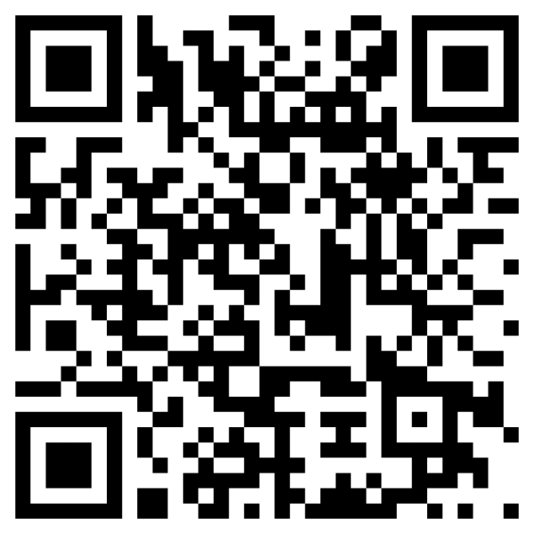
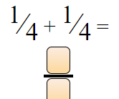
Independent work: Adding Unit Fractions
Objective statement #2: I can add unit fractions to create bigger fractions.
How to do it: Each link/QR code will take you to a different set of problems. Answer questions until you feel that you have mastered the concept. If you struggle at first, keep trying until you get 3 in a row correct.
QR | HYPER-LINK | PREVIEW | STANDARD
 | ADDING UNIT FRACTIONS https://www.commoncoresheets.com/adding-unit-fractions/411/oat |  | 2.NF.1
Notes:
ADDING UNIT FRACTIONS
Total # of problems attempted: ____
# Correct on 1st try: ____
# Correct on 2nd try: ____
Which problems challenged me the most? Draw or write them below:

Slide 43
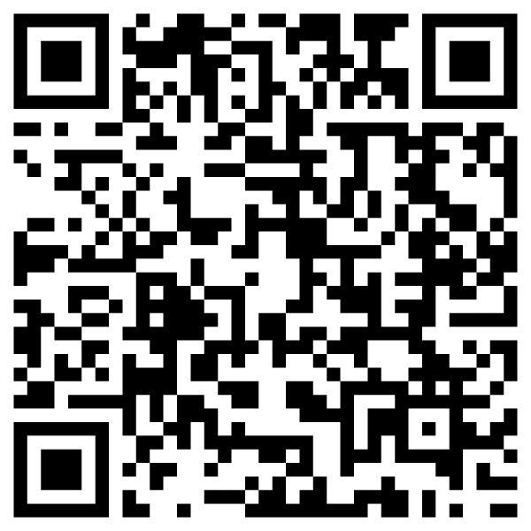
Independent work: Number lines
Objective statement #3: I can label a number line.
How to do it: Each link/QR code will take you to a different set of problems. Answer questions until you feel that you have mastered the concept. If you struggle at first, keep trying until you get 3 in a row correct.
QR | HYPER-LINK | PREVIEW | STANDARDS
 | DETERMINING THE VALUE https://www.commoncoresheets.com/determining-fraction-value-on-a-number-line/485/oat |  | 2.NF.1
Notes:
DETERMINING THE VALUE
Total # of problems attempted: ____
# Correct on 1st try: ____
# Correct on 2nd try: ____
Which problems challenged me the most? Draw or write them below:

Slide 44
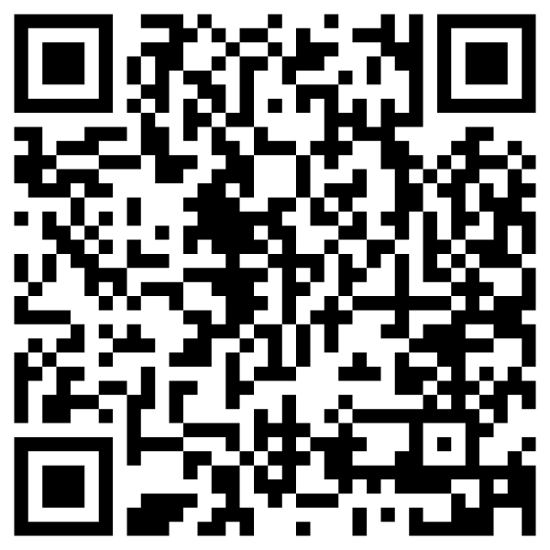
Independent work: Number lines
Objective statement #3: I can label a number line.
How to do it: Each link/QR code will take you to a different set of problems. Answer questions until you feel that you have mastered the concept. If you struggle at first, keep trying until you get 3 in a row correct.
QR | HYPER-LINK | PREVIEW | STANDARDS
 | FINDING FRACTIONS ON NUMBER LINE https://www.commoncoresheets.com/identifying-fraction-location-on-a-number-line/463/oat |  | 2.NF.2
Notes:
FINDING FRACTIONS ON NUMBER LINE
Total # of problems attempted: ____
# Correct on 1st try: ____
# Correct on 2nd try: ____
Which problems challenged me the most? Draw or write them below:

Slide 45
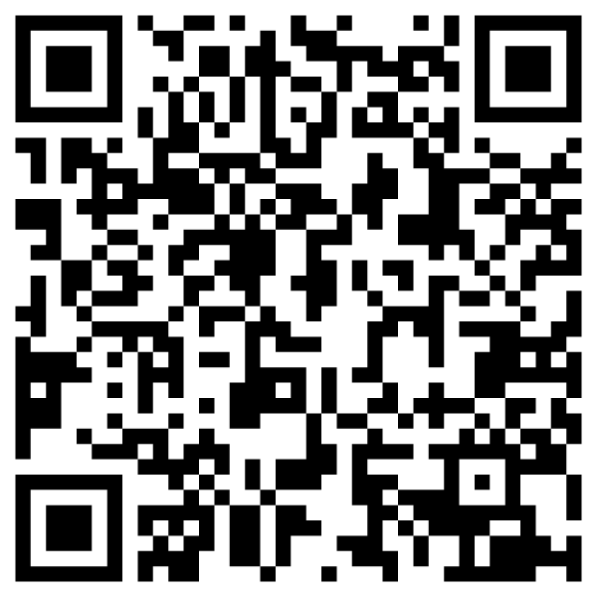
Independent work: Number lines
Objective statement #3: I can label a number line.
How to do it: Each link/QR code will take you to a different set of problems. Answer questions until you feel that you have mastered the concept. If you struggle at first, keep trying until you get 3 in a row correct.
QR | HYPER-LINK | PREVIEW | STANDARDS
 | FINDING FRACTIONS #2 https://www.commoncoresheets.com/identifying-improper-fraction-location-on-a-number-line/466/oat |  | 2.NF.3
Notes:
FIND FRACTIONS (ON NUMBER LINE) #2
Total # of problems attempted: ____
# Correct on 1st try: ____
# Correct on 2nd try: ____
Which problems challenged me the most? Draw or write them below:

Slide 46
Extra challenge: Express the fractions of a partitioned shape
The Bi-Pride flag has three colors that were chosen and sized specifically to represent a spectrum of people who are attracted to people of the same and opposite sexes. The pink stripe, which symbolizes same sex attraction, and the blue stripe, which symbolizes opposite sex attraction, are the same size as one another. The part where the blue and pink “overlap” in the middle, the purple, is exactly one-half the size of the other colors.
Notes:
The area of the blue part = the area of the pink part
The area of blue is two times the area of purple
The area of pink is also two times the area of purple

Slide 47
Extra challenge: Express the fractions of a partitioned shape
________
+ ______
+ ______
___ + ___ + ___ + ___ + ___
___ + ___ + ___

Slide 48
Think about how this value is being expressed
We see the fraction model change. Where do we see change?
What stays the same?
What do you think about the operations we see at the end?

