Slide 1


INTRO TO FRACTIONS
Lesson 2: Composing Fractions
INSTRUCTOR’S SLIDES

Slide 2
Lesson 2 Content Standards
IL ABE/ASE Math Standards
2.NF.1 Understand a fraction 1/𝑏 as the quantity formed by 1 part when a whole is partitioned into b equal parts; understand a fraction 𝑎/𝑏 as the quantity formed by a parts of size 1/𝑏.
2.NF.2 Understand a fraction as a number on the number line; represent fractions on a number line diagram.
a. Represent a fraction 1/𝑏 on a number line diagram by defining the interval from 0 to 1 as the whole and partitioning it into b equal parts. Recognize that each part has size 1/𝑏 and that the endpoint of the part based at 0 locates the number 1/𝑏 on the number line.
b. Represent a fraction 𝑎/𝑏 on a number line diagram by marking off a lengths 1/𝑏 from 0. Recognize that the resulting interval has size 𝑎/𝑏 and that its endpoint locates the number 1/𝑏 on the number line.
2.NF.3 Explain equivalence of fractions in special cases, and compare fractions by reasoning about their size.
c. Express whole numbers as fractions, and recognize fractions that are equivalent to whole numbers.
3.NF.3 Understand a fraction 𝑎/𝑏 with a > 1 as a sum of fractions 1/𝑏:
a. Understand addition and subtraction of fractions as joining and separating parts referring to the same whole.
b. Decompose a fraction into a sum of fractions with the same denominator in more than one way, recording each decomposition by an equation. Justify decompositions by using a visual fraction model.
Targeted SMPs: 5, 7, 8

Slide 3

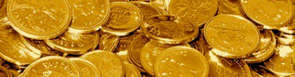
Slide deck contents
RED
PINK
ORANGE
YELLOW
GREEN
BLUE
INDIGO
PURPLE
GOLD
Recall: Composing Units
Videos & Practice:
Goals & Objectives
Lesson: Fractions Compose Whole and Non-whole Numbers
Discussion & Modeling: Tape Diagrams, Number Lines
Activity: Paired Problem-Solving
Independent Task: What does your flag express?
Post-Test: Targeted Exercises
Debate: Comparing expressions

Slide 4
learn: Why is adding unit fractions important?
Unit fractions are the cornerstone of all numbers in our rational number system and the key to understanding the parts of the number system you and I will work with most on a daily basis.
rational number: a number expression in the form a/b, any number that can be written as a ratio (or fraction) of two integers
Fun fraction fact:
All rational numbers, both whole and non-whole, can be created using sums of unit fractions.
Take notes, ask questions

Slide 5
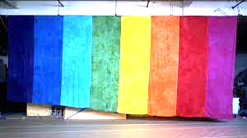
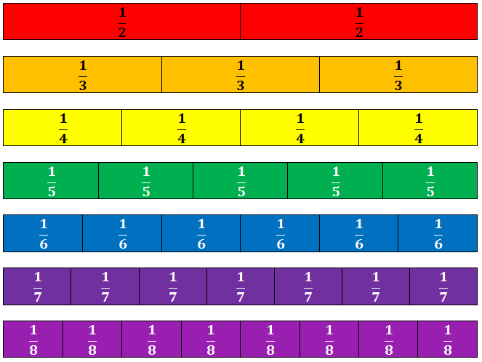
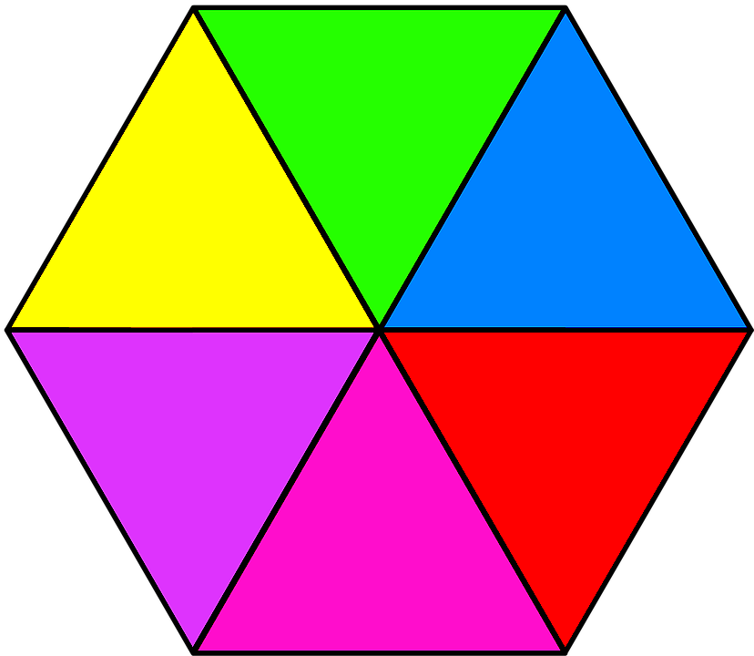
INTRO TO FRACTIONS
Lesson 2:
Composing Fractions
course name
class name
date

Slide 6
Pre-required learning
Before starting this lesson, students should be able to…
Find whole numbers on a number line
Decode a visual fraction model
Count fluently up to 20, from any number 0-19
SKILL / KNOWLEDGE | LESSON | PRACTICE
Use a number line | Finding number line values | Common Core Sheets: Find Integers on a Numberline
Know that fractions can be modeled with partitioned shapes | Fractions are parts | Name the fraction worksheet
3. Add up to 20 | N/A | N/A
Review these concepts before continuing

Slide 7
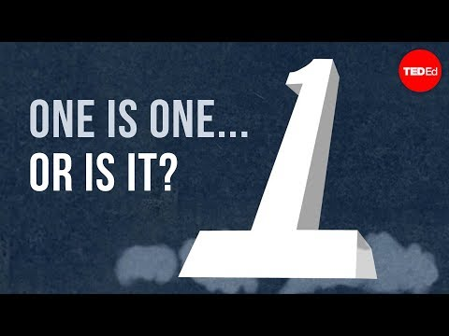

Recall: Composing units
Vocab terms:
partition - the process of dividing something into parts
compose - the process of adding together to make a new unit
Remember composing
Notes:
Review “The last fraction lesson concerned units and the concept of 1. Something else we learned about units was that you could compose and partition all units. Do we remember what partition means?” (To cut into equal parts) Click to reveal definition.
Explain “Now, we’re going to focus on the word compose.” Play video clip.
Discuss with students the definition and examples for the word compose, as seen in the video, then click to reveal the word’s definition.
Ask “As we move on and learn how to add fractions, how might the concepts of partitioning and composing be relevant to us?”

Slide 8
Recall: Composing units
1 + 1 + 1 + 1 + 1 + 1 + 1 + 1 + 1 + 1 = 10
Ten (10) ones becomes a ten-rod (bundling)
Or…
A ten-rod can become ten units (unbundling)
=
=
Remember composing and decomposing
Notes:
Remind students that they explored units last time when learning about fractions. Ask “Where do we see ‘one’ in these blocks?” Students should point out every blue unit is one. Point out that the tenrod represents one ten as well.
Recall composing and decomposing when learning about place value. Ask students what they remember about composing/bundling. Students may remember that bundling 10 units makes one ten/tenrod (composing, or recomposing). Re-state: “Right, so we put together a sum of units until we created another unit.” Click to reveal text.
Ask students what they remember about composing/bundling. One ten/tenrod makes 10 units (decomposing). Re-state: “We broke apart one unit into equal amounts of a smaller unit”

Slide 9

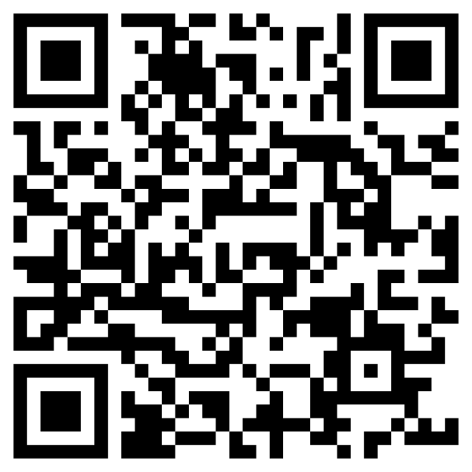
Notice: What’s happening? What do you notice?
Video
Think: What do you already know? What’s new?
Notes:
Play video, then ask students to discuss what they saw. Ask how it relates to the concepts being reviewed (i.e.: composing and decomposing/partitioning)
Potential conversation starters:
What is happening here? What is changing? How?
What looks familiar to you? What was new, if anything?

Slide 10

INTRO: Composing / decomposing with fractions
composed
decomposed
¼ + ¼ + ¼ + ¼
Take notes, ask questions
Notes:
Explain “Composing is the process of putting things together to make something new, whereas decomposing numbers is taking the smaller components apart and viewing them next to each other. Think of the difference as puzzle pieces. A whole puzzle is composed of hundreds or thousands of pieces. When decomposed, each piece is viewed as its own part. The puzzle pieces never go away, because we’re not subtracting. But we are taking apart the whole puzzle to reveal the many smaller pieces.”
Click to separate parts, reveal expression.
Explain: “If we have a whole partitioned into four parts, we have fourths. If we take each of those parts, we have one-fourth plus one-fourth plus one-fourth plus one-fourth. Creating written expressions like this one will be one focus of this lesson as we decompose, or partition, whole units into a series of smaller fractional units.”

Slide 11
Overview of lesson 2: What am I going to learn?
Language Objectives - I will be able to…
Content Objectives - I will be able to…
Partition a whole number or fraction into a sum of like fractions, including repeated unit fractions
Combine unit fractions in expressions to create like fractions
Show that adding simple* unit fractions creates bigger fractions
  By counting and composing fraction tiles
  By labeling and counting on number lines
Discuss and describe addition of fractions using vocabulary terms: partition, compose, decompose, sum, like fractions, expression, equal
Know the objectives
Notes:
Introduce students to objectives and goals for the lesson, relating back to review concepts and to lesson 1 when possible. Explain that, for this lesson, simple fractions have denominators of 1 to 10.
Note about modeling: Students have previously used fraction-modeling software and pen/paper to partition circles and rectangles. This lesson will build off of those models to include digital and tangible tools, specifically fraction tiles/bars and number lines.

Slide 12
Goals of this lesson…
Tasks of this lesson…
Overview of lesson 2: What will learning look like?
Recognize that all fractions are sums of unit fractions
Understand that rational numbers can be expressed as fractions
Understand that there are many ways to break apart numbers
Explore fractions using models: physical/digital fraction bars and number lines
Paired practice creating expressions
Create measuring strips
End goals for this lesson

Slide 13
OBJECTIVES:
#1: Students will be able to partition a whole number or a fraction into a sum of like fractions, including only unit fractions.
#2: Students will be able to create like fractions by adding unit fractions.
“I-Can…” Statements:
I can partition a number into a sum of unit fractions.
I can create like fractions.
Focus on objectives, ask questions

Slide 14
Learn: Fractions are sums of unit fractions
1 student + 1 student =
1 inch + 1 inch =
1 hundred + 1 hundred =
1 part + 1 part =
1/4 + 1/4 =
2 students
2 inches
2 hundred[s]
2 parts
2 fourths = 2/4
VOCABULARY:
Fractions that have the same fractional unit are called like fractions.
Ask and answer questions
Notes:
Explain “It’s easiest to understand adding fractions once you understand that adding fractions is much like adding other numbers with units. Listen to the language we use when we add units.”
Use leading questions to get students to hear the pattern of adding quantities in specified units.
Students should specify the terms they’re adding in their responses (i.e.: two inches, two students, so forth). Generate other examples if necessary, until students reflexively answer with units.
Ask: “What is one student plus one student? (Two students) Click for answer.
What do we get when you add one inch and one inch? (Two inches) Click for answer.
One hundred plus one hundred? (Two hundred[s]) Click for answer.
One part plus one part? (Two parts) Click for answer.
What is one-fourth plus one-fourth? (Two-fourths) Click for answer.
Explain “Remember that a fraction’s denominator is the name of the fraction (i.e.: fractional units) and the numerators are their numbers. We don’t add names; we add numbers. But we can only add two numbers together if they are in the same unit. Fractions that are in the same fractional unit are called like fractions. Click: to reveal definition.

Slide 15

Learn: Fractions are sums of unit fractions
VOCABULARY:
In math, an expression is any number or numbers with operations connecting them.
Conceptual expressions
Written expressions
¼
+ ¼
+ ¼
Take notes, ask questions
Notes:
Remind students that expressions can take on many forms in math. This lesson focuses on matching the modeling (aka: the visual) to the written (aka: the numbers and operations). Talk through partitioning a shape and shading in units to represent a fraction. Click to show the animation of partitioning/shading the square.
Explain “We see here three expressions that represent the same value: three-fourths. In each expression, we could say we are partitioning (or decomposing) a whole unit into four equal parts and adding together three of those parts. Notice that the second expression is showing the unit fractions that compose the expression of ¾. When partitioning a fraction into a sum of its unit fractions, remember that you are only taking apart that top number, the numerator. If we add 1 three times, we get three. Likewise, if we add one-fourth three times, we get three fourths.”
Check for understanding before moving on.

Slide 16
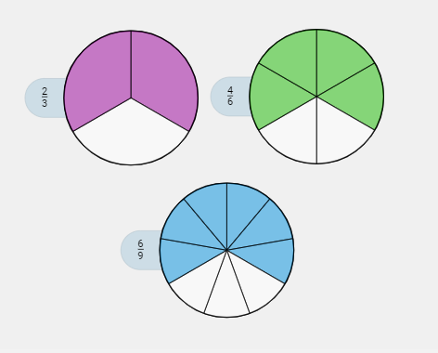
Try: To express fractions as sums of unit fractions
How could you express a sum of unit fractions that is depicted by each model?
⅓ + ⅓
⅙ + ⅙ + ⅙ + ⅙
1/9 + 1/9 + 1/9 + 1/9 + 1/9 + 1/9
1) Determine the fractional unit, based on how the fraction is partitioned.
2) Count the number of parts shaded.
3) Create a sum of unit fractions to represent the shaded parts of the circles.
Talk through the steps, take notes
Notes:
Explain to students that they are going to practice what we’ve learned by decomposing these fractions to sums of unit fractions.
Think aloud how to interpret the 2/3 circle: “For the first circle, I see we have thirds, and two of those thirds are filled in. This circle represents 2/3 and its expression can be broken down (or decomposed) into 1/3 + 1/3.” Click to reveal expression.
Direct students to talk you through creating expressions for the 4/6 and 6/9, revealing other circles and expressions as they’re covered:
2nd click: 2nd expression appears, third fraction appears
3rd click: 3rd expression appears

Slide 17
Try: To express fractions as sum of unit fractions
Learning Check!
Write expressions
Notes:
Explain to students that they are going to be presented with three area models, for which they will write the fraction represented and a sum of unit fractions for each.
Click for reveal.

Slide 18
Try: To express fractions as sum of unit fractions
Write expressions
Notes:
Click for second shape

Slide 19
Try: To express fractions as sum of unit fractions
Write expressions
Notes:
Click to reveal second fraction.
Ask students how they did and what questions they have, before checking answers

Slide 20
ChecK Your Answers
Answers:
1/2; ½
3/6; ⅙ + ⅙ + ⅙
2/3; ⅓ + ⅓
4/6; ⅙ + ⅙ + ⅙ + ⅙
1/3; ⅓
2/6; ⅙ + ⅙
Self-assess, ask questions
Notes:
Click to reveal answers.
Ask students what they notice about the figures.
Ask students how they did and what questions they have.

Slide 21


Learn: To express the parts of a shape as a sum of fractions.
How many equal parts does this Rainbow Pride flag have? What is the fractional unit?
What is an expression that shows the sum of each part?
+
+
+
+
+
Discuss flag’s composition
Notes:
Explain to students that most flags are created with colors whose proportions can be represented with fractions; this is especially true with LGBTQ+-oriented flags, or Pride Flags, but is also true of many national flags.
Use the Pride flag as an example to walk students through decomposing a whole unit into a sum of repeated unit fractions.
Remind students the first step is to identify the fractional unit.
Ask “How do we identify the fractional unit?” (Count how many equal parts the whole has been partitioned into)
1st Click: Reveals first questions.
Repeat questions. (Six parts, sixths)
2nd Click: Reveals last question.
Repeat/clarify question. Let students give some answers and input.
3rd Click: Expression appears, followed by color bands
Ask, “How can we know that this expression completely summarizes the parts of the flag? In other words, when doing this on your own, how can you check your work to be sure you’ve covering all of the parts?” Students might count 6 parts or remember that 6 sixths is a whole.

Slide 22



Practice: Expressing the parts of a shape as a sum of fractions.
Ukraine
Armenia
Mauritius
1/2 + 1/2
1/3 + 1/3 + 1/3
1/4 + 1/4 + 1/4+ 1/4
Work in pairs to create expressions
Notes:
Direct students to work with a partner to recreate these flags in their note-taking guide and to create an expression of the sum of fractions for each flag. Students can use pencil to outline the colors and either shade in the parts (with highlighter, colored pens/pencils, etc.) or label the colors of each part.
Review as a class. Click to reveal answers.

Slide 23
Remember: Fractions are sums of like fractions.
4
¼
+ ¼
+ ¼
+ ¼
4
4
2/4
+ ¼
+ ¼
4
Take notes, ask questions
Notes:
Remind students that like fractions are any fractions with the same denominator.
Say “Let’s talk about other ways to decompose a number into a sum of fractions. We know that adding 1 four times gets four. What other numbers can we add together to get 4?” (2+1+1; 2+2; 1+3; etc.). Click to reveal second possibility for decomposing 4/4.
Explain “So, we can decompose numbers in many ways, not just by adding 1 unit at a time. Just like how we can decompose all other numbers in many ways, we can find multiple ways to decompose fractions as well.”

Slide 24



Practice: Expressing the parts of a shape as a sum of fractions.
Bhutan
Austria
Uganda
1/2 + 1/2
1/3 + 1/3 + 1/3
1/6 + 1/6 + 1/6 + 1/6 + 1/6 + 1/6
2/3 + 1/3
2/6 + 2/6 + 2/6
Work in pairs to create expressions
Notes:
Encourage students to combine fractional units of the same color for these expressions if possible.
Allow students to write their answers.
Review all three as a class. Click to reveal first set of answers.
Ask students if they got anything else besides unit fractions. Click again to reveal an alternative expression.
Explain “You may notice how the colors on some flags are repeated, but the parts are easy to distinguish because they are partitioned into amounts that are equal to the others parts of the flag. So, Austria’s flag is 2/3 red, but we can easily see it as 1/3 and 1/3 because it has a white stripe in the middle that is also 1/3. Our eyes are trained now to see three equal parts and think, ‘Those are thirds.’ ”

Slide 25
Practice: Expressing the parts of a shape as a sum of fractions.
Work in pairs to create expressions
Notes:
Direct students to work with a neighbor to discuss potential expressions representing the shaded parts of these shapes.
Allow about three to five minutes to discuss.
As a class, review various expressions for each shape.

Slide 26
OBJECTIVES:
#3a Students will be able to show that adding simple unit fractions creates bigger fractions, by counting and composing fraction tiles.
“I-Can…” Statements:
I can use fraction tiles to show that unit fractions compose bigger fractions.
Focus on objectives, ask questions

Slide 27
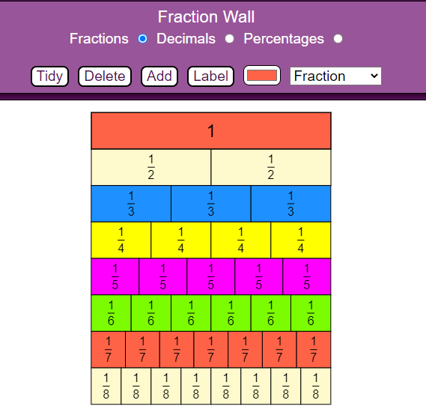
Try: Exploring and working with fraction tiles
OFFLINE:
fraction tiles (paper of plastic)
ONLINE: Fraction Wall
Learn new fraction tools
Notes:
Students should have either tangible manipulatives (plastic or paper fraction tiles) or use the digital Fraction Wall to follow along.
Project MathsBot.com’s fraction wall.
Explain and demonstrate that fraction tiles/fraction bars help us see the addition of unit fractions:
We can see how many individual unit fractions compose one whole.
We can see how big fractions are in comparison to one another (use “stack” feature to compare unit fractions) by laying multiple units side by side
We can compare fractions to our common benchmark fractions, like ½ and ¼ and ¾
Highlight these features of the tools, found in both the offline and online versions:
The unit fractions in each row are shown
Each tile shown is labeled as a unit fraction, colored according to its unit, and laid next to identical tiles.
Each row equates to one whole

Slide 28
Try: Exploring and working with fraction tiles
1/2 + 1/2
1/3 + 1/3 + 1/3
1/4 + 1/4 + 1/4 + 1/4
1/5 + 1/5 + 1/5 + 1/5 + 1/5
1/6 + 1/6 + 1/6 + 1/6 + 1/6 + 1/6
Use fraction tiles to answer
Notes:
Students should have either tangible manipulatives (plastic or paper fraction tiles) or the digital Fraction Wall to follow along.
Explain “Each row of tiles represents a value of 1, demonstrated by the total number of unit fractions needed to make it a whole unit. We can see that two halves make up one whole, for example. We could express 1 whole as a sum of halves as shown here: 1/2 plus 1/2. This expression shows the decomposition of a whole unit by halves.”
Ask “What about thirds? How could we decompose a whole into a sum of thirds? What would that look like?” (“⅓ + ⅓ + ⅓”) Click for answer. Repeat for fourths.
Ask “What patterns are we seeing?” Students should be able to see that the higher the denominator, the more parts in the whole, or something to this effect. Ask students to continue the pattern and guess what fifths and sixths will look like. Click to reveal.
Ask “What are you noticing about these tools?” Allow time for students to discuss what they’re noticing.

Slide 29

Let’s break it down!
Check in: Objectives 1 & 2
¼ | ¾
1. Can you point out which of the fractions above is a unit fraction?
2. Can you state how many of the unit fractions compose the non-unit fraction?
Notes:
Remind students that one of the main objectives so far is to combine or add unit fractions to create like fractions.
Ask students to describe their understanding using a fraction: The total number of parts will be the total number of questions here (5), and the numerator will be the number of questions to which they can answer “yes.”

Slide 30
Check in: Objectives 1 & 2
1. Do you understand how fraction bars show us how unit fractions compose bigger fractions?
2. In the flag activity, did you understand the expressions we created that expressed the sum of fractions?
3. Did your expressions for this part of the lesson contain like fractions and have addition operations (+) in them?
Express your level of understanding.
Notes:
Remind students that another main objective today is to partition, or decompose, numbers into a sum of like fractions.
Note: If there are quite a few responses that are less than 4/5, ask students to indicate (with a finger count) which question is giving them the most trouble. If there is a common outlier, address that concept specifically to mitigate confusion.

Slide 31
OBJECTIVES:
#3b Students will be able to show that adding simple unit fractions creates bigger fractions, by labeling and counting on number lines.
“I-Can…” Statements:
I can use number lines to show that unit fractions compose bigger fractions.
Focus on objectives, ask questions
Notes:
Remind students that they are going to be using number lines for the second half of this lesson and will be recalling their number line skills.

Slide 32
REcall: Using a number line
What do you remember about using a number line?
Given points.
The intervals/segments.
0 4
Moving right to add and left to subtract.
Moving across intervals to add.
0 + 1 + 1 + 1 = 3
Recall number line operations
Notes:
Briefly review number line basics. If students need a demonstration, use this link: https://apps.mathlearningcenter.org/number-line/

Slide 33
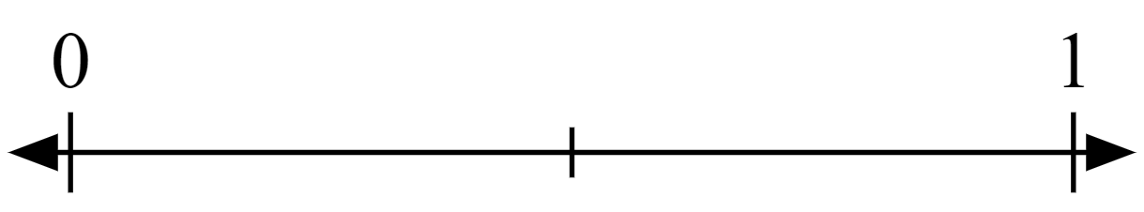
Learn: To partition number lines like shapes
How do we get thirds?
…sixths?
Practice modeling
Notes:
Explain that using a number line for fraction-modeling uses both number line reasoning and the skills learned when partitioning shapes into equal parts. Using the animations provided, compare the process of partitioning a rectangle to partitioning, or segmenting, a number line.
1st click: Reveals blue rectangle, followed by partitions, followed by box disappearing.
2nd click: Text “...sixths?” appears, followed by blue box, followed partitions, followed by blue box disappearing.
Note: Segmenting a whole into a number that is not rooted in two is challenging without the support of software, so this is a chance to have students practice approximating where to place the hash marks when working with thirds and sixths. Encourage students to use fraction tiles as they start partitioning shapes and lines into odd numbers.

Slide 34
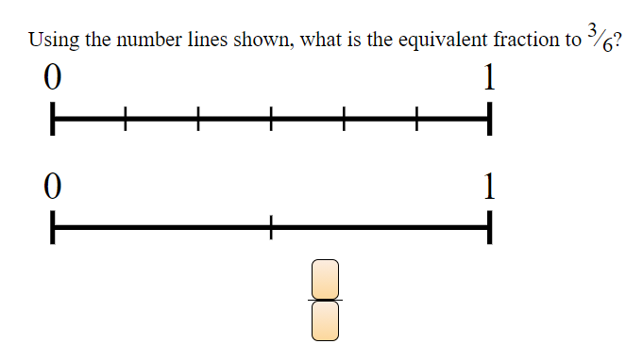
LEARN: To locate fractions as points on a number line
Two parts = halves
Placing the fraction ½ on the number line looks like this:
Practice modeling
Notes:
Explain the fractional unit here and how we know the tick at the halfway point is ½.

Slide 35


LEARN: To count and label points on a number line
Six parts = sixths
Where would we place the point 4/6?
Practice modeling
Notes:
Point out that you are not using a shape anymore and just marking the number line directly.
Explain the fractional unit here, how we know what it is, and how we know what each tick represents. Be sure to use adding language to explain how each point is the result of adding multiple unit fractions.
Click sequence:
1st click: Fractions ⅙ through ⅚ fade in
2nd click: Question in white text fades in
3rd click: Blue dot fades in

Slide 36

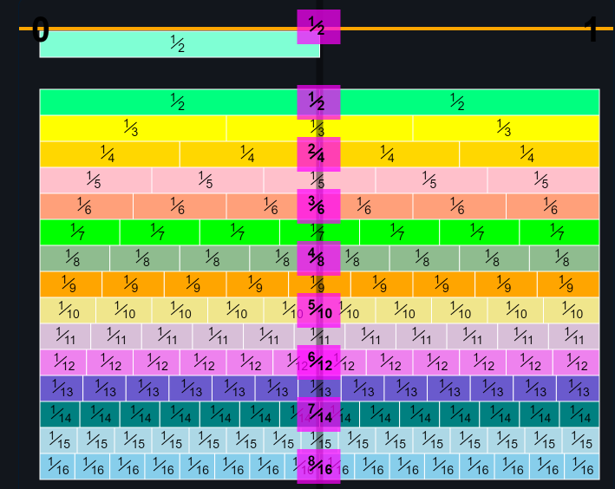
Explore: Using number line diagrams to add unit fractions
INTERACTIVE:
MLC’s Number line app
DISPLAY:
MathsisFun Number Line
Explore fraction tools
Notes:
Display MLC’s Number Line, using fraction-marked ticks of your chosen denomination.
Review number adding on a number line, if necessary.
Show students how every added unit is in the fractional unit represented by the number line. (For example, you should be able to see a ¼ bar being added to itself four times from 0 to 1).
Relate this back to the fraction tiles:
Each tile shown is added to the tiles to its left to create a new fraction
We add units from left to right as we count with fractional units, just like with whole numbers. One-eighth plus one-eighth plus one-eighth is the same as one plus one plus one eighth, OR three-eighths.
The right edge of each tile is where the “point” on the number line would fall that represents the total of the tiles to the left
Display MathsisFun’s number line. “What are you some things you’re noticing when you’re seeing these number lines in front of you? Which of these tools do you think you could use to add unit fractions? Try to use your math language so we can all access your observations.” Allow time for students to discuss.
If students don’t mention it, ask what they’re noticing or supposing about fractions after 1 (or four-fourths). “How do we represent fractions that are greater than a whole?” Allow students to give some input before starting the next activity.

Slide 37
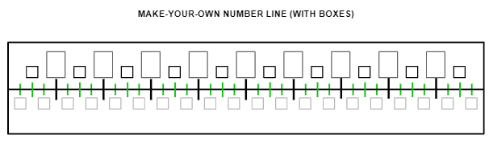
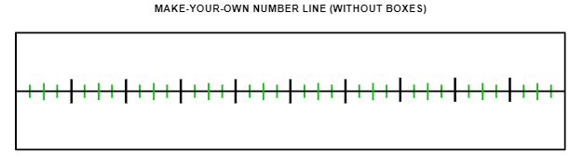
Create: Number line diagrams by adding unit fractions
MAKE A COPY
Explore fraction tools
Notes:
Tell students they are going to see how whole numbers can be represented as fractions. They will do so by using both fraction tiles and number line diagrams.
Pair students for this activity.
This activity is copied in the student guides for students to write down their number lines’ values on paper. Students can use a copy of the Google slides, or they can physically manipulate printed versions of the lines and tiles.

Slide 38
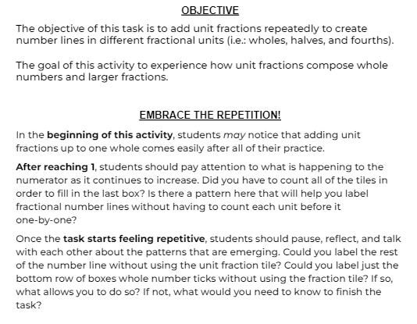
Notes:
Objective and strategy slide provided in attached Google Slides file, to help keep students on task.

Slide 39
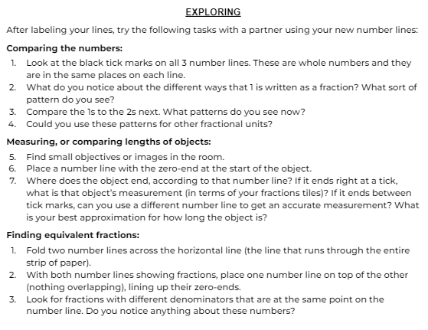
Notes:
Exploration slide provided in attached Google Slides file, to help students use their number lines and focus on what the numbers in their lines mean.
Note: students will have to cut out at least one set of number line strips in order to complete some of these tasks.

Slide 40
Discuss: Number line diagrams by adding unit fractions
Think of patterns you saw, vocabulary words we’ve learned, or anything else we’ve discussed so far that came up during this task:
What did you notice RIGHT AWAY?
What did you notice AFTER A WHILE?
What did your partner help you to see?
DID THIS TASK MAKE YOU SAY, “I WONDER IF/HOW ___________________________________” (ABOUT NUMBER LINES)?
Discuss task experience
Notes:
Prompt reflective discussion with students about the number line tasks. What did they notice, what do they have questions about, etc.

Slide 41
Check for understanding: Using a number line
Learning Check!
Can you express a fraction using a number line diagram?
Can you count multiple unit fractions using a number line diagram?
Can you say what unit this fraction line is segmented into?
Can you label its tick marks?
Rate your own understanding. Thumbs up?
Notes:
Remind students that a main objective is to model the sums of unit fractions, which is what the number line task allowed them to do.
Click to remove banner.
Ask students to consider how comfortable they feel in segmenting a number line and give a discreet thumbs up/down/sideways.

Slide 42
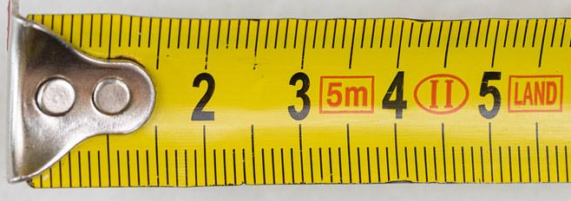
Discuss: How is this like adding fractions on a number line?
Discuss, give and ask for opinions
Notes:
Ask “What about this tool resembles a number line? Do we use it the same as a number line? How so?”
Explain that this measuring tape uses the Metric System, which uses a base-10 number system. One whole is a centimeter here, and each centimeter is divided up into 10 smaller units, which are millimeters. There are 9 marks between each of the centimeters, creating 10 spaces between them. Shown in the picture is the 2 cm mark, then ten ticks for ten millimeters, or tenths, between the 2 and the 3. The tenth tick lands where 3cm is. Click once.
Ask what they think about the larger tick between the whole numbers. Let students give input.
Explain “Different-sized tick marks indicate different fractional units, just as the number line did. The taller tick here is at the halfway point between the whole units. It still marks a partition between the tenths (at the 5/10 mark, specifically), but it also symbolizes a different unit fraction as well: a half. We see that there are ten-tenths between 2 and 3 cm as well as two-halves.” Click to reveal pink half tiles.

Slide 43
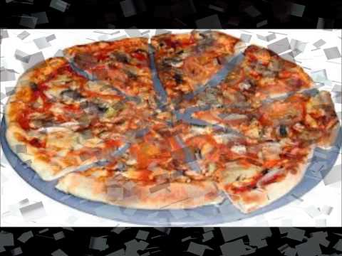
Review: Fraction Feud
Find examples of fractions
Notes:
Divide students up amongst two “families.” Explain that each family will choose one of the images shown in this video to “challenge” the other family. A challenge means that the other family has to explain how the image shown relates to fractions. The challenge is won by the defending family if they can explain (in a complete sentence, using at least one vocabulary term) how the image demonstrates fraction reasoning. If the family is unable to establish a connection, they have lost the challenge. The feud continues until a family loses three challenges or two challenges in a row.
If a lot of students are playing, host two games (so, four families total) simultaneously.
Play video.
Have students discuss their ideas amongst their families. Give about 30 seconds per person in family for discussions.
Images + timestamps:
0:08 bread slices
0:15 Quarter-pounder sandwich
0:21 Google cake
0:28 February calendar
0:34 chocolate bar
0:41 cards
0:47 clock tower
0:55 eggs
1:01 ferris wheel
1:07 flower
1:13 gas prices
1:20 mile markers
1:27 kittens
1:33 styrofoam plate
1:40 measuring cups
1:46 measuring spoons
1:53 flag
1:59 piggy bank
2:06 moon
2:12 orange slices
2:19 paper plane
2:25 piano keys
2:31 pizza
2:39 Platform 9 ¾
2:46 dog and puppies
2:51 tires
2:58 Skittles
3:04 stairs
3:11 sushi
3:18 toilet paper
3:23 towels
3:32 diced vegetables
3:38 glass of water
3:43 watermelon

Slide 44
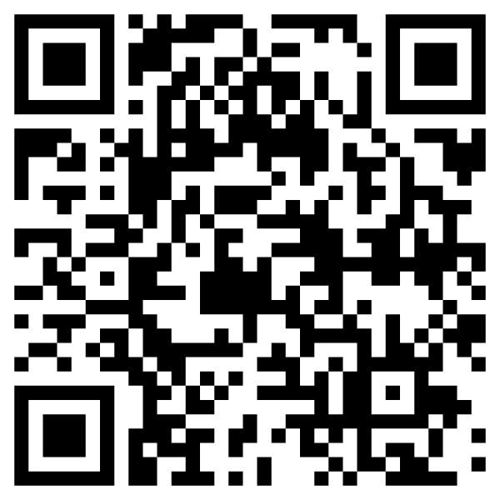
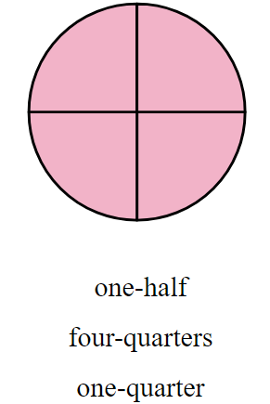
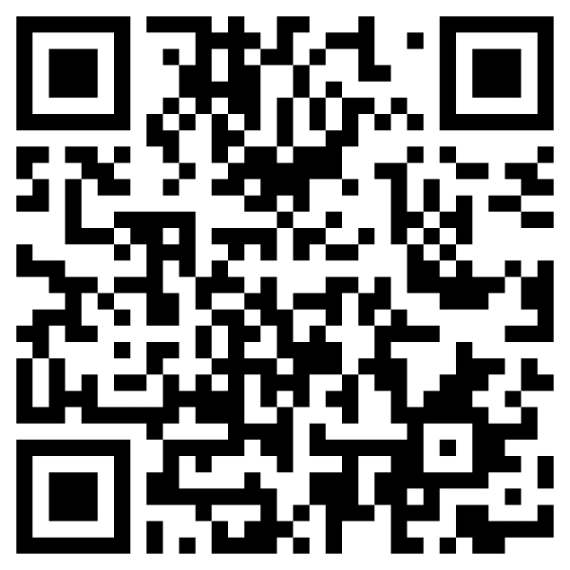
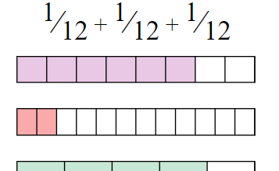

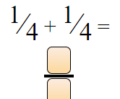
Independent work: Adding Unit Fractions
Objective statement #2: I can add unit fractions to create bigger fractions.
How to do it: Each link/QR code will take you to a different set of problems. Answer questions until you feel that you have mastered the concept. If you struggle at first, keep trying until you get 3 in a row correct.
QR | HYPER-LINK | PREVIEW | STANDARD
 | https://www.commoncoresheets.com/naming-fractions/483/oat |  | 2.NF.1 2.NF.3
 | https://www.commoncoresheets.com/adding-parts-of-a-whole/410/oat |  | 2.NF.1
 | https://www.commoncoresheets.com/adding-unit-fractions/411/oat |  | 2.NF.1

Slide 45
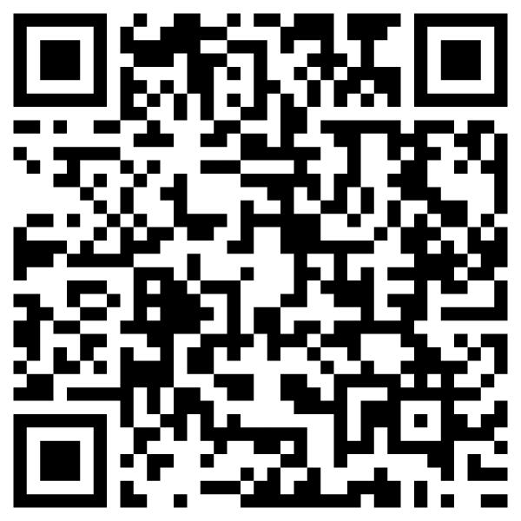
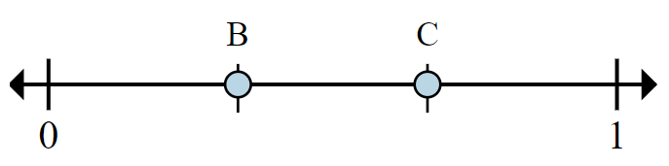
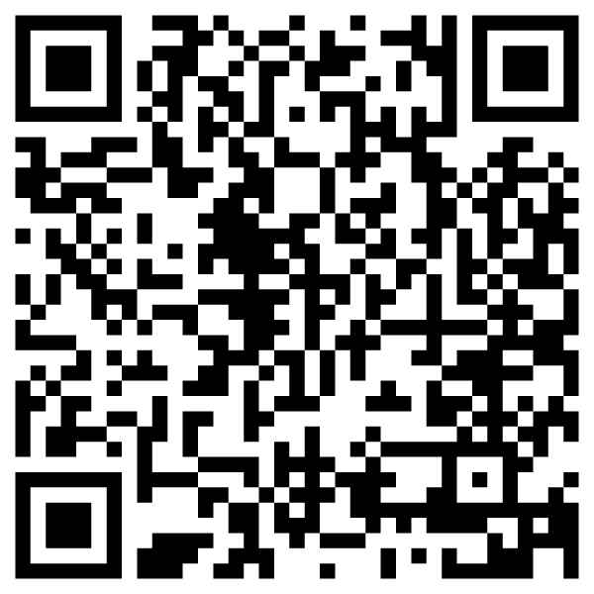

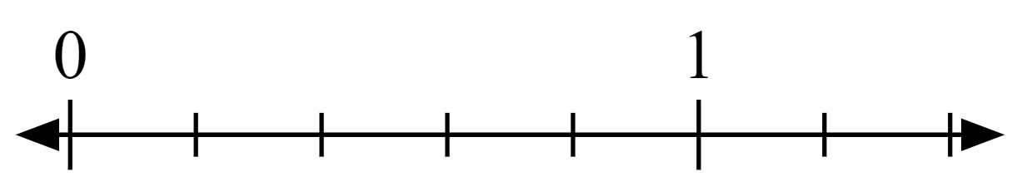
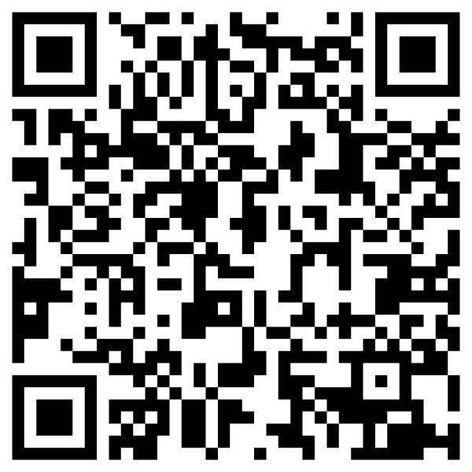

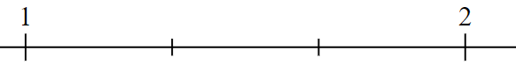
Independent work: Number lines
Objective statement #3b: I can label a number line.
How to do it: Each link/QR code will take you to a different set of problems. Answer questions until you feel that you have mastered the concept. If you struggle at first, keep trying until you get 3 in a row correct.
QR | HYPER-LINK | PREVIEW | STANDARDS
 | https://www.commoncoresheets.com/determining-fraction-value-on-a-number-line/485/oat |  | 2.NF.1
 | https://www.commoncoresheets.com/identifying-fraction-location-on-a-number-line/463/oat |  | 2.NF.2
 | https://www.commoncoresheets.com/identifying-improper-fraction-location-on-a-number-line/466/oat |  | 2.NF.3

Slide 46

Extra challenge: Express the fractions of a partitioned shape
The Bi-Pride flag has three colors that were chosen and sized specifically to represent a spectrum of people who are attracted to people of the same and opposite sexes. The pink stripe, which symbolizes same sex attraction, and the blue stripe, which symbolizes opposite sex attraction, are the same size as each other. The part where the blue and pink “overlap” in the middle, the purple, is exactly one-half the size of the other colors.
Work in pairs to create expressions
Notes:
Say “We’ve discussed adding units of a flag when given the parts. What happens when the parts are given to us in real-life terms instead of math terms? Can we still figure out the math?”
Give directions “The Bisexual Pride flag is the only pride flag that doesn’t follow the tradition of having equally-sized, different-colored stripes placed next to one another. But there is still a fractional unit used to compose this flag. Using the details provided and what you know about unit fractions, you are going to work with a partner to decide what the fraction is for each color of this flag.”
Click to reveal details.

Slide 47
Extra challenge: Express the fractions of a partitioned shape
2 parts
+ 1 part
+ 2 parts
1/5 + 1/5 + 1/5 + 1/5 + 1/5
2/5 + 1/5 + 2/5
Discuss your reasoning
Notes:
Let students work in pairs for about five minutes.
Ask students to share their thoughts and reasoning as they went about figuring out this challenge. “What fractional units did you find? And how did you arrive at your answers?”
Remind students that, to figure out the decomposition of the whole, they should first be looking for the fractional unit. In order to find the unit, we find the number of parts. “For this flag, we are told that the pink is twice as big as the purple stripe. This means that for every one part of purple we have two parts pink. We also know it’s the same for blue. 1st Click: “# parts” text appears.
Ask “What is 2 + 1 + 2?” (Five.) “What fractional unit do we get when we partition a whole into five equal parts?” (Fifths.) Ask “How do we decompose a whole into a sum of unit fractions when the unit is fifths?” (⅕ + ⅕ + ⅕ + ⅕ + ⅕) 2nd Click to reveal flag partitions and expression of unit fractions.
Say “Yes, and what is one-fifth plus one-fifth?” (Two-fifths) 3rd Click to reveal simplified expression.

Slide 48
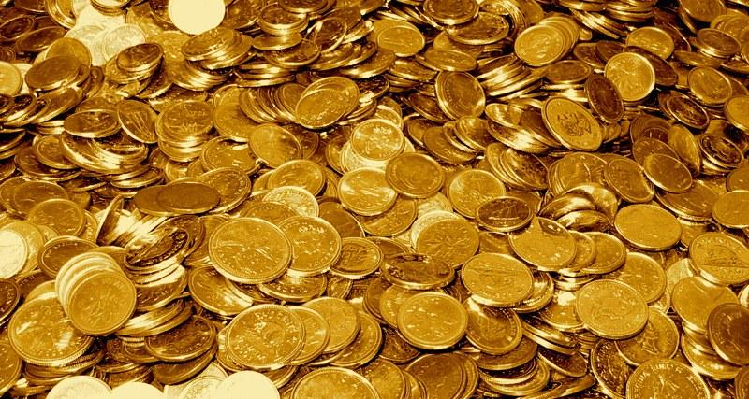
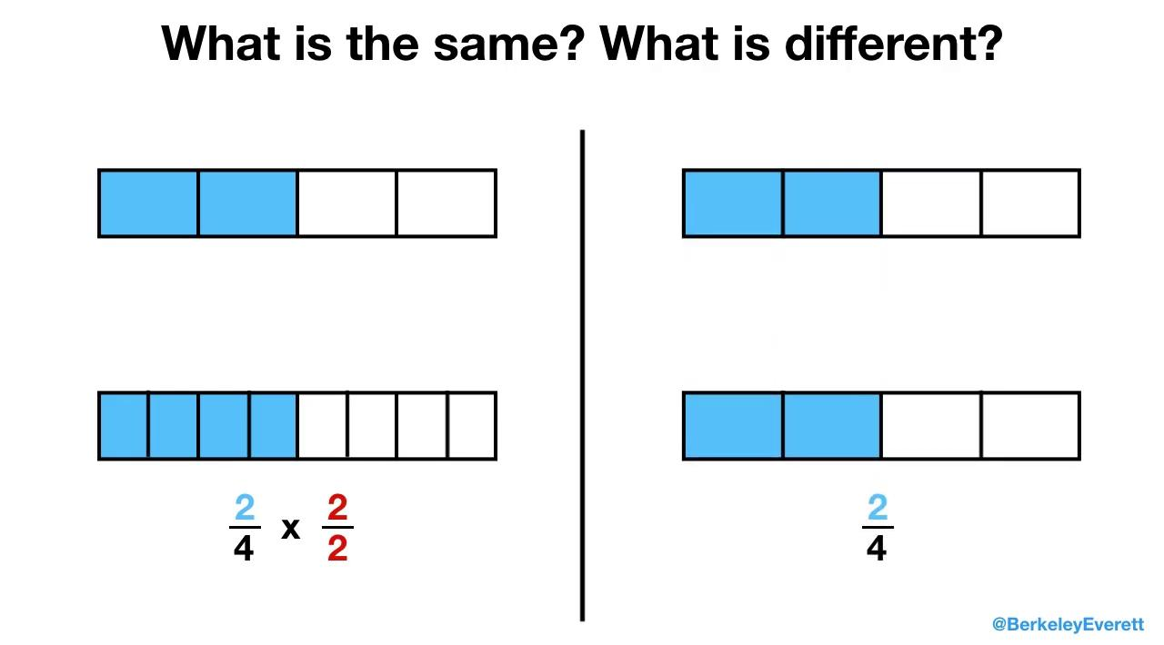
Think about how this value is being expressed
We see the fraction model change. Where do we see change?
What stays the same?
What do you think about the operations we see at the end?
Notes:
Play video, asking students to focus on what stays the same and what changes.
After watching once, generate discussion.
Possible questions:
What are the amounts represented here?
Does the first amount change?
Why or why not? How so?
How does this relate to what we have been learning?

