Slide 1

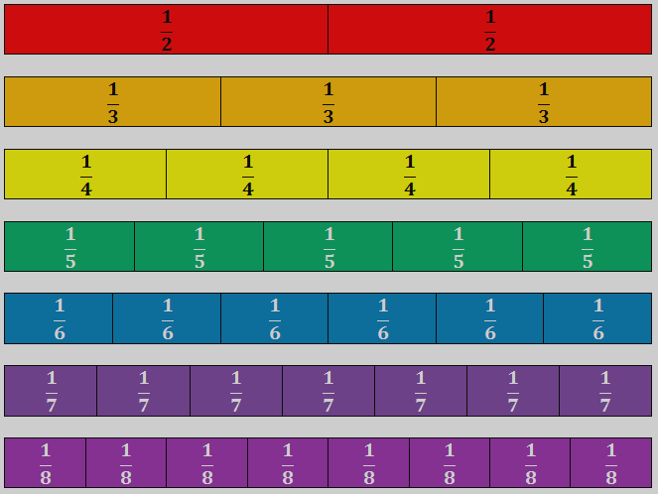
INTRO TO FRACTIONS
Lesson 1:
The Unit Fraction
INSTRUCTOR’S SLIDES
course name
class name
date

Slide 2

Lesson 1: The Unit Fraction
IL ABE/ASE Math Standards - The Unit Fraction
2.G.3 Partition circles and rectangles into two, three, or four equal shares, describe the shares using the words halves, thirds, half of, a third of, etc., and describe the whole as two halves, three thirds, four fourths. Recognize that equal shares of identical wholes need not have the same shape.
2.G.5 - Partition shapes into parts with equal areas. Express the area of each part as a unit fraction of the whole. For example, partition a shape into 4 parts with equal area, and describe the area of each part as 1/4 of the area of the shape.
2.NF.1 Understand a fraction 1/𝑏 as the quantity formed by 1 part when a whole is partitioned into b equal parts; understand a fraction 𝑎/𝑏 as the quantity formed by a parts of size 1/𝑏.
2.NF.3 Explain equivalence of fractions in special cases, and compare fractions by reasoning about their size.
d. Compare two fractions with the same numerator … by reasoning about their sizes
Targeted SMPs: 2, 3, 4

Slide 3
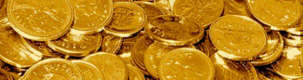
Slides Overview
RED
ORANGE
YELLOW
GREEN
BLUE
INDIGO
PURPLE
PINK
GOLD
Recall: What is a Unit?
Overview | Goals & Objectives
Lesson: Counting and Naming Fractional Units
Discussions | Notice & Wonder | Learning Checks
Discussion: Millionaire Stats | Flag Fractions
Independent Review Activities
Post-Test
Videos & Practice: Comparing Numbers, Shapes
Brainstorm: Burger Wars
Notes:
Eye with a slash = Slide[s] hidden during presentation

Slide 4
INTRO TO FRACTIONS
Lesson 1:
The Unit Fraction
course name
class name
date

Slide 5
Prerequisite learning: Comparing values, shapes, place value
Before starting this lesson, students should be able to…
Identify and create rectangles, squares, and circles
Count to 10 fluently (not included in table)
It would be helpful, for students to be able to…
Compare two whole numbers using “greater than” and “less than”
Know place values of ones and tens and know that ten ones make up a ten
SKILL / KNOWLEDGE | LESSON | PRACTICE
Use less than and greater than symbols: <, > | Video: Inequality symbols (watch until 3m:30s) | Khan Academy: Compare two-digit numbers
Identify and create squares, rectangles, and circles | Video: Identify basic shapes (with examples) Read: Identify Basic Shapes | Khan Academy: Practice Identifying Shapes 1
Know place values of ones and tens | Video: Place Values (Two Digits) | Khan Academy: Practice (three activities total)
Review these concepts if necessary
Notes:
These independent mini-lessons can be assigned to any students who seem to be struggling with certain concepts that students are assumed to have learned.

Slide 6
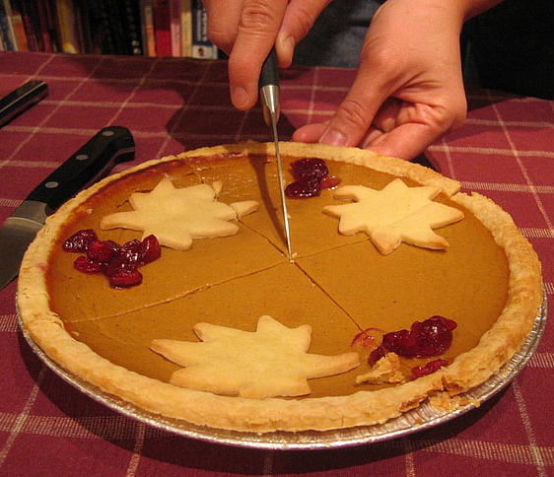
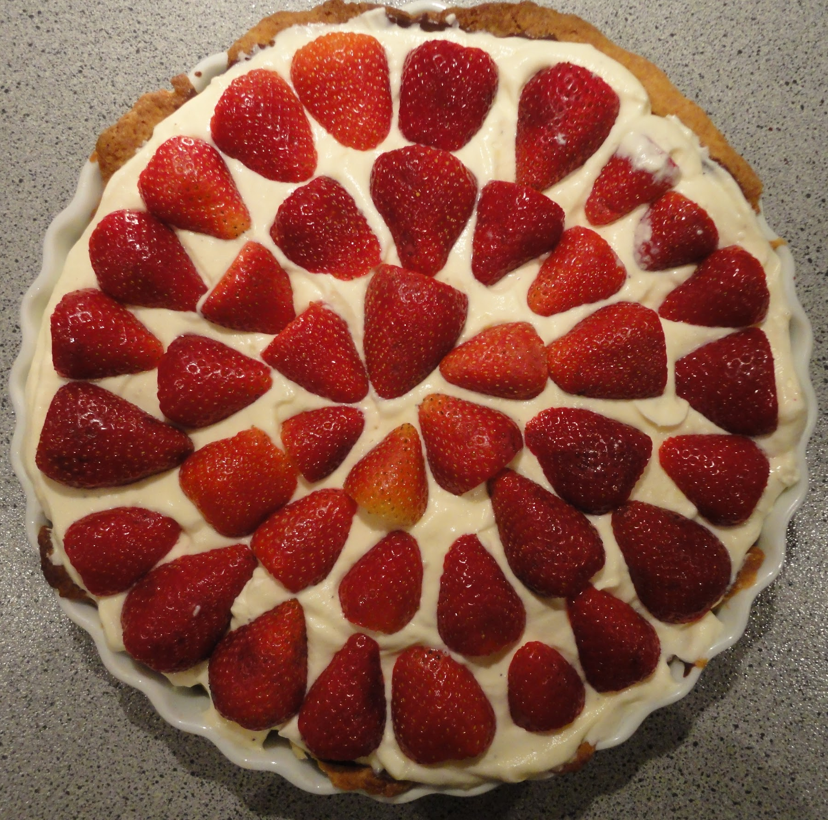
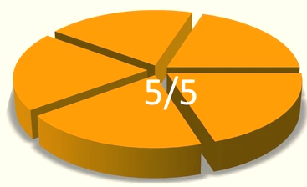

Intro: “A share of the pie” challenge
Draw pies and serving sizes
Notes:
Ask students how often they’re able to slice a pie (or any round food) for other people. Is it difficult to know how large or small to cut the slices? How does one decide the size of the pie slices? Allow students to given input before continuing.
Group students into about groups of 3-6 (Try to have a variety, if possible) and have them complete the Intro challenge provided in their student guides. Tell students they’re going to work together to divide up two pies among the members of the group.
After some time, display images of circles cut into equal parts with a Google image search.
When ready, click to reveal example cuts of fifths and model an explanation for students to follow when presenting their pies. Let students present their creations and explain their reasoning.
After presenting, prompt a discussion reflecting on the approaches they took to sizing their pie pieces: “How did you get started, adjust your approach, know you were heading in the right direction? Which pie was more difficult to divide up, and why? How many people ended up with pie that was smaller than an evenly sliced piece? Larger?

Slide 7
Lesson Overview 1/2: What am I going to learn?
Content Objectives - I will be able to…
Language Objectives - I will be able to…
Count and name the fractional unit of a partitioned shape
Partitioning a shape or number into 1-8 equal parts
Choose a unit fraction that is less than or greater than another, reasoning about the size of the units
Describe and discuss fractions using fraction language: unit [fraction], partition, equal parts, whole, fractional unit, numerator, denominator
Understand the objectives
Notes:
Introduce objectives, goals, and tasks.
Tell students that, for this lesson, they will be partitioning (or, dividing up) many shapes and images into equally sized parts. Briefly explain the items on this list with the class, relating to the opening activity. First objective: “I should be able to look at an image (like the pies you have made, with the equally sized pieces) and know the fractional unit–if it is divided up into fourths, fifths, halves, and so forth. I should also know that when a whole is NOT divided up into equal parts that it is not showing me a fraction.”

Slide 8
Lesson overview 2/2: What does learning look like?
Goals of this lesson…
Tasks of this lesson…
Understand unit fractions (also called fractional units) as numbers
Communicate understanding of unit fractions to others
Interpret and express unit fractions in writing and with models/shapes
Create, discuss, and label fraction models
Problem-solve in pairs, using knowledge of unit fractions
Use modeling and reasoning in a mock workplace situation
Understand the objectives
Notes:
(Continued) Introduce objectives, goals, and tasks.
Tell students that they are going to be communicating a lot for this lesson–learning and using a lot of fraction language to communicate their own thoughts as well as considering what others are saying. As well as speaking, they will be modeling fractions to communicate as well.

Slide 9
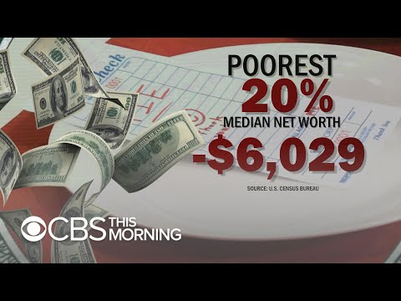
Intro: “A share of the pie” challenge
FOCUS: How can modeling be used as a communication tool?
Watch, notice, discuss
Notes:
Introduce video: “This clip shows a talk show segment host trying to engage strangers in a math-based discussion. I liked how this clip showed a couple things: first, that fractions are found anywhere in life (here, we will see it them in statistics/economics/politics); and, second, that modeling math concepts helps people to better understand or see data that they would not be able to comprehend otherwise. As you’re watching, pay attention to your own understanding of what the host is showing you and to the audience’s reaction.”
After video, generate discussion with class about the way that This Morning show host is communicating with strangers and how they respond, then about how students can use modeling both to understand and to communicate.
List of potential discuss questions:
What happened in this clip? What did this show host want to discuss?
How did the strangers respond to him before and after he used pie to draw them in?
How much do you think the pie helped with the participants’ understanding?
What were you learning or unlearning along with the participants?
Do you think the message will stick better because of the 3D model, versus just seeing a drawing? Why or why not?
Where else have you seen this sort of math modeling before?
How could you use modeling to communicate an amount?
What are some other ways this sort of modeling could be used to communicate to others? By whom and for whom? What might the context be?
Can you think of some other numbers that people generally have a difficult time understanding that could be better explained using a pie or a other visual aid? How?

Slide 10

Recall: What is a unit?
unit - a standard amount in which quantities or values can be counted; also another name for one (For example, in a place value chart, the units place may instead be called the ones place.)
- Units are the “ones” (blocks, place value)
- Units are a standard for measuring or quantifying
- They can be added together to make up bigger amounts
Remember working with units
Notes:
Say “Let’s focus first on the unit in unit fractions. Unit fractions are exactly what their name implies: fractions that we use as units. For that reason, it’s important to understand what we mean when we say unit. So, let’s discuss what we can remember about units before we build on that knowledge to include fractions. Think all the way back to counting. What is a unit?”
Let students share what they know and think with the class. Students should be able to recall that units are ones, or blocks if they’ve worked with blocks and tenrods. Or, that units is a term used when measuring or adding. If a student shares an example of a “unit” in real life, summarize/restate their contributions in a way that reinforces the definition of “unit” provided (on slide).
1st click for definition.
2nd click to reveal examples of previous learning.

Slide 11
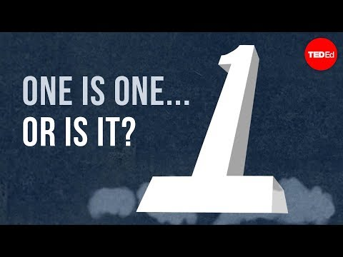
Recall: What is a unit?
Vocab term
partition - the process of dividing something into parts
Remember working with units
Notes:
Say “We’ve said that units are ones. But, what is 1? And, is one always one?”
Let students respond if they choose, then ask, “What if I said I could also make 1 equal 2 or 4?” Students may pick up the reasoning by recalling some examples from the video.
Tell students to note how the narrator uses the vocabulary word partition.
Play video to refresh their memory.
After the video, ask “Does the narrator believe 1 is always 1? How do we know?”
Ask “How was the word partition used here? What does it mean? What was partitioned? What happened then?”

Slide 12
Recall: What is a unit?
1 = ?
1 ten = 10
1 foot = 12 inches
1 dozen = 12 donuts
1 quarter = 25 cents
Remember adding with units
Notes:
Explain, “Depending on what you call a unit, the possibilities are limitless for what 1 can be. Almost every object or countable unit can be broken up into any amount of smaller units. Recall how we saw that a pie can be divided up into 3, 4, or 5 equal slices.”
Click for first equality statement.
Say “According to the ‘One’ video, 1 can represent a ten if we choose that smaller unit to break the whole up into. Just as one ten can equal 10, 10 units, or 10 ones…”
(Click for remaining equality statements.) Continue “One can also be 12, because one foot equals 12 inches. Same with a dozen donuts. And a quarter could be seen as 1 quarter or 25 cents.”

Slide 13
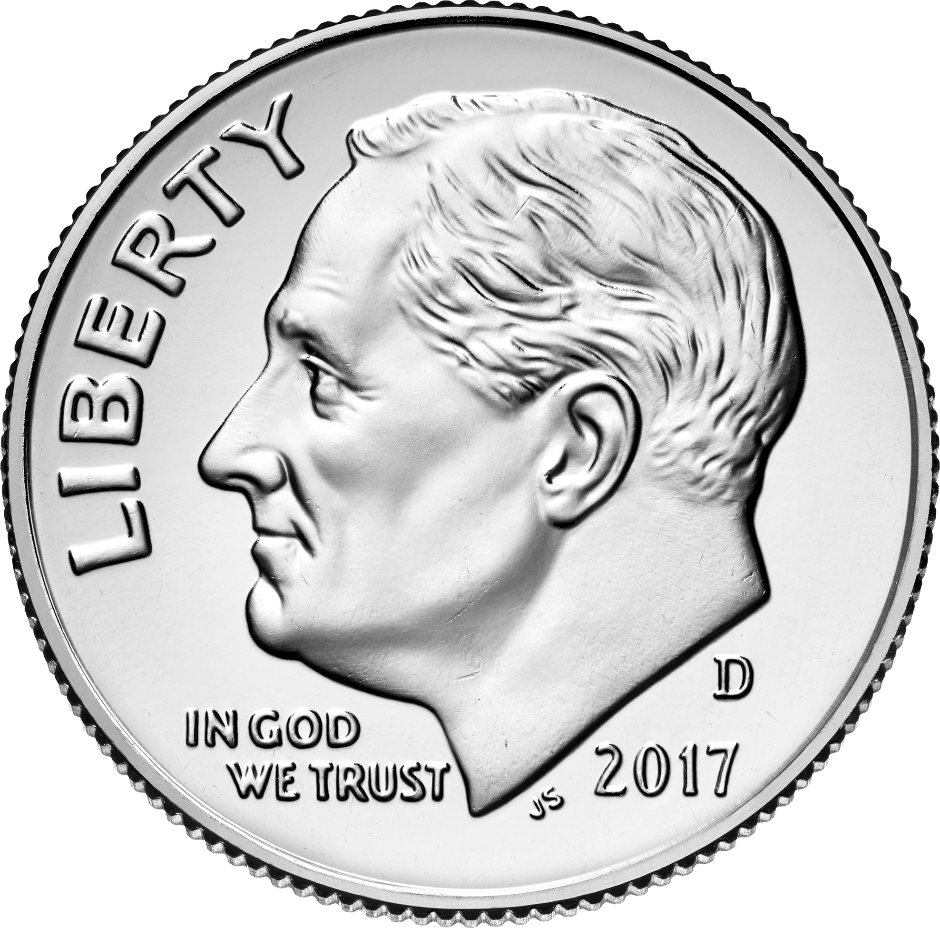
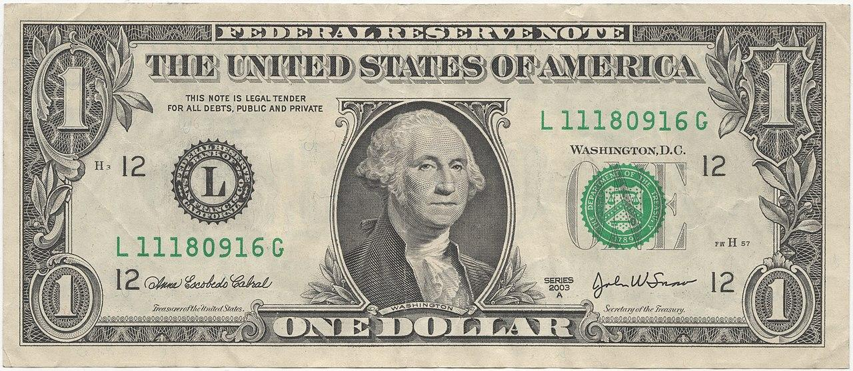
Recall: What is a unit?
Vocab term
part - a smaller section, share, or segment of a whole
How do we partition money?
=
One ten
1 10
_____ dollar can be exchanged for _____ dimes.
This means that ___ dollar can be partitioned into ____ equal parts, or units. Those parts are called tenths.
Think, write, share aloud
Notes:
Say “We have all probably worked with whole numbers and parts of those whole numbers in many ways. Think about what we do when we exchange a dollar bill for change.”
Fill in the blanks of the cloze, with students: “We can exchange a dollar for 10 dimes, because 10 dimes has the same value as 1 dollar. That means a dollar can be partitioned into 10 equal parts.”
Click to reveal fill-in words for blanks.
Review definition of part (an smaller section, share, or segment of a whole).
Ask students to discuss different ways to get equal parts of a dollar, and repeat using the cloze

Slide 14
OBJECTIVE STATEMENT # 1:
I can count and name fractional units
I can count and name the fractional unit of a partitioned shape.
Focus on objectives, ask questions
Notes:
Remind students of first main objective, remind students of the definitions of “unit” and “partition,” and clarifying the meaning of this objective.

Slide 15

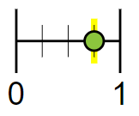
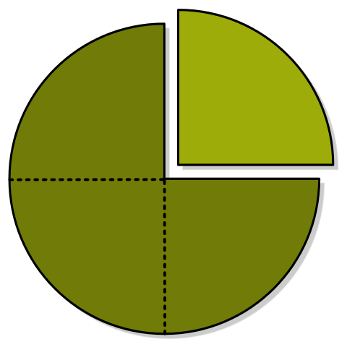
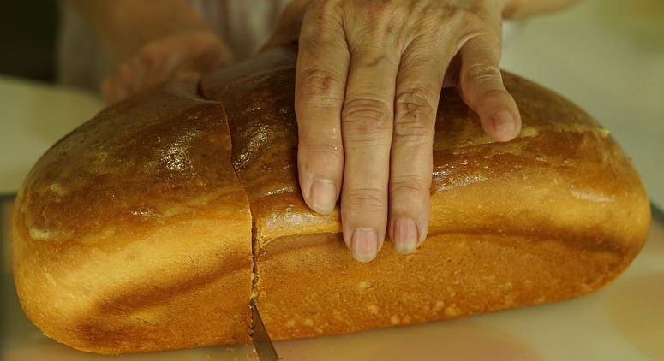

learn: That we express fractions in many ways everyday.
Authentically
(aka: practical application and “when I’m going to use this in real life”)
Conceptually
(aka: representations, like models and drawings)
In writing
(aka: words and numbers)
Three out of four
Take notes, ask questions
Notes:
Explain the 3 main ways to express fractions, which are used everyday. All forms of expression will be addressed in this lesson at some length, but the focus will be taking what we already know and are familiar with (everyday, real-life, practical) and turning that into a model that we can work with.
Click to reveal examples.
Continue: “After going from what we recognize to what we can create on paper, producing and working with written fractions will make more sense. The duty of mathematicians/math students is to understand numbers, including fractions, to be able to work with them no matter the context.”

Slide 16

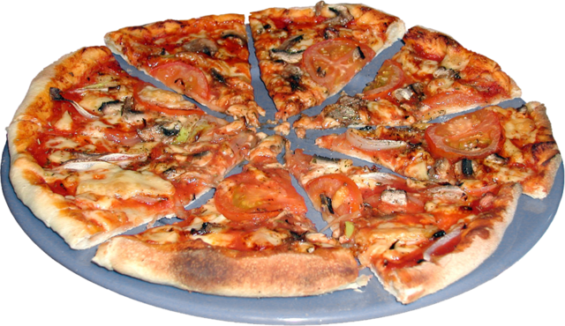
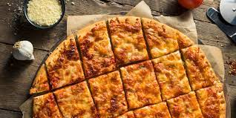
learn: That we express fractions in many ways everyday.
If you believe in equality, say ‘no’ to party cut pizza!
Equally-sized pieces of pizza are examples of fractional units. Each slice represents a unit fraction.
unit fraction - one part of an equally partitioned whole; a fraction with a numerator of 1 (examples: one-half, ⅓)
fractional unit - the name for the part of an equally partitioned whole (examples: halves, eighths)
Take notes, ask questions, offer examples
Notes:
Explain “Fractions are all around us. Anytime we divide a whole unit into smaller equal-sized shares, we can represent the new quantity using a fraction. One of the most well-known contexts for fractions is food. Let’s look at pizza to understand fractions.”
Click once. Clarify definitions.
Generate discussion with students about what they’ve noticed about the sizes and number of pizza slices in a pizza. Here are some potential conversation-starters:
Who has made pizzas professionally? Did you get to cut the pizzas? What was that like?
Why do you think some pizzas are cut into different numbers of slices?
Has the number or sizes of slices made a difference in which size you chose to order?
Have you ever asked for pizza to be cut into a specific number of slices?
Do you have any experiences with receiving a pizza when the shares are not equally-sized?
Why is important to divide up a whole pizza into smaller, equal-sized shares?
Click again to get picture of party-cut pizza, with red text. Be prepared for arguments in favor of party-cut pizzas.

Slide 17
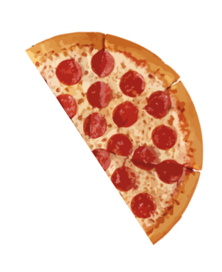
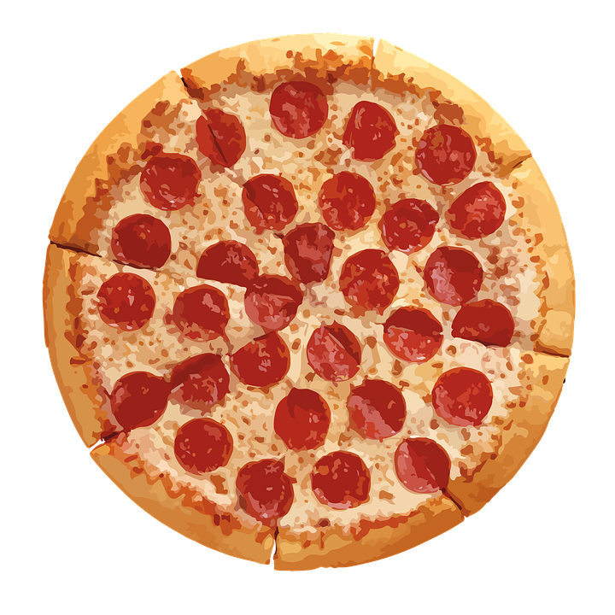
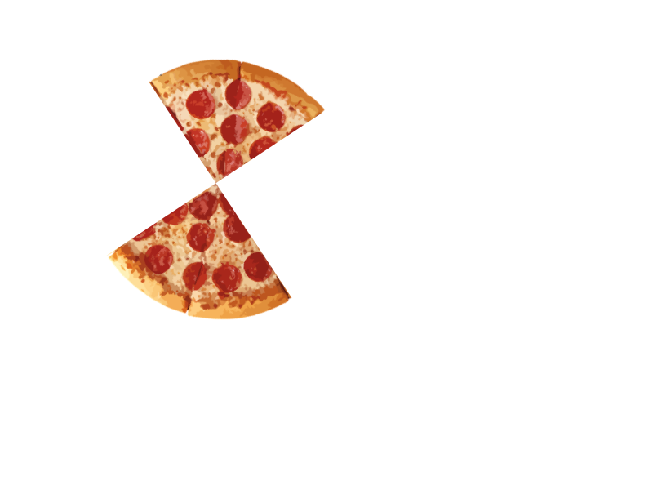
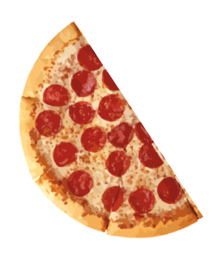
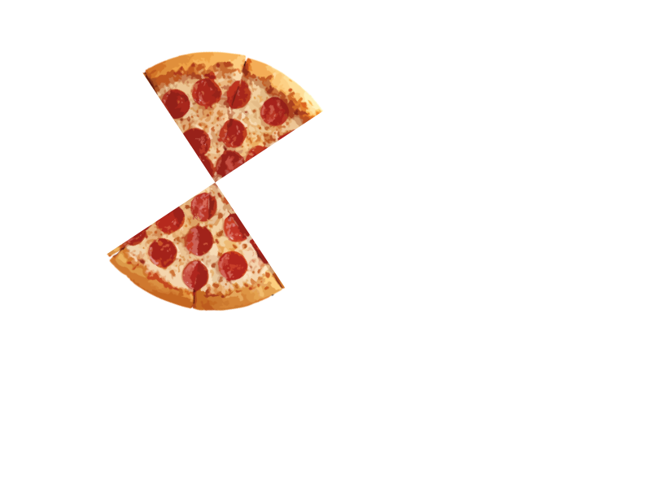
learn: To count and name the fractional units of a partitioned shape
The name and size of the fractional unit change according to how many share result from the partitioning.
Take notes, ask questions
Notes:
Read white text.
Explain that we can see many parts, or shares, we create at each partition and how the size changes. First, we get halves. Then, fourths.
Click once to cut pizza in half. Click again to create fourths.
Explain that halves and fourths are examples of fractional units.

Slide 18
learn: To count and name the fractional units of a partitioned shape
The shape is partitioned into …
one part
two parts
four parts
quarters or fourths
The fractional unit is…
wholes
halves
one-quarter
one-fourth
The unit fraction in words…
one [whole]
one-half
Watch, take notes, ask questions
Notes:
Say “The name of a fractional unit comes from how many parts the whole unit has been partitioned into. You probably already know and use some or all of these three fractional units everyday. What are some examples of when you’ve used the word “half” or “quarter”?”
Click to reveal the first two shapes’ features.
Explain “If the whole is in one piece, meaning it is not partitioned, we’re working with a whole unit. We refer to these as wholes. We call this “one”, or “one whole.” If we partition a whole into two equal parts, we have partitioned the unit into halves. We call one of these smaller units one-half.
Click for fourths’ features.
Explain “When a whole is partitioned into four parts, we can call the fractional units fourths OR quarters. Interestingly, this is the only fractional unit with two names. You can use either.”

Slide 19
learn: To count and name the fractional units of a partitioned shape
These rectangles are partitioned into four equal parts. The fractional units are fourths or quarters.
Watch, notice, ask questions
Notes:
Explain to students that a shape can be partitioned into the same number of equal parts in many different ways, but the limitation of most digital modeling software (which they’re about to use) is that it will only use horizontal or vertical partition lines. However, in real life, parting a whole unit is sometimes not standard.
Describe the process of partitioning a shape into equal sections, which students will have to recreate on paper. Ask students what they notice about the ways that the shapes are partitioned.
Explain “It is important to remember that the fractional units do NOT have to be the same shape to be equal in size. In the first two squares, all of the fourths are equally-sized fourths. These are all valid unit fractions, and they each represent the same area of the square.”

Slide 20
learn: To count and name the fractional units of a partitioned shape
These rectangles are not partitioned into equal parts. These are not fractional units.
Take notes, ask questions
Notes:
Explain “While fractional units do not have to be the same shape, they must be equal in size. These shapes are each partitioned into four parts, but the parts are not equally sized.”

Slide 21
Try: To count and name the fractional units of a partitioned shape
Learning Check!
If one person is eating a pizza, they get the whole pizza.
Splitting between two people? Each share is one-half of a pizza.
Dividing the pizza amongst four friends would make each serving one-quarter of the whole pizza.
Yes, you could have a whole pizza for yourself…
Or... you could half it with a friend!
Three friends and you? Better go with fourths.
Answer aloud + write to yourself
Notes:
Explain “For this Learning Check, I will partition this pizza into the same fractional units as the squares from before, and you all will tell me *aloud* what fractional unit the pizza is at each step of the cutting process. While you’re doing that, you will also write the unit fraction that represents one serving at each step, either using numbers or spelling out the names of the fractions.
Prompt + click sequence:
Say “Before we’ve started cutting, what unit do we have?” Students: “whole”
1st Click to reveal first line of yellow text, followed by two halves replacing whole.
Ask for unit. “half[s]”
2nd Click to reveal second line of yellow texts, followed by halves being replaced with fourths.
Ask for unit. “fourths/quarters”
3rd Click to reveal third line of yellow texts, followed by white/colorful text.
Point out the unit fractions written in white, and ask students how they did.

Slide 22
learn: To name fractional units
To express fractional units in writing, we generally use ordinal numbers, with two (sometimes three) exceptions:
If the whole is equally partitioned into… the fractional units are….
one part
two parts
whole[s]
half[ves]
three parts
four parts
five parts
six parts
seven parts
eight parts
twenty-two (22) parts
one hundred (100) parts
= thirds
= fourths / quarter[s]
= fifths
= sixths
= sevenths
= eighths
= twenty-seconds
= one-hundredths
Read, take notes, ask questions
Notes:
Explain that the names of the three fractional units covered in depth so far (wholes, halves, and quarters) happen to be exceptional because how we named them goes against the rule for naming all other units. Every other fractional name corresponds to the ordinal number of that denominator, which is what we call that number’s place in the sequence of whole numbers from 1 on. So, after counting how many equal parts a unit is divided into, if it’s more than two, think of how that number would be announced in a competition or in a sequence: the number 8 is eighth[s], 22 = twenty-second[s], 100 = hundredth[s], etc. This lesson will only cover fractions up to eighths, but the next two will go a little farther.
Ask students what at this point needs to be clarified before students can have a whole-class discussion.

Slide 23

learn: To name a unit fraction
one part =
whole
two parts =
halves
four parts =
fourths
1 .
. 1 .
. 1 .
1
numerator
Here are three ways to partition the same shape into different amounts of equal parts. What do you notice here?
denominator
Notice, take notes, ask questions
Notes:
Explain that students are now going to learn how to express fractions using numbers, specifically looking at unit fractions. All fractions can be expressed what we call fractional notation, which use two numbers and a number line.
Point out the fraction line on the fractions and let students know that the numbers above and below the fraction line have their own unique functions.
Click to reveal the denominator label.
Explain that the denominator tells the name of the unit (aka: the fractional unit).
Say “Look at the number of equal parts of these rectangles and look at the denominators. This word denominator essentially means ‘one that gives a name to.’ So, the denominator tells us the name of the unit.”
Click to reveal the numerator label.
Say “On top of the fraction line, the numerator, whose name means “to number or to count,” tells us how many of that unit we are working with. A unit fraction always has a numerator of one. We have one-whole, one-half, and one-fourth. We often show the units we’re working with by shading the number of parts dictated by the numerator. Keep in mind that other fractions will have numerators that are not one, so you may see these shapes later with more parts shaded in.”
Summarize: “So, when looking at a fraction in number form, we should know how many parts a whole has been partitioned into AND how many of those parts we are working with. We should also know that if it’s just one part, that part is the unit fraction.”
Added note:
If students have confusion with denominator and numerator, point out the root words “nom” and “numer” to help them:
“Nom” is found in some other words relating to names and naming. In Spanish, nombre means name. A nominee means to someone who’s been named to run for office.
“Numer” will likely be easier to remember as that root can be found in many common/ish words: number and numeral, enumerate (to list or count), numerous (a large amount of something). It is also one letter off from “number”

Slide 24

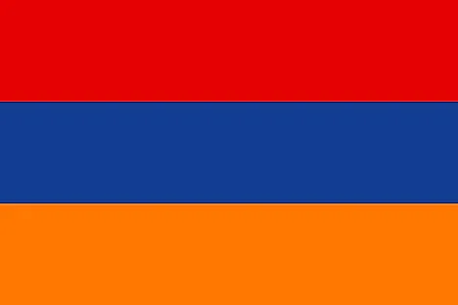

Practice: Naming fractional unit and expressing each part as a unit fraction of the whole.
Learning Check!
Ukraine
Armenia
Mauritius
halves
1/2 , 1/2
thirds
1/3 , 1/3 , 1/3
fourths/quarters
1/4 , 1/4 , 1/4 , 1/4
Write the unit and the fractions
Notes:
Tell students they will be doing this learning check in pairs. They will be looking at flags, naming the fractional unit of each flag, and expressing each part as a numerical fraction, which means writing a denominator and numerator separated by a fraction line.
Click to remove “Learning Check!” textbox
Allow students to discuss and write their answers.
Click to reveal answers
Review as a class.
Ask students how they did.
Ask how many halves/thirds/fourths each flag contained. Restated: “Two halves make up a whole flag. Three thirds make up a whole. Four fourths make a whole. What is the pattern here? Do you think this pattern continues forever?”

Slide 25




share: What do you notice? What do you wonder?
Observe, think, share (pairs), discuss (group)
Notes:
Say “Here are four multi-colored rectangles. Let’s take about a minute to write down some of what you are noticing about the images on this slide.” After students have had opportunity to write down their thoughts, ask them to share their observations aloud.
After a minute, direct them to share what they’re wondering about or what questions they have with a partner/small group. Remind students to consider what their classmates are sharing.
After another minute or so, allow pairs/groups to share aloud what they discussed. Ask “Did anyone’s partner share something that made you think a little differently about what you’re seeing?”

Slide 26
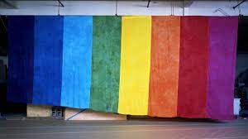

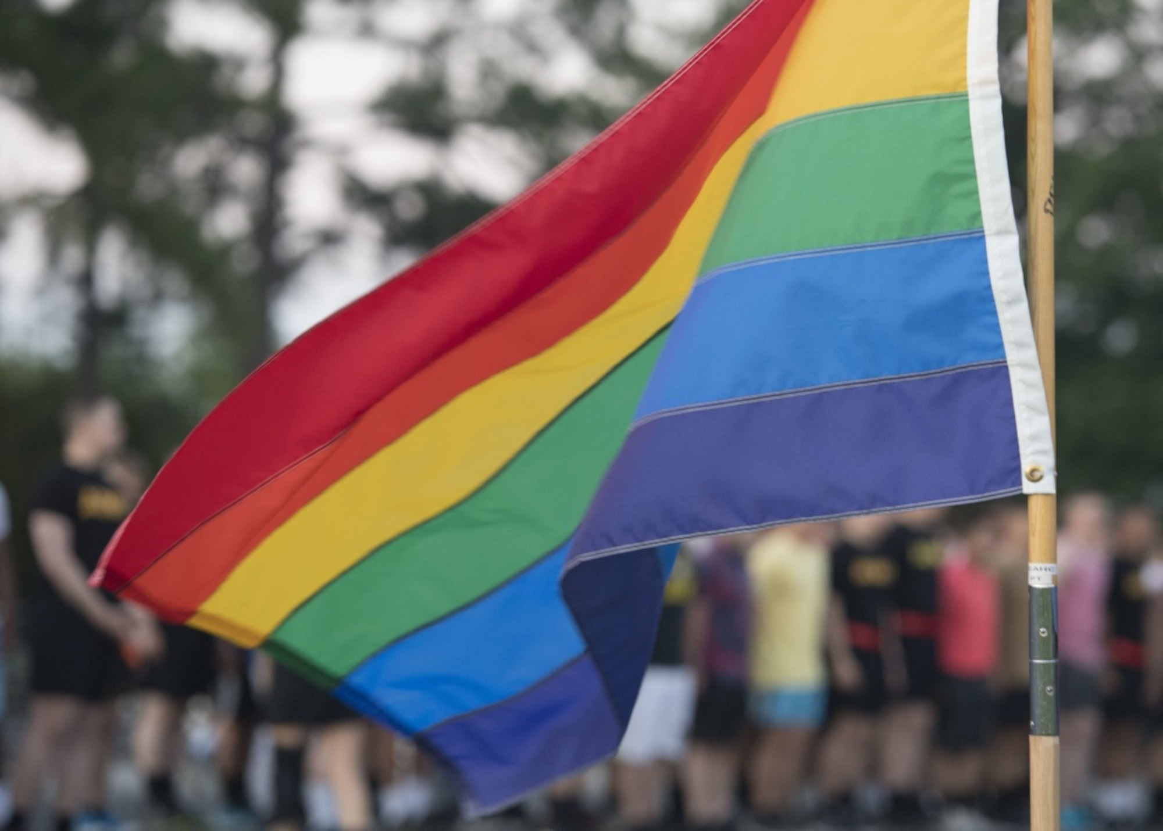
Share: What do you notice? What do you wonder?
Observe, think, share (pairs), discuss (group)
Notes:
Explain “Like food, flags are also an excellent and universally-relevant example of fractions in real life. Fractions are especially applicable to Pride flags, as almost each flag is made with a series of equally-sized stripes.”
Share briefly the history of the Rainbow pride flag to provide more context, linking students’ observations, wonderings, and questions to historical facts whenever possible:
The first pride flag had eight colors (pink, red, orange, yellow, green, turquoise, indigo/blue, and violet) and was designed by Gilbert Baker, who debuted it in the San Francisco Gay Freedom Day Parade in June 1978
Pink was removed in 1979 because that color of fabric was rare to find, inhibiting mass production
Before it had a chance to be flown, the flag also lost its turquoise stripe shortly after the pink’s removal, to make the number of colors on the flag an even number again
The flag with these remaining colors (red, orange, yellow, green, blue, and purple) remains the most recognized Pride flag now
Even with modern reinterpretations that address intersectionality within the LGBTQ+ community (such as the Philadelphia Pride flag released in 2017 that added black and brown), the same six colors continue to serve as the basis of Pride flags
Ask “What happens to each color of the flag as a result of the different changes? Let’s look at them in model-form again.” Go to next slide

Slide 27
Notes:
Ask “How can we use our fraction language to describe the revisions that this flag has undergone?
Continue asking questions until students use fraction language, understand that colors of the flags are represented by eights and sixths, and acknowledge the negative correlation between number of colors in the flag versus the size of each stripe (More colors = smaller sized stripes)
Potential questions:
How many parts is each flag partitioned into?
Focusing on the yellow stripe, what is the fraction of yellow in each flag?
Which stripes are biggest or covers more of a flag than others? Which are smallest? Why is that?
How is the flag changing over time?

Slide 28
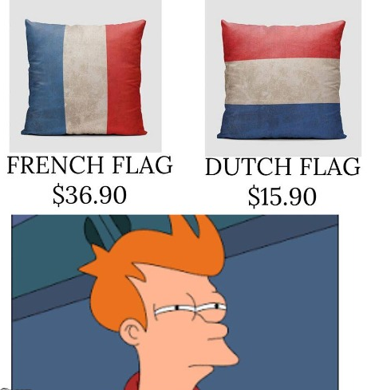
Try it out: Find the fractional units in different flags!
World Flags
Pride Flags
[world flags]
[pride flags]
Point out which flags fit the description
Notes:
Explain to students that colors often hold deep cultural meanings, and the colors of national, or other culturally-derived, flags are often chosen intentionally. Even if the colors themselves are not selected intentionally, though, the meanings ascribed to each color are. This means that two countries will often have very similar-looking flags (same colors and fractional units) but the designs will hold different meanings to their respective nations.
Display flags. Ask students to point out flags with backgrounds that display colors in certain fractional units. Common units of national flags:thirds, halves, fourths, and wholes. Use this website to see all national flags: https://flagsworld.org/. Common units of pride flags: fifths, sixths, and sevenths, with a couple fourths and thirds. https://www.unco.edu/gender-sexuality-resource-center/resources/pride-flags.aspx.
Encourage students to find non-fractional units as well (that is, flags with unequally partitioned units).

Slide 29
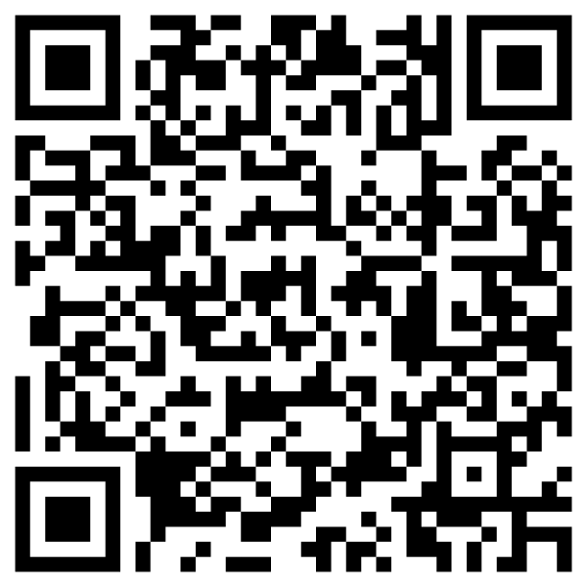
Practice: Naming unit fractions
What are your odds of becoming a millionaire?
Discuss some things you notice about this infographic:
Where do you see fractions?
What does this make you think about?
What do you wonder about?
Take notes, discuss, ask questions
Notes:
Show this infographic with students.
Encourage students to think about what they have learned about fractions so far in order to find the fractions here (e.g.: finding the whole vs. the part). Explain to students that finding a fraction of a group of people is much the same as finding a fractional unit of a whole, as this is just another example of how 1 can be more than 1.
Give students five minutes discuss with a partner their answers to the questions.

Slide 30

Quick Check in “Put a finger down”
Objective #1 I can recognize fractional units of a whole
Put a finger down if…
You said, “This pizza is whole, and cut into halves/fourths.”
You identified fractional units of national flags as halves/thirds/fourths, and wrote ½, ⅓, and ¼ in numerical form for each of the flags’ parts.
You were able to see which Pride flags display colors in sixths, sevenths, and eighths.
I can name a unit fraction by remembering the denominator’s ordinal number.
Put a finger down for every yes
Notes:
Remind students that the first main objective today is to identify fractional units by counting the number of equal parts of a partitioned whole.
Ask students to hold four fingers up and put one down for every statement that applies as instructor reads them off.
Check in with students to assess understanding before moving on.

Slide 31
OBJECTIVE STATEMENT #2:
I can model fractions
I can partition a shape or number into 1-8 equal parts to create fractional units
Clarify objectives, ask questions

Slide 32
Learn & Try: To partition a shape into equal parts
Visual models can help us understand fractional units.
Phet
MLC
Follow along, take notes, ask questions
Notes:
MODEL shapes with 1-3 equally-sized parts:
Model briefly for students how to use fraction modeling software.
Using your software of choice, talk through the process of partitioning whole shapes into equal parts.
Show what it looks like to partition a shape into 1-3 equal parts with one part shaded in.
Reinforce the connection between the numerator/denominator and what they’re seeing in the model.
DIRECT students to copy models:
Direct and help students to access the modeling software and page in their note-taking guides with pre-labeled rectangles to partition. Tell them to recreate rectangles with fractional units of wholes, halves, and thirds in their notes. Each example can be shown with one shape.
DIRECT students to use software to create shapes with 4-8 equally-sized parts:
Tell students to digitally model 5 rectangles (of the same size) partitioned into 4 to 8 equal parts, place rectangles on top of each other, and notice how the fractional units get consecutively smaller.
Ask “What are the patterns here? How does the size of the unit fraction change as we add more parts to the whole? If we partition another rectangle, how many parts would it have to have to make an even smaller unit? What is the smallest unit fraction you make with this software? What is the smallest you think could make without software?”

Slide 33
Notice + Wonder: What are the odds?
View: What are your odds of becoming a millionaire?
Discuss some things you notice about this infographic:
Where do you see fractions?
What does this make you think about?
What do you wonder about?
Take notes, discuss, ask questions
Notes:
Show this infographic with students.
Ask students the questions listed to promote discussion.
Explain to students that finding a fraction of a group of people is much the same as finding a fractional unit of a whole, as this is just another example of how 1 can be more than 1 part.

Slide 34
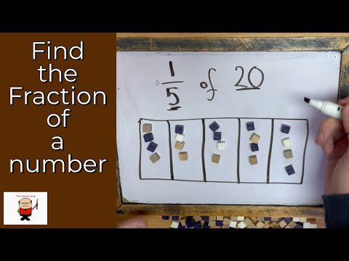
Learn: To partition a whole number into equal parts
Steps: Draw a partitioned shape and place counters
Follow along, take notes, ask questions
Notes:
Highlight the connection between the partitioned shape here and the rectangles created in the modeling software: students should understand how the fraction relates to the steps.
Students can practice this method using the rectangles in their note-taking guide and a pencil to distribute the numbers across the parts evenly.

Slide 35
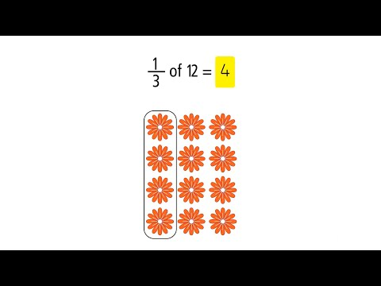
learn: To partition a whole number into equal parts
Steps: Create an array, circle sets, and count quantities
Follow along, take notes, ask questions
Notes:
Similar to last strategy but in reverse. Recreating this one means creating a number of columns (denominator) with icons distributed evenly across columns until the array contains exactly the whole number. Counting the quantity in ## (numerator) of those groups will be the product. Students can practice this using counters on transparency sheets or markers/whiteboards.

Slide 36
learn: To partition a whole number into equal parts
View: What are your odds of becoming a millionaire?
Hispanic (1 in 15)
Asian; White (1 in 5 for each)
Holds a college degree (1 in 6)
Holds a postgraduate degree (1 in 3)
Partition whole numbers
Notes:
Project the infographic and use/answer the questions from earlier to promote discussion. Explain that 1 in 5 is the same as 1/5. So, “1 in 5 white people will be achieve millionaire status means that one-fifth of whatever the total white American population is will have achieved that status at some point. Point out that the fractions are given, but the whole number–the total population–is not.
Notes:
Next slide is an optional modeling slide for this exercise to show 1/3, 1/5, and 1/6. Slide 37 shows model of 1/15 of 30.
Whiteboards or paper in sheet protectors are accessible modeling tools: students can create columns and dot them or manipulate counters to create arrays of 30

Slide 37
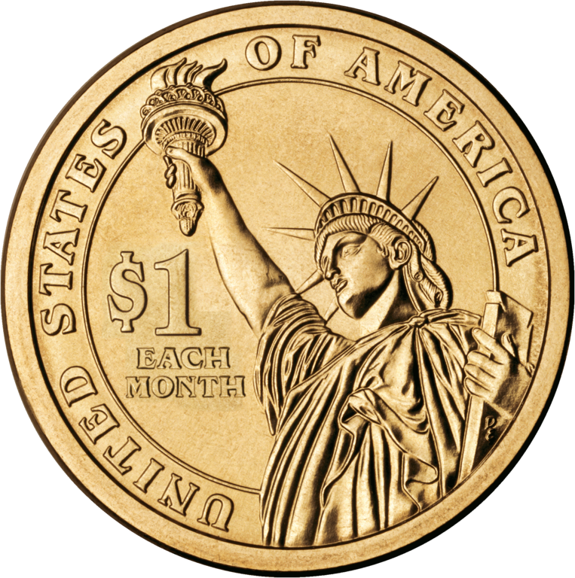
1 2 3 4 5 6
(1 in 6)
(1 in 5)
(1 in 3)
Notes:
Note: This optional slide is for modeling 1/3, 1/5, and 1/6 of 30.
Whiteboards or paper in sheet protectors are accessible modeling tools: students can follow along by creating columns and dotting them or manipulate counters to create arrays of 30.
Model with students how 1 in 3, 5, 6, and 15 looks using the partitioned columns method: Outside of presentation mode, arrange the 30 coins into 6, 5, and 3 groups. (Opaque black shield provided to screen unused columns)
To re-stack coins:
Hold Shift key while clicking multiple coins or draw box around coins (click outside of coins and drag cursor to create a box to cover the images), right click on one of the images, and select “Align Horizontally > Center.” Right click on a coin again and select “Align Vertically > Middle.”

Slide 38
learn: To partition a whole number into equal parts
View: What are your odds of becoming a millionaire?
Model the likelihood of achieving millionaire status for 30 Americans of each of the following categories:
Hispanic (1 in 15)
Asian; White (1 in 5 for each)
Holds a college degree (1 in 6)
Holds a postgraduate degree (1 in 3)
Partition whole numbers
Notes:
Project the infographic and use/answer the questions from earlier to promote discussion. Explain that 1 in 5 is the same as 1/5. So, “1 in 5 white people will achieve millionaire status means that one-fifth of whatever the total white American population will have achieved that status at some point. Notice that the fractions are given but that doesn’t tell us exactly how many people that fraction is.”

Slide 39
(1 in 6)
(1 in 5)
(1 in 3)
1 2 3 4 5 6 7 8 9 10 11 12 13 14 15
Notes:
30 coins arranged into 15 groups.

Slide 40
Quick Check-in
Objective #2: I can partition shapes and numbers into equal parts
Do you feel like you can do at least one of the following?
Draw lines on paper shapes to make equally-sized parts?
Use fraction-modeling software partition a shape into equal shares?
Partition a rectangular or circular object into a specific number of equal parts (up to 8)?
Do you feel like you can do the following?
Find the fraction of a whole number by grouping counters into parts and counting them?
Thumbs up/down/sideways
Notes:
Check in with students, reminding them that the second main objective today is to create unit fractions. Ask students to self-assess how confident they’re feeling in this specific objective. They can give thumbs up/sideways/down.
Ask what needs to be clarified before moving on.

Slide 41
OBJECTIVE STATEMENT # 3:
I can compare unit fractions
3: I can choose a fractional unit that is less than or greater than another, reasoning about the size of the fractional unit
Clarify objectives, ask questions
Notes:
Remind students that the third main objective today is to compare fractional units. This could look like ordering multiple unit fractions by size or by choosing a unit fraction that fits a certain description (such as “smaller than ½”), using either modeling or reasoning to get to answer. Students should be developing proficiency with this objective with unit fractions at this point, so this section jumps straight into modeling and discussion as a group.

Slide 42
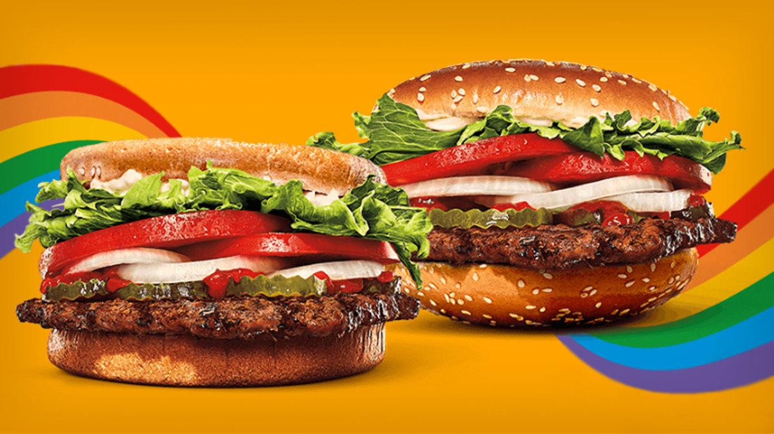
This or that?
Notes:
Use this scenario to gauge whether students are comfortable comparing the sizes of two unit fractions. Skip ahead to slide 47, if necessary.
Say “I am going to describe two burgers and then ask which one is the “better value” based on the information you have. These burgers have the same basic toppings and ingredients, and are priced the exact same. The only significant difference between the two is that the beef patty on Burger A is a third of a pound, while Burger B’s patty is one-fourth of a pound. Burger A tastes slightly better than Burger B. Knowing all of this, which burger would you choose and why?”

Slide 43
Learn: To compare multiple fractions side-by-side
Visual modeling can help us compare fractional units.
Reasoning about fractions can also help us compare unit fractions.
The more people we share our pizza with, the smaller a serving size becomes.
The fewer people we have to split our winning Powerball ticket among, the richer we each are when we win.
More hands make light work.
Shapes
Fraction bars
Follow along, take notes, ask questions
Notes:
VIsual modeling:
Show shape-modeling again, noting that it’s important to keep the whole units the same size when comparing them. Demonstrate Geogrebra’s fraction bars. Compare unit fractions on both within eighths.
Reasoning:
Explain “We can also set aside our modeling tools sometimes and use just our understanding of fractions to compare fraction sizes. As we know, we can think of our parts as shares, so let’s consider fractions in terms of sharing.”
Ask “If you have a pizza, would you rather share that pizza with one person and yourself, or with four people? Note that the pizza remains the same size regardless of how many people are eating it.” (One person). Click for text.
Ask “If you split a pool of money with others, are you hoping that you’re sharing with more people or fewer?” (Fewer). Click for text.
Ask “Have you ever worked somewhere when a lot of your coworkers quit without much notice? If so, what did that do to your own workload?” (Increased hours or responsibilities) “Would more or less help make the work easier to manage?” (More) Click for text.

Slide 44
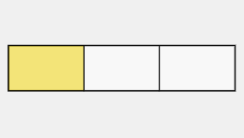
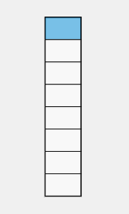
Learn: To write an inequality comparing two fractions
Write the written expressions for each shaded fraction model.
a
b
1
3
Then, write an inequality statement comparing these two expressions:
____ >____
1
a
b
⅓
⅛
8
Follow along, take notes, ask questions
Notes:
Note: This slide is optional. Present only if students need to present comparisons as inequalities.
Review comparing numbers as a statement. Remind students what the “greater than” and “less than” symbols are.
Think aloud as you interpret the top visual model. Click once to reveal 3 and 1, respectively.
Repeat for bottom fraction: click again to reveal 8 and 1, respectively.
Explain “If I want to compare these two fractions using the > (greater than) sign, I am going to place the larger fraction to the left. I can see that one-third is larger, so it is going on the left.” Click to reveal ⅓ and ⅛.

Slide 45
Try: To order fractions
four parts = fourths
one part shaded
eight parts = eighths
one part shaded
five parts = fifths
one part shaded
. 1 .
. 1 .
. 1 .
These are three fractional units from the same whole.
Order from smallest to largest
Notes:
Note: This slide is optional. Present only if students need practice ordering unit fractions.
Have students order the shaded units for practice, starting with the smallest and ending with the largest. Specify whether you want to students to write as an inequality.
As an inequality: ⅛ < ⅕ < ¼
As a list: ⅛, ⅕, ¼

Slide 46
Quick Check in “Put a finger down”
Objective #3 I can compare unit fractions
I can…
Recognize when a unit fraction is larger or smaller than another, using modeling to help to see the difference.
Recognize when one unit fraction is larger or smaller than another when they are only written in numeral form, based on what I have learned about unit fractions.
Choose a unit fraction that is smaller than another, based on what I know about unit fractions.
Put a finger down for every yes
Notes:
Check in with students, reminding them that the third main objective today is to compare unit fractions using modeling and reasoning about their sizes.
Ask students to participate in “Put a finger down”
Read off statements.
Ask students what needs to be reviewed or clarified now that the instructional parts of the lesson are over.

Slide 47
InDIVIDUAL OR PARTNER PRACTICE: Fractional units
Objective statement #1: I can count and name fractional units of a partitioned shape
How to do it: Each link will take you to a different game or set of review questions. Answer questions until you feel that you have mastered the concept. If you struggle at first, keep trying until you get 3 in a row correct. Complete on your own or with one classmate.
HYPER-LINK | DIRECTIONS | FOCUSES
Fraction Splat | Play first two levels. | Determining equality and number of parts
Equal parts | Select the shapes partitioned into equal parts. | Determining equality parts
Fractions of the Shapes | Choose the partitioned shape that answers the question. | Naming the fractional unit by counting parts
Fractions up to one-fourth | Select the fraction that answers the question. | Expressing fractions in fractional notation

Slide 48
Small group activities: Fractional units
Objective statement #3: I can compare unit fractions
How to do it: Choose an activity to complete with a classmate or small group of classmates. List of activities and directions are found here.
ACTIVITY TYPE | DIRECTIONS
DISCUSSION | Review the infographic What Are Your Odds of Becoming a Millionaire?. Have a discussion focused on one or more of the provided question sets.
GAME | An opportunity to play with your new fraction knowledge in the styles of some familiar commercially-sold games.

Slide 49

Post-test
Objective statement #1: I can count and name fractional units
How to do it: Fill in the blanks of the following statements. The statements are about the fraction 1/2.
Fractional unit | FILL IN THE BLANK STATEMENTS |  | Answer
 | This fraction’s whole unit has been partitioned into ____ (how many?) parts.
 | This fractional unit is called one-_________.
Answer questions on your own

Slide 50


Post-test
Objective statement #2: I can create fractional units.
How to do it: Draw with pen and paper, use a modeling software, or edit this slide to demonstrate how to partition the following shapes into the number of equal parts shown by the fractions’ denominators (to the right). Then, write the expression for one of those units.
⃞
—
2
⃞
—
6
⃞
—
4
Answer questions on your own
Notes:
Partition a shape into 1-8 equal parts (2.G.3)

Slide 51



LESSON GOALS: Pre-assessment
Objective statement #3: I will be able to choose fraction that is greater than another.
How to do it:: Order the units from smallest to largest, placing the smallest fractional units on the left and the greatest on the right.
SMALLER
LARGER
Answer questions on your own
Notes:
Model:
Order two to four fractional units of the same whole according to size (2.NF.3d)

Slide 52
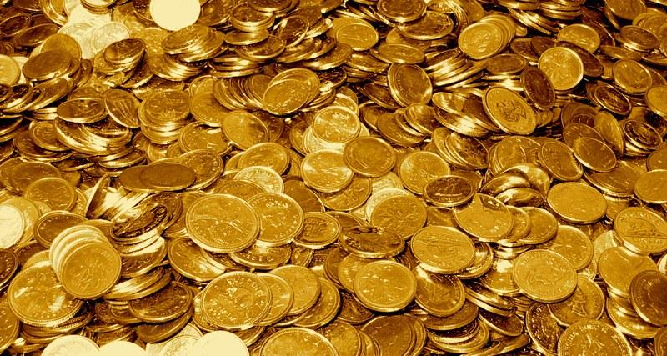
The gold .
Notes:
Explanation of GOLD slides:
Irish myth says that if you get to the end of a rainbow, you will find a pot of gold. Leprechaun folklore has withstood the test of time, and it’s easy to see why: it’s a fun and light-hearted trope that doesn’t rely on harmful stereotyping and can be understood by most people groups. Plus, who doesn’t love a rainbow!
Chasing a rainbow in search of gold has become a universal symbol of what it means to pursue something. Humans tend to be chasers by nature. Sometimes, the pursuit is not out of a genuine desire for that object of desire, but simply for the pursuit itself, to have something to work toward and to experience the wonder of figuring something out. In life, we never actually know whether our current pursuit will result in what we define as success. However, time spent on learning is never wasted. Many of our pursuits in classes end in a nice, neat answer. Then, sometimes, we get an answer that sends us on yet another chase. Furthermore, s
ome journeys have no end at all, which causes the experience to become the treasure itself. To guarantee finding the gold, it is best to be open-minded, flexible, and willing to learn, unlearn, and relearn.

Slide 53









Marketing Misunderstanding:
The fractions in our food
This is a true story, starring
A&W and McDonalds
restaurant chains.
In the 1980s, McDonalds had been enjoying success with their larger-than-life burger called the Quarter Pounder. To nobody’s surprise, it had been very successful in the American markets since its debut in the early 70s. So much so that another chain decided to try to compete.
1
Notes:
Read intro.
Text in slide:
This is a true story, starring A&W and McDonalds restaurant chains.
In the 1980s, McDonalds had been enjoying success with their larger-than-life burger called the Quarter Pounder. To nobody’s surprise, it had been very successful in the American markets since its debut in the early 70s. So much so that another chain decided to try to compete.

Slide 54

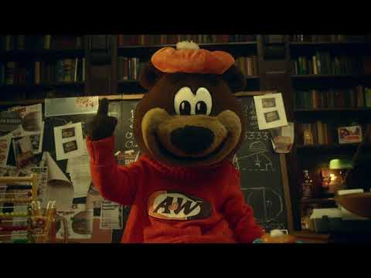




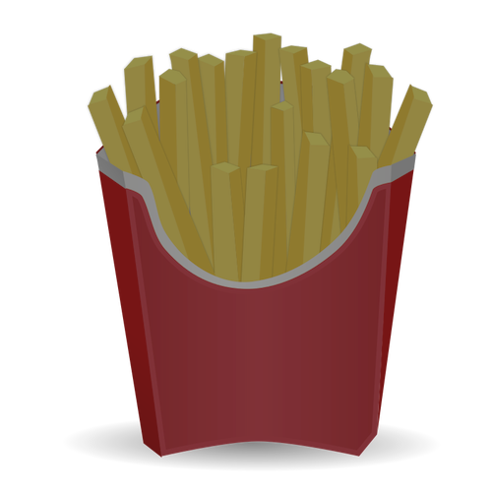
Marketing Misunderstanding: The Story
2
Notes:
Options for storytelling:
Play this shortened clip and then go to Slide 53 for questions.
See next seven slides for the story retold, as illustrated by The Office.
Read A&W’s blog together: https://awrestaurants.com/blog/aw-third-pound-burger-fractions, use slides 53-55 for deeper thinking questions.
To engage students with comprehension questions, punctuate the story’s in-class narration as necessary.
Ask questions at the end of the video to ensure understanding.
For instructors to build their own background knowledge, this thorough article discusses the larger implications of the lessons learned: https://bettermarketing.pub/the-a-w-third-pounder-failed-because-people-didnt-understand-fractions-a86b966a973a

Slide 55
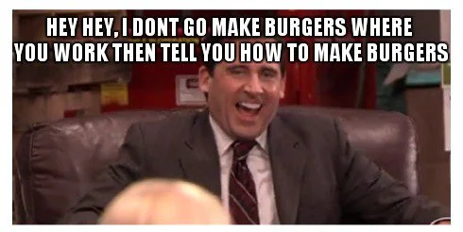

Marketing Misunderstanding: The Story
In the 1980s, A. Alfred Taubman had just bought A&W, a direct competitor of McDonalds. Seeing the success that McDonalds was having with their QP burger, Taubman decided to compete. A&W released their Third-of-a-Pound Burger.
3
Notes:
Click for GIF.
Text in slide:
In the 1980s, A. Alfred Taubman had just bought A&W, a direct competitor of McDonalds. Seeing the success that McDonalds was having with their QP burger, Taubman decided to compete. A&W released their Third-of-a-Pound Burger.

Slide 56


Marketing Misunderstanding: The Story
Taubman put full effort into setting the TPB up for success. At ⅓ of a pound, the TPB was bigger and even outperformed the QP in blind taste tests.
A&W matched the price of their competitor’s sandwich and promoted their new product heavily with a campaign entitled “Third Is the Word.”
A&W’s TPB had all the ingredients for success.
4
Notes:
Click for image (x2).
Text in slide:
Taubman put full effort into setting the TPB up for success. At ⅓ of a pound, the TPB was bigger and even outperformed the QP in blind taste tests.
A&W matched the price of their competitor’s sandwich and promoted their new product heavily with a campaign entitled “Third Is the Word.”
A&W’s TPB had all the ingredients for success.

Slide 57
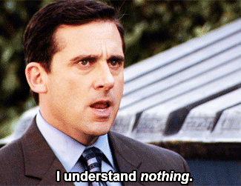
Marketing Misunderstanding: The Story
And it was an epic failure.
A&W’s sandwich was anything BUT successful. The reception was cold and the exact opposite reaction that Taubman had planned for.
5
The businessman was puzzled.
Notes:
Click for last line and GIF.
Text in slide:
And it was an epic failure.
A&W’s sandwich was anything BUT successful. The reception was cold and the exact opposite reaction that Taubman had planned for.
The businessman was puzzled.

Slide 58

Marketing Misunderstanding: The Story
6
He wanted to know WHY customers were not crazy about his sandwich!
So, he hired a research firm to investigate…
Notes:
Click for GIF and 2nd line of text.
Text in slide:
He wanted to know WHY customers were not crazy about his sandwich!
So, he hired a research firm to investigate…

Slide 59
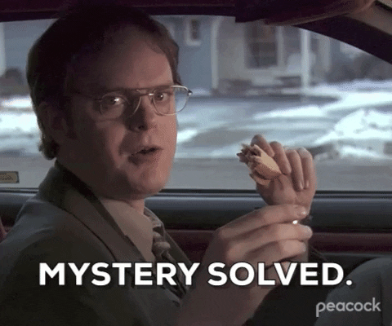
Marketing Misunderstanding: The Story
7
The research company got to work. One of the efforts used to collect data was focus groups, wherein lay the answers A&W was looking for.
Many customers in these focus groups, even those who preferred the taste of A&W’s product, expressed the same general concern about the product: "Why should I pay the same amount for only a third-pound of meat when I could get a quarter-pound at the other place?"
In other words, customers thought that 1/4 of a pound of meat was larger than 1/3.
Notes:
Read. Click to reveal last line of texts and gif.
Ask for recap, “In your own words, how would you explain why customers were choosing McDonalds’ burger over A&W’s larger burger? What was their reasoning? What information did they have?”
Ask “The customers’ fractional understanding was incorrect, but do you think they were correct in reasoning that paying the same amount for the bigger sandwich would have been the better deal? Why? (Yes, more for their money)
Text in slide:
The research company got to work. One of the efforts used to collect data was focus groups, wherein lay the answers A&W was looking for.
Many customers in these focus groups, even those who preferred the taste of A&W’s product, expressed the same general concern about the product: "Why should I pay the same amount for only a third-pound of meat when I could get a quarter-pound at the other place?"
In other words, customers thought that 1/4 of a pound of meat was larger than 1/3.

Slide 60
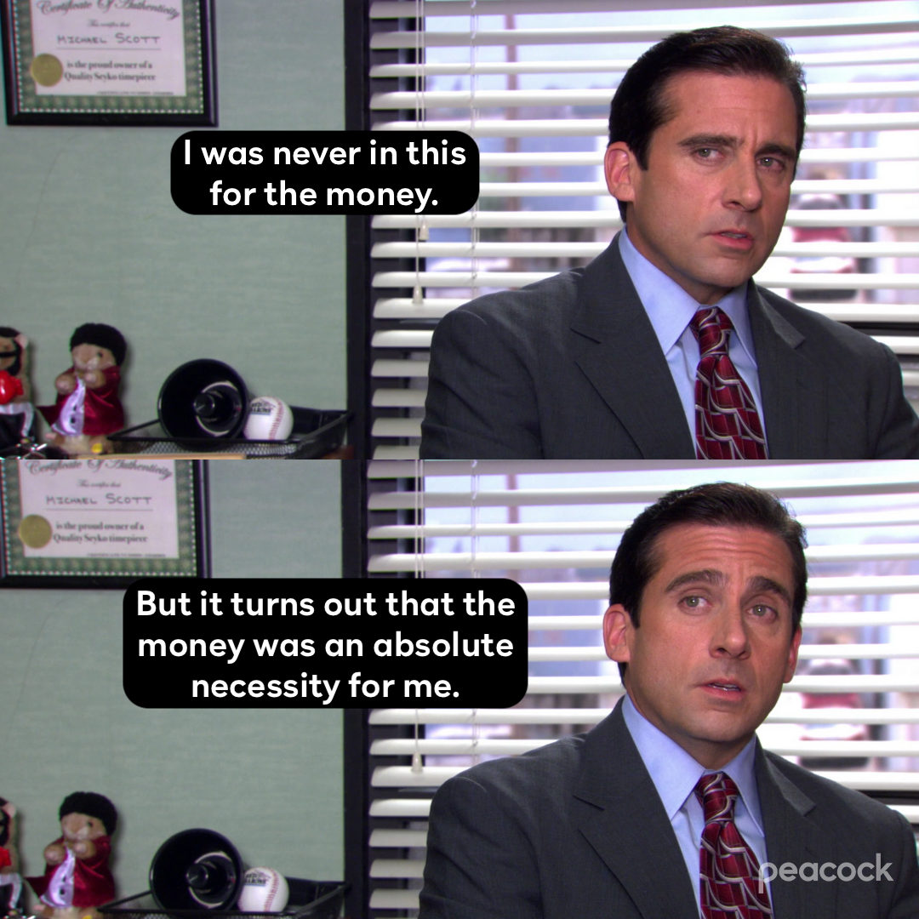
Discuss: Making informed decisions
8
Notes:
Generate discussion about making informed decisions as consumers:
“Getting a good deal is important to most customers, and this example shows how understanding math helps us as customers to make beneficial decisions. Many missed out on getting a bigger, and potentially better tasting, sandwich. Instead, they were fooled by their own assumptions of what the numbers meant.”
“I wonder how customers could have known or learned the math needed to make an informed decision. What sort of math do you use when deciding on a product to buy or choosing between two products? How do you find the better deal or the best product for you?”

Slide 61

Discuss: Making informed decisions
A&W’s “Third is the Word” campaign was so poorly received that this campaign is now seen as one of the biggest flops in marketing history.
9
Notes:
Read. Click for GIF.
Generate discussion on the lessons to be learned from the business/professional side.
“Do you think this flop was preventable?
What could have A&W done differently from the start?
What about while the campaign was going on?
Why do you think this one little misunderstanding wasn’t caught and corrected earlier?
Could that level of misunderstanding happen now? Why or why not?
Ask “Clearly, there was a gap between the company’s message about their product and the audience’s understanding of it. Why do you think Taubman and his company never considered the possibility that the public would have a totally different understanding of the math involved? What are some ways you suppose they could be better connected to the customer and their experience?”

Slide 62
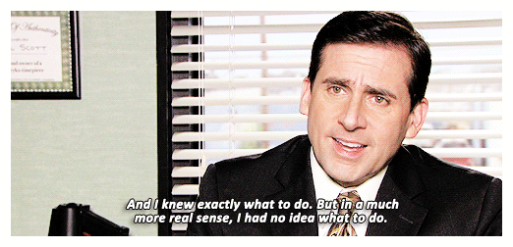
Discuss: Making informed decisions
10
Taubman said he learned an important lesson about communication: “Sometimes the messages we send to our customers through marketing and sales information are not as clear and compelling as we think they are.”
Notes:
Read text. Click for GIF.
Prompt discussion: “There are many examples of communication, or miscommunication, in this story: How did A&W communicate to the public? And, what were their direct or indirect messages?” Some examples:
Advertising platforms (They used TV and radio commercials) to alert customers about their new product
How they named and priced their product
Marketing campaign message and the name “Third is the Word”
Taubman and A&W assuming that everyone would understand that ⅓ is bigger than ¼.
“How did A&W receive feedback from their audience?”
Taste tests
Customers’ reception (or lack thereof)
Research team’s efforts, focus groups
As global citizens/current and future professionals in our respective fields, what lessons about communication can we take away from this experience?”
Possible stems (can also replace “communication” with “critical thinking” or “working with/leading a team” terminology):
To be a better communicator, it is important to _______________________.
When communicating, it helps to _______________________.
Communication is crucial to success because ______________________.

Slide 63
Marketing Misunderstanding: Your turn
11
After their royal flop, instead of trying for a comeback, A&W cut their losses and ceased efforts to compete directly for McDonalds’ QP customer base.
About 40 years later, however, they decided to capitalise on their flop and market their old burger in a new way, using the lessons learned from their 1980s campaign.
If you were in charge of the company and this had happened today, what could you have done to try for an immediate comeback?
Notes:
Read text.
Ask “What do you think the company should have done in response to the findings? Try educating customers? Create a different product whose success doesn’t rely on understanding fractions? Try a different marketing message or medium?”
Ask “What if this happened today? Thinking about our unprecedented access to computers, smart phones, and social media, as well as the way the world views and talks about food, customer service, competition, consumerism, etc… Could this sort of huge misunderstanding happen today? Why or why not?
If this flop had happened today, what do you think A&W could have done differently moving forward? What might that look like?”

