Slide 1

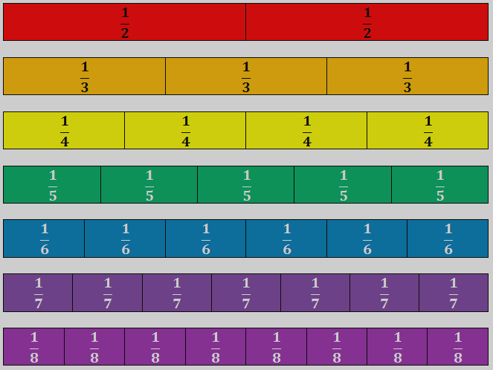
INTRO TO FRACTIONS
Lesson 1:
The Unit Fraction
STUDENT’S NOTE-TAKING GUIDE

Slide 2

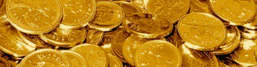
Slides Overview
RED
ORANGE
YELLOW
GREEN
BLUE
INDIGO
PURPLE
PINK
GOLD
Recall: What is a Unit?
Overview | Goals & Objectives
Lesson: Counting and Naming Fractional Units
Discussions | Notice & Wonder | Learning Checks
Discussion: Millionaire Stats | Flag Fractions
Independent Review Activities
Post-Test
Videos & Practice: Comparing Numbers, Shapes
Brainstorm: Burger Wars
Notes:
Eye with a slash = Slide[s] hidden during presentation

Slide 3
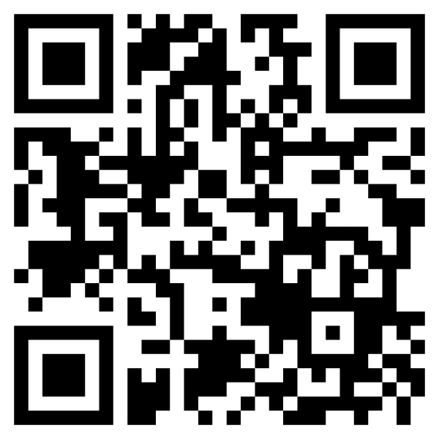
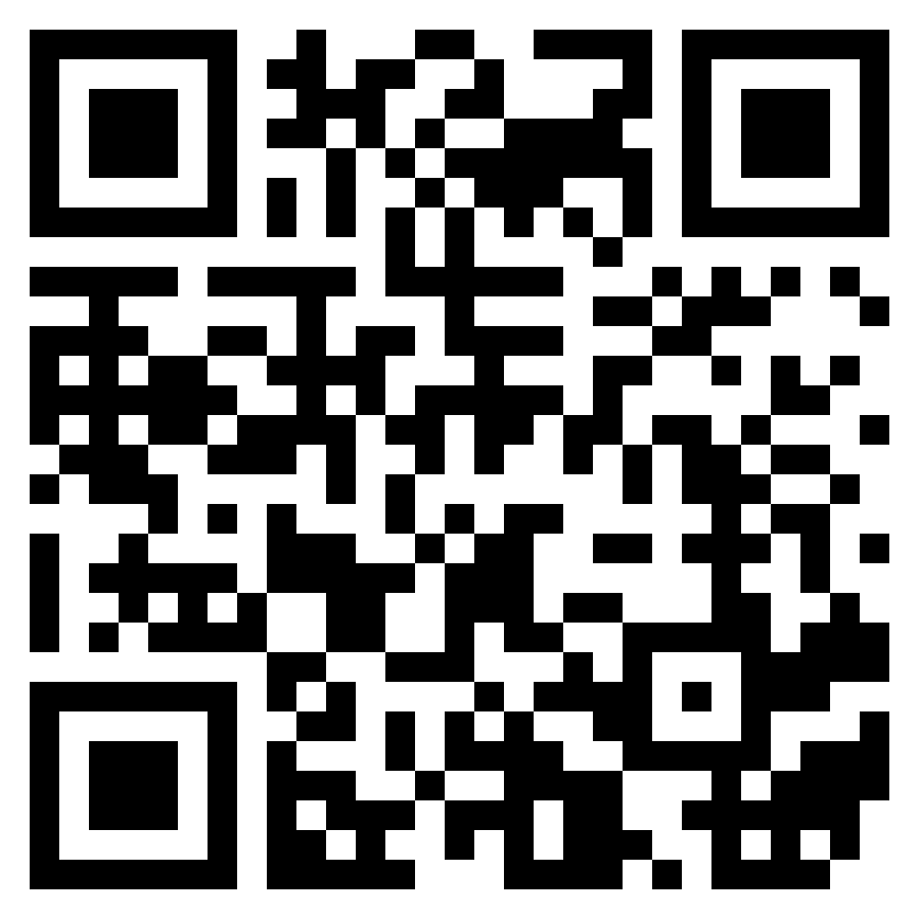
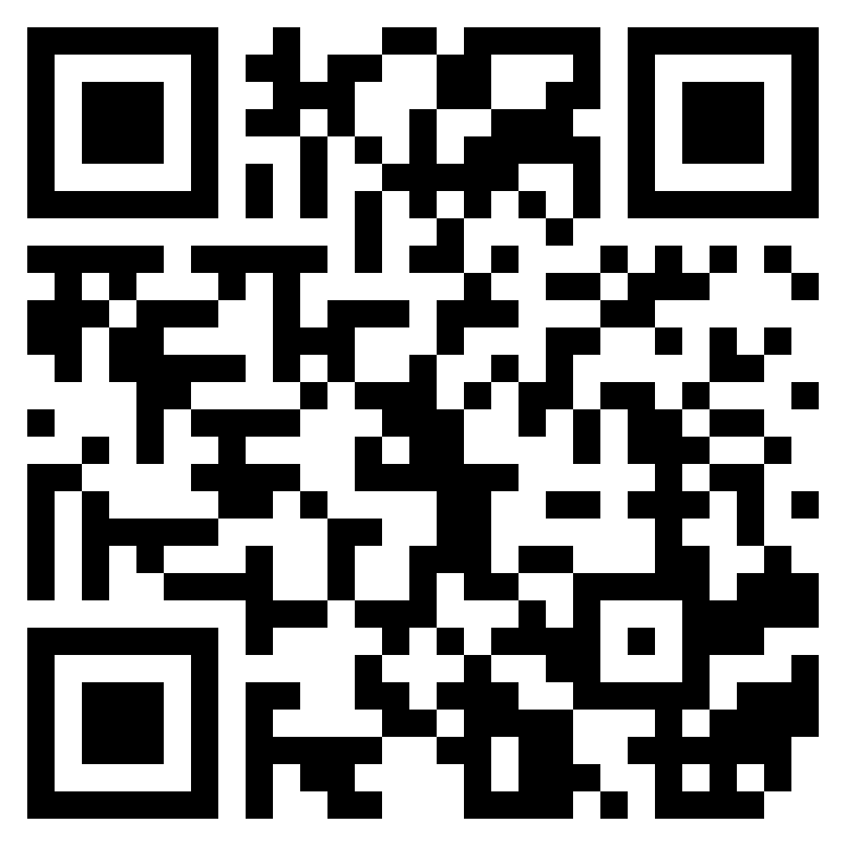
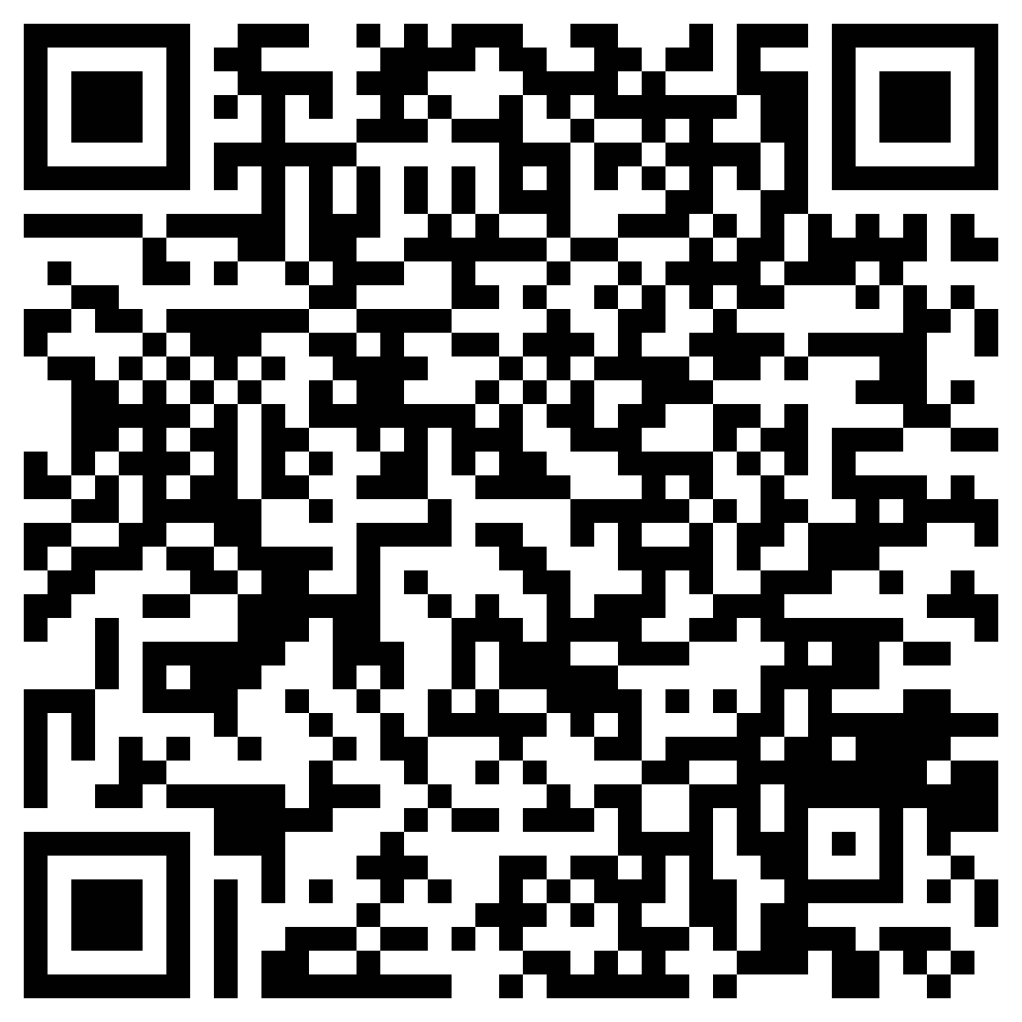
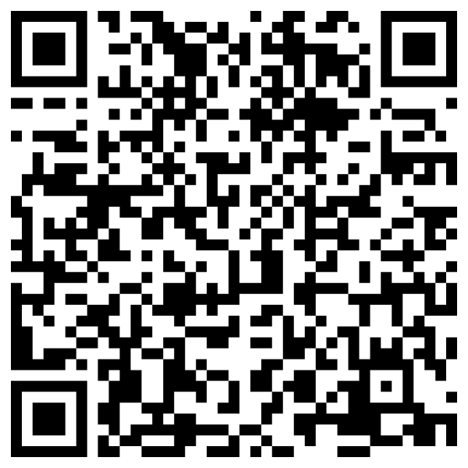
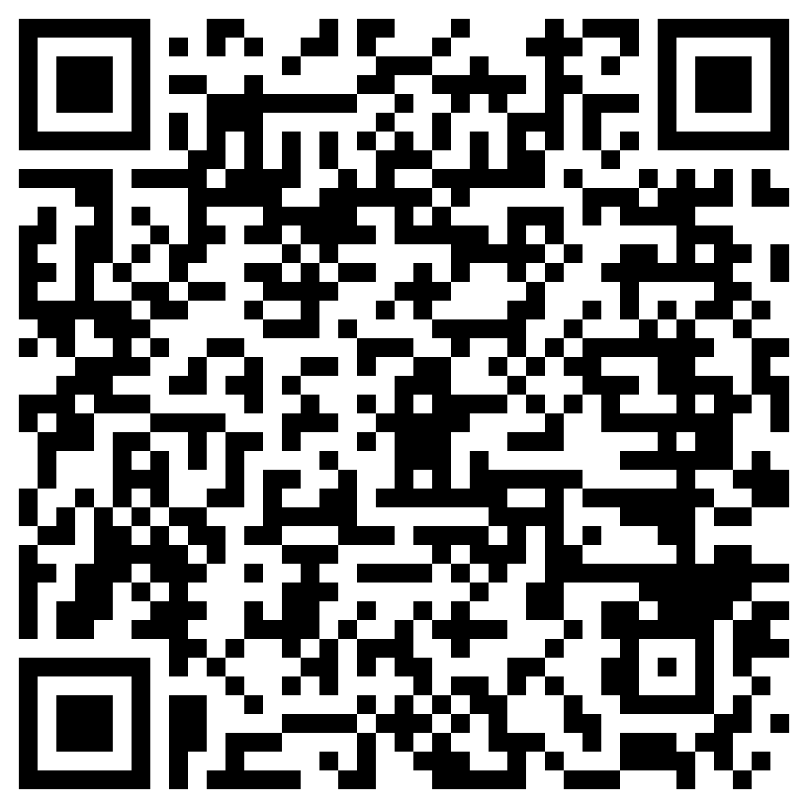
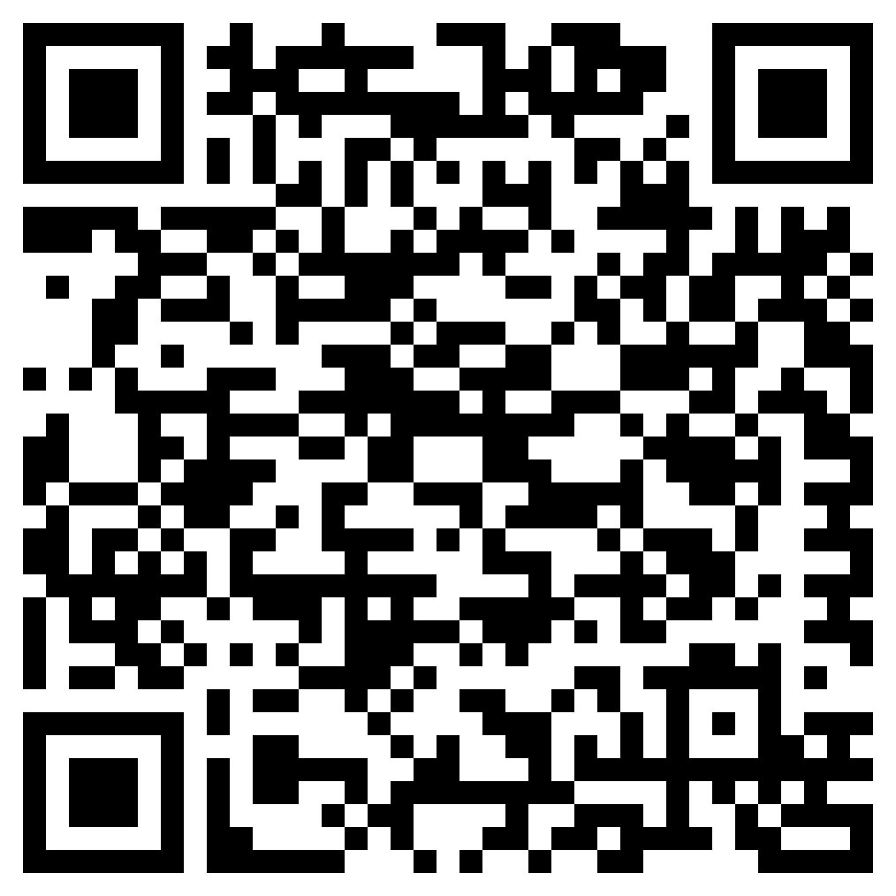
Prerequisite learning: Comparing values, shapes, place value
Before starting this lesson, you should be able to…
Identify and create rectangles, squares, and circles
Count to 10 easily
It would be helpful if you are able to…
Compare two whole numbers using “greater than” and “less than” symbols: < , >
Know place values of ones and tens and know that ten ones make up a ten
SKILL / KNOWLEDGE | Use less than and greater than symbols: <, > |  | Identify and create squares, rectangles, and circles |  | Know place values of ones and tens
LESSON | Watch: Inequality symbols (watch until 3m:30s) |  | Watch: 4 Basic shapes | Read: Identify Basic Shapes | Video: Mr. J’s Place Values (Two Digits)
PRACTICE | Do: Khan Academy: Compare two-digit numbers |  | Do: Khan Academy: Practice Identifying Shapes 1 |  | Do: Khan Academy Practice (three activities total)
Review these concepts if necessary
Notes:
Complete these independent mini-lessons if you need to!

Slide 4
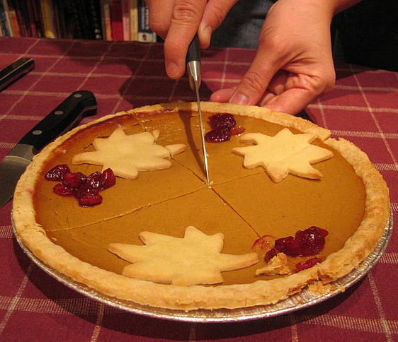
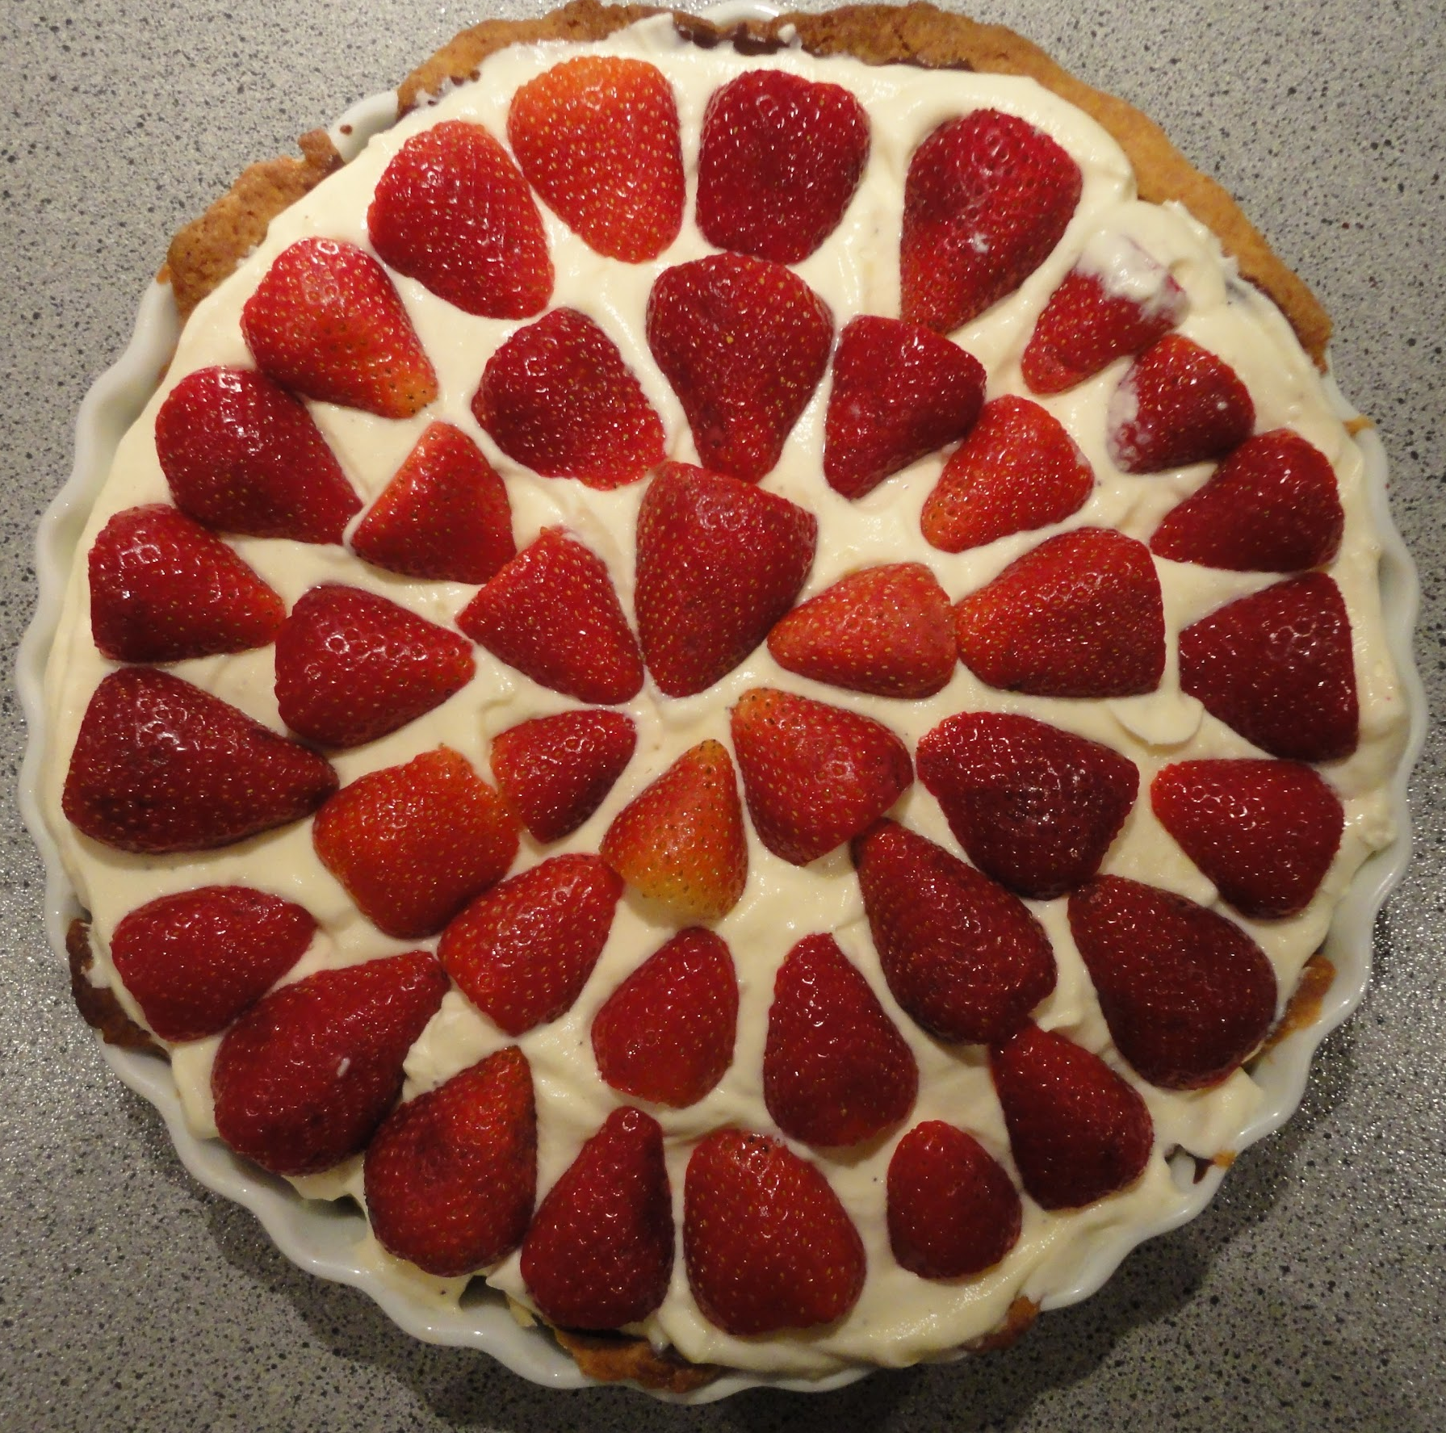
Intro: “A share of the pie” challenge
Notes:
Reflection questions about sizing pie pieces:
How did you get started?
How did your approach (to cutting the pie) change as you went along?
How did you know you were heading in the right direction?
Which pie was more difficult to divide up, and why?
How many people ended up with pie that was smaller than an evenly sliced piece? Larger?

Slide 5
Lesson Overview 1/2: What am I going to learn?
Content Objectives - I will be able to…
Language Objectives - I will be able to…
Count and name the fractional unit of a partitioned shape
Partition a shape or number into 1-8 equal parts
Choose a unit fraction that is less than or greater than another, reasoning about the size of the units
Describe and discuss fractions using fraction language: unit [fraction], partition, equal parts, whole, fractional unit, numerator, denominator
Understand the objectives

Slide 6
Lesson overview 2/2: What does learning look like?
Goals of this lesson…
Tasks of this lesson…
Understand unit fractions (also called fractional units) as numbers
Communicate understanding of unit fractions to others
Interpret and express unit fractions in writing and with models/shapes
Create, discuss, and label fraction models
Problem-solve in pairs, using knowledge of unit fractions
Use modeling and reasoning in a mock workplace situation
Understand the objectives

Slide 7
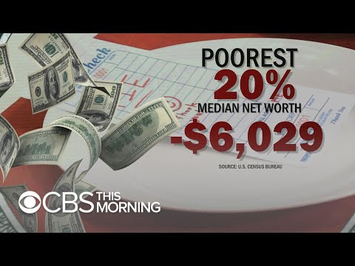
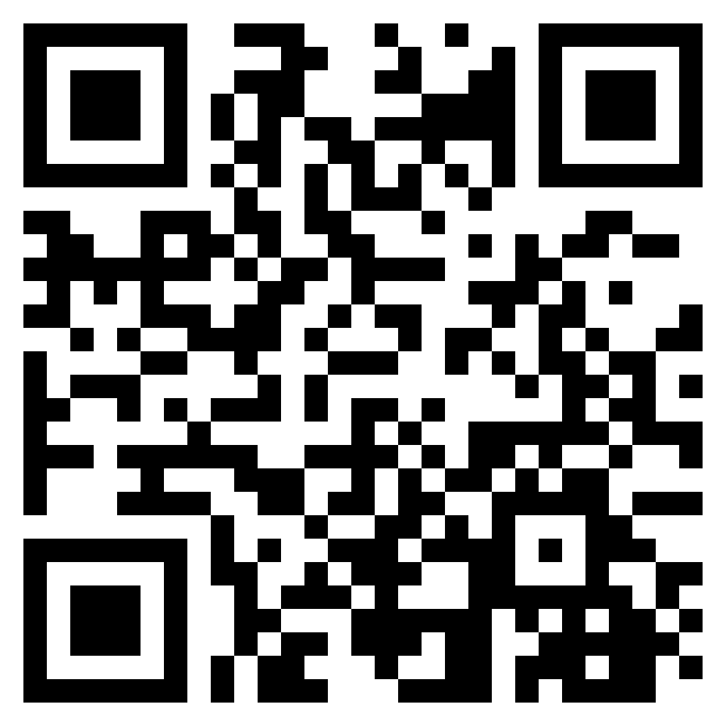
Intro: “A share of the pie” challenge
Notes:
VIDEO NOTES:
True/False? Circle “T” if the statement is true. If the statement is false, circle “F” and correct the part of the sentence that is false to make it true.
T / F - The tv news anchor in this video wants to discuss wealth inequality in America with strangers at a mall.
__________________________________________________________________.
T / F - Nobody stops to talk with him until he offered free pie.
__________________________________________________________________.
T / F - The show host presents five (5) plates, which represent five different types of workers in America.
__________________________________________________________________.
T / F - He also presents a pie, which represents the collective wealth of all Americans.
__________________________________________________________________.
T / F - He then asks people to place parts of the pie on the plates according to what they believe accurately represent that population’s share of the wealth.
__________________________________________________________________.
T / F - The host then reveals that the middle class have the largest share of the wealth pie.
__________________________________________________________________.
T / F - The participants were mostly not surprised by what they saw.
__________________________________________________________________.
T / F - The summary of the experiment showed that wealth is pretty much equally divided up among Americans.
__________________________________________________________________.
DISCUSSION QUESTIONS
How much do you think the pie helped with the participants’ understanding?
How much did it help with your own understanding?
Do you think the message sticks better because of the hands-on model, versus just seeing a drawing? Why or why not?
Where else have you seen this sort of math modeling before?
How have you used modeling to communicate an amount or a value of something?
What are some other ways this sort of modeling could be used to communicate to others? By whom and for whom? What might the context be?

Slide 8
Recall: What is a unit?
______ - a standard amount in which quantities or values can be counted; also another name for one (For example, in a place value chart, the units place may instead be called the ones place.)
- Units are the ______ (blocks, place value)
- Units are a ___________ for measuring or quantifying
- They can be added together to make up bigger amounts

Slide 9
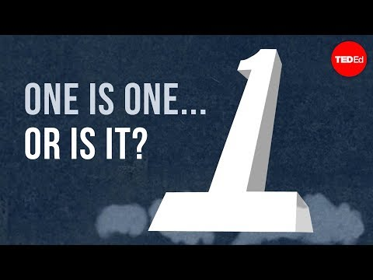
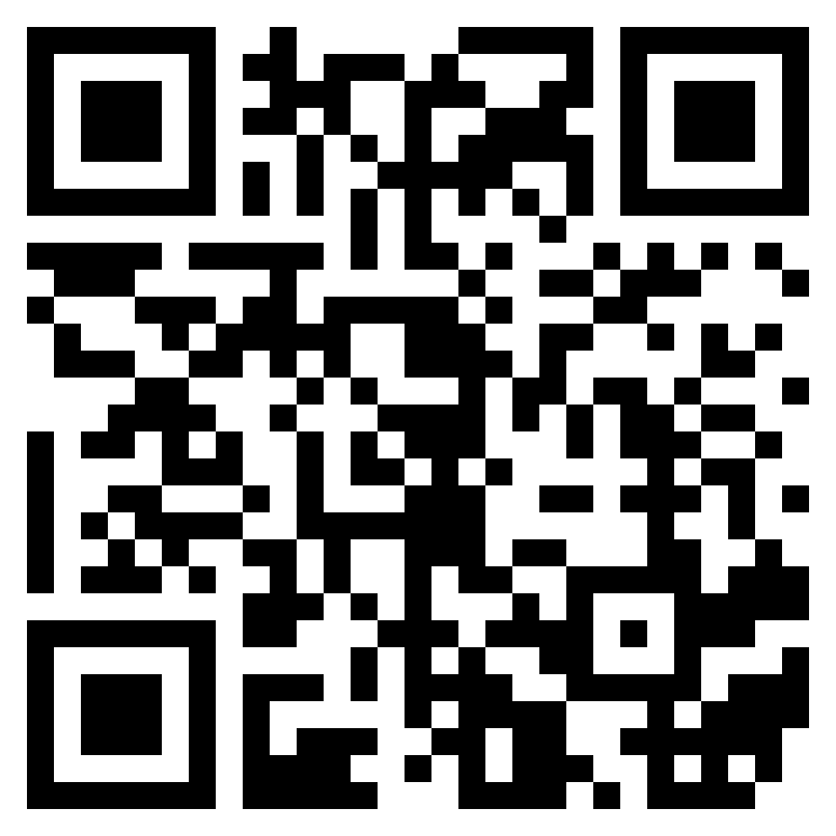
Recall: What is a unit?
Notes:
VOCAB
partition: the process of dividing something into smaller _________.
FILL-IN-THE-BLANKS
“Our whole number system depends on being able to change what we count as ______ .”
“There are two ways to change units; we can compose and we can ____________________ .”
When a unit starts out as one whole thing and is divided into smaller parts, those smaller parts are called ___________________ _______________________ .
TRUE/FALSE: Circle “T” if the statement is true. If the statement is false, circle “F.”
T / F - We can do everything with partitioned units that we can do with composed units.
T / F - Numbers always represent the same amounts, no matter their context.
T / F - A ten cannot be a unit because unit means one.

Slide 10
Recall: What is a unit?
1 = ?
1 ten = 10
1 foot = 12 inches
1 dozen = 12 donuts
1 quarter = 25 cents
Notes:
Examples (from video) of how “1 is not always 1”:
– A bag of apples
– A box of toaster pastries
– Writing numbers past 9
– A dozen eggs

Slide 11
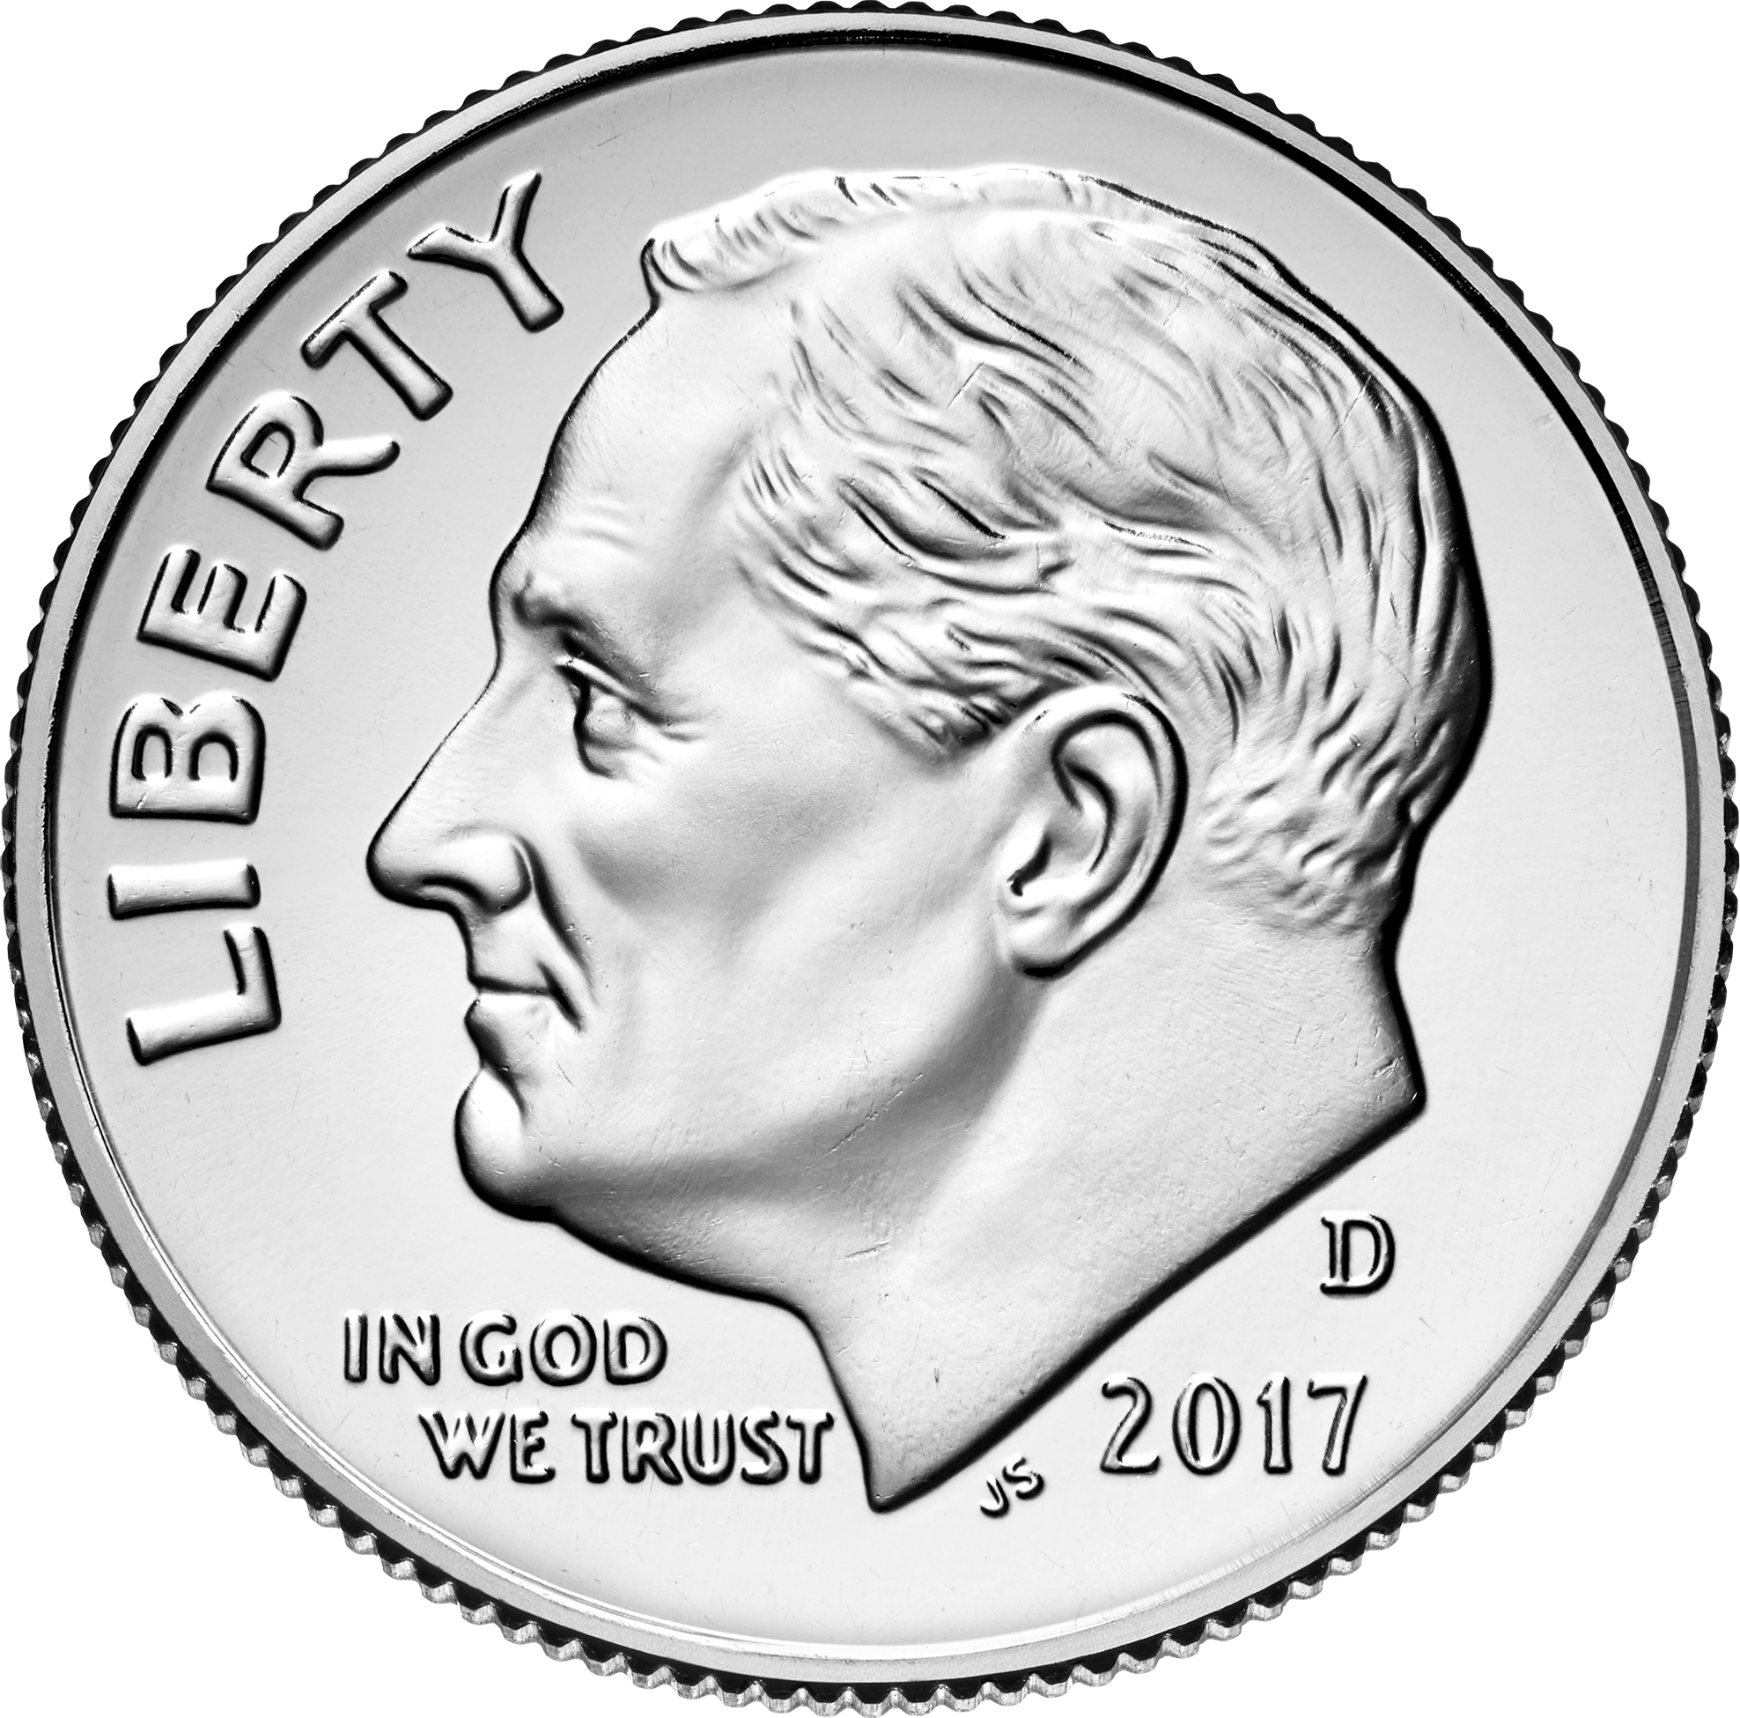
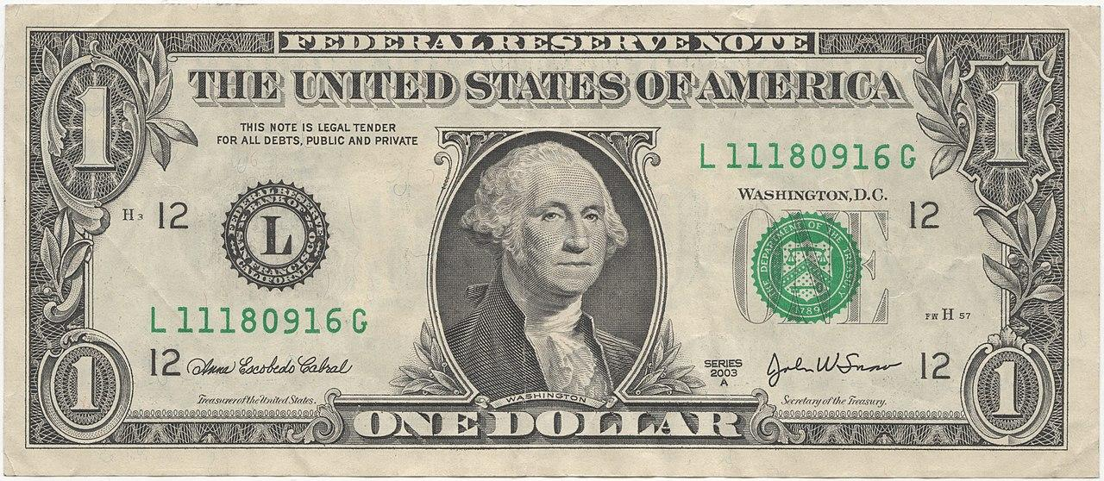
Recall: What is a unit?
How do we partition money?
=
_____ dollar can be exchanged for _____ dimes.
This means that ____ dollar can be partitioned into ____ equal parts, or units. Those parts are called tenths.
Notes:
VOCAB
part: a smaller ___________, __________, or ______________ of a whole
OTHER EXAMPLES
_____ dollar can be exchanged for _____ __________.
This means that ___ dollar can be partitioned into ____ equal parts, or units.
_____ dollar can be exchanged for _____ __________.
This means that ___ dollar can be partitioned into ____ equal parts, or units.
_____ dollar can be exchanged for _____ __________.
This means that ___ dollar can be partitioned into ____ equal parts, or units.

Slide 12
OBJECTIVE STATEMENT # 1:
I can count and name fractional units
I can count and name the fractional unit of a partitioned shape.

Slide 13

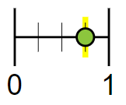
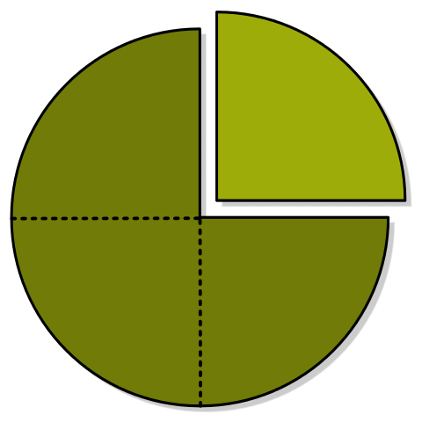
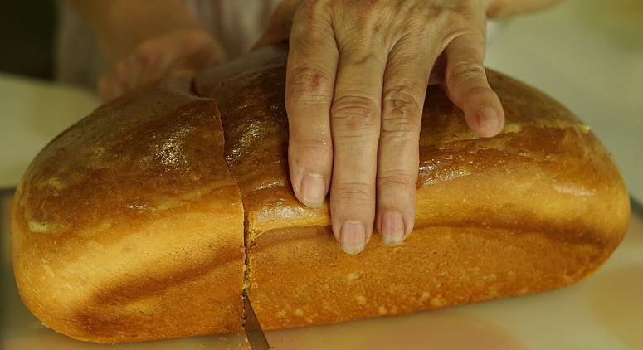

learn: That we express fractions in many ways everyday.
Authentically
(aka: practical application and “when I’m going to use this in real life”)
Conceptually
(aka: representations, like models and drawings)
In writing
(aka: words and numbers)
Three out of four
Notes:
Name the 3 main ways to express fractions:
_____________: This is how we use fractions in the world, at our jobs, at home, etc. This way of expressing fractions is often the foundation for word problems.
_____________: Using shapes and models that help us see how big a quantity is when we don’t know or cannot show its context, this expression is easy for us to read, copy, and re-create on paper.
_____________: By using numbers, we can do math problems using standard algorithms. This lets us solve equations and other math problems that would be too complicated or too much to recreate in real life or draw on paper.

Slide 14
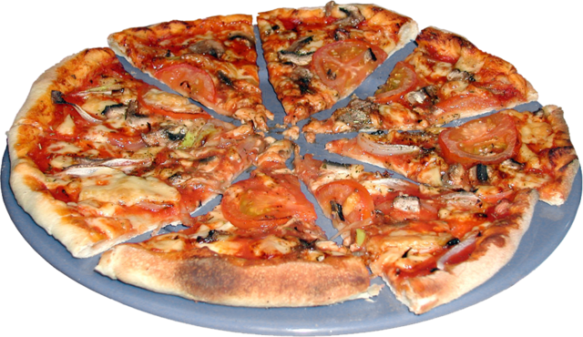
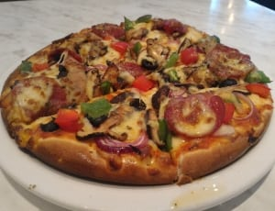
learn: That we express fractions in many ways everyday.
Equally-sized pieces of pizza are examples of fractional units. Each slice represents a unit fraction.
Notes:
VOCAB
unit fraction: one ______ of an equally-partitioned ________; a fraction with a numerator of 1
fractional unit: the _______ for the part of an equally-partitioned whole

Slide 15
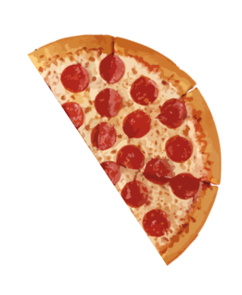
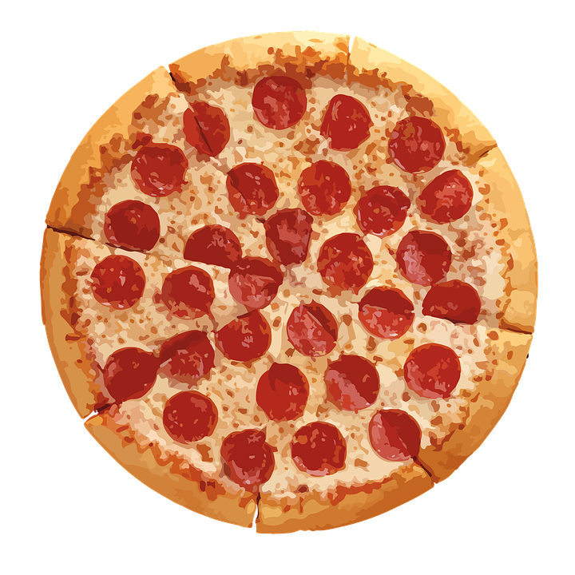
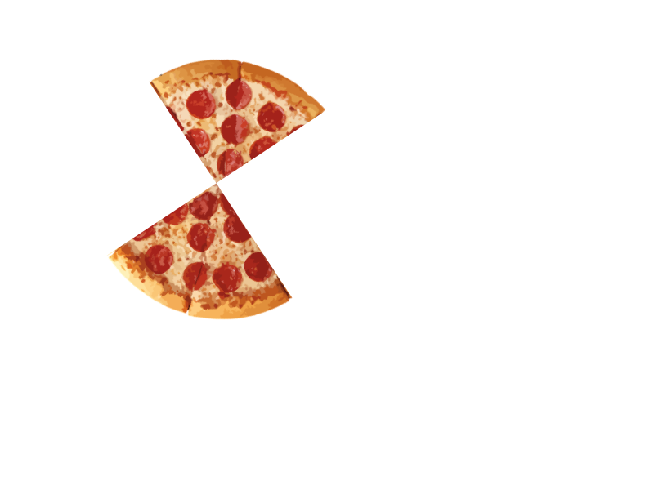
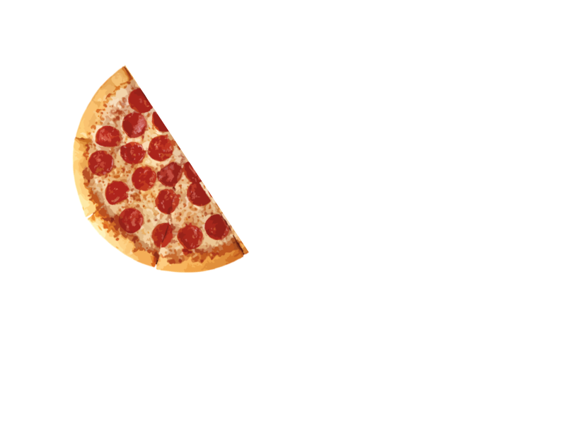
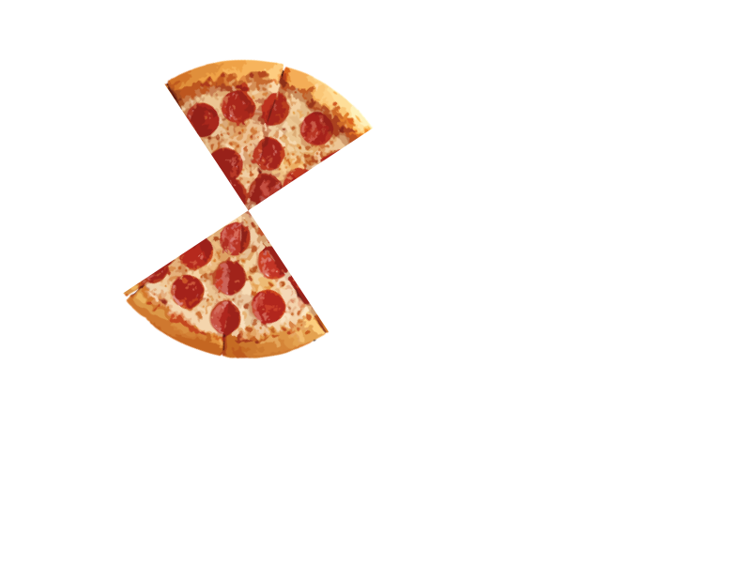
learn: To count and name the fractional units of a partitioned shape
The name and size of the fractional unit change according to how many share result from the partitioning.
Notes:
FILL-IN-THE-BLANK
Each time we _____________ a shape, we create fractions.
Halves and fourths are examples of ______________________ __________.
OTHER NOTES
_____________________________________________________________________
_____________________________________________________________________
_____________________________________________________________________

Slide 16
learn: To count and name the fractional units of a partitioned shape
The shape is partitioned into …
_______ part
_______ parts
_______ parts
The fractional unit is…
________ or ________
________
________
one-_______
The unit fraction in words…
one _______
one-_______
one-_______
Notes:
FILL-IN-THE-BLANK
The name of a fractional unit comes from how many _______ the whole unit has been _________________________ into.
What is so special about one-fourth? ________________________________________________________________.
OTHER NOTES
_____________________________________________________________________
_____________________________________________________________________
_____________________________________________________________________

Slide 17
learn: To count and name the fractional units of a partitioned shape
Partition these shapes into four equal parts to make fourths or quarters.
Notes:
TRUE OR FALSE?
T / F A shape can be partitioned into the same number of equal parts in many different ways.
T / F Partitioning a whole unit looks the same every time.
T / F Fractional units do NOT have to be the same shape to be equal in size.
T / F The parts that are created by partitions do not have to be equal in size to be considered fractional units.

Slide 18
Try: To count and name the fractional units of a partitioned shape
If ____ person is eating a pizza, they get the ________ pizza.
Splitting between _____ people? Each share is _____-_____ of a pizza.
Dividing the pizza amongst _____ friends would make each serving _____ -_________ of the whole pizza.
Notes:
Name the fractional unit:
Before partitions: _______________________________
One partition: ___________________________________
Two partitions: __________________________________

Slide 19
learn: To name fractional units
To express fractional units in writing, we generally use ordinal numbers:
If the whole is equally partitioned into… the fractional units are….
one part
two parts
whole[s]
half[ves]
three parts
four parts
five parts
six parts
seven parts
eight parts
twenty-two (22) parts
one hundred (100) parts
= thirds
= fourths / quarter[s]
= fifths
= sixths
= sevenths
= eighths
= twenty-seconds
= one-hundredths
Notes:
The names of fractions generally come from ordinal numbers. What are the three exceptions?
1. ______________________________
2. _____________________________
3. _____________________________
OTHER NOTES
_____________________________________________________________________
_____________________________________________________________________
_____________________________________________________________________

Slide 20

learn: To name a unit fraction
one part =
whole
two parts =
halves
four parts =
fourths
1 .
. 1 .
. 1 .
1
(a)
(b)
Notes:
FILL-IN-THE-BLANK
A unit fraction can be expressed with numbers using fractional notation. The names of the two numbers in a fraction are (a) _________________ and (b) _______________________.
The ________________________ names the unit.
The ________________________ quantifies, or numbers, the unit.
A unit fraction’s numerator is always ____________.
OTHER NOTES
_____________________________________________________________________
_____________________________________________________________________
_____________________________________________________________________

Slide 21
Practice: Naming fractional unit and expressing each part as a unit fraction of the whole.
Ukraine
Armenia
Mauritius
________
_/_ , _/_
________
_/_ , _/_ , _/_
________
_/_ , _/_ , _/_ , _/_
Notes:
FILL-IN-THE-BLANK
Ukraine’s flag is composed of ________ (how many?) _______________ (name of unit).
Mauritius’ flag is composed of ________ _______________.
Armenia’s flag is composed of ________ _______________.

Slide 22




share: What do you notice? What do you wonder?
Notes:
Write down your thoughts about what you’re seeing:
____________________________________________________________________________
____________________________________________________________________________
____________________________________________________________________________

Slide 23
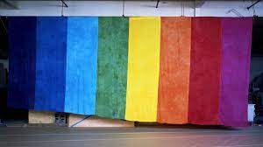


Share: What do you notice? What do you wonder?
Notes:
The history of the Rainbow pride flag:
Gilbert Baker designed the first pride flag, which had ________ (how many?) colors. This flag’s fractional unit was _______________________.
Pink was removed in 1979 because that color of fabric was not commonly found, which prevented the flag from being mass-produced. This meant that the flag now had __________ colors.
To make the number of colors on the flag an even number again, the turquoise stripe was also removed, making each of the flag’s stripes cover one-____________ of the whole flag.
The flag with these remaining colors (red, orange, yellow, green, blue, and purple) remains the most recognized Pride flag now. Each of the colors that remain take up (more / less) space than they did on the original flag.
The stripes on the Philadelphia Pride flag (released in 2017 that added black and brown) are the same size as the ones on which of the earlier Pride flags? __________________________________

Slide 24
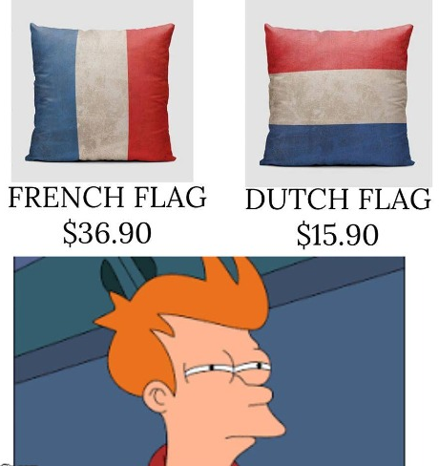
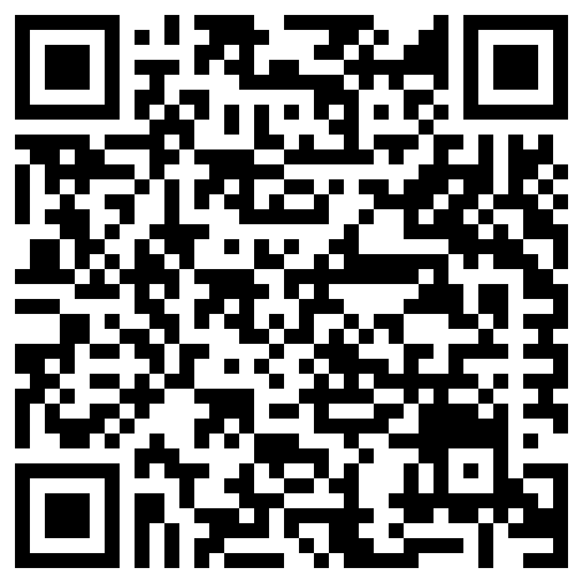
Try it out: Find the fractional units in different flags!
World Flags
Pride Flags
Notes:
National flags
Thirds: __________________________________________________________________________________
halves: __________________________________________________________________________________
fourths: _________________________________________________________________________________
wholes: __________________________________________________________________________________
Use this website to see all national flags: https://flagsworld.org/
Pride flags
thirds: ___________________________________________________________________________________
fourths: _________________________________________________________________________________
fifths: ____________________________________________________________________________________
sixths: ___________________________________________________________________________________
sevenths: ________________________________________________________________________________
Pride flags: https://www.unco.edu/gender-sexuality-resource-center/resources/pride-flags.aspx

Slide 25

Quick Check in “Put a finger down”
Objective #1 I can recognize fractional units of a whole
Put a finger down if…
You said, “This pizza is whole, and cut into halves/fourths.”
You identified fractional units of national flags as halves/thirds/fourths, and wrote ½, ⅓, and ¼ in numerical form for each of the flags’ parts.
You were able to see which Pride flags display colors in sixths, sevenths, and eighths.
I can name a unit fraction by remembering the denominator’s ordinal number.
Notes:
CHECKLIST:
❐ pizza portions
❐ Pride flag stripes (sixths, sevenths, and eighths)
❐ flag fractional units
❐ naming a unit fraction

Slide 26
OBJECTIVE STATEMENT #2:
I can model fractions
I can partition a shape or number into 1-8 equal parts to create fractional units
Clarify objectives, ask questions

Slide 27
Learn & Try: To partition a shape into equal parts
—
—
—
Notes:
MODELING CHECKLIST:
❐ whole, shaded
❐ halves, one part shaded
❐ thirds, one part shaded
❐ labels
How does the size of the unit fraction change as we add more parts to the whole?
__________________________________________________________________________________

Slide 28
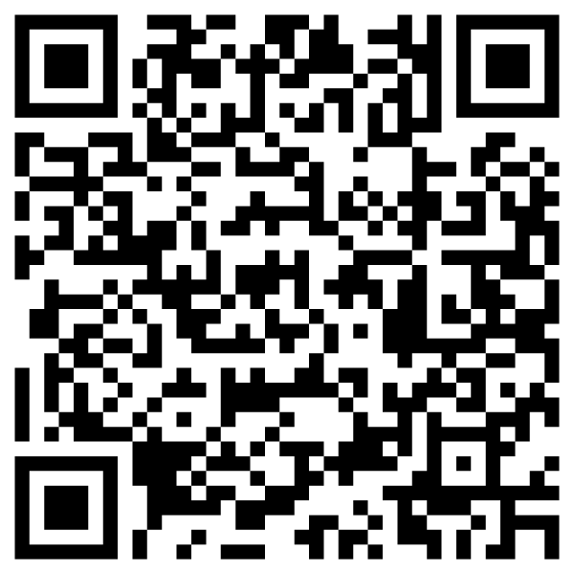
Notice + Wonder: What are the odds?
View: What are your odds of becoming a millionaire?
Discuss some things you notice about this infographic:
Where do you see fractions?
What does this make you think about?
What do you wonder about?
Notes:
Answer the questions, then discuss with a partner:
1. Where do you see fractions in this infographic?
__________________________________________________________________________
2. What does this make you think about?
__________________________________________________________________________
3. Finish the sentence:
“I wonder __________________________________________________________________.”

Slide 29
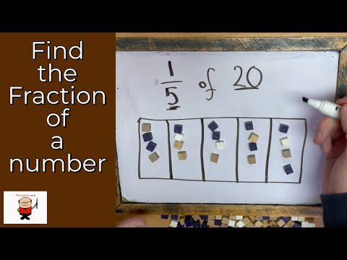
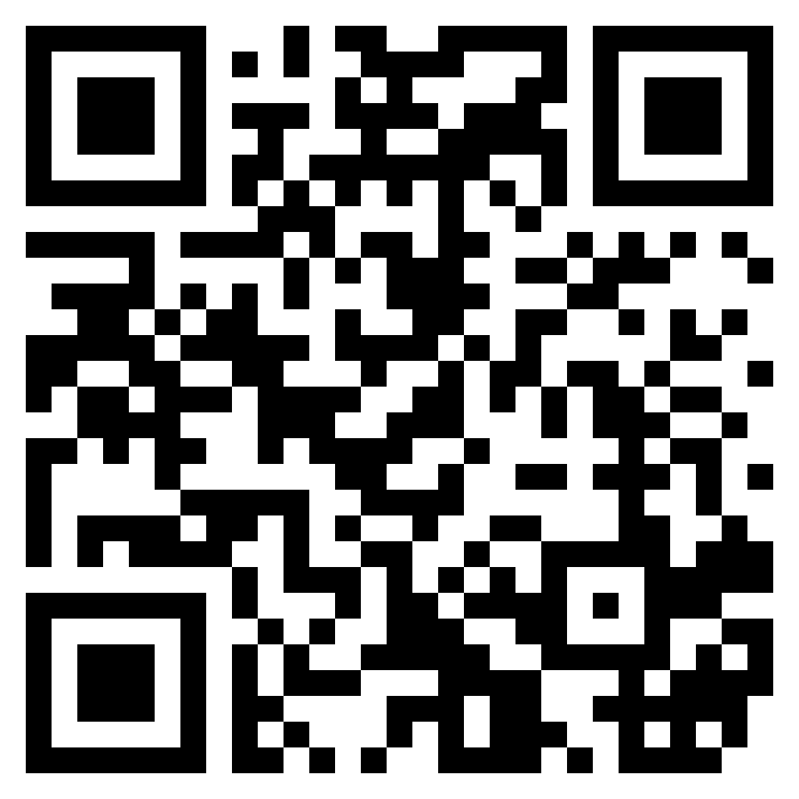
Learn: To partition a whole number into equal parts
Steps: Draw a partitioned shape and place counters
Notes:
STEPS
1. Draw a rectangle.
2. Locate the denominator of the fraction.
3. Partition the rectangle into that fraction’s unit (named by its denominator).
4. Divide up the whole number into singles by using counters. (For example: the number 20 becomes 20 ones)
5. Place one counter in each partitioned unit. Repeat until all counters are used.
6. If the fraction is a unit fraction, count the number of counters in one of rectangle’s parts.

Slide 30
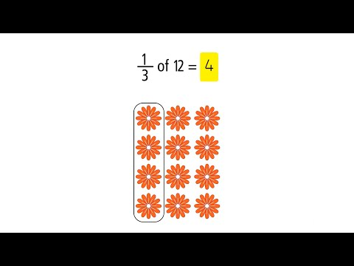
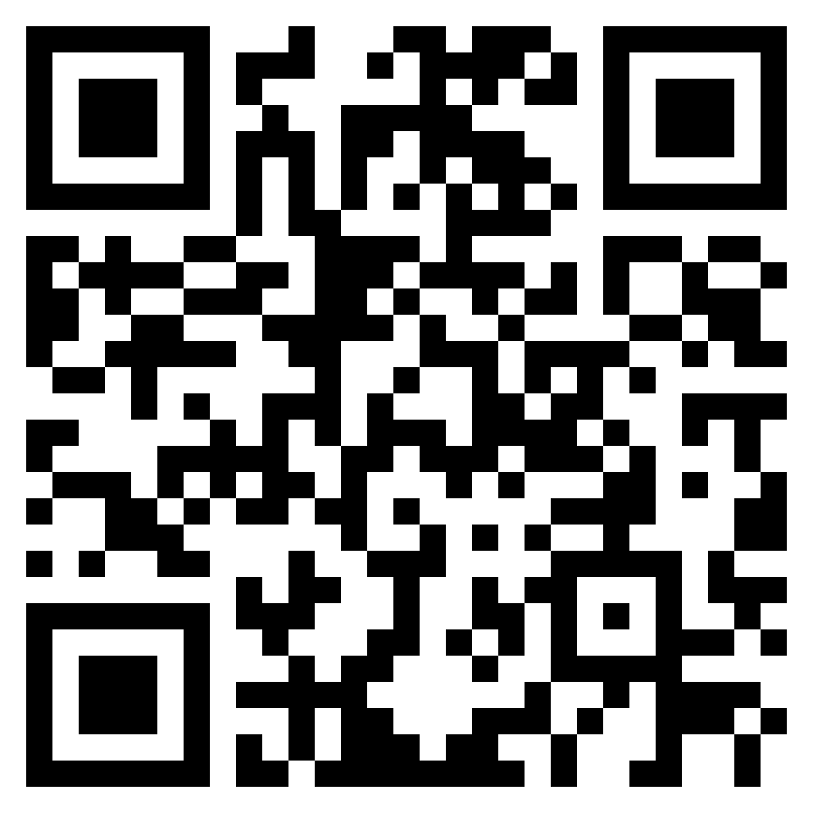
learn: To partition a whole number into equal parts
Steps: Create an array, circle sets, and count quantities
Notes:
STEPS
1. Locate the denominator of the fraction.
2. Draw that many objects in a row.
3. Continue drawing similar rows until your array contains the same number of objects as the whole number.
4. If the fraction is a unit fraction, circle one of the columns.

Slide 31
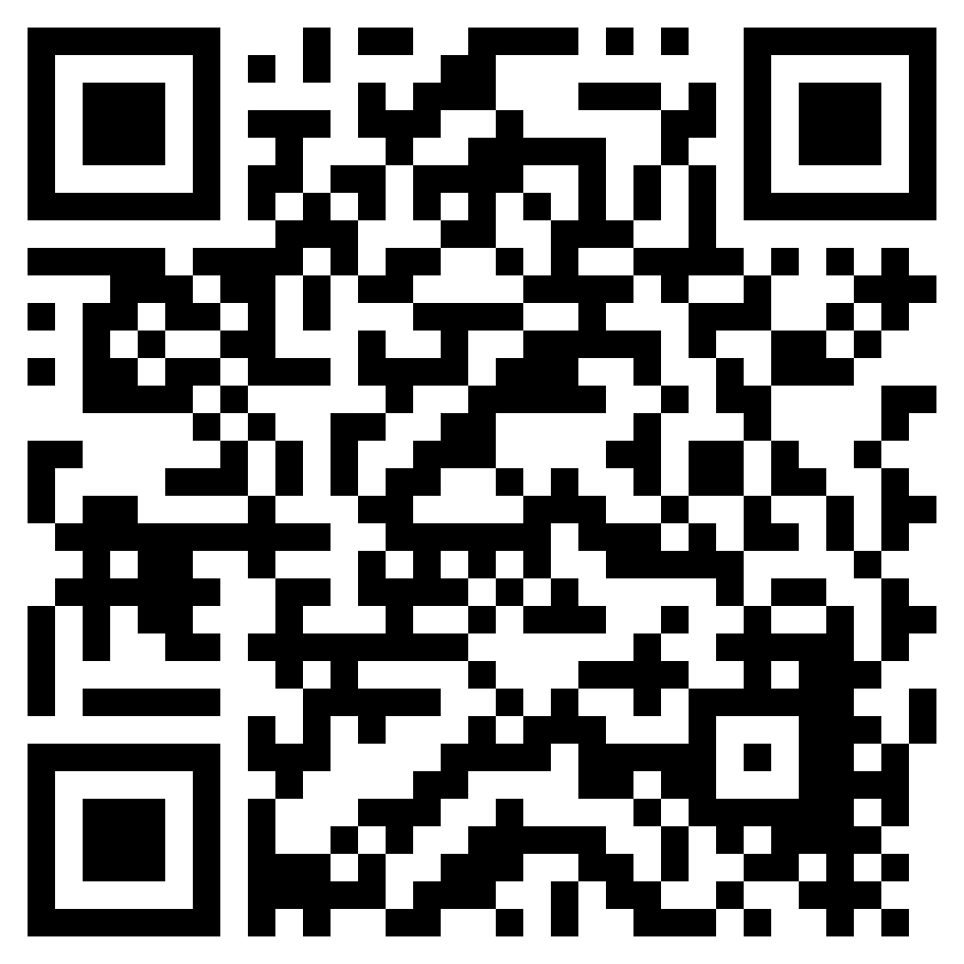
learn: To partition a whole number into equal parts
View: What are your odds of becoming a millionaire?
Hispanic (1 in 15)
Asian; White (1 in 5 for each)
Holds a college degree (1 in 6)
Holds a postgraduate degree (1 in 3)

Slide 32
PRACTICE: To partition a whole number into equal parts
View: What are your odds of becoming a millionaire?
—
—
—
Notes:
Answer the questions, then discuss with a partner:
1. Where do we see fractions in this infographic?
__________________________________________________________________________
2. What does this make you think about?
__________________________________________________________________________
3. Finish the sentence:
“I wonder __________________________________________________________________.”

Slide 33
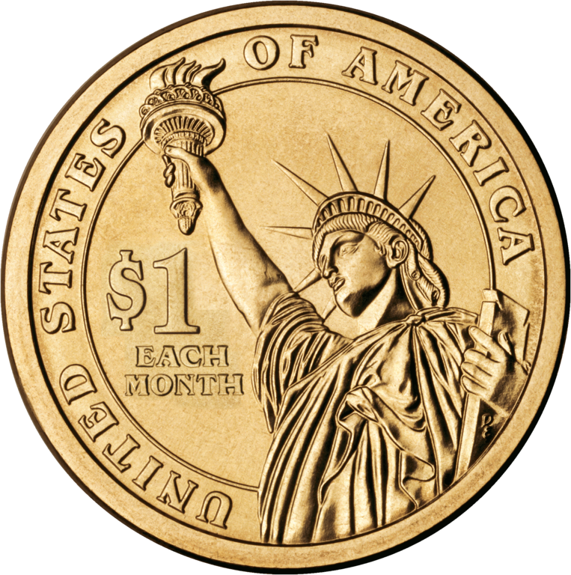
1 2 3 4 5 6
Notes:
The odds of becoming a millionaire, according to this infographic, for people who hold a college degree are 1 in 6. That means that out of 30 people who hold a college degree, the odds are that five (5) of them will become millionaires.

Slide 34
1 2 3 4 5
Notes:
The odds of becoming a millionaire, according to this infographic, for white and Asian Americans are 1 in 5. That means that out of 30 white or Asian people, the odds are that six (6) of them will become millionaires.

Slide 35
1 2 3
Notes:
The odds of becoming a millionaire, according to this infographic, for people who hold an advanced degree are 1 in 3. That means that out of 30 people that hold such a degree, the odds are that ten (10) of them will become millionaires.

Slide 36
1 2 3 4 5 6 7 8 9 10 11 12 13 14 15
Notes:
The odds of becoming a millionaire, according to this infographic, for people who are hispanic are 1 in 15.
Here are 30 coins arranged into 15 groups. We see that 1/15 of 30 is two. Of 30 people, odds are that two of them will become millionaires.

Slide 37
Quick Check-in
Objective #2: I can partition shapes and numbers into equal parts
Do you feel like you can do at least one of the following?
Draw lines on paper shapes to make equally-sized parts?
Use fraction-modeling software partition a shape into equal shares?
Partition a rectangular or circular object into a specific number of equal parts (up to 8)?
Do you feel like you can do the following?
Find the fraction of a whole number by grouping counters into parts and counting them?
Notes:
OBJECTIVE #2 CHECKLIST:
❐ make equal parts out by drawing lines on a shape
❐ use modeling software
❐ partition a rectangle or circle into __ number of parts
❐ find the fraction of a whole number by parting and counting counters

Slide 38
OBJECTIVE STATEMENT # 3:
I can compare unit fractions
3: I can choose a fractional unit that is less than or greater than another, reasoning about the size of the fractional unit

Slide 39
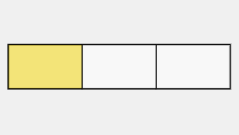
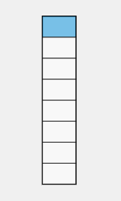
Learn: To write an inequality comparing two fractions
Write the written expressions for each shaded fraction model.
a
b
1
3
Then, write an inequality statement comparing these two expressions:
____ > ____
1
a
b
8

Slide 40
Try: To order fractions
four parts = fourths
one part shaded
eight parts = eighths
one part shaded
five parts = fifths
one part shaded
—
—
—
These are three fractional units and unit fractions from the same whole.
Notes:
The smallest of the shaded units above is ________
The largest shaded unit is _______.
The order of the fractions from smallest to largest is: _______ , _______ , and _______ .
The inequality expressing the order of the fractions from smallest to largest is _______ < _______ < _______ .

Slide 41
Quick Check in “Put a finger down”
Objective #3 I can compare unit fractions
I can…
Recognize when a unit fraction is larger or smaller than another, using modeling to help to see the difference.
Recognize when one unit fraction is larger or smaller than another when they are only written in numeral form, based on what I have learned about unit fractions.
Choose a unit fraction that is smaller than another, based on what I know about unit fractions.
Notes:
OBJECTIVE 3 CHECKLIST:
❐ compare fractions with modeling
❐ recognize a one unit fraction is smaller than another when it has a bigger denominator
❐ choose a one unit fraction that is smaller than another

Slide 42
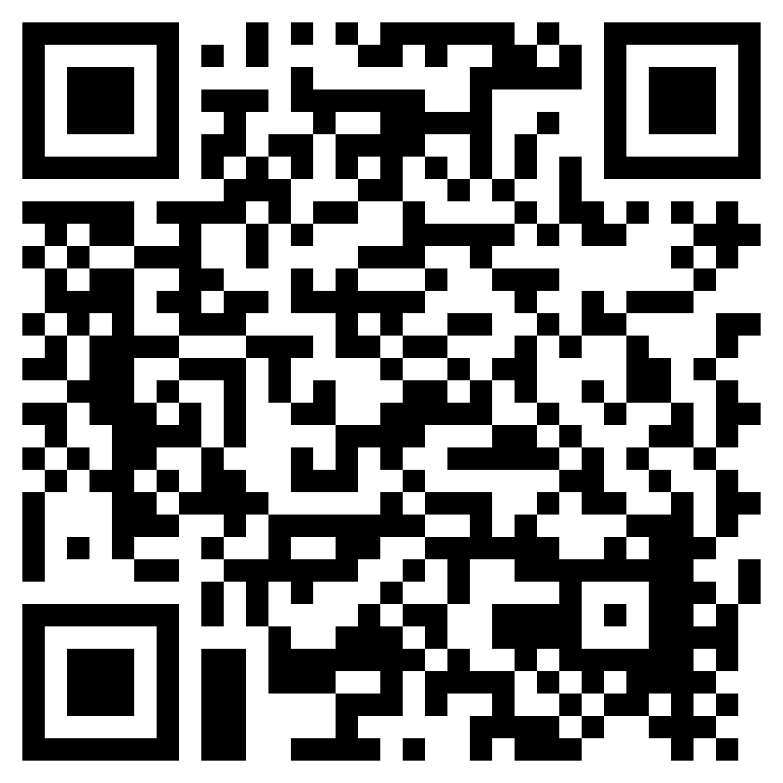
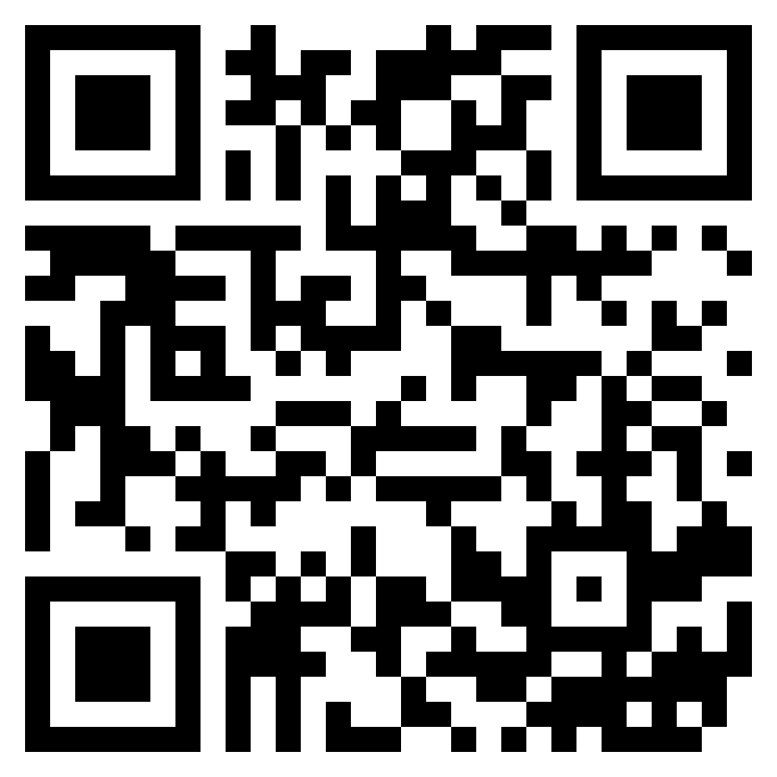
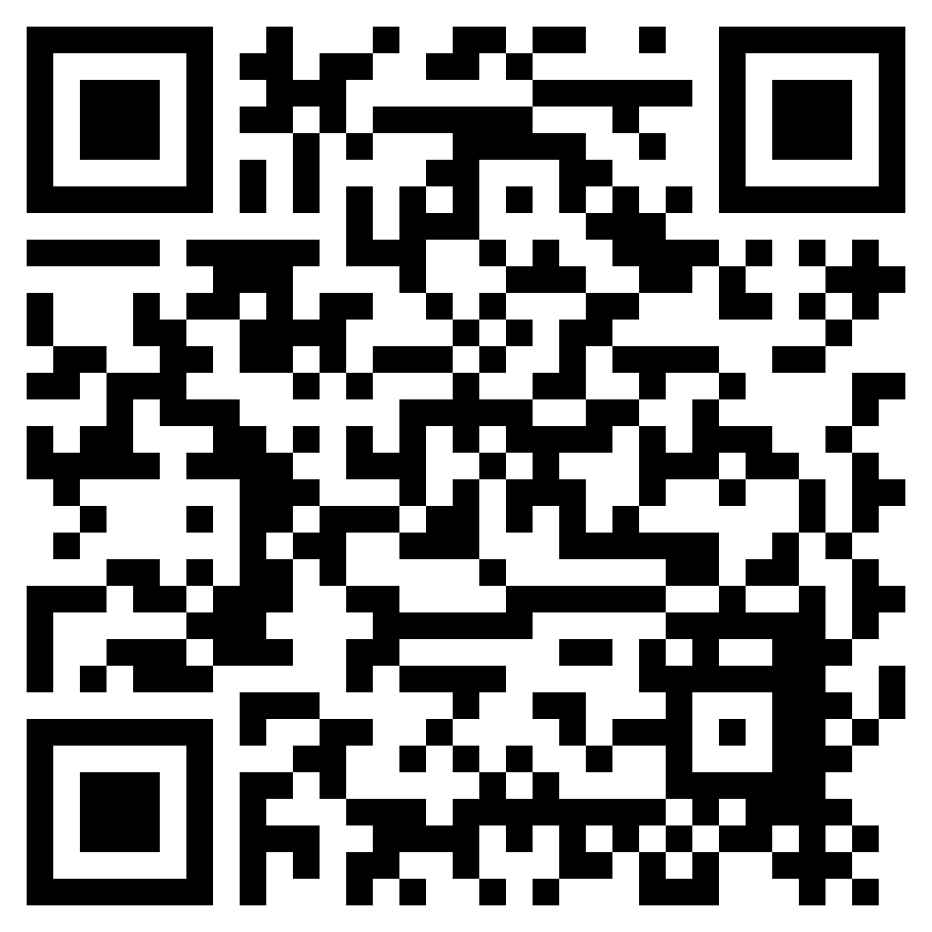
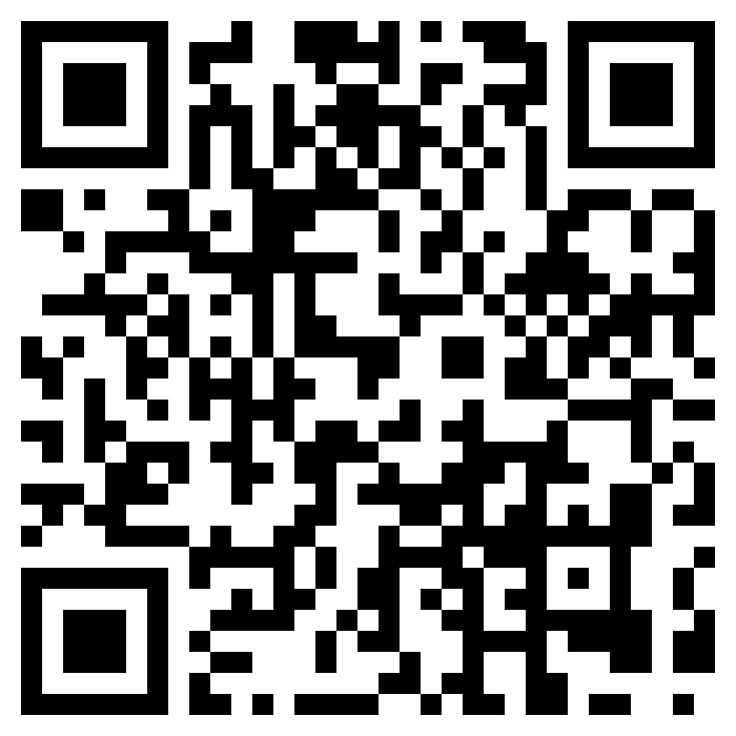
Objective statement #1: I can count and name fractional units of a partitioned shape
Fraction Splat |  | Equal parts | Fractions of Shapes | Fractions up to one half
1 | 2 | 1 | 1 | 1
Relaxed / Timed | Relaxed / Timed | N / A | N / A | N / A
SCORE: _____ | SCORE: _____ | ____ out of 5 stars | ____ out of 5 stars | ____ out of 5 stars
Notes:
[FOR STUDENTS WITH PAPER COPIES]
Fraction splat - https://www.sheppardsoftware.com/math/fractions/fractions-splat-game/
Equal parts - https://www.mathgames.com/skill/2.5-equal-parts
Fractions of the shapes - https://www.mathgames.com/skill/2.6-identify-fractions-of-shapes
Fractions up to one-fourth - https://www.mathgames.com/skill/2.7-identify-fractions-up-to-fourths

Slide 43
Objective statement #1: I can count and name fractional units of a partitioned shape
HYPER-LINK | LEVEL | MODE | RESULT
Fraction Splat | 1 | Relaxed / Timed | SCORE: _______
 | 2 | Relaxed / Timed | SCORE: _______
Equal parts | 1 | N / A | ____ out of 5 stars
Fractions of the Shapes | 1 | N / A | ____ out of 5 stars
Fractions up to one-fourth | 1 | N / A | ____ out of 5 stars
Notes:
[FOR STUDENTS WITH DIGITAL COPIES]
Fraction splat - https://www.sheppardsoftware.com/math/fractions/fractions-splat-game/
Equal parts - https://www.mathgames.com/skill/2.5-equal-parts
Fractions of the shapes - https://www.mathgames.com/skill/2.6-identify-fractions-of-shapes
Fractions up to one-fourth - https://www.mathgames.com/skill/2.7-identify-fractions-up-to-fourths

Slide 44
Small group activities: Fractional units
Objective statement #3: I can compare unit fractions
How to do it: Choose an activity to complete with a classmate or small group of classmates. List of activities and directions are found here.
ACTIVITY TYPE | DIRECTIONS
DISCUSSION | Review the infographic What Are Your Odds of Becoming a Millionaire?. Have a discussion focused on one or more of the provided question sets.
GAME | An opportunity to play with your new fraction knowledge in the styles of some familiar commercially-sold games.

Slide 45

Post-test
Language objective #1: I can count and name fractional units
Fractional unit | FILL IN THE BLANK STATEMENTS |  | Answer
 | This fraction’s whole unit has been partitioned into ____ (how many?) parts.
 | This fractional unit is called one-_________.
Notes:
How to:
Write the correct word in the blanks of the statements. The statements are about the fraction 1/2.

Slide 46


Post-test
Language objective #2: I can model fractions.
⃞
—
2
⃞
—
6
⃞
—
4
Notes:
How to:
1. Draw with pen and paper, use a modeling software, or edit this slide to demonstrate how to partition the following shapes into the number of equal parts shown by the fractions’ denominators (to the right).
2. Then, complete the written expression to express the value of one of those parts.

Slide 47



Post-test
Language objective #3: I can compare fractions.
SMALLER
LARGER
Notes:
How to:
Order the fractions from smallest to largest, placing the smallest unit fractions on the left and the greatest on the right.

Slide 48
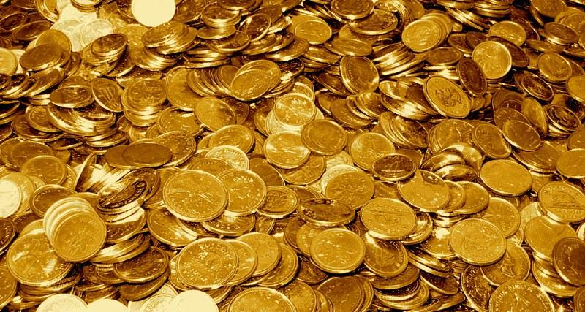
The gold .
Notes:
Explanation of GOLD slides:
Irish myth says that if you get to the end of a rainbow, you will find a pot of gold. Leprechaun folklore has withstood the test of time, and it’s easy to see why: the trope is fun, light-hearted, and can be understood and appreciated by most people. Plus, everyone loves rainbows!
Chasing a rainbow in search of gold has become a universal symbol of what it means to pursue something. Humans tend to be chasers by nature. Sometimes, the pursuit is not out of a genuine desire for the eyed prize, but simply for the pursuit itself, to have something to work toward and to experience the wonder of figuring something out.
In life, we never actually know whether our current pursuit will result in what we want. That’s why we should view the time and energy spent working towards our goals as opportunities to learn. Time spent pursuing knowledge is never wasted; knowledge is a tool that can’t be taken away. Many of our pursuits in class end in a nice, neat answer. Sometimes, though, we get an answer that sends us on another chase. Further still, some pursuits have no end at all, which makes the experience the treasure itself. To guarantee that you will always find your “gold”, it is best to look for knowledge rather than an answer. Be open-minded, flexible, and willing to learn, unlearn, and relearn.

Slide 49






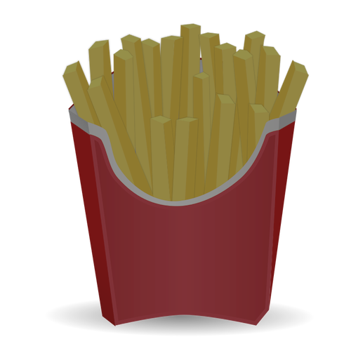
Marketing Misunderstanding: The story
Notes:
Text from “Marketing Misunderstanding” slides:
Slide 1:
This is a true story, starring A&W and McDonalds restaurant chains.
In the 1980s, McDonalds had been enjoying success with their larger-than-life burger called the Quarter Pounder. To nobody’s surprise, it had been very successful in the American markets since its debut in the early 70s. So much so that another chain decided to try to compete.
Slide 3:
In the 1980s, A. Alfred Taubman had just bought A&W, a direct competitor of McDonalds. Seeing the success that McDonalds was having with their QP burger, Taubman decided to compete. A&W released their Third-of-a-Pound Burger.
Slide 4:
Taubman put full effort into setting the TPB up for success. At ⅓ of a pound, the TPB was bigger and even outperformed the QP in blind taste tests.
A&W matched the price of their competitor’s sandwich and promoted their new product heavily with a campaign entitled “Third Is the Word.”
A&W’s TPB had all the ingredients for success.
Slide 5:
And it was an epic failure.
A&W’s sandwich was anything BUT successful. The reception was cold and the exact opposite reaction that Taubman had planned for.
The businessman was puzzled.
Slide 6:
He wanted to know WHY customers were not crazy about his sandwich!
So, he hired a research firm to investigate…
Slide 7:
The research company got to work. One of the efforts used to collect data was focus groups, wherein lay the answers A&W was looking for.
Many customers in these focus groups, even those who preferred the taste of A&W’s product, expressed the same general concern about the product: "Why should I pay the same amount for only a third-pound of meat when I could get a quarter-pound at the other place?"
In other words, customers thought that 1/4 of a pound of meat was larger than 1/3.
Slide 8:
[Meme] I was never in this for the money.
But it turns out that the money was an absolute necessity for me.
Slide 9:
A&W’s “Third is the Word” campaign was so poorly received that this campaign is now seen as one of the biggest flops in marketing history.

Slide 50

Discuss: Making informed decisions
Taubman said he learned an important lesson about communication: “Sometimes the messages we send to our customers through marketing and sales information are not as clear and compelling as we think they are.”
Notes:
How did A&W communicate to the public? And, what were their direct or indirect messages? Some examples:
Advertising platforms
Naming and pricing their product
Marketing campaign message and name “Third is the Word”
How did A&W receive feedback from their audience?
__________________________________
__________________________________
__________________________________
What did A&W not communicate to the public?
__________________________________
__________________________________
__________________________________

Slide 51
Marketing Misunderstanding: Your turn
After their royal flop, instead of trying for a comeback, A&W cut their losses and ceased efforts to compete directly for McDonalds’ QP customer base.
About 40 years later, however, they decided to capitalise on their flop and market their old burger in a new way, using the lessons learned from their 1980s campaign.
If you were in charge of the company and this had happened today, what could you have done to try for an immediate comeback?
Notes:
What is one lesson about communication can we take away from this experience? (See below for sentence starters)
____________________________________________________________________________________
____________________________________________________________________________________
____________________________________________________________________________________
____________________________________________________________________________________.
Optional sentence stems (you can also replace “communication” with “critical thinking”).
To be a better communicator/leader, it is important to _______________________
When communicating/leading a team, it helps to ____________________________
Communicating/working with others is crucial to success because ____________

