Slide 1



Set for Success
Set for Success
Set for Success
LESSONS IN GOAL-SETTING

Slide 2
Set for Success
Set for Success:
Lessons in Goal-setting
contents:
Making Numbers Count Excerpt
Intro Activities
  Blue Dots Task Sheets
    Frames A + B
    Frames C + D
    Frames E + F
    Frames G + H
    Frames I + J
    Ten-Frame Dots
  Green Squares Task Sheets
    3 x 4
    4 x 4
    5 x 4
Crowd Control (materials)
  Sheet 1: Suggested response
  Sheet 2: Started response

Slide 3
Lesson 2 Objectives + Standards
Lesson Objectives
Break up a long-term goal metric into smaller increments of consistent progress, using operation strategies and number sense
Represent a plan for incremental progress visually
Create a progress tracking graphic using document-editing software
Content Standards
3.OA.4 - Find all factor pairs for a whole number in the range 1-100. Recognize that a whole number is a multiple of each of its factors. Determine whether a given whole number in the range 1-100 is a multiple of a given one-digit number. Determine whether a given whole number in the range 1-100 is prime or composite.
3.NBT.5 - Multiply a whole number of up to four digits by a one-digit whole number, and multiply two two-digit numbers, using strategies based on place value and the properties of operations. Illustrate and explain the calculation by using equations, rectangular arrays, and/or area models.
2.OA.4 Use addition to find the total number of objects arranged in rectangular arrays with up to 5 rows and up to 5 columns; write an equation to express the total as a sum of equal addends.
2.OA.5 - Interpret products of whole numbers (e.g., interpret 5 x 7 as the total number of objects in 5 groups of 7 objects each). For example, describe a context in which a total number of objects can be expressed as 5 x 7.
1.OA.8 - Apply properties of operations as strategies to add and subtract. Examples: If 8 + 3 = 11 is known, then 3 + 8 = 11 is also known (commutative property of addition). To add 2 + 6 + 4, the second two numbers can be added to make a ten, so 2 + 6 + 4 = 2 + 10 = 12 (associative property of addition). Students need not use formal terms for these properties
1.CC.3 Write numbers from 0 to 20. Represent a number of objects with a written numeral 0-20 (with 0 representing a count of no objects).

Slide 4
Below is an excerpt from the ‘Introduction’ chapter of Making Numbers Count by Chip Heath and Karla Starr:
¹ The working world is full of [numbers]. From athletes to climate scientists to marketing professionals, people use numbers to measure their work, press their case, and motivate others to change.
² But with all the numbers floating around, it’s easy to start believing that everyone else is more on top of the numbers than we are, that somehow we missed the right class or lack the right gene, and that we are constantly at a disadvantage in understanding and using these excessively common objects.
³ But here’s a secret: nobody really understands numbers.
⁴ Nobody.
⁵ That’s just a fact of being human. Our brains evolved to deal with very small numbers. We can recognize 1, 2, and 3 at a glance, up to 4 or 5 if we’re lucky. You can get a sense of this from any kid’s counting book; your brain shouts “3!” when you see a picture of 3 goldfish, no counting necessary. That’s a process called subitizing, which our brains developed long before numerical systems were invented.
⁶ Indeed, most languages in the world and throughout history have names for the numbers 1, 2, 3, 4, and 5. But after that, the supply of numbers with names runs dry, and the language is forced to resort to a generic word such as lots for all the other numbers—from 6 and 7 on up to a billion gazillion.

Slide 5
LESSONS IN GOAL-SETTING | ACTIVITY HANDOUT 2.1a
FRAME A
FRAME B
LESSONS IN GOAL-SETTING | ACTIVITY HANDOUT 2.1a
Notes:
LESSONS IN GOAL-SETTING | ACTIVITY HANDOUT 2.1a
Frame A: 9 dots
Frame B: 10 dots

Slide 6
LESSONS IN GOAL-SETTING | ACTIVITY HANDOUT 2.1b
FRAME C
FRAME D
LESSONS IN GOAL-SETTING | ACTIVITY HANDOUT 2.1b
Notes:
LESSONS IN GOAL-SETTING | ACTIVITY HANDOUT 2.1b
Frame C: 7 dots
Frame D: 5 dots

Slide 7
LESSONS IN GOAL-SETTING | ACTIVITY HANDOUT 2.1c
FRAME E
FRAME F
LESSONS IN GOAL-SETTING | ACTIVITY HANDOUT 2.1c
Notes:
LESSONS IN GOAL-SETTING | ACTIVITY HANDOUT 2.1c
Frame E: 8 dots
Frame F: 3 dots

Slide 8
LESSONS IN GOAL-SETTING | ACTIVITY HANDOUT 2.1d
FRAME G
FRAME H
LESSONS IN GOAL-SETTING | ACTIVITY HANDOUT 2.1d
Notes:
LESSONS IN GOAL-SETTING | ACTIVITY HANDOUT 2.1d
Frame G: 4 dots
Frame H: 2 dots

Slide 9
LESSONS IN GOAL-SETTING | ACTIVITY HANDOUT 2.1e
FRAME I
FRAME J
LESSONS IN GOAL-SETTING | ACTIVITY HANDOUT 2.1e
Notes:
LESSONS IN GOAL-SETTING | ACTIVITY HANDOUT 2.1e
Frame 9: 6 dots
Frame 10: 1 dot

Slide 10
LESSONS IN GOAL-SETTING | ACTIVITY HANDOUT 2.1f (SIDE A)
Notes:
LESSONS IN GOAL-SETTING | ACTIVITY HANDOUT 2.1f
Frame 9: 6 dots
Frame 10: 1 dot

Slide 11
LESSONS IN GOAL-SETTING | ACTIVITY HANDOUT 2.1f (SIDE B)
Notes:
LESSONS IN GOAL-SETTING | ACTIVITY HANDOUT 2.1f
Frame 9: 6 dots
Frame 10: 1 dot

Slide 12
A
B
C
D
LESSONS IN GOAL-SETTING | ACTIVITY HANDOUT 2.2a
Notes:
LESSONS IN GOAL-SETTING | ACTIVITY HANDOUT 2.2a

Slide 13
A
B
C
D
LESSONS IN GOAL-SETTING | ACTIVITY HANDOUT 2.2b
Notes:
LESSONS IN GOAL-SETTING | ACTIVITY HANDOUT 2.2b

Slide 14
A
B
C
D
LESSONS IN GOAL-SETTING | ACTIVITY HANDOUT 2.2c
Notes:
LESSONS IN GOAL-SETTING | ACTIVITY HANDOUT 2.2c

Slide 15
A
B
C
D
LESSONS IN GOAL-SETTING | ACTIVITY HANDOUT 2.2d
Notes:
LESSONS IN GOAL-SETTING | ACTIVITY HANDOUT 2.2d

Slide 16
LESSONS IN GOAL-SETTING | ACTIVITY HANDOUT 2.3a
Notes:
LESSONS IN GOAL-SETTING | ACTIVITY HANDOUT Sheet 2.3a

Slide 17
LESSONS IN GOAL-SETTING | ACTIVITY HANDOUT 2.3b
Notes:
LESSONS IN GOAL-SETTING | ACTIVITY HANDOUT Sheet 2.3b

Slide 18
LESSONS IN GOAL-SETTING | ACTIVITY HANDOUT 2.3c
Notes:
LESSONS IN GOAL-SETTING | ACTIVITY HANDOUT Sheet 2.3c

Slide 19
COUNTING BLOCKS
10 → x 12 ↓

Slide 20
Progression of math visuals
(from counting to multiplying)
Counting
Skip-counting
Addition
Composing
Repeat Addition
Multiplying
Counters:
Ten Frames:
Groups/Sets:

Slide 21
Progression of math visuals
(from composing to multiplying)
Blocks and Tenrods:
Arrays:
Area Models:

Slide 22
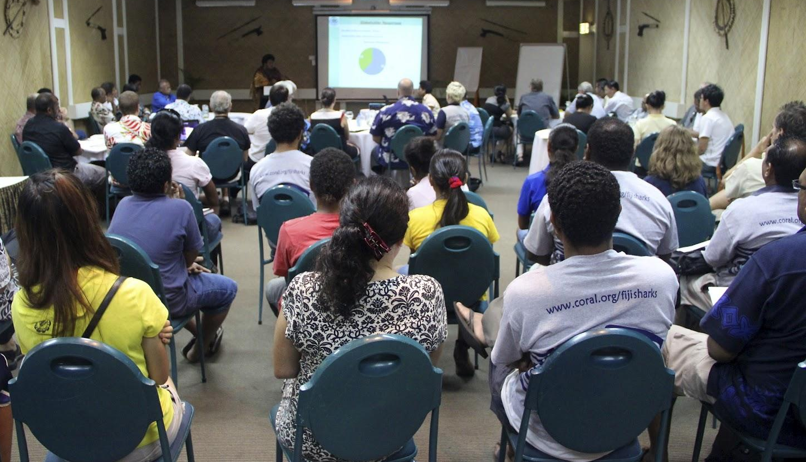


Which would be a reasonable estimation of how many people are in this room?
A) 10 people
B) 20 people
C) 40 people
D) 100 people
Which would be a reasonable estimation of how many people are in this picture?
A) 20 people
B) 100 people
C) 200 people
D) 500 people
Which would be a reasonable estimation of how many people are in this room?
A) 100 people
B) 1,000 people
C) 10,000 people
D) 100,000 people
Notes:
LESSONS IN GOAL-SETTING | ACTIVITY HANDOUT 2.4a
ANSWERS:
C,B,B

Slide 23
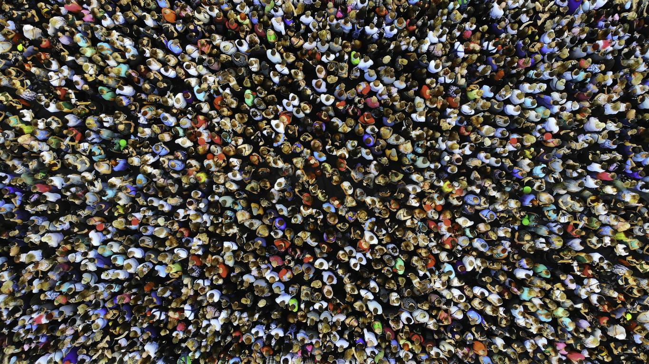

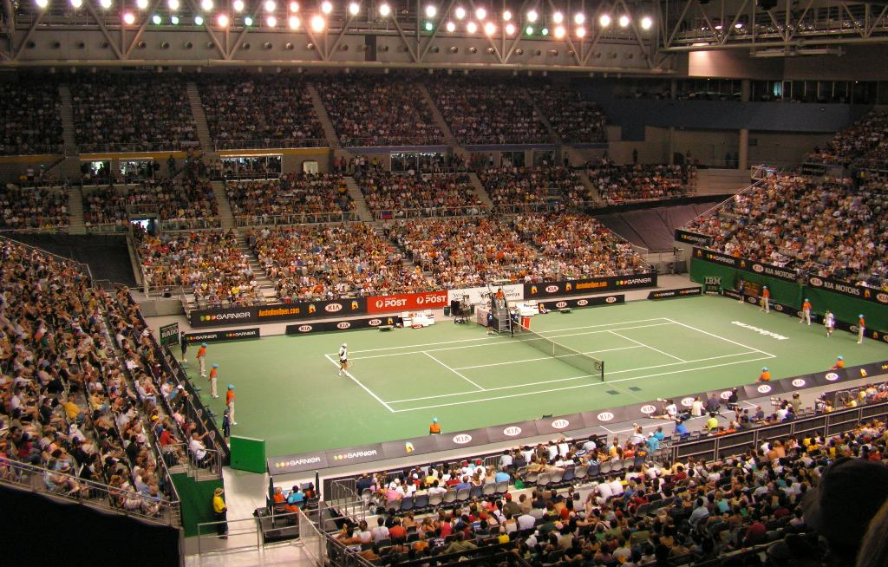
Which would be a reasonable estimation of how many people are in this picture?
A) 100 people
B) 500 people
C) 1,000 people
D) 5,000 people
Which would be a reasonable estimation of how many people are in this room?
A) 20 people
B) 200 people
C) 2,000 people
D) 20,000 people
What are some reasonable estimations of how many people are in this stadium?
Notes:
LESSONS IN GOAL-SETTING | ACTIVITY HANDOUT 2.3b
ANSWERS:
C, B, answers vary (~5K for the picture, ~10K for stadium)

Slide 24
Notes:
LESSONS IN GOAL-SETTING | ACTIVITY HANDOUT 2.3c
SOLUTIONS:
#1. ~7-10 people per column, 5 columns; ~35-50 people, closest to 50
#2. ~11-16 people per square, 8 squares; ~88-128 people, closest to 100
#3. Answers and approaches will vary. Students should see that the row closest to the camera has only a few people, whereas the rows further back are much more densely packed. So, the middle and top rows should be relied on when calculating the amount of people in the whole room ~20+ in middle row and ~30-40+ in top row; 30 x 20 = 600, or 30 x 30 = 900; 600 and 900 are closest to 1,000 than any other options

Slide 25
Notes:
LESSONS IN GOAL-SETTING | ACTIVITY HANDOUT 2.3d
SOLUTIONS:
#1. ~16-22 people per square, 60 squares (totaling 960-1,320); ~1K people
#2. Answers will vary but should be reasonably close to 200. Could do vertical columns and count number of students in one, then multiply it by the number of columns
#3. Answers will vary but should be in the thousands, less than 10K (for pic) and about 10K (estimating the whole stadium). Possible entry points: number of seats in a row close to the front of picture, number of rows from top of bleachers to bottom, how many sections of seats are seen

Slide 26
How to read pages by color of titles
Green = layout, with explanations and an example
Blue = full blank copy is what a student would print out to start using (if not typing text into the blanks)
Red = filled in with examples of student “writing”
Pink = instructions, extra help

Slide 27
MULTIPLICATION CHART
12 x 12
X | 1 | 2 | 3 | 4 | 5 | 6 | 7 | 8 | 9 | 10 | 11 | 12
1 | 1 | 2 | 3 | 4 | 5 | 6 | 7 | 8 | 9 | 10 | 11 | 12
2 | 2 | 4 | 6 | 8 | 10 | 12 | 14 | 16 | 18 | 20 | 22 | 24
3 | 3 | 6 | 9 | 12 | 15 | 21 | 21 | 24 | 27 | 30 | 33 | 36
4 | 4 | 8 | 12 | 16 | 20 | 24 | 28 | 32 | 36 | 40 | 44 | 48
5 | 5 | 10 | 15 | 20 | 25 | 30 | 35 | 40 | 45 | 50 | 55 | 60
6 | 6 | 12 | 18 | 24 | 30 | 36 | 42 | 48 | 54 | 60 | 66 | 72
7 | 7 | 14 | 21 | 28 | 35 | 42 | 49 | 56 | 63 | 70 | 77 | 84
8 | 8 | 16 | 24 | 32 | 40 | 48 | 56 | 64 | 72 | 80 | 88 | 96
9 | 9 | 18 | 27 | 36 | 45 | 54 | 63 | 72 | 81 | 90 | 99 | 108
10 | 10 | 20 | 30 | 40 | 50 | 60 | 70 | 80 | 90 | 100 | 110 | 120
11 | 11 | 22 | 33 | 44 | 55 | 66 | 77 | 88 | 99 | 110 | 121 | 132
12 | 12 | 24 | 36 | 48 | 60 | 72 | 84 | 96 | 108 | 120 | 132 | 144

Slide 28

Finding icons and images
Icons found within Google Slides:
Insert > Image > Search the web
Insert > Table
Insert > Shapes
Options from outside of Google Slides:
Google search, or directly from a website
  Save image + insert
  Copy image + paste
Websites:
  https://icons8.com/
Image search tips:
Use singular, common nouns when searching
Try different combinations of words until you find what you want
Type the name of the object, along with “black and white” or “icon”

Slide 29
Online Digital Literacy lesson material:
Intro to Google Slides:
https://edu.gcfglobal.org/en/googleslides/getting-started-with-your-presentation/1/
Working with text:
https://edu.gcfglobal.org/en/googleslides/text-basics/1/
Adding pictures and shapes:
https://edu.gcfglobal.org/en/googleslides/adding-pictures-and-shapes/1/

Slide 30
Placing icons and images
Tips and tricks to getting a tidy array
Hold the Shift key while creating shapes to get proportional icons
Save time by selecting an image (or multiple images) and typing Ctrl+D keys to duplicate
To change more than one image or text box at once, hold the Ctrl button while selecting images. You can now move, align, or distribute them (see below).
To align icons, select images on the page to align and right click. Choose Align Vertically for columns and Horizontally for rows.
To space icons out evenly, select images and right click. Then, choose Distribute (rows = horizontal; columns = vertical).
Objects are automatically “layered” according to when they were created. So, first objects are on the bottom. Latest are near the top. You can change the order: Right click on an object, choose Order, and send it “to the back” (which means that all other objects go on top of it) or “backward” (which means that it just falls behind the last thing created). You can do the same with bringing earlier objects to the front.

Slide 31
Resizing icons and images
Height is longer than width
≠ a symmetrical shape
Hold down the ‘Shift’ key to get symmetrical shapes and keep image proportions

Slide 32
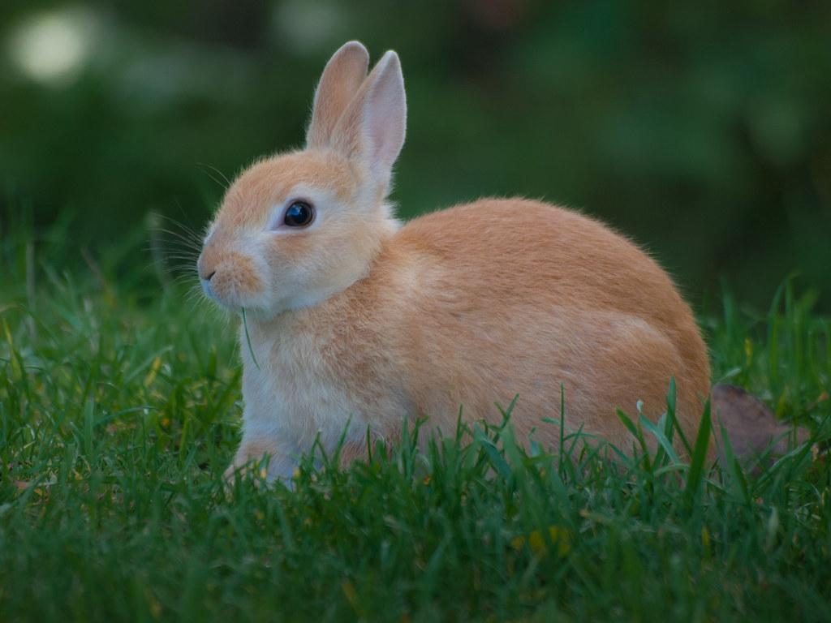
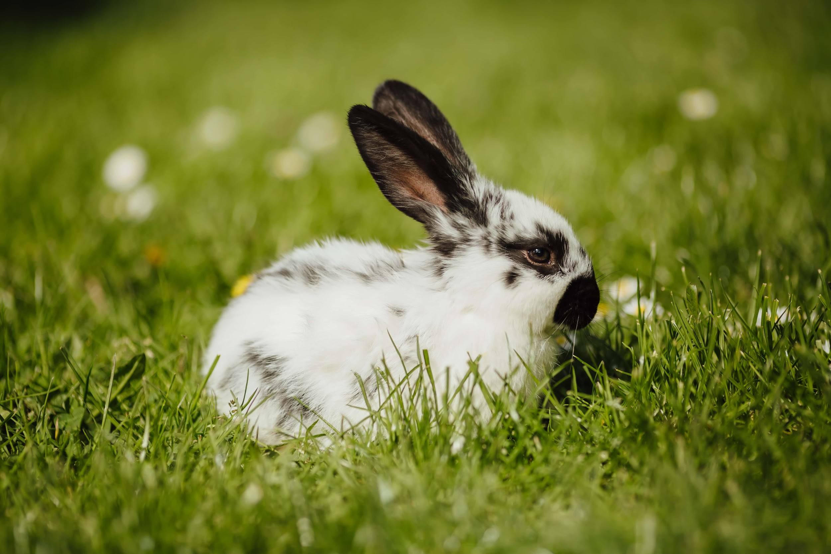
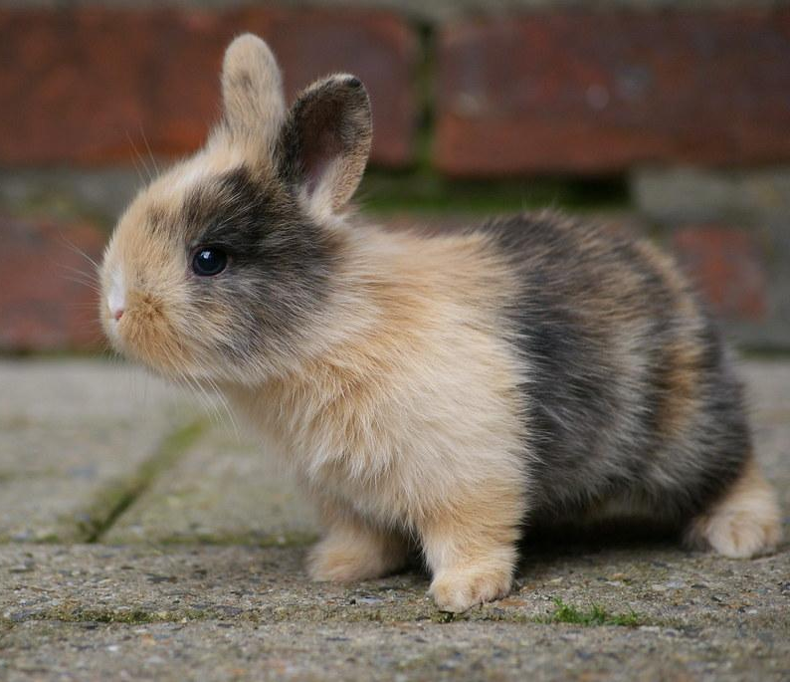
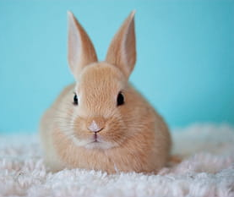
DIGITAL LITERACY TASKS - EXAMPLES
Task 1: Save the Bunnies! Text boxes & Images
Goal: Create a box big enough to “house” four bunny images
Objectives:
Find four bunny images and add to slide
Create a perimeter around the bunnies by adding and formatting a text box to be big enough to hold them
Bonus points if the bunnies are similarly sized and/or sitting in straight rows
Task 2: Tic-Tac-Toe! (Tables and shapes)
Goal: Create and play a game of Tic-Tac-Toe with a friend
Objectives:
Create a Tic-Tac-Toe grid using table or lines
Create your icons using one shape, duplicated up to five icons
Take turns placing icons in a grid’s cells until one person gets three in a row
Task 3: Challenge a friend! Typing / editing
Goal: Create a set of challenges for your buddy
Objectives:
Navigate to classmate’s slide
Using a textbox, write one sentence about goal-setting, but leave a blank for your classmate to fill in.
In the same textbox, write one math equation with a blank for a number or an operation (either side of the equality sign).
Using a second textbox, describe how your classmate must edit the text in it (e.g.: “bold, blue text”; “right aligned, Calibri font”).
Student 1:
Goals must be ____________, not vague or general.
12 x __ = 36
Student 1:
Arial font, blue, center-aligned
Student 2:
Goals must be _specific_, not vague or general.
12 x 3 = 36
Student 2:
Arial font, blue, center-aligned

Slide 33
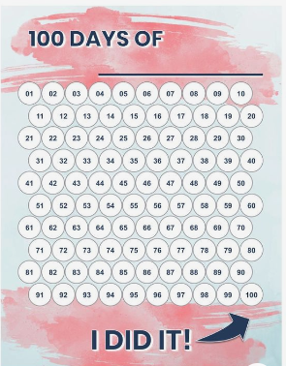
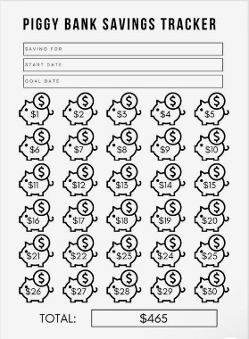
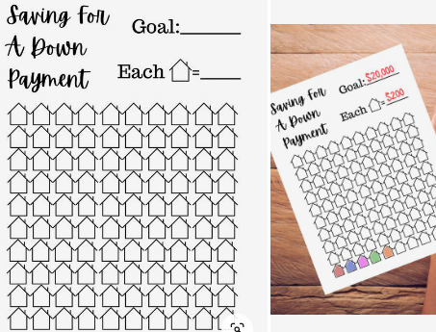
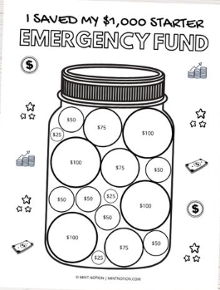
Example trackers:
Savings tracker: $10K House Savings
Coloring page: Bubble-Gum Jar!
counters
array
Notes:
An example of a progress tracker where the creator used a “good enough” number: https://www.pinterest.com/pin/377809856257236502/
Differing amounts of incremental progress: https://www.pinterest.com/pin/627407791845573495/
Book trackers for kids (different amounts and subtotal progress is marked as progress is made, rather than totaled at the end): https://letscraftinstead.com/book-tracker-printables/
Tracks amounts per day, two columns of 15 days and same unit per day: https://www.pinterest.com/pin/426716133456332136/

Slide 34
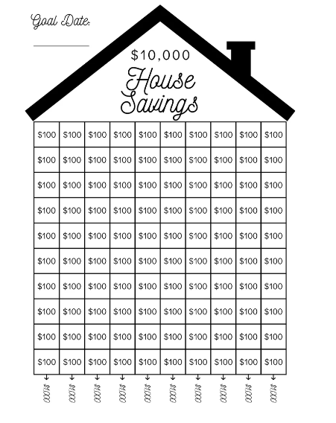

Slide 35
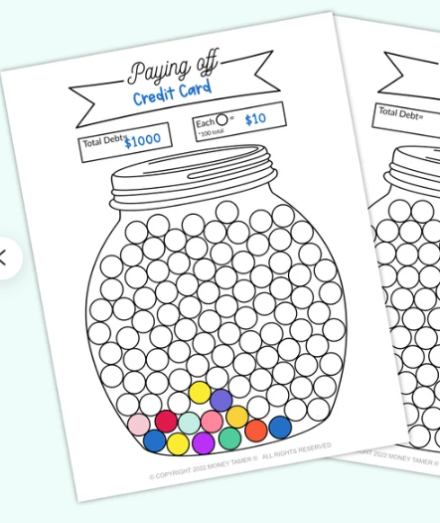

Slide 36
Calendar
Example
M | T | W | TH | F
1 | 2 | 3 | 4 | 5
8 | 9 | 10 | 11 | 12
15 | 16 | 17 | 18 | 19
22 | 23 | 24 | 25 | 26
1
= task was done this day
GOAL
___ days x 4 weeks = complete ____ times monthly
ACTUAL
___ days = chore completed ___ times this month
What
This kind of tracking can be used like a series of mini-calendars to record tasks that are completed on a regular basis (chores, homework, showering, etc.).
Why
Recording the completion of multiple repetitive tasks is much easier when the data is all on one page. This visual gives feedback right away on completion of many tasks over the same time, including which day of the week this progress tends to be made.
Decide which days per week you want to include. This will tell you the number of columns your table will need.
Decide how many weeks you want to track (number of rows).
Add an additional row of cells on top of the table to place the days of the week
Insert a table with the right number of columns and rows (including the extra row for labeling)
Label days of the week on top row
Optional: Fill in the cells with each day’s date
How
The math
You must decide which days each week you will track this task for completion status. That number becomes the number of columns of your chart. The rows will be how many weeks you will monitor this task, plus the header column for labeling.
For the equation, you will choose how many times a week you are aiming to accomplish this task and multiply that by the number of weeks you’re monitoring it. When you’re recording the progress, you fill in the blanks of your ACTUAL data with the right numbers.

Slide 37
House Chore Chart
(Example blank)
= chore was completed
GOAL:
_3_ days x _4_ weeks = each chore will be completed _12_ times monthly
Laundry
Dishes
M | T | W | TH | F
1 | 2 | 3 | 4 | 5
8 | 9 | 10 | 11 | 12
15 | 16 | 17 | 18 | 19
22 | 23 | 24 | 25 | 26
M | T | W | TH | F
1 | 2 | 3 | 4 | 5
8 | 9 | 10 | 11 | 12
15 | 16 | 17 | 18 | 19
22 | 23 | 24 | 25 | 26
ACTUAL
___ days = laundry completed ___ times
ACTUAL
___ days = dishes completed ___ times
Trash / Dusting
Vacuum
M | T | W | TH | F
M | T | W | TH | F
1 | 2 | 3 | 4 | 5
8 | 9 | 10 | 11 | 12
15 | 16 | 17 | 18 | 19
22 | 23 | 24 | 25 | 26
1 | 2 | 3 | 4 | 5
8 | 9 | 10 | 11 | 12
15 | 16 | 17 | 18 | 19
22 | 23 | 24 | 25 | 26
ACTUAL
___ days = trash taken out ___ times
ACTUAL
___ days = vacuuming completed ___ times

Slide 38
House Chore Chart
(Example filled out)
= chore was completed
Laundry
Dishes
M | T | W | TH | F
1 | 2 | 3 | 4 | 5
8 | 9 | 10 | 11 | 12
15 | 16 | 17 | 18 | 19
22 | 23 | 24 | 25 | 26
M | T | W | TH | F
1 | 2 | 3 | 4 | 5
8 | 9 | 10 | 11 | 12
15 | 16 | 17 | 18 | 19
22 | 23 | 24 | 25 | 26
ACTUAL
_12_ days = laundry completed _12_ times
ACTUAL
_11_ days = dishes done _11_ times
Trash / Dusting
Vacuum
M | T | W | TH | F
1 | 2 | 3 | 4 | 5
8 | 9 | 10 | 11 | 12
15 | 16 | 17 | 18 | 19
22 | 23 | 24 | 25 | 26
M | T | W | TH | F
1 | 2 | 3 | 4 | 5
8 | 9 | 10 | 11 | 12
15 | 16 | 17 | 18 | 19
22 | 23 | 24 | 25 | 26
ACTUAL
_13_ days = trash/dusting completed _13_ times
ACTUAL
_11_ days = vacuuming completed _11_ times

Slide 39

Iconic rate
Unit rate format, where 1 icon represents a chosen amount of incremental progress
Example
one icon = _______________
x = of studying .
What
This method uses an area model or an array of icons/shapes, each of which represent certain amounts of time, space, money, weight, or some other measurable unit. The unit represents the incremental progress made towards a goal on a consistent basis.
Why
This type of tracking is good for breaking down a goal into smaller, manageable chunks of progress. Making progress in fixed, repeated increments is also good for general habit-building, which helps ensure long-term success.
How
Creating this model requires the toolbar’s “Insert” feature
Option 1: Search the web for an array icon, via Slides
  “Insert” > “Image” > “Search the web”
  Search for an icon (any object that could “represent” your goal)
Option 2: Choose an icon from the internet, via Google search
  Explore icons through Google search or on a specific website
  Save chosen icon to PC
  “Insert” > “Image” > “Upload from computer” and choose the file you saved
Option 3: Create an array of shapes
  “Insert” > “Shape” > choose your shape
  Click on your page and drag cursor to make shape
Option 4: Create an area model using a table
  “Insert” > “Table” > choose your grid dimensions
  Dimension inputs are # of columns X # of rows
The Math
To use this model, the student must choose a goal number that can be factored more than two ways. This should give you three factors to work with: one unit rate and two side lengths of your area model or array. You will also write an equation that reflects the math of the goal statement.

Slide 40
ASSIGNMENTS LOGGED
(Example blank)
= 1 assignment in that subject
LANGUAGE ARTS - READING
LANGUAGE ARTS - WRITING
SOCIAL STUDIES
SCIENCE
MATH
Notes:
Using area models

Slide 41



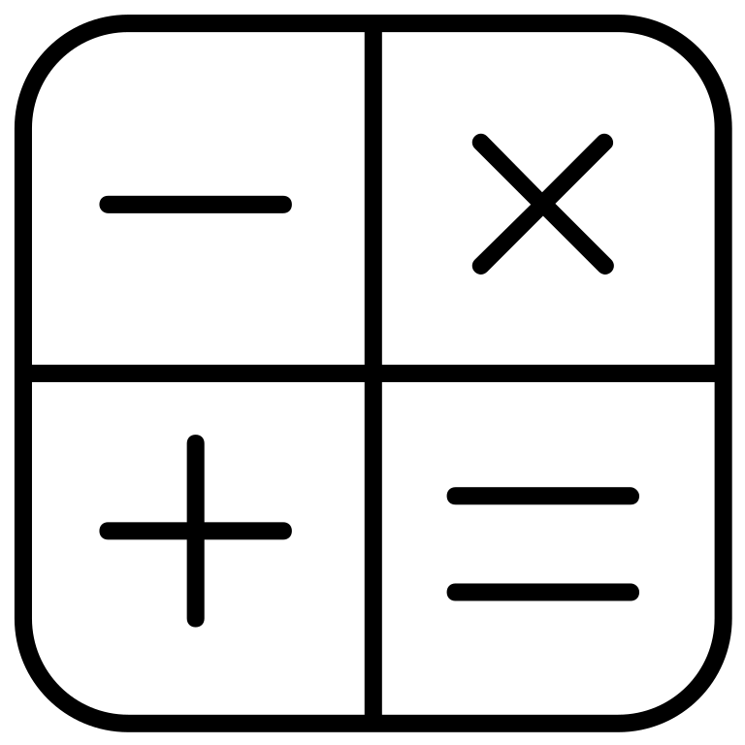
STUDY HOURS
(Example blank)
Format:
(# of icons) x (increments of progress) = (total # hours)
LANGUAGE ARTS - READING
one book = _______________
x = of studying .
LANGUAGE ARTS - WRITING
one pencil = _______________
x = of studying .
SOCIAL STUDIES
one map = _______________
x = of studying .
SCIENCE
one beaker = _______________
x = of studying .
MATH
one calculator icon = _______________
x = of studying .
Notes:
Using arrays

Slide 42
STUDY HOURS
FILLED IN WITH EXAMPLES
Unit rate format, where 1 icon represents chosen amount of incremental progress
Format: (# of icons) x (increments of progress) = (total progress made)
Example: 10 icons x 2 hour each = 20 hours of studying for Reading
LANGUAGE ARTS - READING
one book = 2 hours of study
20 books x 2 hours = 40 hours of studying Reading
LANGUAGE ARTS - WRITING
one pencil = 2 hours of study
20 pencils x 2 hours = 40 hours of studying Writing
SOCIAL STUDIES
one map = 1 hour of study
20 maps x 1 hour = 20 hours of studying Social Studies
SCIENCE
one beaker = 1 hour of study
20 pencils x 1 hour = 20 hours of studying Science
MATH
one calculator icon = 1.5 hours of study
20 icons x 1.5 hours = 30 hours of studying Math

Slide 43

Chunking
4
5
4
8
10
10
30
40
50
50
30
20
3
5
4
8
3
3
5
8
What
This kind of tracking gives you variability in pacing your progress by chunking steps into different amounts. It’s a good way to break up a not-so-neat number and track it visually. To mark your progress, color in a number to correspond with the amount of progress made. For example, if I place $3 in my rainy-day fund, I will color in one of the $3 rain drops.
Why
Some of us need to be able to make inconsistent amounts of progress toward our goals. This highly-flexible method allows you to challenge yourself to take both big and small steps. The advantage to having a mix of both is that neither the number of steps nor the size is overwhelming.
How
Search for a black-and-white (or, black-and-transparent) image you like, either in Slides or via a Google search
Choose an image with dark, defined lines and white/transparent spaces to add numbers
Alter and add to image with extra lines or shapes, if necessary
Decide what your addends will be (make sure it adds up to your long-term goal number)
Insert one addend per open space
The math
Your goal number will be the sum of all numbers on your coloring page. This requires counting the number of spaces that need to be filled and deciding what addends to use to express that goal number. You will place an addend in each space.

