Slide 1



Set for Success
Set for Success
Set for Success
LESSONS IN GOAL-SETTING

Slide 2
Set for Success
Set for Success:
Lessons in Goal-setting
contents:
Reflection Statements
Making Numbers Count excerpt
Vocabulary [Frayer model]
  Academic
    Extras
  Math-Specific
    Extras
  Digital Literacy
    Extras
Intro Activities
  Blue Dots Task Sheets
  Green Squares Task Sheets
Tools
  Multiplication chart
  Progression of Math Visuals
Crowd Control (materials)
  Sheet 1: Suggested response
  Sheet 2: Started response
Extra
  Tech Tip sheets
  Tracker examples

Slide 3
Reflection Statements:
Pre- & Post-Assessments
Pre-Lesson
CONTENT STATEMENTS | Agree or disagree?
I feel like I can handle working with “big” numbers. | agree | disagree
I feel like I understand numbers at least as well as the average person is expected to. | agree | disagree
I know how to break big numbers up into groups of smaller numbers. | agree | disagree
I can represent addition or multiplication of whole numbers visually. | agree | disagree
LIFE STATEMENTS
I can work ahead of time to meet a deadline. | agree | disagree
I am good at guessing about how much time something will take. | agree | disagree
I have at least one tool that I can use to help me reach a goal. | agree | disagree
I believe that not achieving one’s goals is due mostly to not knowing how to use the proper tools and not due to lacking work ethic. | agree | disagree
Post-Lesson
CONTENT STATEMENTS | Agree or disagree?
I feel like I can handle working with “big” numbers. | agree | disagree
I feel like I understand numbers at least as well as the average person is expected to. | agree | disagree
I know how to break big numbers up into groups of smaller numbers. | agree | disagree
I can represent addition or multiplication of whole numbers visually. | agree | disagree
LIFE STATEMENTS
I can work ahead of time to meet a deadline. | agree | disagree
I am good at guessing about how much time something will take. | agree | disagree
I have at least one tool that I can use to help me reach a goal. | agree | disagree
I believe that not achieving one’s goals is due mostly to not knowing how to use the proper tools and not due to lacking work ethic. | agree | disagree

Slide 4
Below is an excerpt from the ‘Introduction’ chapter of Making Numbers Count by Chip Heath and Karla Starr:
¹ The working world is full of [numbers]. From athletes to climate scientists to marketing professionals, people use numbers to measure their work, press their case, and motivate others to change.
² But with all the numbers floating around, it’s easy to start believing that everyone else is more on top of the numbers than we are, that somehow we missed the right class or lack the right gene, and that we are constantly at a disadvantage in understanding and using these excessively common objects.
³ But here’s a secret: nobody really understands numbers.
⁴ Nobody.
⁵ That’s just a fact of being human. Our brains evolved to deal with very small numbers. We can recognize 1, 2, and 3 at a glance, up to 4 or 5 if we’re lucky. You can get a sense of this from any kid’s counting book; your brain shouts “3!” when you see a picture of 3 goldfish, no counting necessary. That’s a process called subitizing, which our brains developed long before numerical systems were invented.
⁶ Indeed, most languages in the world and throughout history have names for the numbers 1, 2, 3, 4, and 5. But after that, the supply of numbers with names runs dry, and the language is forced to resort to a generic word such as lots for all the other numbers—from 6 and 7 on up to a billion gazillion.

Slide 5
Academic Vocabulary
WORD: quantify
DEFINITION: to express or measure the amount (or quantity) of something | EXAMPLE:
SYNONYM: | NON-EXAMPLE:
WORD: increment
DEFINITION: an amount by which something grows repeatedly | EXAMPLE:
SYNONYM: | NON-EXAMPLE:
WORD:proportionally
DEFINITION: keeping the same ratio to another quantity when resizing. When two quantities change proportionally, they grow or shrink at the same rate. | EXAMPLE:
SYNONYM: | NON-EXAMPLE:

Slide 6
Math Vocabulary
WORD: array
MATH DEFINITION: an arrangement of items in same-sized rows and same-sized columns | EXAMPLE:
BROAD DEFINITION: an ordered series or arrangement | NON-EXAMPLE:
WORD: area model
MATH DEFINITION: a rectangular diagram or model that represents factors of a product with its height (or length) and width | EXAMPLE:
BROAD DEFINITION: The area is the surface space that something occupies. A model is a representation of something else. | NON-EXAMPLE:
WORD: factors
MATH DEFINITION: a number or quantity that is multiplied with another quantity to make a given product | EXAMPLE:
BROAD DEFINITION: facts or reasons that contribute to a specific result or outcome | NON-EXAMPLE:

Slide 7
Digital Literacy Vocabulary
WORD: table
DEFINITION: set of facts or data arranged in a display using columns and rows | EXAMPLE:
HOW TO REMEMBER: We often set the table specifically so that people can take something from it. | CONNECTION TO OTHER VOCAB: Tables contain columns and rows.
WORD: columns
DEFINITION: the vertical (up-and-down lines) of data in a table | EXAMPLE:
HOW TO REMEMBER: Think of structural columns, also called pillars. | CONNECTION TO OTHER VOCAB:
WORD: rows
DEFINITION: the horizontal (left-to-right) lines of data in a table | EXAMPLE:
HOW TO REMEMBER: Think of how a shelf holds a row of books, or how you row across a lake. | CONNECTION TO OTHER VOCAB:

Slide 8
Extra Vocabulary Frames 1
WORD:
DEFINITION: | EXAMPLE:
SYNONYM: | NON-EXAMPLE:
WORD:
DEFINITION: | EXAMPLE:
SYNONYM: | NON-EXAMPLE:
WORD:
DEFINITION: | EXAMPLE:
SYNONYM: | NON-EXAMPLE:
Notes:
Used for Academic Vocab

Slide 9
Extra Vocabulary Frames 2
WORD:
MATH DEFINITION: | EXAMPLE:
BROAD DEFINITION: | NON-EXAMPLE:
WORD:
MATH DEFINITION: | EXAMPLE:
BROAD DEFINITION: | NON-EXAMPLE:
WORD:
MATH DEFINITION: | EXAMPLE:
BROAD DEFINITION: | NON-EXAMPLE:
Notes:
Used for Math Vocab

Slide 10
Extra Vocabulary Frames 3
WORD:
DEFINITION: | EXAMPLE:
HOW TO REMEMBER: | CONNECTION TO OTHER VOCAB:
WORD:
DEFINITION: | EXAMPLE:
HOW TO REMEMBER: | CONNECTION TO OTHER VOCAB:
WORD:
DEFINITION: | EXAMPLE:
HOW TO REMEMBER: | CONNECTION TO OTHER VOCAB:
Notes:
Used for D.L. Vocab

Slide 11
BLUE DOTS ACTIVITY
Part One - Student Task Sheet 2.1a
OVERVIEW + OBJECTIVE:
Part One of this activity uses a series of scattered dots to show you at what point the number of dots becomes too large for your brain to immediately, or fluently, understand. By the end of the first part, you should be able to indicate which numbers you can see and immediately know without having to count them.
INSTRUCTIONS:
ROUND 1
1. Everyone places their set of frames in front of them but behind a visual blockade of some sort (e.g.: an open, upstanding two-pocket folder). Each person takes turns being the Presenter, showing the other students (called the Viewers) one frame, revealing it for one (1) second, then placing it out of view. Without counting the dots, the Viewers will see if they know how many dots are on each card.
2. Between frame presentations, viewers will state (or guess) the number of dots they saw and discuss how confident they feel about knowing the number of dots on that frame. The presenter then lets students see the card again, counting the dots to confirm the correct amount.
3. Using the key below, viewers will note on their results chart which numbers they got correct and when they felt most confident about their answers.
KEY:
✅ Place a checkmark over the numbers you guessed correctly.
◯ Circle the numbers where your answer came within 1 of the correct answer (Example: If it was 7 and you guessed 6 or 8, circle the number.)
Place a dot under the number to indicate when you felt confident about your answer, whether or not you were right. See example.
ROUND 2
1. Everyone passes their pile to the person on their right.
2. Round 2 is played the same as Round 1. However, to make sure nobody is memorizing the frames, Presenters may opt to turn their frames sideways or upside down when presenting them.
3. After the second round, students should fill in the rest of their results table and then discuss within their group their answers to the questions provided on their handout.
EXAMPLE OF A COMPLETED CHART:
1 | 2 | 3 | 4 | 5 | 6 | 7 | 8 | 9 | 10

Slide 12
BLUE DOTS ACTIVITY
Part One - Student Task Sheet 2.1a
Record your results here:
Round 1 | 1 | 2 | 3 | 4 | 5 | 6 | 7 | 8 | 9 | 10
Round 2 | 1 | 2 | 3 | 4 | 5 | 6 | 7 | 8 | 9 | 10
PART ONE DISCUSSION QUESTIONS:
Round 1 Review Questions
How do you feel when looking at the dots without being able to count them?
_______________________________________________________________________________.
Why do you suppose you feel more capable subitizing some numbers rather than others?
_______________________________________________________________________________.
When viewing the frames you guessed incorrectly, do you see any noticeable differences in amounts of dots present? Why do you think that is?
_______________________________________________________________________________.
Round 2 Review Questions
(Choose one of the frames that you incorrectly guessed to answer #2 and #3.)
How was the experience different from the first to second round?
_______________________________________________________________________________.
Is there a way to arrange the dots (on your missed frame) so that you can easily tell what number you’re looking at?
_______________________________________________________________________________.
How might you express the dots on this frame using a written equation?
_______________________________________________________________________________.
How could you relate this activity to goals and goal-setting?
_______________________________________________________________________________.

Slide 13
BLUE DOTS ACTIVITY
Part Two - Student Task Sheet 2.1b
OVERVIEW + OBJECTIVE:
Part Two shows that we can break up bigger numbers into a more “brain-friendly” way, using a ten-frame to anchor our reasoning. By the end of this activity, you should see and be able to describe how you can structure a larger number into two smaller numbers to more easily arrive at the sum total.
INSTRUCTIONS:
1. Line up from least number of dots to greatest the frames of ten-frame dots.
2. Look at 1 to 5 first and discuss with your partner what you’re noticing.
3. Then, look at 5 to 10. Discuss what is changing to the frame as the number of dots gets bigger.
4. Place the scattered-dot frames next to their corresponding ten-framed cards.
5. Discuss what you’re noticing about how the structure affects your understanding of the number you’re seeing: Does a number look like less or more when it’s framed instead of scattered randomly? Do you think it would be easier to count when it’s structured?
6. Discuss out loud your answers to the questions below.
PART TWO DISCUSSION QUESTIONS:
How was placing framed dots next to each other different from placing the scattered-dot frames next to each other?
_______________________________________________________________________________
_______________________________________________________________________________.
How did having the frames change the way you saw the same amount of numbers?
_______________________________________________________________________________
_______________________________________________________________________________.
Choose a number that you missed on the first part of the activity and find its corresponding ten-framed card. If you were to express that ten-framed number as an addition expression of two numbers, what would that expression look like? Fill in the blank with your answer: ____ + ____.
How could this activity relate to what we have learned about goals and goal-setting?
_______________________________________________________________________________.

Slide 14
GREEN SQUARES ACTIVITY
Part One - Student Task Sheet 2.2a
OVERVIEW + OBJECTIVE:
This part of the activity uses pairs of grouped squares to show how large numbers can be arranged as equally-sized sets of smaller numbers, expressed as columns and rows. By the end, you should see and be able to describe how large quantities can be represented by using repeated increments of smaller numbers.
SETUP
Place squares (or whatever tokens have been provided) between you and a partner.
INSTRUCTIONS
With the activity sheets provided, you and your partner[s] will complete the following steps and related discussion prompts for each sheet:
STEPS | DISCUSSION PROMPT
1. Place the folded paper so that you both can see the scattered squares. Before counting, guess how many squares you are seeing. | Explain the reasoning behind your guess.
3. Count the squares one at a time. Then, try counting other increments–2 at a time, 3 at a time, etc. | What’s the largest increment you can count in (without leaving leftover squares)?
4. Turn the paper over to the other side. Notice the array of the same number of squares. | How many rows are there? How many squares are in a row? Did you count in those increments?
5. Notice how the pattern provided of the array provides a structure for the squares. | Do the repeating rows and columns help you to count the squares without counting them one at a time? How so?
DISCUSSION QUESTIONS
Discuss your responses to these questions with your partner. Take notes on your discussion to share with the class:
What are some things you notice about the way the array structures the squares?
______________________________________________________________________________
______________________________________________________________________________.
How easy or difficult was it to count the scattered squares in different increments?
______________________________________________________________________________
______________________________________________________________________________.
How easy or difficult was it counting the arrayed squares in different increments?
______________________________________________________________________________
______________________________________________________________________________.
Which method was the best for your brain when counting the squares?
______________________________________________________________________________
______________________________________________________________________________.

Slide 15
GREEN SQUARES ACTIVITY
Part Two - Student Task Sheet 2.2b
OVERVIEW + OBJECTIVE:
The second part of this activity requires students to use manipulatives to show how to structure a large number into an array. By the end of this activity, students should be able to express a given number as an array consisting of # columns and # rows.
SETUP
Place square cut-outs (or whatever tokens have been provided) between you and a partner.
INSTRUCTIONS
For each of the tasks below, count out the number of squares indicated. With your partner, place the squares side-by-side and top-to-bottom to form rectangles. The squares cannot overlap, and all squares must be used. What you will end up with is an array. You will count the number of rows and columns used and place that number in the blanks of the expressions provided. Note: not all spaces will be filled in.
squares: 24 (rows) x (columns) _2_ x _12 _3_ x _8_ _4_ x _6_ | _12 x _2_ _8_ x _3_ _6_ x _4_ | squares: 30 ___ x ___ ___ x ___ ___ x ___ | ___ x ___ ___ x ___ ___ x ___
squares: 16 ___ x ___ ___ x ___ ___ x ___ | ___ x ___ ___ x ___ ___ x ___ | squares: 40 ___ x ___ ___ x ___ ___ x ___ | ___ x ___ ___ x ___ ___ x ___
squares: 20 ___ x ___ ___ x ___ ___ x ___ | ___ x ___ ___ x ___ ___ x ___ | squares: 36 ___ x ___ ___ x ___ ___ x ___ | ___ x ___ ___ x ___ ___ x ___
number: 27 ___ x ___ ___ x ___ ___ x ___ | ___ x ___ ___ x ___ ___ x ___ | number: 72 ___ x ___ ___ x ___ ___ x ___ | ___ x ___ ___ x ___ ___ x ___

Slide 16
MULTIPLICATION CHART
12 x 12
X | 1 | 2 | 3 | 4 | 5 | 6 | 7 | 8 | 9 | 10 | 11 | 12
1 | 1 | 2 | 3 | 4 | 5 | 6 | 7 | 8 | 9 | 10 | 11 | 12
2 | 2 | 4 | 6 | 8 | 10 | 12 | 14 | 16 | 18 | 20 | 22 | 24
3 | 3 | 6 | 9 | 12 | 15 | 21 | 21 | 24 | 27 | 30 | 33 | 36
4 | 4 | 8 | 12 | 16 | 20 | 24 | 28 | 32 | 36 | 40 | 44 | 48
5 | 5 | 10 | 15 | 20 | 25 | 30 | 35 | 40 | 45 | 50 | 55 | 60
6 | 6 | 12 | 18 | 24 | 30 | 36 | 42 | 48 | 54 | 60 | 66 | 72
7 | 7 | 14 | 21 | 28 | 35 | 42 | 49 | 56 | 63 | 70 | 77 | 84
8 | 8 | 16 | 24 | 32 | 40 | 48 | 56 | 64 | 72 | 80 | 88 | 96
9 | 9 | 18 | 27 | 36 | 45 | 54 | 63 | 72 | 81 | 90 | 99 | 108
10 | 10 | 20 | 30 | 40 | 50 | 60 | 70 | 80 | 90 | 100 | 110 | 120
11 | 11 | 22 | 33 | 44 | 55 | 66 | 77 | 88 | 99 | 110 | 121 | 132
12 | 12 | 24 | 36 | 48 | 60 | 72 | 84 | 96 | 108 | 120 | 132 | 144

Slide 17
Progression of math visuals
(from counting to multiplying)
Counting
Skip-counting
Addition
Composing
Repeat Addition
Multiplying
Counters:
Ten Frames:
Groups/Sets:

Slide 18
Progression of math visuals
(from composing to multiplying)
Blocks and Tenrods:
Arrays:
Area Models:

Slide 19
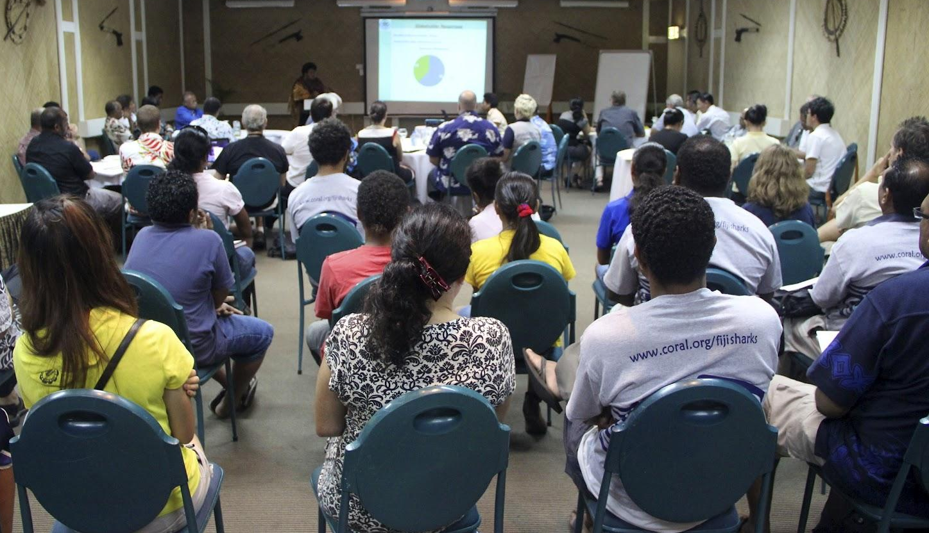


Notes:
LESSONS IN GOAL-SETTING | ACTIVITY HANDOUT 2.3c
SOLUTIONS:
#1. ~7-10 people per column, 5 columns; ~35-50 people, closest to 50
#2. ~11-16 people per square, 8 squares; ~88-128 people, closest to 100
#3. Answers and approaches will vary. Students should see that the row closest to the camera has only a few people, whereas the rows further back are much more densely packed. So, the middle and top rows should be relied on when calculating the amount of people in the whole room ~20+ in middle row and ~30-40+ in top row; 30 x 20 = 600, or 30 x 30 = 900; 600 and 900 are closest to 1,000 than any other options

Slide 20
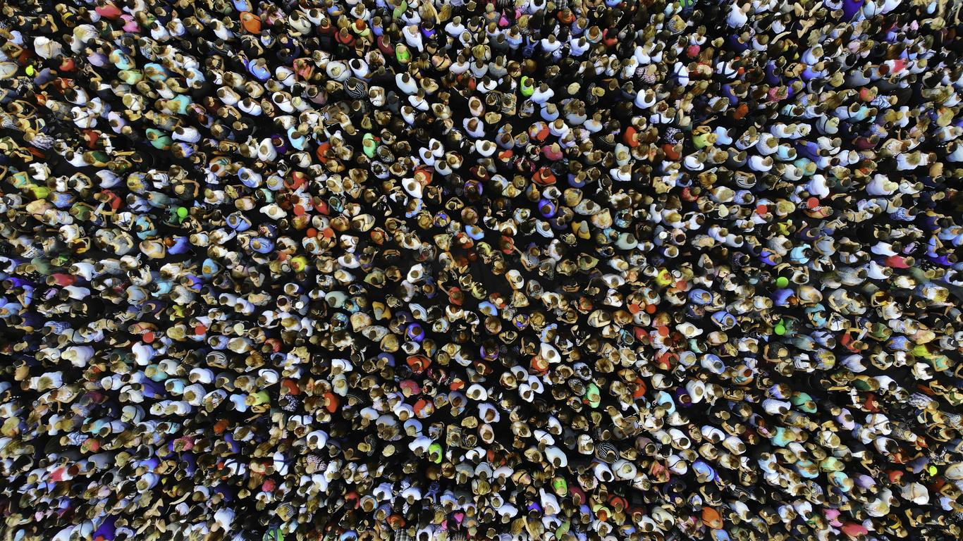

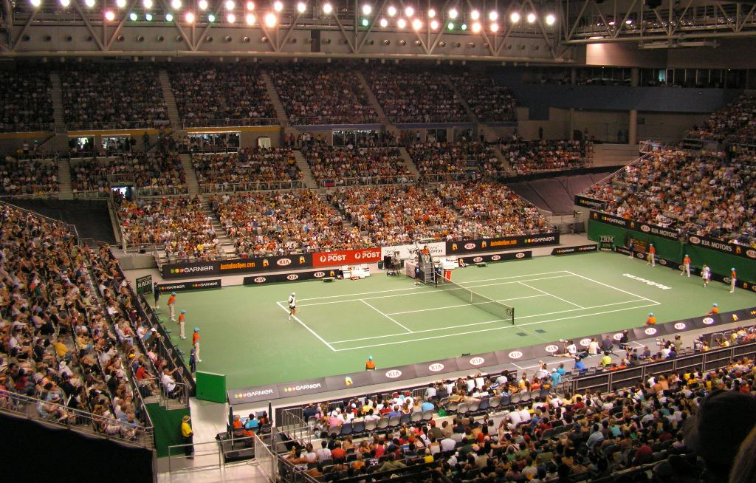
Notes:
LESSONS IN GOAL-SETTING | ACTIVITY HANDOUT 2.3d
SOLUTIONS:
#1. ~16-22 people per square, 60 squares (totaling 960-1,320); ~1K people
#2. Answers will vary but should be reasonably close to 200. Could do vertical columns and count number of students in one, then multiply it by the number of columns
#3. Answers will vary but should be in the thousands, less than 10K (for pic) and about 10K (estimating the whole stadium). Possible entry points: number of seats in a row close to the front of picture, number of rows from top of bleachers to bottom, how many sections of seats are seen

Slide 21
How to read pages by color of titles
Green = layout, with explanations and an example
Blue = full blank copy is what a student would print out to start using (if not typing text into the blanks)
Red = filled in with examples of student “writing”
Pink = instructions, extra help

Slide 22
Online Digital Literacy lesson material:
Intro to Google Slides:
https://edu.gcfglobal.org/en/googleslides/getting-started-with-your-presentation/1/
Working with text:
https://edu.gcfglobal.org/en/googleslides/text-basics/1/
Adding pictures and shapes:
https://edu.gcfglobal.org/en/googleslides/adding-pictures-and-shapes/1/

Slide 23
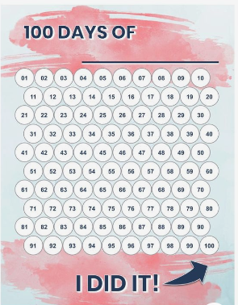
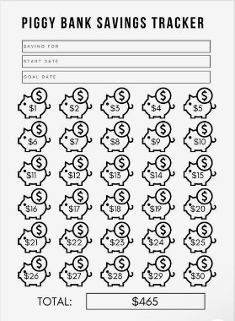
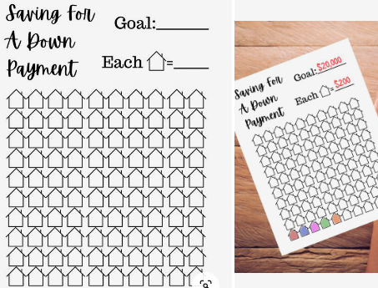
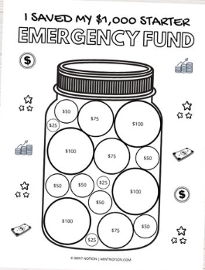
Example trackers:
Savings tracker: $10K House Savings
Coloring page: Bubble-Gum Jar!
counters
array
Notes:
An example of a progress tracker where the creator used a “good enough” number: https://www.pinterest.com/pin/377809856257236502/
Differing amounts of incremental progress: https://www.pinterest.com/pin/627407791845573495/
Book trackers for kids (different amounts and subtotal progress is marked as progress is made, rather than totaled at the end): https://letscraftinstead.com/book-tracker-printables/
Tracks amounts per day, two columns of 15 days and same unit per day: https://www.pinterest.com/pin/426716133456332136/

Slide 24
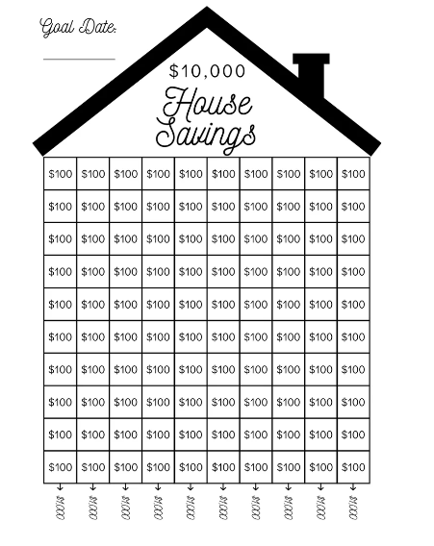

Slide 25
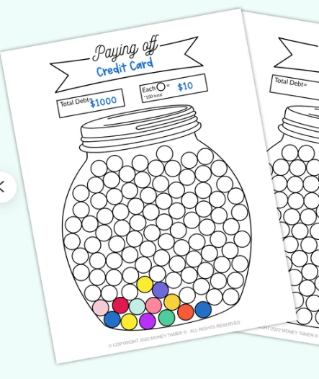

Slide 26

Finding icons and images
Icons found within Google Slides:
Insert > Image > Search the web
Insert > Table
Insert > Shapes
Options from outside of Google Slides:
Google search, or directly from a website
  Save image + insert
  Copy image + paste
Websites:
  https://icons8.com/
Image search tips:
Use singular, common nouns when searching
Try different combinations of words until you find what you want
Type the name of the object, along with “black and white” or “icon”

Slide 27
Placing icons and images
Tips and tricks to getting a tidy array
Hold the Shift key while creating shapes to get proportional icons
Save time by selecting an image (or multiple images) and typing Ctrl+D keys to duplicate
To change more than one image or text box at once, hold the Ctrl button while selecting images. You can now move, align, or distribute them (see below).
To align icons, select images on the page to align and right click. Choose Align Vertically for columns and Horizontally for rows.
To space icons out evenly, select images and right click. Then, choose Distribute (rows = horizontal; columns = vertical).
Objects are automatically “layered” according to when they were created. So, first objects are on the bottom. Latest are near the top. You can change the order: Right click on an object, choose Order, and send it “to the back” (which means that all other objects go on top of it) or “backward” (which means that it just falls behind the last thing created). You can do the same with bringing earlier objects to the front.

Slide 28
Resizing icons and images
Height is longer than width
≠ a symmetrical shape
Hold down the ‘Shift’ key to get symmetrical shapes and keep image proportions

Slide 29
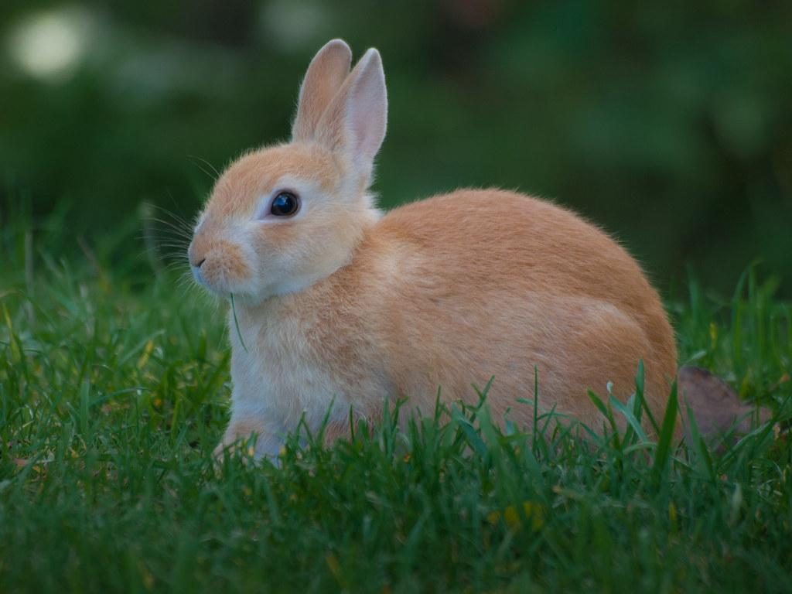
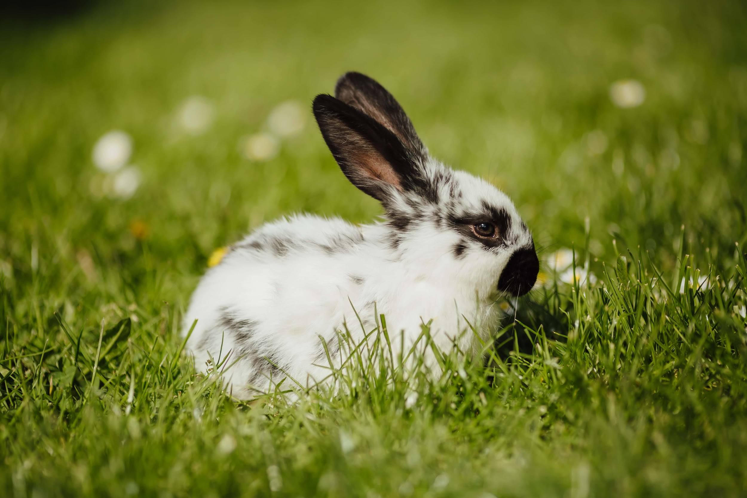
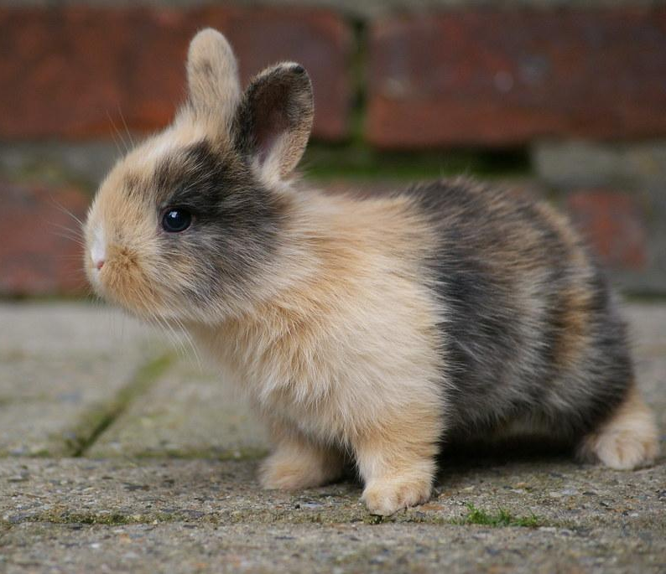
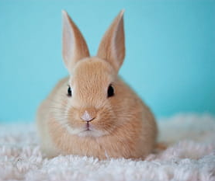
DIGITAL LITERACY TASKS - EXAMPLES
Task 1: Save the Bunnies! Text boxes & Images
Goal: Create a box big enough to “house” four bunny images
Objectives:
Find four bunny images and add to slide
Create a perimeter around the bunnies by adding and formatting a text box to be big enough to hold them
Bonus points if the bunnies are similarly sized and/or sitting in straight rows
Task 2: Tic-Tac-Toe! (Tables and shapes)
Goal: Create and play a game of Tic-Tac-Toe with a friend
Objectives:
Create a Tic-Tac-Toe grid using table or lines
Create your icons using one shape, duplicated up to five icons
Take turns placing icons in a grid’s cells until one person gets three in a row
Task 3: Challenge a friend! Typing / editing
Goal: Create a set of challenges for your buddy
Objectives:
Navigate to classmate’s slide
Using a textbox, write one sentence about goal-setting, but leave a blank for your classmate to fill in.
In the same textbox, write one math equation with a blank for a number or an operation (either side of the equality sign).
Using a second textbox, describe how your classmate must edit the text in it (e.g.: “bold, blue text”; “right aligned, Calibri font”).
Student 1:
Goals must be ____________, not vague or general.
12 x __ = 36
Student 1:
Arial font, blue, center-aligned
Student 2:
Goals must be _specific_, not vague or general.
12 x 3 = 36
Student 2:
Arial font, blue, center-aligned

Slide 30
Calendar
Example
M | T | W | TH | F
1 | 2 | 3 | 4 | 5
8 | 9 | 10 | 11 | 12
15 | 16 | 17 | 18 | 19
22 | 23 | 24 | 25 | 26
1
= task was done this day
GOAL
___ days x 4 weeks = complete ____ times monthly
ACTUAL
___ days = chore completed ___ times this month
What
This kind of tracking can be used like a series of mini-calendars to record tasks that are completed on a regular basis (chores, homework, showering, etc.).
Why
Recording the completion of multiple repetitive tasks is much easier when the data is all on one page. This visual gives feedback right away on completion of many tasks over the same time, including which day of the week this progress tends to be made.
Decide which days per week you want to include. This will tell you the number of columns your table will need.
Decide how many weeks you want to track (number of rows).
Add an additional row of cells on top of the table to place the days of the week
Insert a table with the right number of columns and rows (including the extra row for labeling)
Label days of the week on top row
Optional: Fill in the cells with each day’s date
How
The math
You must decide which days each week you will track this task for completion status. That number becomes the number of columns of your chart. The rows will be how many weeks you will monitor this task, plus the header column for labeling.
For the equation, you will choose how many times a week you are aiming to accomplish this task and multiply that by the number of weeks you’re monitoring it. When you’re recording the progress, you fill in the blanks of your ACTUAL data with the right numbers.

Slide 31
House Chore Chart
(Example blank)
= chore was completed
GOAL:
_3_ days x _4_ weeks = each chore will be completed _12_ times monthly
Laundry
Dishes
M | T | W | TH | F
1 | 2 | 3 | 4 | 5
8 | 9 | 10 | 11 | 12
15 | 16 | 17 | 18 | 19
22 | 23 | 24 | 25 | 26
M | T | W | TH | F
1 | 2 | 3 | 4 | 5
8 | 9 | 10 | 11 | 12
15 | 16 | 17 | 18 | 19
22 | 23 | 24 | 25 | 26
ACTUAL
___ days = laundry completed ___ times
ACTUAL
___ days = dishes completed ___ times
Trash / Dusting
Vacuum
M | T | W | TH | F
M | T | W | TH | F
1 | 2 | 3 | 4 | 5
8 | 9 | 10 | 11 | 12
15 | 16 | 17 | 18 | 19
22 | 23 | 24 | 25 | 26
1 | 2 | 3 | 4 | 5
8 | 9 | 10 | 11 | 12
15 | 16 | 17 | 18 | 19
22 | 23 | 24 | 25 | 26
ACTUAL
___ days = trash taken out ___ times
ACTUAL
___ days = vacuuming completed ___ times

Slide 32
House Chore Chart
(Example filled out)
= chore was completed
Laundry
Dishes
M | T | W | TH | F
1 | 2 | 3 | 4 | 5
8 | 9 | 10 | 11 | 12
15 | 16 | 17 | 18 | 19
22 | 23 | 24 | 25 | 26
M | T | W | TH | F
1 | 2 | 3 | 4 | 5
8 | 9 | 10 | 11 | 12
15 | 16 | 17 | 18 | 19
22 | 23 | 24 | 25 | 26
ACTUAL
_12_ days = laundry completed _12_ times
ACTUAL
_11_ days = dishes done _11_ times
Trash / Dusting
Vacuum
M | T | W | TH | F
1 | 2 | 3 | 4 | 5
8 | 9 | 10 | 11 | 12
15 | 16 | 17 | 18 | 19
22 | 23 | 24 | 25 | 26
M | T | W | TH | F
1 | 2 | 3 | 4 | 5
8 | 9 | 10 | 11 | 12
15 | 16 | 17 | 18 | 19
22 | 23 | 24 | 25 | 26
ACTUAL
_13_ days = trash/dusting completed _13_ times
ACTUAL
_11_ days = vacuuming completed _11_ times

Slide 33

Iconic rate
Unit rate format, where 1 icon represents a chosen amount of incremental progress
Example
one icon = _______________
x = of studying .
What
This method uses an area model or an array of icons/shapes, each of which represent certain amounts of time, space, money, weight, or some other measurable unit. The unit represents the incremental progress made towards a goal on a consistent basis.
Why
This type of tracking is good for breaking down a goal into smaller, manageable chunks of progress. Making progress in fixed, repeated increments is also good for general habit-building, which helps ensure long-term success.
How
Creating this model requires the toolbar’s “Insert” feature
Option 1: Search the web for an array icon, via Slides
  “Insert” > “Image” > “Search the web”
  Search for an icon (any object that could “represent” your goal)
Option 2: Choose an icon from the internet, via Google search
  Explore icons through Google search or on a specific website
  Save chosen icon to PC
  “Insert” > “Image” > “Upload from computer” and choose the file you saved
Option 3: Create an array of shapes
  “Insert” > “Shape” > choose your shape
  Click on your page and drag cursor to make shape
Option 4: Create an area model using a table
  “Insert” > “Table” > choose your grid dimensions
  Dimension inputs are # of columns X # of rows
The Math
To use this model, the student must choose a goal number that can be factored more than two ways. This should give you three factors to work with: one unit rate and two side lengths of your area model or array. You will also write an equation that reflects the math of the goal statement.

Slide 34
ASSIGNMENTS LOGGED
(Example blank)
= 1 assignment in that subject
LANGUAGE ARTS - READING
LANGUAGE ARTS - WRITING
SOCIAL STUDIES
SCIENCE
MATH
Notes:
Using area models

Slide 35



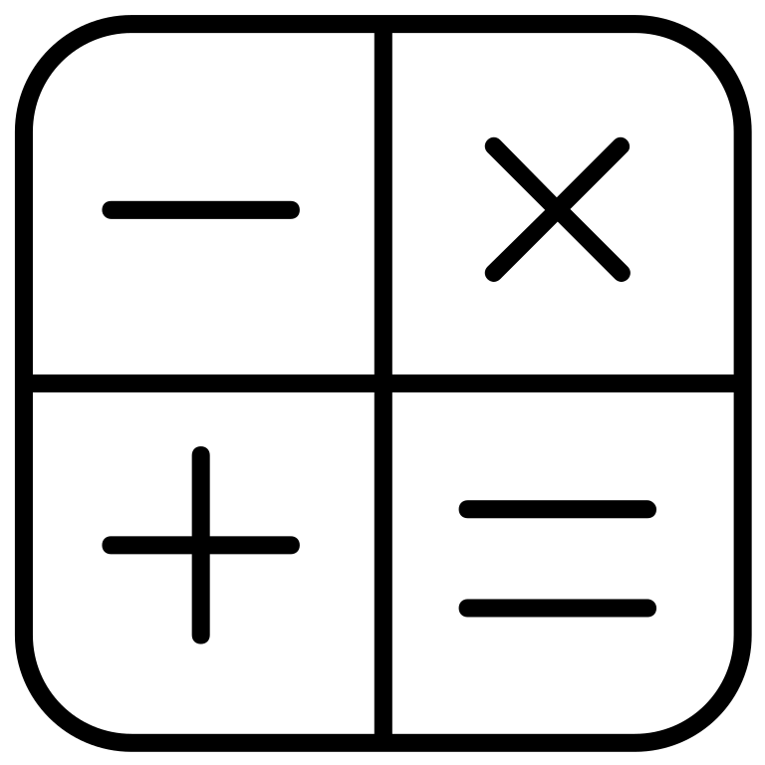
STUDY HOURS
(Example blank)
Format:
(# of icons) x (increments of progress) = (total # hours)
LANGUAGE ARTS - READING
one book = _______________
x = of studying .
LANGUAGE ARTS - WRITING
one pencil = _______________
x = of studying .
SOCIAL STUDIES
one map = _______________
x = of studying .
SCIENCE
one beaker = _______________
x = of studying .
MATH
one calculator icon = _______________
x = of studying .
Notes:
Using arrays

Slide 36
STUDY HOURS
FILLED IN WITH EXAMPLES
Unit rate format, where 1 icon represents chosen amount of incremental progress
Format: (# of icons) x (increments of progress) = (total progress made)
Example: 10 icons x 2 hour each = 20 hours of studying for Reading
LANGUAGE ARTS - READING
one book = 2 hours of study
20 books x 2 hours = 40 hours of studying Reading
LANGUAGE ARTS - WRITING
one pencil = 2 hours of study
20 pencils x 2 hours = 40 hours of studying Writing
SOCIAL STUDIES
one map = 1 hour of study
20 maps x 1 hour = 20 hours of studying Social Studies
SCIENCE
one beaker = 1 hour of study
20 pencils x 1 hour = 20 hours of studying Science
MATH
one calculator icon = 1.5 hours of study
20 icons x 1.5 hours = 30 hours of studying Math

Slide 37

Chunking
4
5
4
8
10
10
30
40
50
50
30
20
3
5
4
8
3
3
5
8
What
This kind of tracking gives you variability in pacing your progress by chunking steps into different amounts. It’s a good way to break up a not-so-neat number and track it visually. To mark your progress, color in a number to correspond with the amount of progress made. For example, if I place $3 in my rainy-day fund, I will color in one of the $3 rain drops.
Why
Some of us need to be able to make inconsistent amounts of progress toward our goals. This highly-flexible method allows you to challenge yourself to take both big and small steps. The advantage to having a mix of both is that neither the number of steps nor the size is overwhelming.
How
Search for a black-and-white (or, black-and-transparent) image you like, either in Slides or via a Google search
Choose an image with dark, defined lines and white/transparent spaces to add numbers
Alter and add to image with extra lines or shapes, if necessary
Decide what your addends will be (make sure it adds up to your long-term goal number)
Insert one addend per open space
The math
Your goal number will be the sum of all numbers on your coloring page. This requires counting the number of spaces that need to be filled and deciding what addends to use to express that goal number. You will place an addend in each space.

