Slide 1
Let’s Warm Up! Quick Review: Area of a Quadrilateral!
(Area = Length x Width)
Brad needs to know how much carpet to buy for his bedroom. The dimensions of his bedroom floor are below. How much carpet does Brad need to buy?
Find the area of the rectangle below.
3cm
Brad’s bedroom
20 ft
9cm
20 ft
Notes:
Formula: Area = length x width
Reminder: area is measured in square units because it measures the entire contents of the two-dimensional shape, not just around the edges, which is the perimeter.
Answers:
20ft. x 20ft = 400ft² of carpet is needed for Brad’s bedroom.
9cm x 3cm = 27cm²

Slide 2
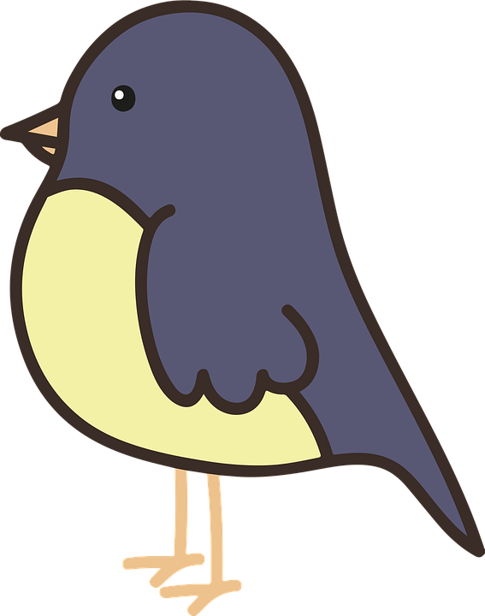
This right prism is our class’s birdhouse!
Find the total area of the front and the back faces of the birdhouse.
6in.
10in.
We can see the dimensions for the front face of the birdhouse:
6 inches tall and 10 inches wide.
The dimensions for the back of the birdhouse are the same as what we see here in the front.
Notes:
The students have just shown that they know how to find the area of a rectangle on slide 1. Now, they need to find the area of a rectangle twice and add the two areas together. Give students a minute to work and after a minute, ask them:
What was your brain doing to find the total area? What did you do first?
Students will likely say that they added the two areas together to come up with the total area. Some students may say that they multiplied either the front or the back area times 2 because the dimensions of the front and the back sides of the birdhouse are the same.
Answer:
Front of bird house area: 6in. x 10in. = 60 sq. in.
Back of bird house area: 6in. x 10in. = 60 sq. in.
Total area of front and back of bird house: 60 + 60 = 120 sq. in.

Slide 3
Now, our birdhouse has a measurement for the depth of the side: 4 inches!
Find the total area of the left side and the right side of the birdhouse.
6in.
4in.
10in.
The dimensions of the left side and the right side of our classroom birdhouse are the same. Do we have enough information to find the area of those sides?
Notes:
Ask students: Did you notice anything similar or different between what you did in the purple slide and this slide?
We are guiding students to recognize that the process was the same but that the measurements were different. The front face and the back of the birdhouse were larger rectangles with larger areas than the sides.
Answer:
Left side: 6in. x 4in. = 24 in²
Right side: 6in. x 4in. = 24in²
Total area of right and left sides: 24in² + 24in² = 48in²

Slide 4
We have figured out the area of the front, the back, the left side, and the right side.
Do we have enough information to figure out the area of the floor of our birdhouse?
6in.
4in.
10in.
What is the area of the birdhouse floor?
Notes:
We DO have enough information: the length of the front of the birdhouse times the width of the side of the house will provide the area of the floor of the house. If students struggle, ask them guiding questions to create a pathway:
-What was the length of the bird house in the front?
-How deep does the birdhouse go back into the yard? Is there a measurement that could tell us that?
-What do we know about solving for the area of a quadrilateral? How do we do it?
Answer:
Area of birdhouse floor: 10in. x 4in. = 40in²

Slide 5
It’s time to figure out the area of the roof that our little bird is standing on.
6in.
4in.
10 in.
Try this one without any help. What is your brain telling you to do? Thinking about our thinking is challenging!
Notes:
We are building a foundation for how to find total surface area, not just zeroing in on this multiplication problem. Keep the essential question of the lesson in mind as you prompt the learners: How can we solve for the surface area of a rectangular prism?
Answer:
Area of birdhouse roof: 10in x 4in. = 40in²

Slide 6
How can we figure out the area for all of the surfaces combined … or, the entire surface area of the birdhouse?
What we know so far
Front: 60in²
Back: 60in²
Left side: 24in²
Right side: 24in²
Floor: 40in²
Ceiling: 40in²
6in.
4in.
10 in.
Explain what you’re thinking using words!
Notes:
Students should be totaling (adding) the six areas they’ve already solved for to come up with a total surface area for the bird house.
Surface area of our birdhouse: 60in² + 60in² + 24in² + 24in² + 40in² + 40in² = 248in²

Slide 7
The surface area of our birdhouse is the sum of the areas of each side of the birdhouse.
6in.
4in.
10in.
60in² + 60in² + 40in² + 40in² + 24in² + 24in² = 248in²
What do you notice about the addends above?
Notes:
Total surface area of our birdhouse: 60in.² + 60in.² + 40in.² + 40in² + 24in.² + 24in.² = 248in²
Walk the students through labeling how we solved for the area of each side:
Floor and ceiling: length x width
Front and back sides: length x height
Left and right sides: width x height
How many of each type of question did we answer? 2 of each.
Is there a rule that we could write to find the total surface area of a shape like this birdhouse (right prism) that would work all the time?
(length x width) + (length x width) + (length x height) + (length x height) + (width x height) + (width x height)

Slide 8
Floor and ceiling:
length x width
Front and back: sides:
length x height
Left and right sides:
width x height
4in
6in.
10in
(length x width) + (length x height) + (width x height) + (length x height) + (width x height)
Simplified:
2lw + 2lw + 2wh = 248in²

Slide 9

Now, it’s time to prove our understanding! Please complete the three questions given on “Applying our Knowledge: Surface Area and Prisms”
Notes:
The performance task should be completed individually as a way of determining each student’s conceptual understanding. It can be classwork or an assignment to bring back to class next time.

