Slide 1


Math Lessons for Students
Calculating Area in Construction
Producer: SIPDC, part of the Illinois Adult Education Professional Development Network
Teacher: Christine Noreik

Slide 2
Please look in the description below this video for links to the math worksheets.
Enjoy this video lesson!

Slide 3


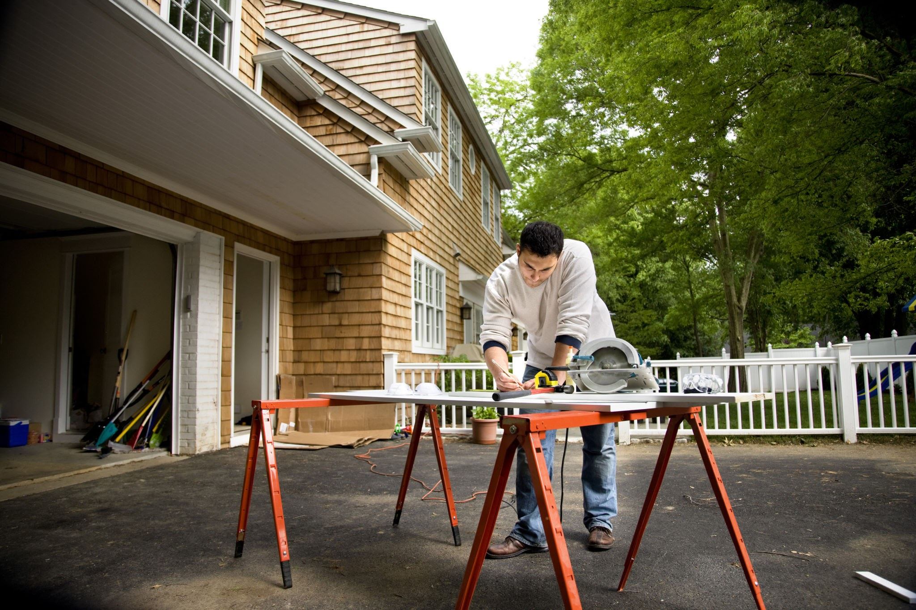

Slide 4
Vocabulary
Area
Composite shape
Square feet
Square
Rectangle
Right angle
Right triangle
Siding
Drywall
Total 2-dimensional space that a flat object takes up
Larger shape made by combining two or more smaller basic shapes
Unit of measurement used in determining area
Flat shape with 4 equal sides and 4 right angles
Flat shape where opposite sides are equal and there are 4 right angles
A 90 degree angle
A triangle with a 90 degree angle
Protective outer layer on the outside of a house
Large plaster panels used inside a house for walls and ceilings

Slide 5

Vocabulary
Plywood
Carpet
Wood panels
Sod
Paving
Asphalt
Engineered wood panel used in basic building projects
Thick woven fabric made for floor covering
Wood pieces that fit together for flooring
Pre- grown grass sheets
The act of covering a surface like a road or driveway with a hard smooth material
Thick black material to cover roads or driveway surfaces
Practice!

Slide 6
Calculating Area
The area of a rectangle :
A= l x w
w
l
The area of a square :
A= s²
s
s

Slide 7
w= 12 ft.
30 ft
l= 25 ft.
30 ft
A= l x w
A= 25 x 12 A= 300 ft²
A= s²
A= 30 x 30 A= 900 ft.²

Slide 8
Calculating Area
The area of a right triangle :
A= ½ b x h
h
b

Slide 9
A= ½ b x h
A= ½ x 15 x 18.5
A= 7.5 x 18.5
A= 138.75 ft.²
h= 18.5 ft.
b= 15 ft.

Slide 10
Area of Composite Shapes
Example #1
Mark’s paint shop has been called for a job painting the siding on a house. What is the total area of one side of the house?

Slide 11
A= s²
A=½ b x h
9.5 ft.
15 ft.
15 ft.
15 ft.

Slide 12
A= s²
A=½ b x h
Side of the house:
A= s²
A= 15² (15 x 15)
A= 225 ft²
9.5 ft.
7.5
7.5
15 ft.
15 ft.
Roof:
A=½ b x h
A= ½ 7.5 x 9.5
A= 3.75 x9.5= 35.625 ft²
35.625 ft² x 2 = 71.25 ft.²
15 ft.
225 + 71.25= 296.25 ft.²

Slide 13
Area of Composite Shapes
Example #2
The Gomez family wants to pave their driveway. How many square feet of asphalt does the paving company need?

Slide 14
Rectangle:
A= l x w
Square:
A= s²
26 ft.
12 ft.
12 ft.

Slide 15
Rectangle:
A= l x w
A= 26 x 12
A= 312 ft²
312 + 144= 456 ft²
Square:
A= s²
A= 12² (12 x 12)
A= 144ft²
26 ft.
12 ft.
12 ft.

Slide 16
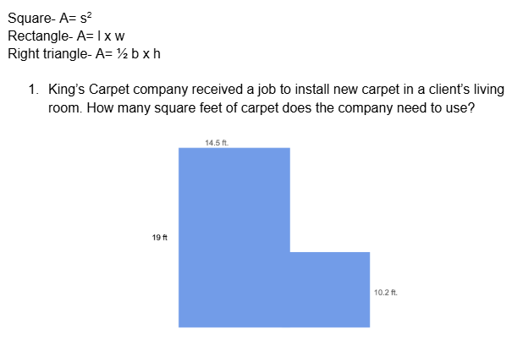
Practice!

Slide 17
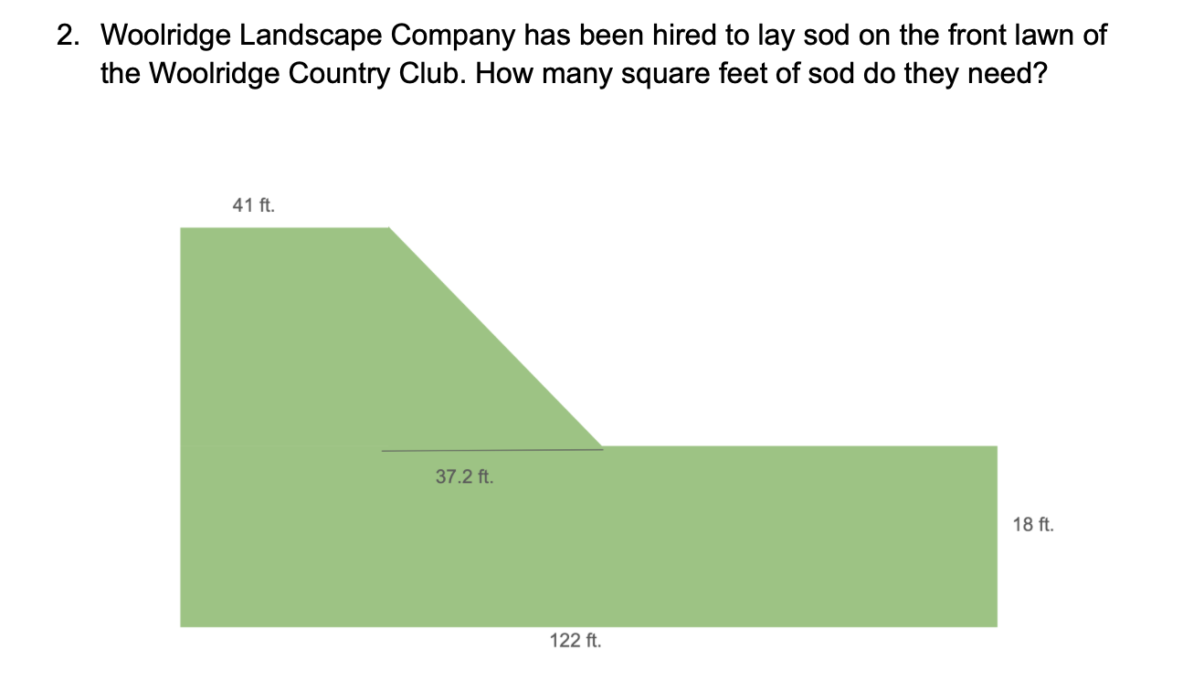

Slide 18
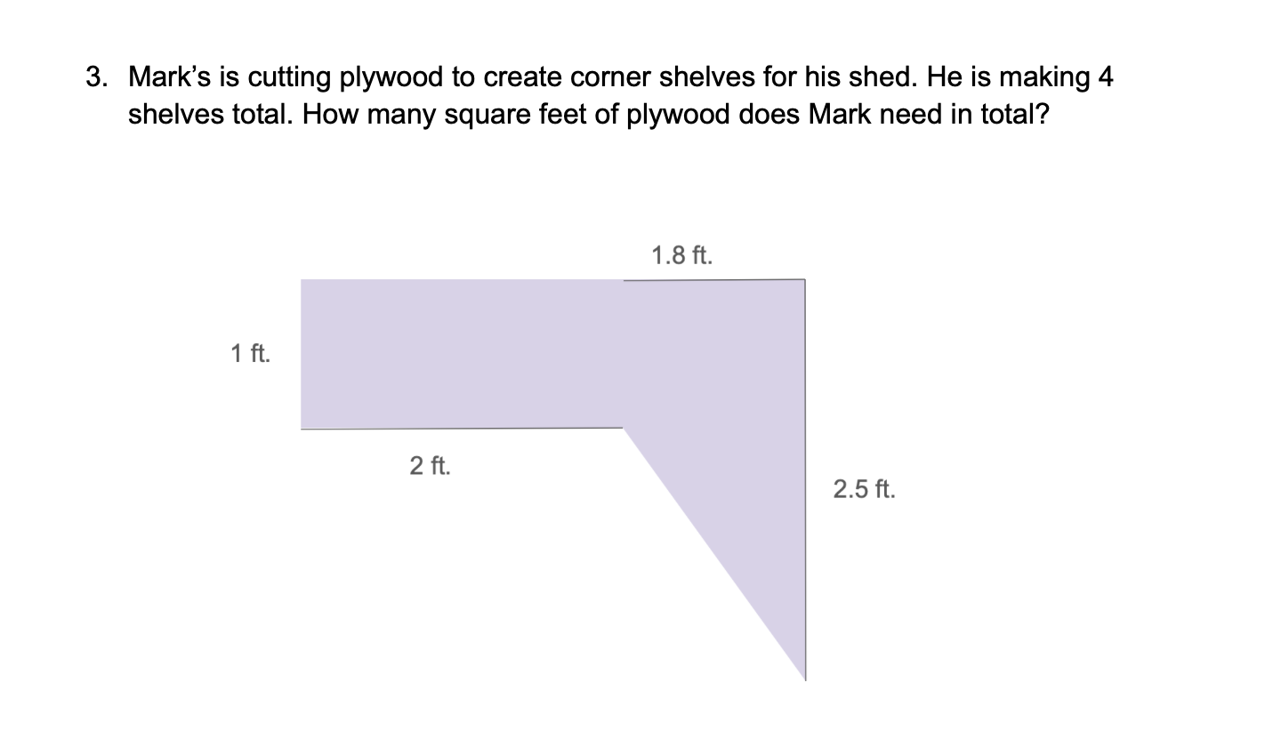

Slide 19
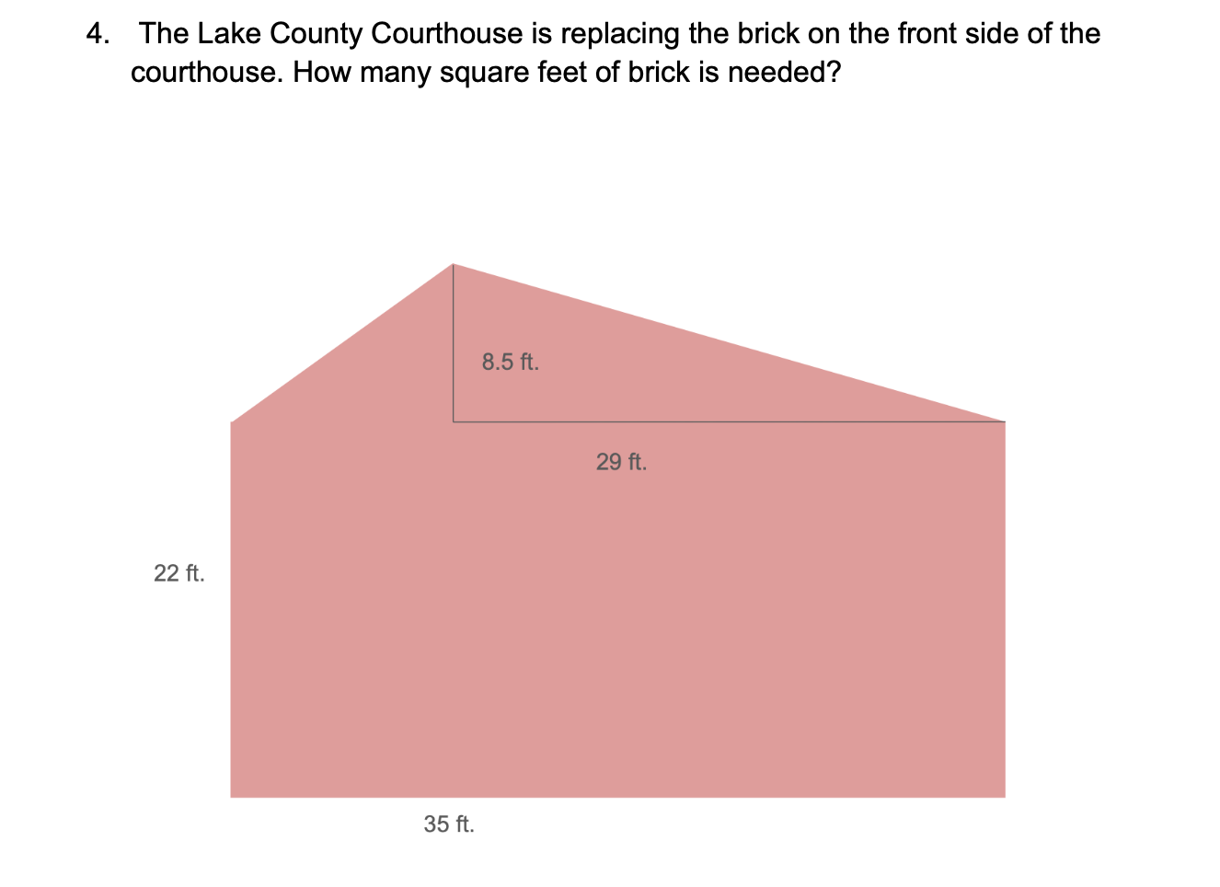

Slide 20
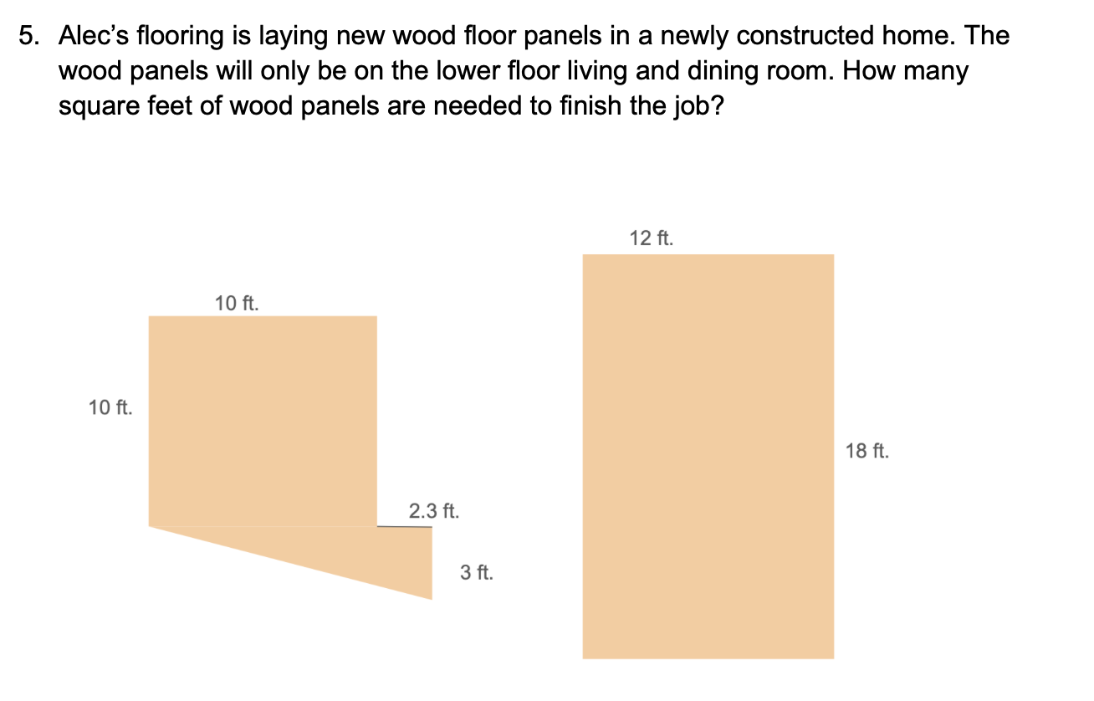

Slide 21
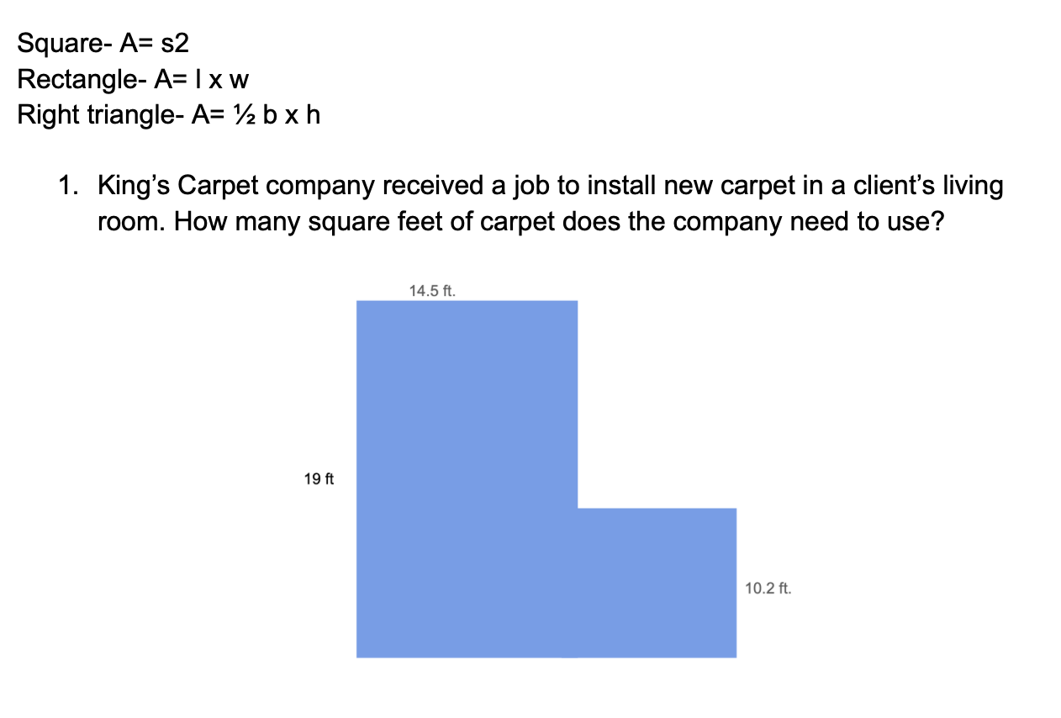
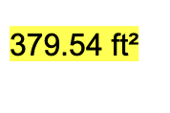

Slide 22
Reflection
  What other scenarios can you think of where one might need to calculate the area of composite shapes in construction?
  What do you think would happen if this calculation was done incorrectly? What impact could that have on the project?
  What other math skills do you think might be important to know in this industry?

