Slide 1


Math Lessons for Students
Probability Concepts in Healthcare
Producer: SIPDC, part of the Illinois Adult Education Professional Development Network
Teacher: Christine Noreik

Slide 2
Please look in the description below this video for links to the math worksheets.
Enjoy this video lesson!

Slide 3
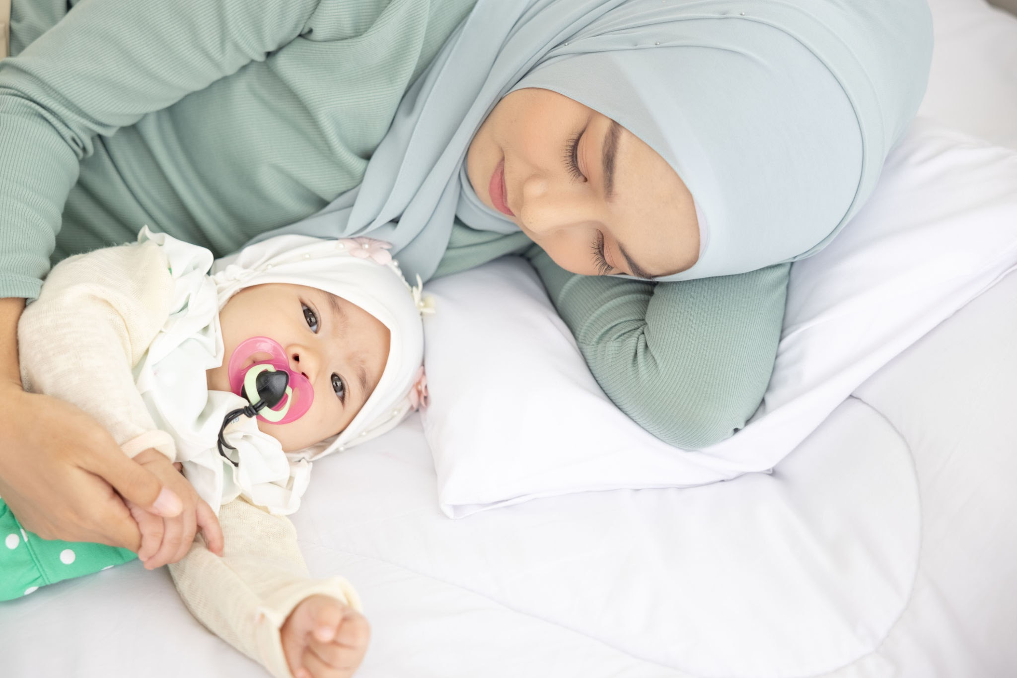
Amina’s story

Slide 4
Vocabulary
Probability -
Pediatrics -
Premature -
Strep throat -
Geriatrics -
Diabetes -
The chances of a an action or event happening
The branch of medicine that is concerned with caring for babies and children
being born before the 37th week of the mother's pregnancy
An illness that is characterized by having a very sore throat and fever
The branch of medicine concerned with caring for older aged people
A disease where a person's body is unable to use or produce insulin to manage sugar levels

Slide 5

Vocabulary
Eczema -
Hypertension -
Arthritis -
Obese -
A skin condition that causes rough patches and itching
High blood pressure
Swelling and pain in the joints
Having a high and unhealthy amount of body fat
Practice!

Slide 6
Probability vs. Certainty
1
100% Chance
Completely certain
0
0% Chance
Not possible

Slide 7
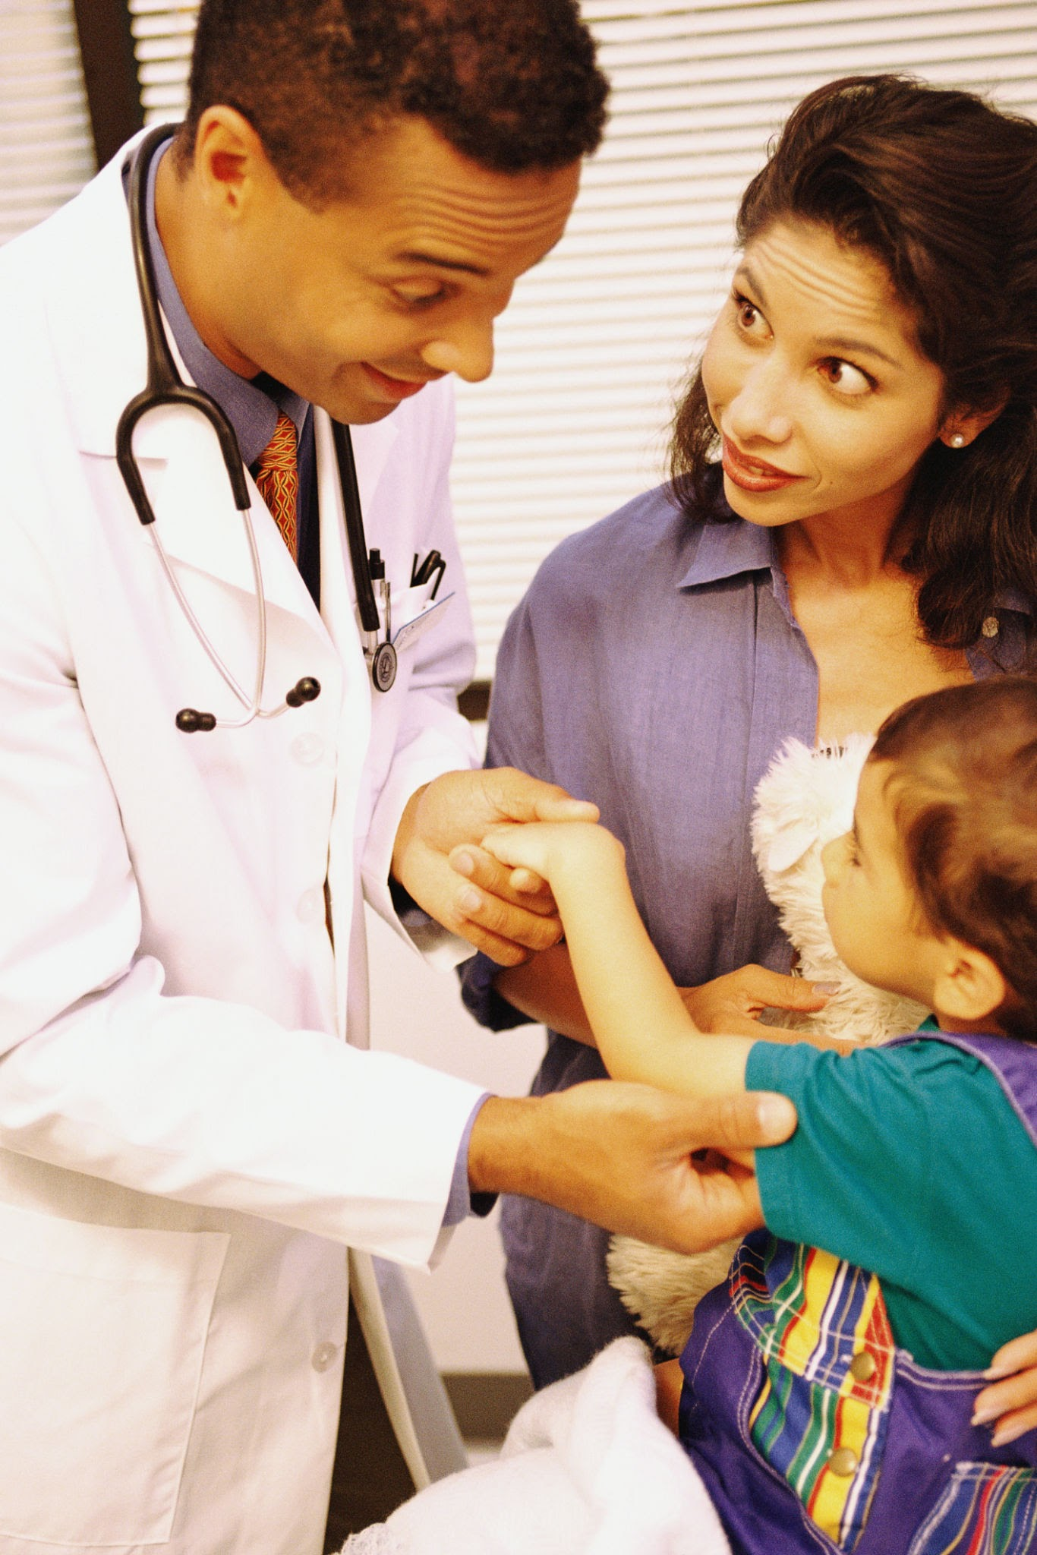
Pediatrics
20.8% of babies are born with blue eyes each year
10.5% of babies are born premature each year
What is the probability of a baby being born BOTH with blue eyes and premature?
https://publications.aap.org/patiented/article-abstract/doi/10.1542/peo_document239/80162/Preterm-Babies-At-the-Hospital?redirectedFrom=fulltext
https://pmc.ncbi.nlm.nih.gov/articles/PMC4956505/

Slide 8
Babies born with blue eyes and premature
Babies born with blue eyes
Babies born premature
?
10.5%
20.8%

Slide 9
Probability Multiplication Rule -
(If both events are completely separate from each other)
P (A and B)= PA x PB
Premature
Blue eyes
Probability of
P(blue eyes and premature)= P(blue eyes) x P(premature)

Slide 10
Babies born with blue eyes and premature
Babies born with blue eyes
Babies born premature
20.8%
?
10.5%

Slide 11
P(blue eyes and premature)= P(blue eyes) x P(premature)
20.8% x 10.5% =
218.4 % ???
0.208 x 0.105 = 0.02184
Percent- out of 100
0.02184 x 100= 2.284
20.8
0.208
2.284 %
10.5
0.105

Slide 12
Babies born with blue eyes and premature
Babies born with blue eyes
Babies born premature
20.8%
2.284%
10.5%

Slide 13

Geriatrics
About 75% of US adults ages 65-80 have some type of heart disease
About 25% of US adults ages 65-80 have diabetes.
What is the probability of a U.S. adult ages 65-80 having BOTH heart disease and diabetes?
https://pmc.ncbi.nlm.nih.gov/articles/PMC6616540/
https://pcna.net/news/unraveling-the-hidden-triggers-of-cardiovascular-risk-in-older-adults/

Slide 14
US adults 65-80 with BOTH heart disease and diabetes?
US adults 65-80 with heart disease
US adults 65-80 with diabetes
75%
25%
?

Slide 15
Probability Multiplication Rule -
(If both events are completely separate from each other)
P (A and B)= PA x PB
Diabetes
Heart disease
Probability of
P(heart disease and diabetes)= P(heart disease) x P(diabetes)

Slide 16
P(heart disease and diabetes)= P(heart disease) x P(diabetes)
75.0
0.75
0.25 x 0.75 = 0.1875
25.0
0.25
0.1875 x 100= 18.75
18.75 %

Slide 17
US adults 65-80 with BOTH heart disease and diabetes?
US adults 65-80 with heart disease
US adults 65-80 with diabetes
18.75%
75%
25%

Slide 18

Your Turn!

Slide 19
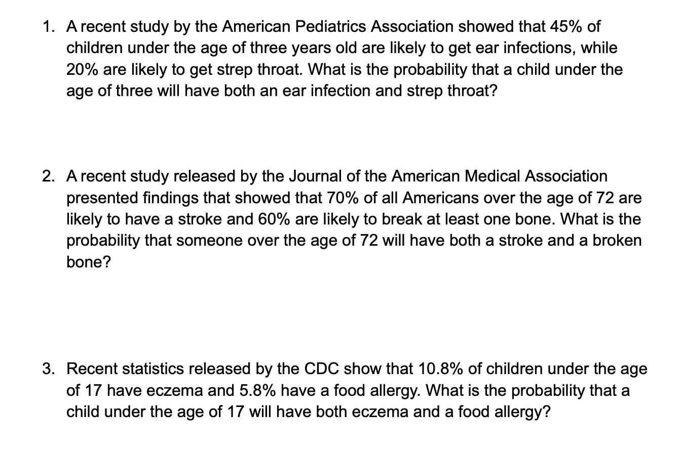

Slide 20
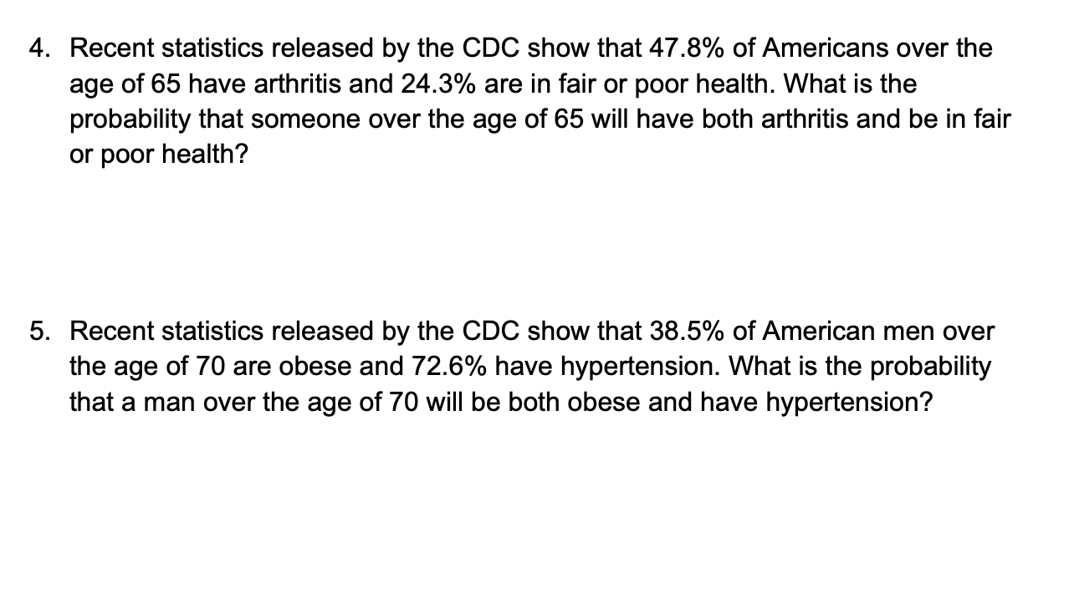

Slide 21
0.45 x 0.20 = 0.09 or 9%

Slide 22
Reflection
  Why do health professionals need to know the probabilities of events like those mentioned in this lesson?
  How will this knowledge help them when dealing with patients?

