Slide 1
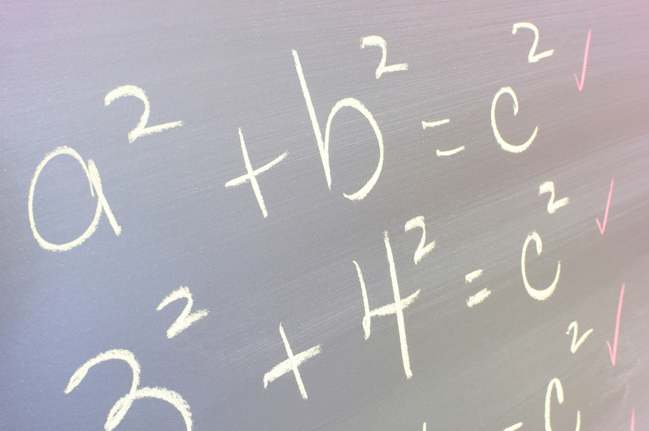

Math Lessons for Students
Percentages in Sales Careers
Producer: SIPDC, part of the Illinois Adult Education Professional Development Network
Teacher: Christine Noreik

Slide 2
Please look in the description below this video for links to the math worksheets.
Enjoy this video lesson!

Slide 3




How do you get paid?
Hourly
Salary
Commission

Slide 4
Vocabulary
Commission -
Percentage -
Decimal -
Real Estate -
Mortgage Broker -
Profit -
Money paid to a salesperson or agent (usually a percentage of the product sold)
Part of a whole expressed in how much out of 100
A number using a decimal point to show whole numbers and parts of a whole number
The industry of buying and selling homes
A person who helps secure a loan for someone interested in buying a home
The amount of money made after a sale

Slide 5

Practice

Slide 6
Calculating a Commission
Calculating a commission involves using percentages and mathematics. Usually, you will hear about a percent that a person will make for a commission. Then you take the sale price or the total sales and use the percentage to calculate the commission.
Taken from: https://www.moneyinstructor.com/lesson/calculatecommission.asp

Slide 7
Example #1
Jeff works as a real estate agent. He has just sold a house that was $230,000. If Jeff makes a 3% commission, how much money did he make when he sold the home?
We need to find what 3% of $230,000 is to figure out how much money Jeff will make.
Taken from: https://www.moneyinstructor.com/lesson/calculatecommission.asp

Slide 8
Step 1
Change the percentage to a decimal
A percentage is “out of 100.” When we have a percentage, we can write it as a decimal. We can drop the percent sign and move the decimal point two places to the left. This move represents the hundredths place because it moves the decimal point two places and the second place is the hundredths place.
3%= 3.0 out of 100
Adapted from: https://www.moneyinstructor.com/lesson/calculatecommission.asp
ones | . | tenths | hundredths
0 | . | 0 | 3
0.03

Slide 9
Step 2
2. Multiply
Multiply the total sale by the commission percentage in decimal form.
The house was $230,000 and Jeff’s commission was 3% or 0.03
230,000 x 0.03= 6,900.00
Jeff will make $6,900.00 when he sells this house
Adapted from: https://www.moneyinstructor.com/lesson/calculatecommission.asp
.

Slide 10
Example #2
Let’s look at what would have happened if Jeff made 3.5% instead of 3%.
Step 1:
Drop the percent and change into a decimal by moving the decimal point two places to the left.
ones | . | tenths | hundredths | thousandths
0 | . | 0 | 3 | 5
3.5%= 0.035
Adapted from: https://www.moneyinstructor.com/lesson/calculatecommission.asp

Slide 11
Example #2
Step 2:
Multiply the total sale of the house by commission percentage in decimal form.
The house was $230,000 and Jeff’s commission was 3.5% or 0.035
230,000 x 0.035=
Jeff will make $8,050 when he sells this house
Adapted from: https://www.moneyinstructor.com/lesson/calculatecommission.asp

Slide 12

Practice

Slide 13
1. A house sold for $130,000. The real estate commission was 4%. How much did the realtor make from the sale?
2. A house sold for $350,000. If the real estate agent makes a 5.5% commission. How much did he/she make from the sale?
3. If the selling agent receives a 2% commission from the sale of the home in problem #2, how much did the selling agent receive?
4. A salesperson earns a 10% commission on total sales for the year. If the total sales for the year were $550,000, how much money did he/she make?
5. A salesperson earns a base of $5000 plus commissions. How much did he/she make for the year if they earned the base plus 12% commissions on $500,000.
Taken from: https://www.moneyinstructor.com/lesson/calculatecommission.asp

Slide 14
6. A real estate agent earns 11% commission on a home that sells for $250,000. How much did he/she earn on this home?
7. A mortgage broker earns 2.5% from the same sale. How much did he/she make?
8. If the selling agent makes 4% on this sale, how much does he/she make in commission?
9. After all of these commissions have been calculated, what is the total amount paid out in commissions?
10. What is the profit left on the home after they have been paid out?
Taken from: https://www.moneyinstructor.com/lesson/calculatecommission.asp

Slide 15
1. A house sold for $130,000. The real estate commission was 4%. How much did the realtor make from the sale?
130,000 x 0.04= 5,200
$5,200
Taken from: https://www.moneyinstructor.com/lesson/calculatecommission.asp

Slide 16
Reflect
Write down or discuss with a family member or friend:
What are the pros and cons of having a commission based job?
Would you personally be interested in a sales job and if so which type?

