Slide 1


Math Lessons for Students
Ratios and Proportions
Producer: SIPDC, part of the Illinois Adult Education Professional Development Network
Teacher: Christine Noreik

Slide 2
Please look in the description below this video for links to the math worksheets.
Enjoy this video lesson!

Slide 3
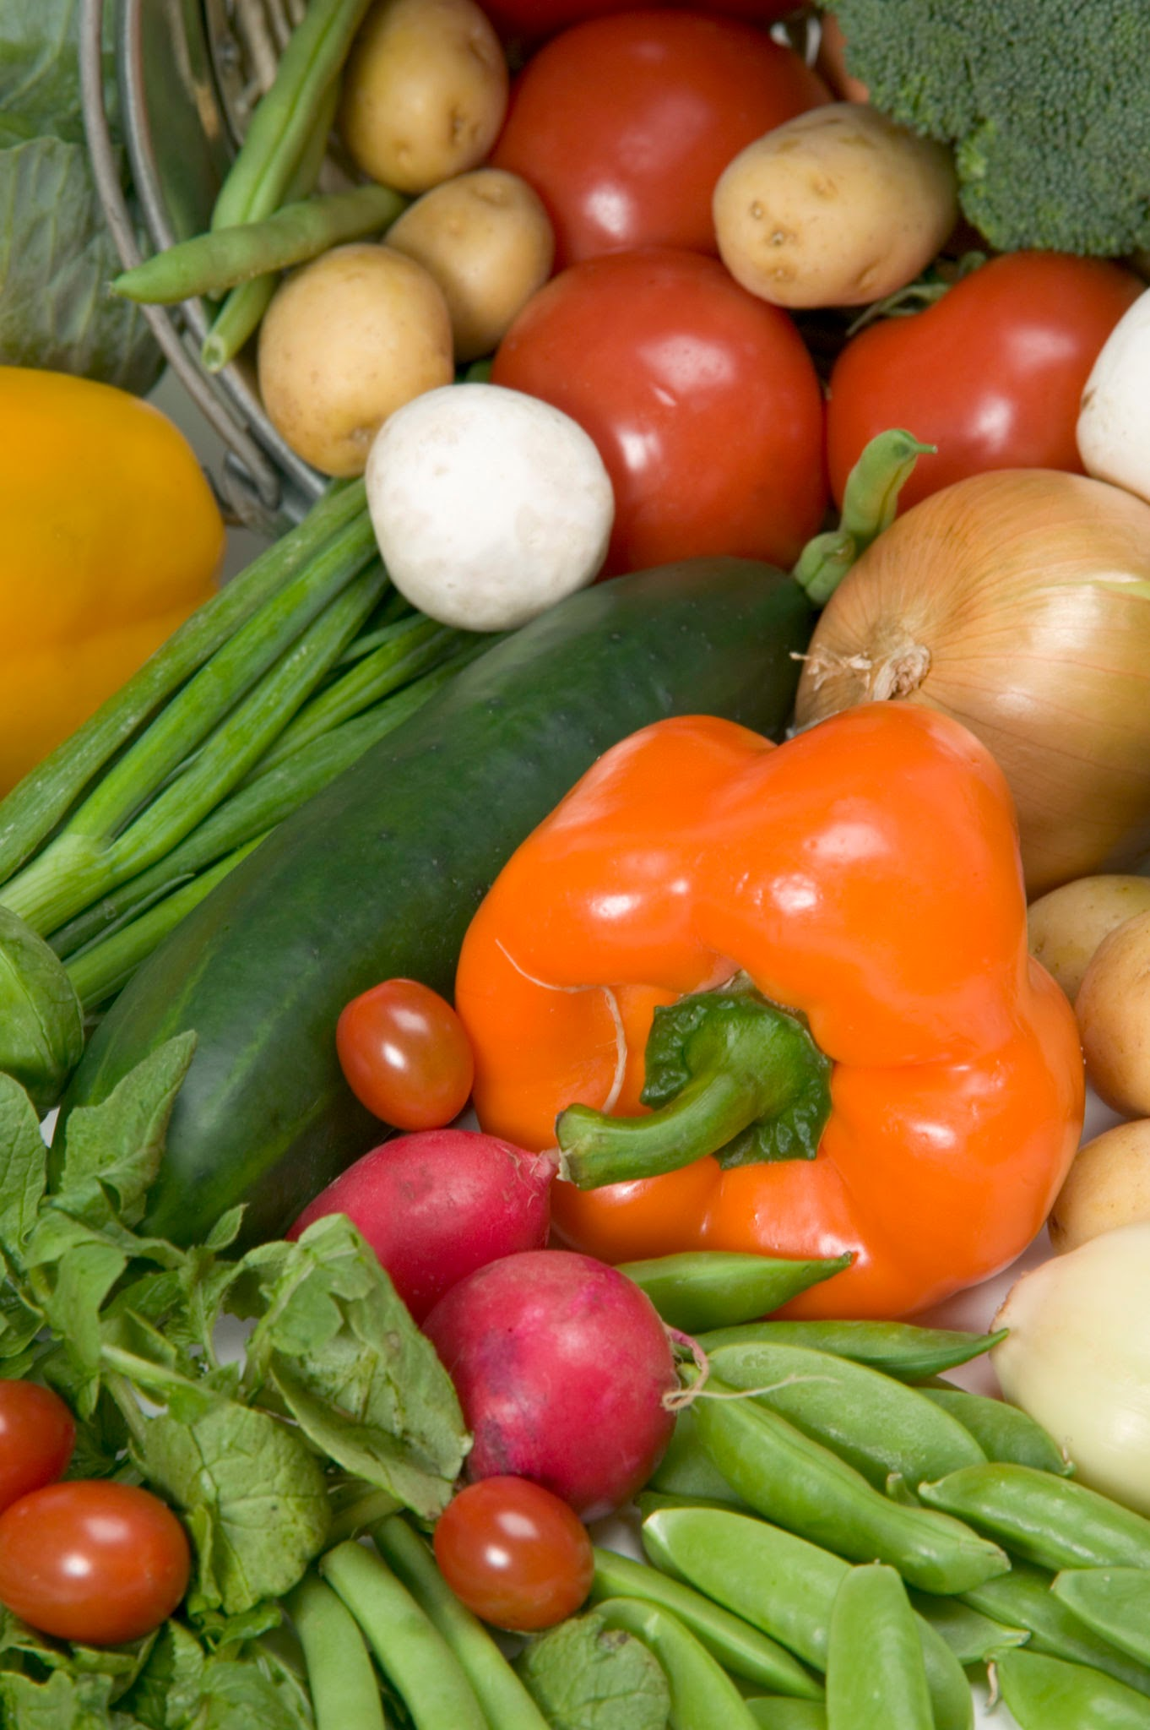
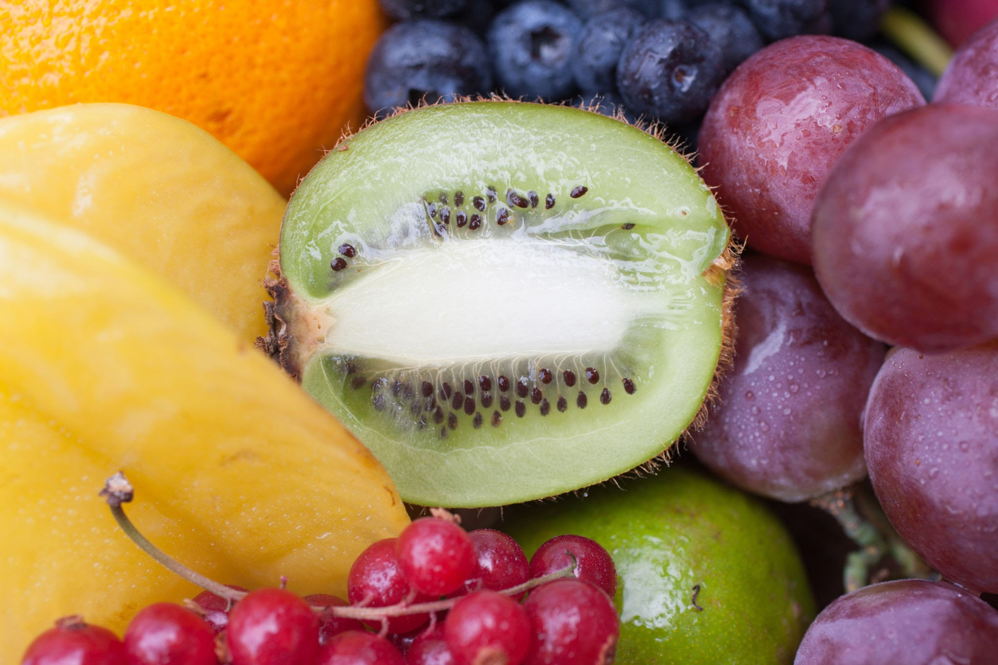
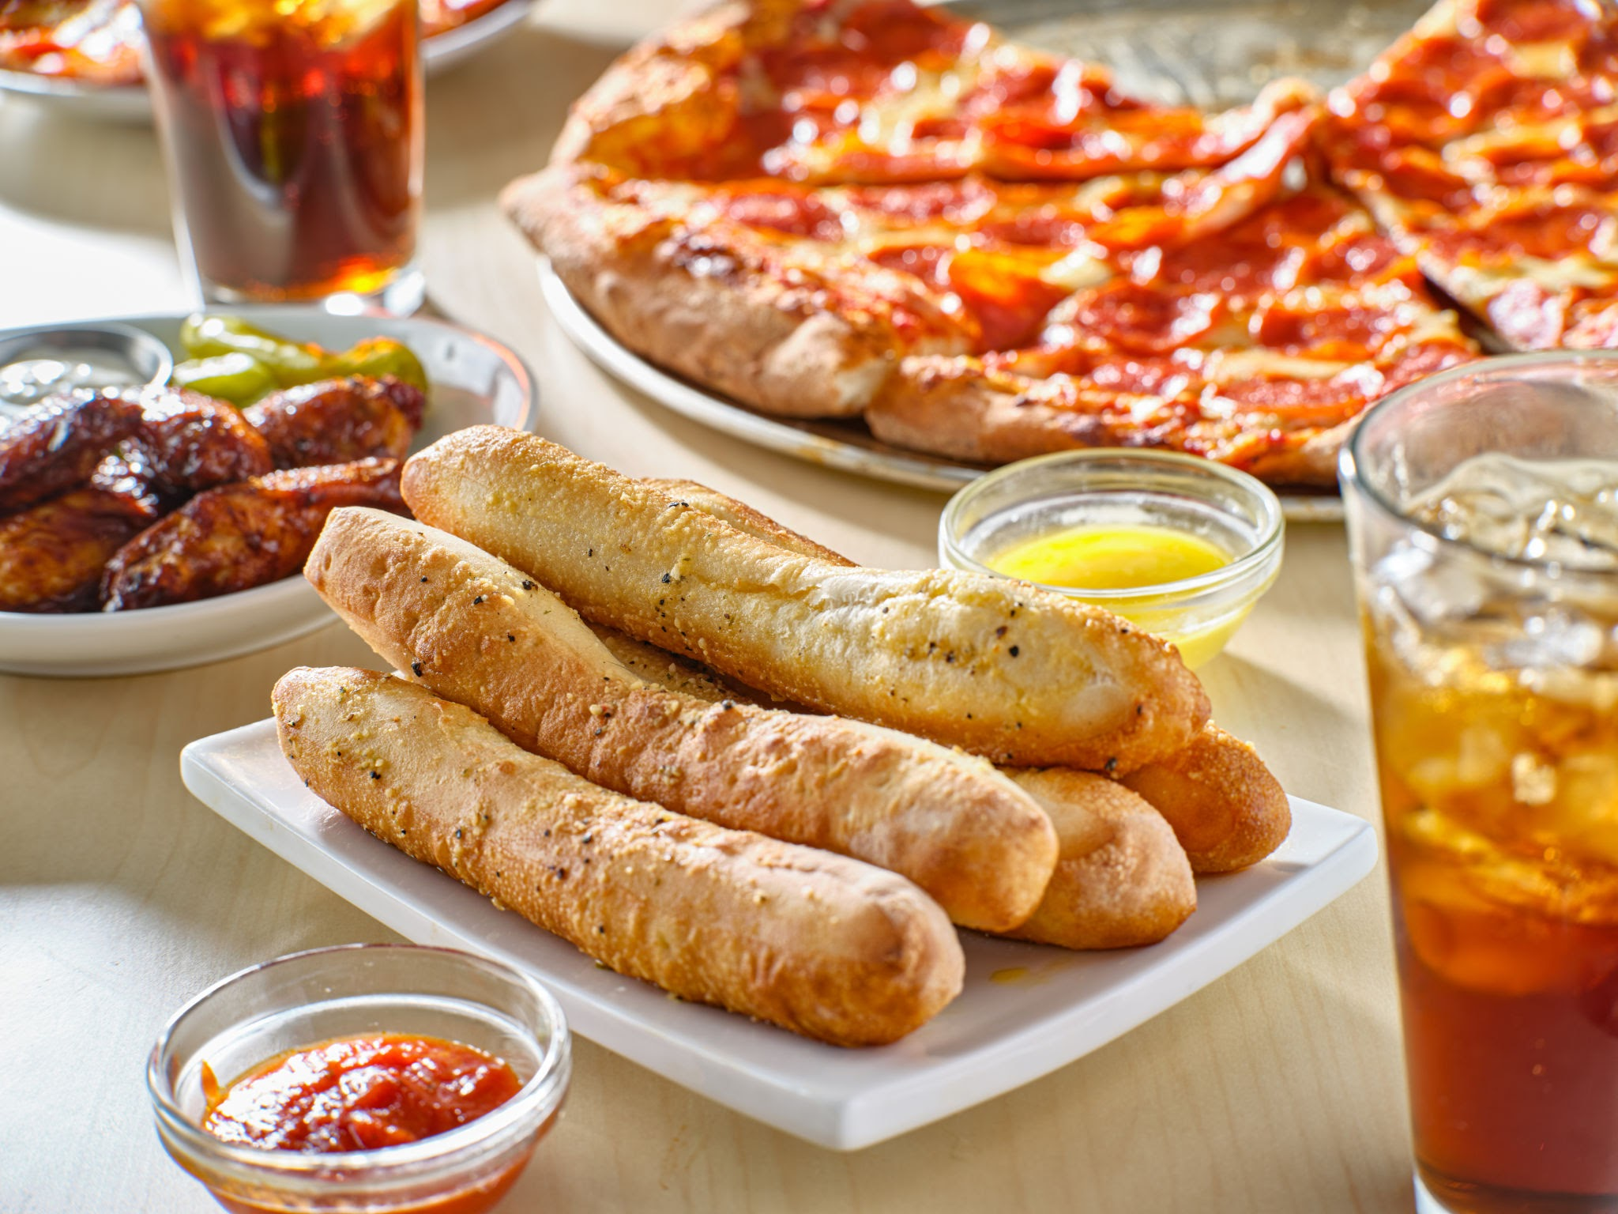
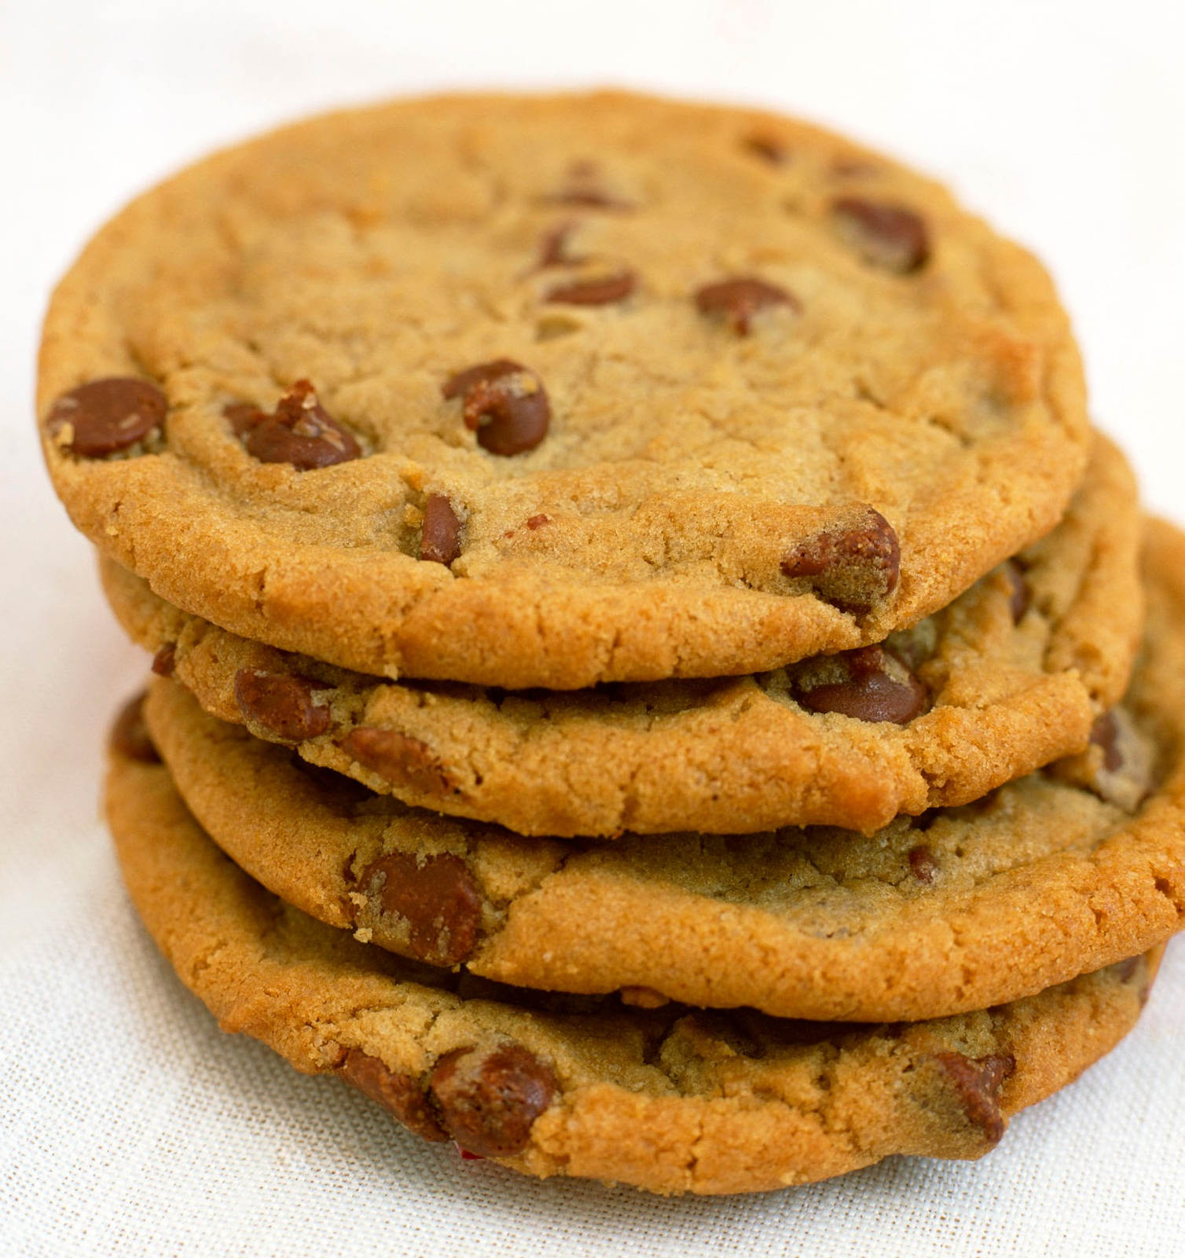
What is Healthy?

Slide 4
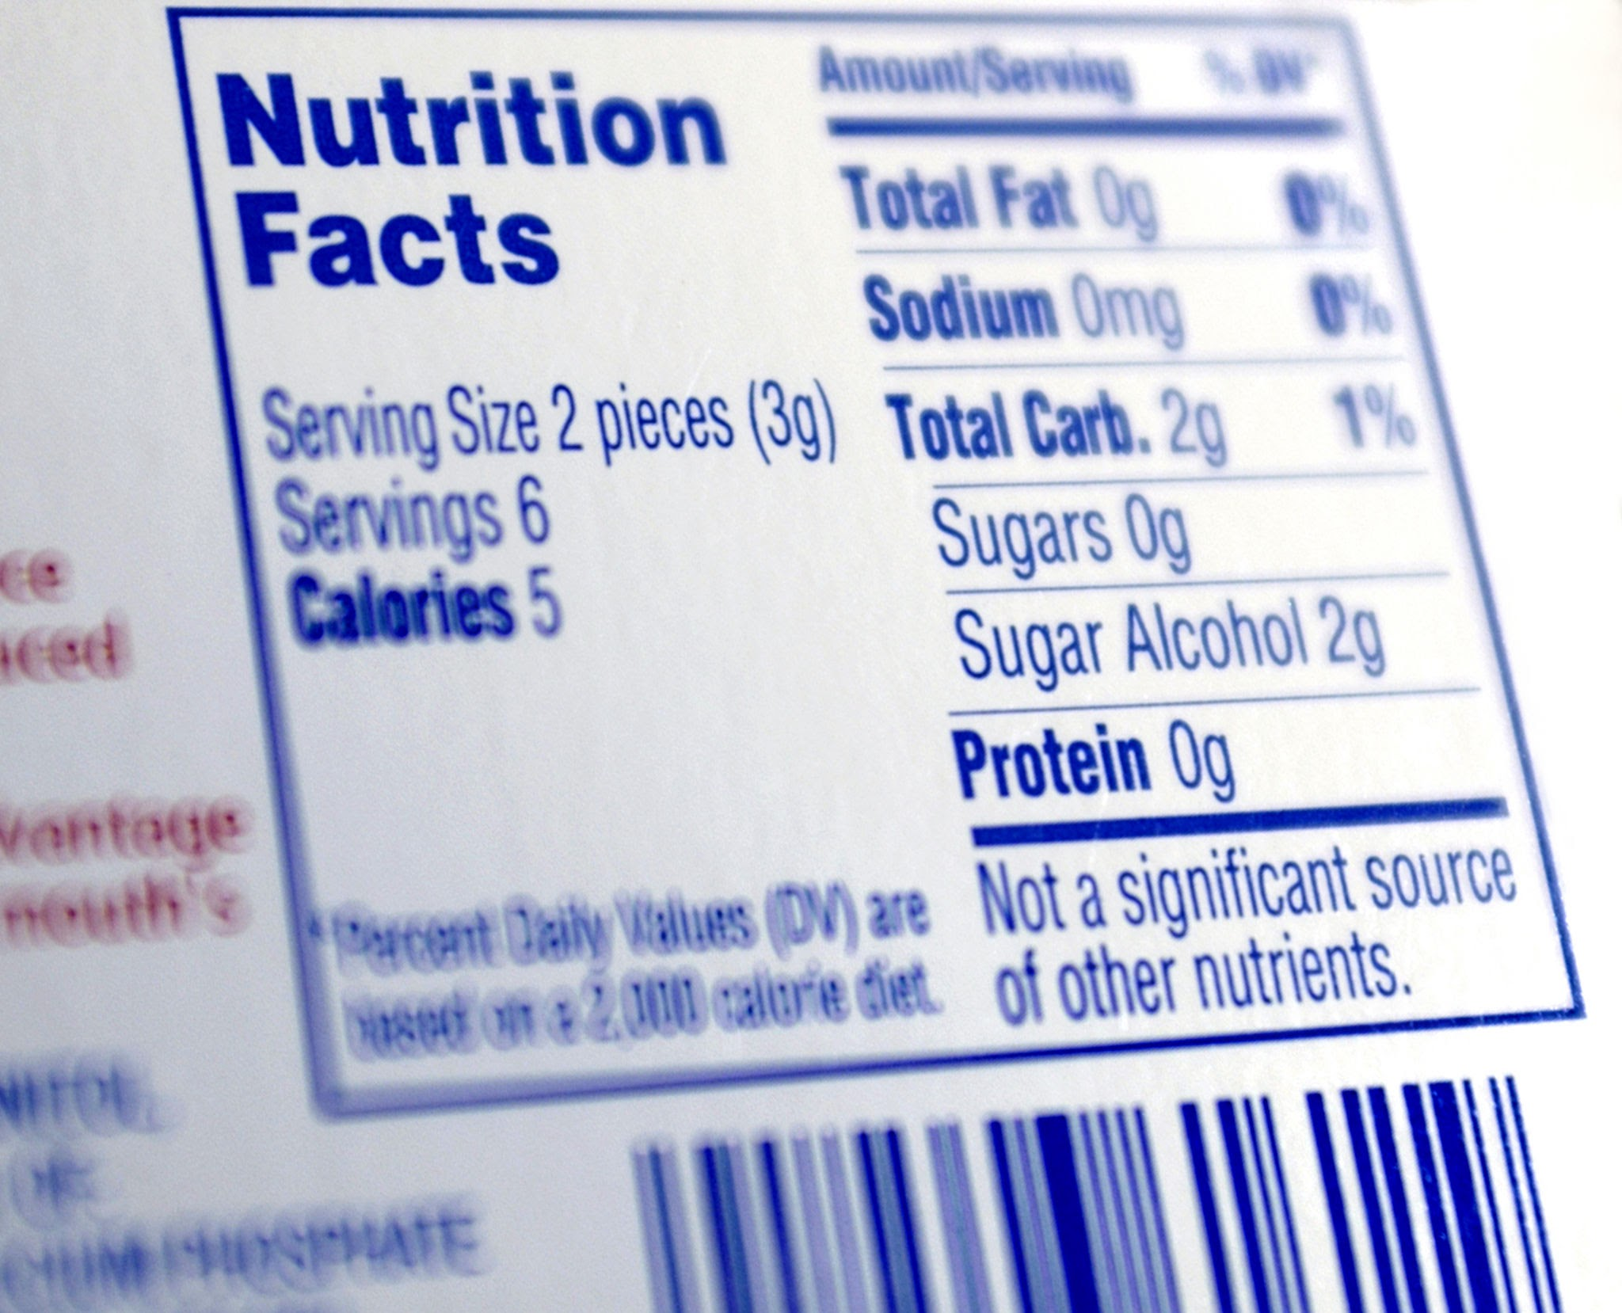
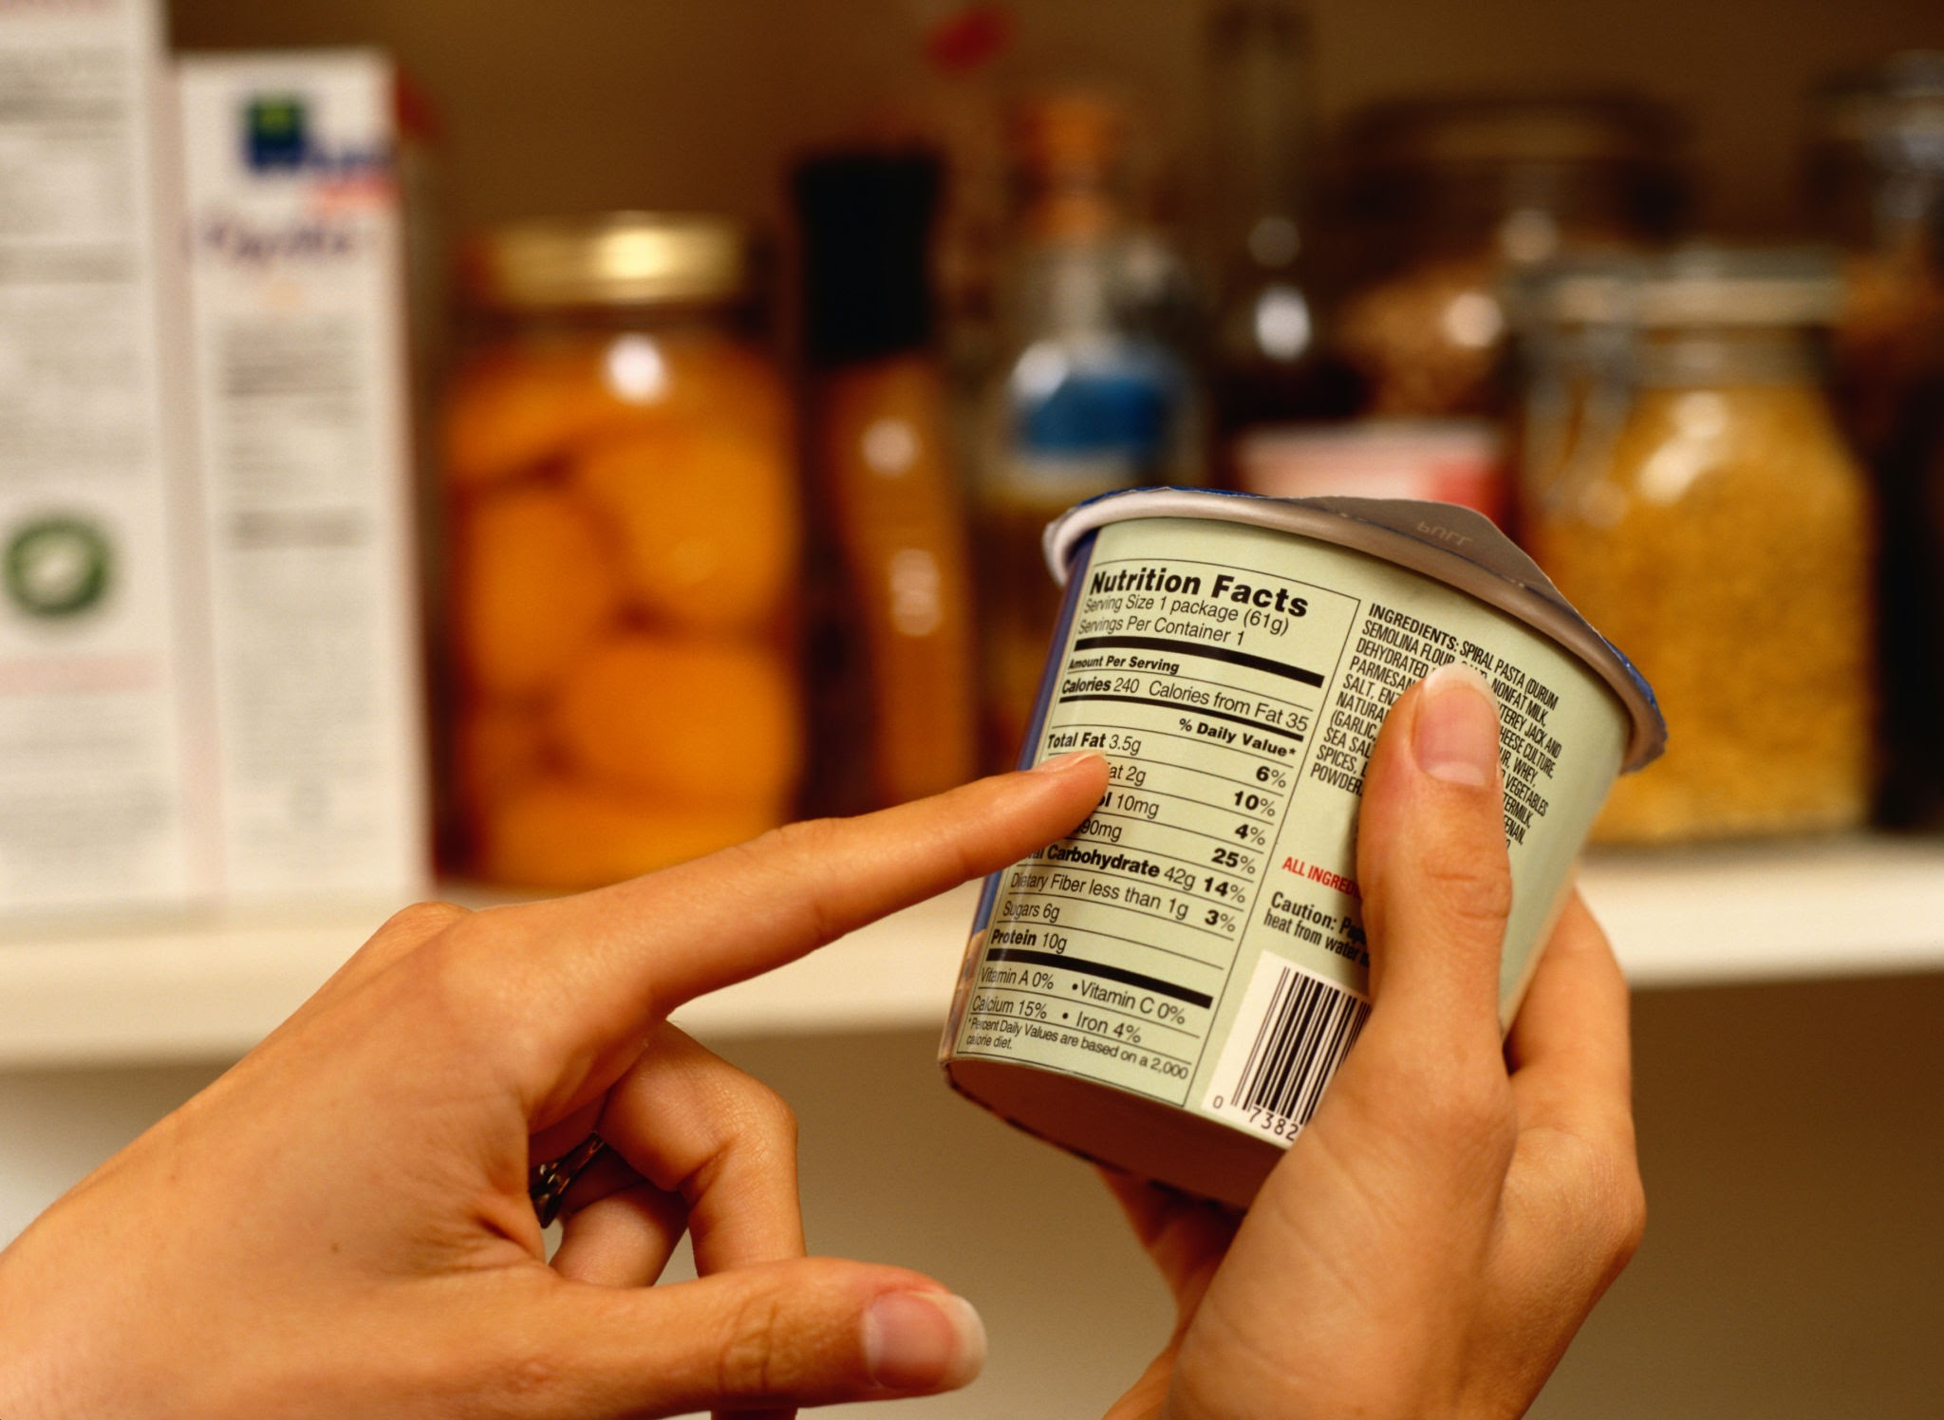

Slide 5

Vocabulary
Nutrition
Nutrients
Serving size
Ratio
Proportion
Numerator
Denominator
Calories
The process of our bodies taking in and using energy to grow
Substances contained in food for human growth
The amount a person should eat from the package at one time
A fraction showing the relationship of 2 values
An equation showing two equal ratios
The number on the top of a fraction
The number on the bottom of a fraction
Energy found in food

Slide 6
How much did you eat?
It is very common that a package of food contains more than one serving size.
It is important as a healthcare professional that you are able to direct your patients to healthy food choices.
Watch the video clip to see a healthcare professional having this conversation.
For Healthcare Professionals: “Talking to Patients About Using the Nutrition Facts Label”

Slide 7
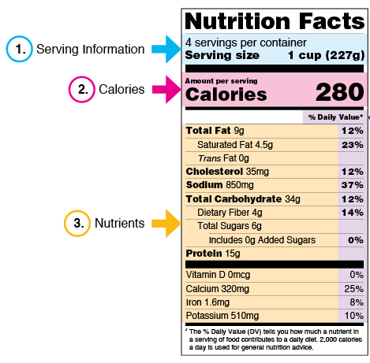

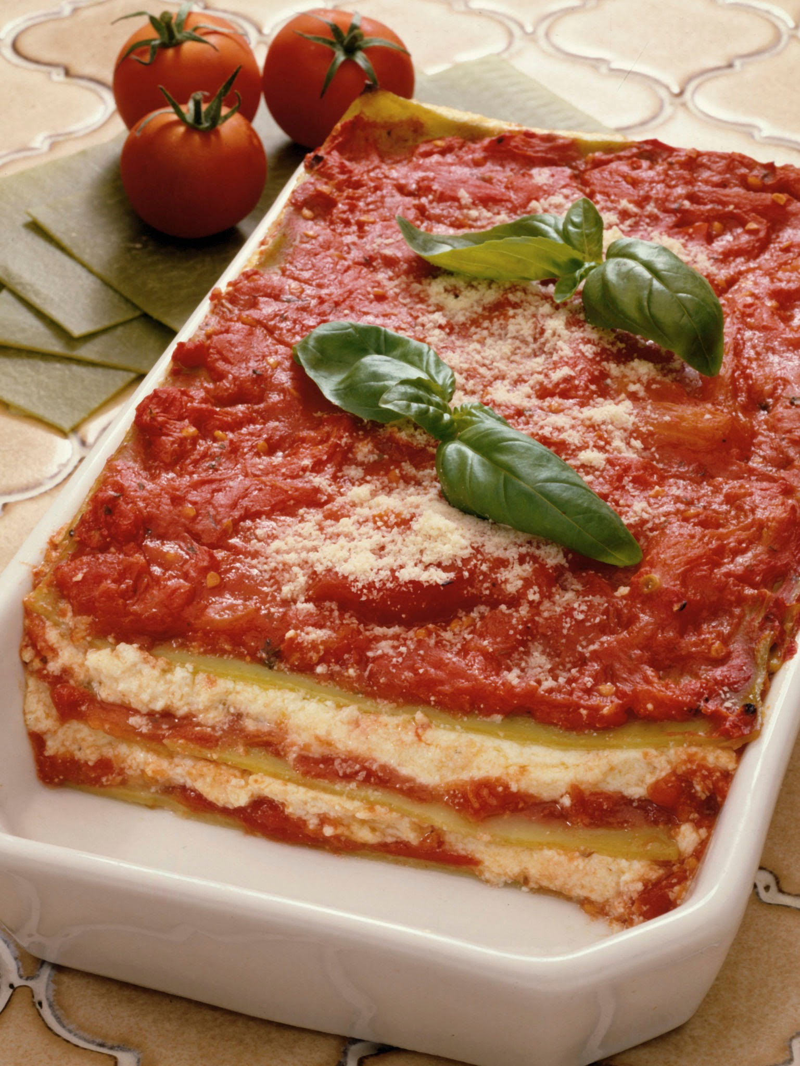
Source:https://www.fda.gov/food/nutrition-facts-label/how-understand-and-use-nutrition-facts-label

Slide 8
Ratios and Proportions
Since are multiple servings per container, you will need to be able to use your math skills to help you calculate how much you are eating.
Calories per serving
Calories per container
=
One serving
Servings in whole container
280
1
?
4
=
Information adapted from PBS https://illinois.pbslearningmedia.org/resource/midlit11.math.splprop/ratio-and-proportional-reasoning-food-labels/

Slide 9
Ratios and Proportions
280
1
?
4
280 x 4
1 x 4
1,120
=
=
4
There are 1,120 calories in the whole container.

Slide 10
Source:https://www.fda.gov/food/nutrition-facts-label/how-understand-and-use-nutrition-facts-label

Slide 11

2
4
1
2
4 servings
=
Whole container
=
Total fat per serving
Total fat in half the container
=
One serving
2 servings
9
1
?
2
=

Slide 12
9
1
?
2
9 x 2
1 x 2
18
=
=
2
There is 18 grams of fat in two servings (half of the container).

Slide 13
Let’s Practice!
How many calories are in one serving?
How many servings per container?
How many calories are there per container?
How many grams of protein are there per serving?
How many grams of protein are there per container?
How many grams of sugar are there per serving?
How many grams of sugar are there per container?

Slide 14
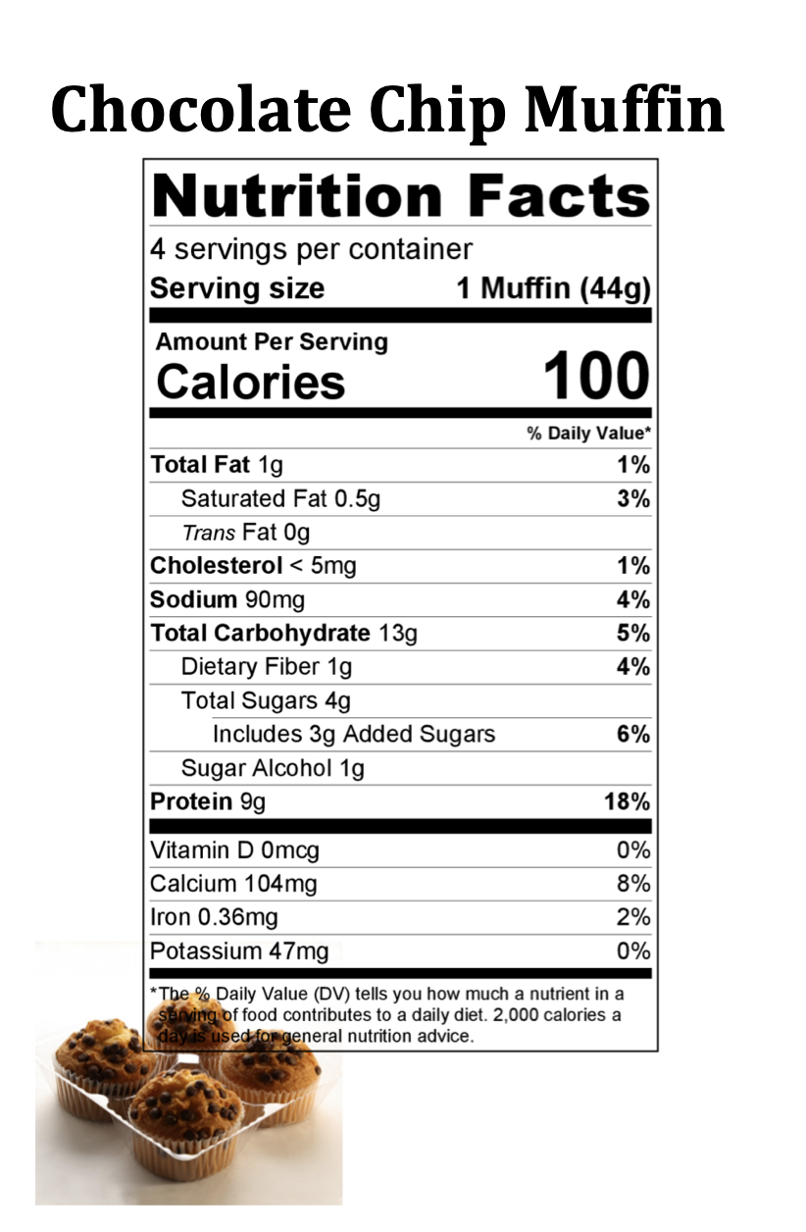
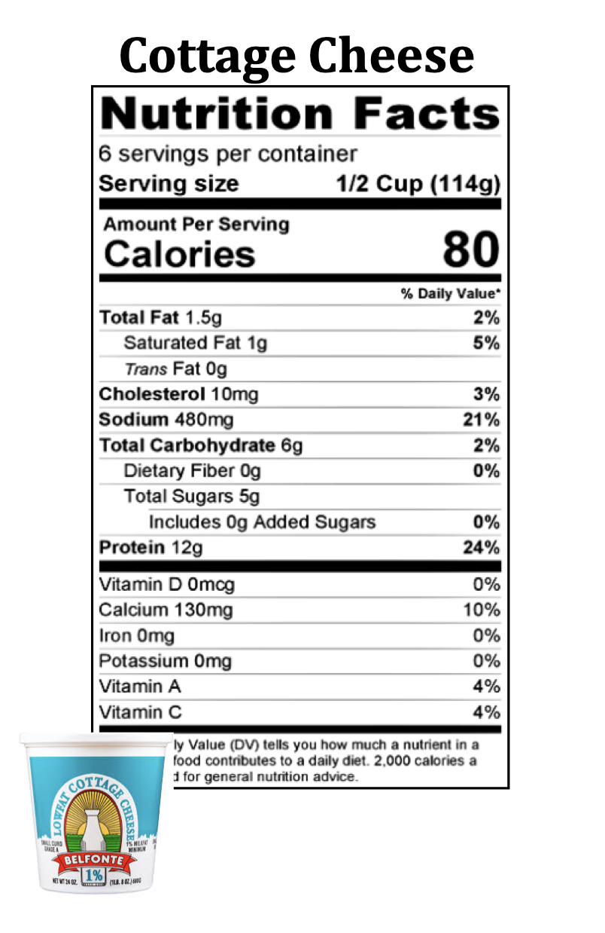
Source: https://cdn.agclassroom.org/media/uploads/2018/08/18/Nutrition_Fact_label_cards.pdf

Slide 15
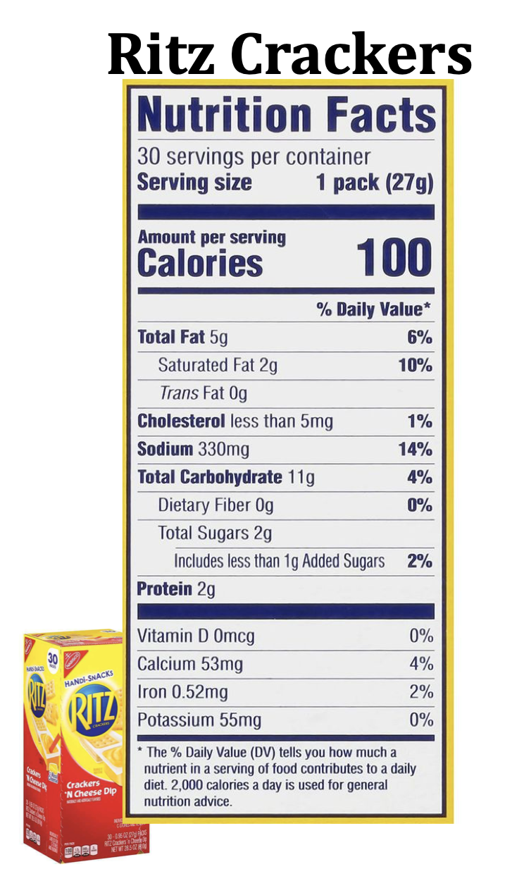
How many calories are in one serving?
How many servings per container?
How many calories are there per container?
How much fat is there per serving?
How much fat is there if you eat 2 servings?
How much sugar is there per serving?
How much sugar is there in 2 servings?
Source: https://cdn.agclassroom.org/media/uploads/2018/08/18/Nutrition_Fact_label_cards.pdf

Slide 16
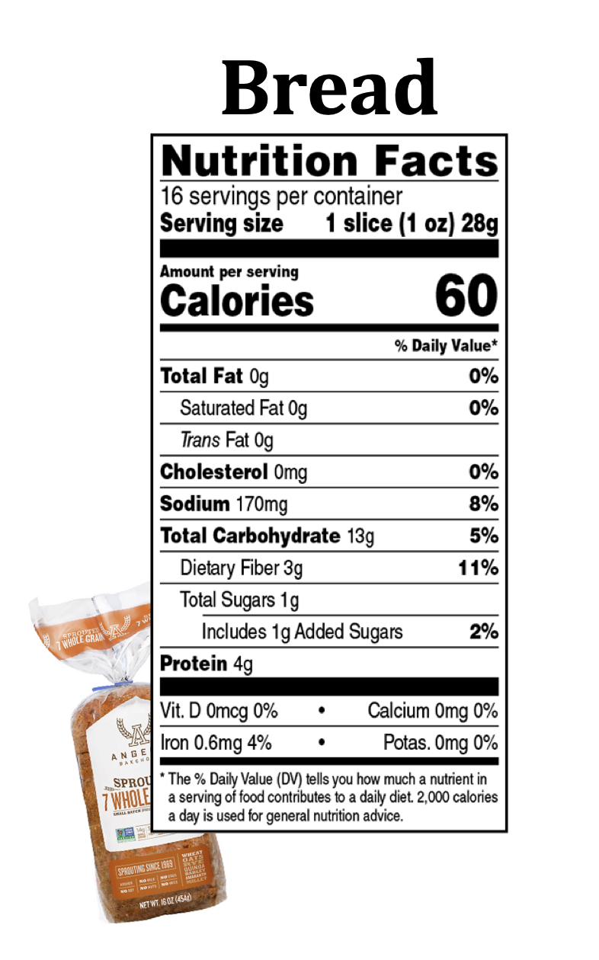
How many calories are in one serving?
How many servings per container?
How many calories are there per container?
How much sodium is there per serving?
How much sodium is there in 2 servings?
How much dietary fiber is there per serving?
How much dietary fiber is there in 4 servings?
Source: https://cdn.agclassroom.org/media/uploads/2018/08/18/Nutrition_Fact_label_cards.pdf

Slide 17
How many calories are in one serving?
100
How many servings per container?
4
How many calories are there per container?
400
How many grams of protein are there per serving?
9
How many grams of protein are there per container?
36
How many grams of sugar are there per serving?
4
How many grams of sugar are there per container?
16

Slide 18
Reflect:
What impact does paying attention to nutrition facts labels have on public health?
  How is healthy nutrition important to preventing and treating illness?
  Have you ever had a conversation with your healthcare provider about nutrition facts labels? How can doctors and nurses be intentional about this?
  After this lesson, what change might you make in your nutrition?

