Slide 1
INTRO TO FRACTIONS
Lesson 3: Comparing Fractions
INSTRUCTOR’S SLIDES

Slide 2
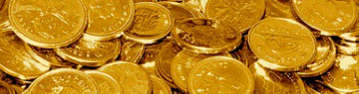
Slide deck contents
RED
PINK
ORANGE
YELLOW
GREEN
BLUE
INDIGO
PURPLE
GOLD
Review comparing unit fractions
none
Goals | Objectives | “I can…” statements
Lesson: Adding fractions in different units
Discussions: Reasoning about fractions | Activity: Human number-line
Small group/partner tasks: Experimenting with fraction sets
Discussion | Learning checks (QR codes)
Post-Learning Activities (Links)
A&W’s comeback

Slide 3
Lesson 3 Content Standards
IL ABE/ASE Math Standards - Equating Fractions
3.NF.8 Add and subtract fractions with unlike denominators (including mixed numbers) by replacing given fractions with equivalent fractions in such a way as to produce an equivalent sum or difference of fractions with like denominators.
3.NF.1 Explain why a fraction 𝑎/𝑏 is equivalent to a fraction (n × a)/(n × b) by using visual fraction models, with attention to how the number and size of the parts differ even though the two fractions themselves are the same size. Use this principle to recognize and generate equivalent fractions.
2.NF.3 Explain equivalence of fractions in special cases, and compare fractions by reasoning about their size.
a. Understand two fractions as equivalent (equal) if they are…. the same point on a number line.
b. Recognize and generate simple equivalent fractions (e.g., 1/2 = 2/4 , 4/6 = 2/3 ). Explain why the fractions are equivalent (e.g., by using a visual fraction model).
Targeted SMPs: 3, 5, 8

Slide 4
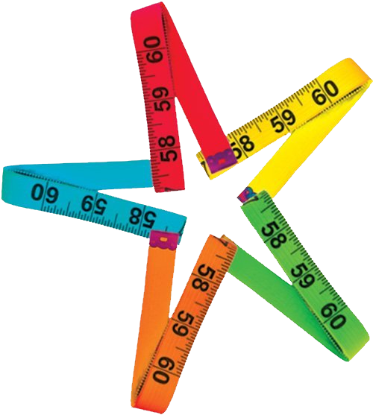
INTRO TO FRACTIONS
Lesson 3:
Comparing Fractions
course name
class name
date

Slide 5
Overview of lesson 3: What am I going to learn?
Content Objectives - I will be able to…
Compare fractions, using reasoning (what I know about fractions) and equivalent fractions (if necessary).
Order fractions on a number line to compare values, finding and using equivalent fractions if necessary.
Recognize equivalent fractions of simple fractions (using virtual modeling tools, hands-on manipulatives, number lines, or pattern reasoning)
Language Objectives - I will be able to…
Reason and explain my own understanding of fraction sizes using vocabulary terms: equivalent fraction, fractional notation, simplify, simplified fraction, compare, equal
End goals for this lesson

Slide 6
Recall: Comparing unit fractions
compare
to state whether a number is smaller, larger, or equal to another
What fractions are these, and how would you compare them?
>
½ ¼
When comparing two unit fractions, the fraction with the lower / higher denominator will be the larger fraction.
Respond + listen to others
Notes:
Generate discussion with the class, asking: “What do you remember about comparing unit fractions? Could we compare these two fractions, even if they have different denominators? Why can we do that? How can we prove that we’re correct?” Remind students of definition of compare if necessary.
Click once to reveal statement.
Recap “We found that the unit fraction with the smaller denominator will always be larger. The reasoning we used was based on what we know about fractions. We know that the more parts that a whole unit is divided up into, the smaller those individual shares (also known as the fractional units) are going to be. We saw this pattern when we modeled it. Now that we understand and know the pattern, though, we don’t have to model a unit fraction every time to know how to compare them.”

Slide 7
OBJECTIVES:
#1: Students will be able to compare fractions, using reasoning and equivalent fractions.
“I-Can…” StatementS:
I can compare fractions.
Focus on objectives, ask questions
Notes:
Expand the first objective to now include finding and using equivalent fractions. Click to reveal highlight.

Slide 8
discuss: How to compare fractions
How might you compare these fraction sets without modeling?
What do the numerators tell me?
What do the denominators tell me?
4/5, 2/5, 5/5
3/3 , 3/6 , 3/9
2/6 , 3/6 , 5/6
2/6 , 2/3 , 2/9
2/3 , 3/6, 3/9
2/3 , 4/6 , 6/9
What kinds of patterns or relationships do I see?
Discuss comparisons
Notes:
Explain “With unit fractions, we can say that the fraction with the larger denominator will always be the smaller number. So, I wonder if all fractions are going to be smaller if they have a larger denominator. In all of the examples on the right, the first fraction has the larger denominator. I bet that I will find that all fractions with a larger denominator will be smaller larger. What do you think?”
Encourage students to argue for or against your hypothesis, come up with examples that justify their stance, etc. Some students may point out something they’ve seen in recent lessons to disprove this theory.
Ask students about what they know about the numbers without modeling them, and give time for them to offer some thoughts. Click to reveal prompts.
Group students (into groups of 2 or 3) and assign them a modeling/reasoning task.

Slide 9
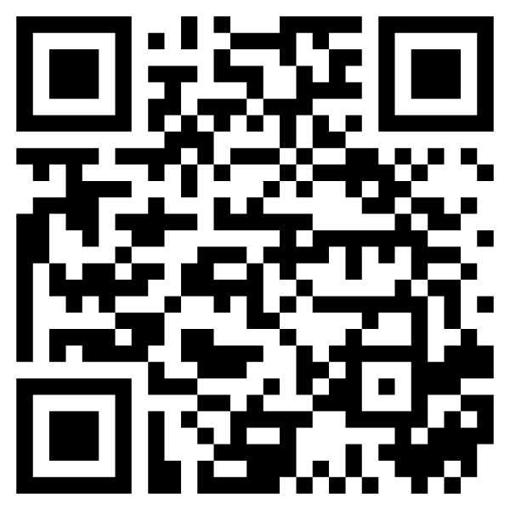
Paired Task: Study fraction sets
How does Fraction Set 1 compare?
Use modeling tools to prove or disprove your theory:
2/6 , 2/3 , 2/9
3/3 , 3/6 , 3/9
2/3 , 4/6 , 6/9
MLC
Work with buddy[ies] to find patterns in fraction sets
Notes:
Prompt students to give a hypothesis before diving in, using what they know about fractions.
Provide digital or tangible tools for students to model and compare their fractions.

Slide 10
Paired Task: Study fraction sets
How does Fraction Set 2 compare?
Use modeling tools to prove or disprove your theory:
2/6 , 3/6 , 5/6
4/5 , 2/5 , 5/5
2/3 , 3/6 , 3/9
MLC
Work with buddy[ies] to find patterns in fraction sets
Notes:
Explain “With unit fractions, we can say that the fraction with the larger denominator will always be the smaller number. So, I wonder if all fractions are going to be smaller if they have a larger denominator. In all of these examples, the first fraction has the larger denominator. I wonder if I will find that all fractions on the left are smaller, since their denominator is larger. What do you think?” Let students give input.
Ask students what they’re noticing about these fractions. They might offer the following: there are a lot of the same numbers (like 2 and 3 and 9), the 3/3 means one, the numerators are the same in the first two sets …
Prompt students to give a hypothesis before diving in, using what they know about fractions.
Provide digital or tangible tools for students to model and compare their fractions.

Slide 11
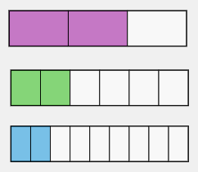
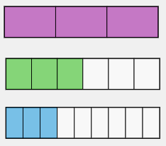
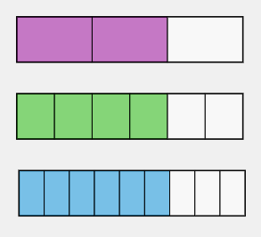
Discuss: How to discuss (your own or another’s) reasoning
What was changing in each set?
What stayed the same?
What thoughts or ideas were you starting to have as you compared what was changing and remaining?
⅔
2/6
2/9
3/3
3/6
3/9
⅔
4/6
6/9
2/9 < 2/6 < 2/6
3/3 > 3/6 > 3/9
2/3 > 4/6 > 6/9
What was one thing you guessed about how the fractions would compare?
What led you to make that guess?
What was different about the last fraction set? How was it like the first two?
How did these differences change or add to your perspective or your ideas?
Did this experiment agree or disagree with your original hypothesis?
Discuss your thoughts
Notes:
Invite the first group[s] of students to share what they did and what they learned when comparing their fractions.
Click once for each set of questions. Ask follow up questions to get students talking about what they noticed, wondered or hypothesized, and how the last set of fractions impacted their reasoning.
Students should conclude that when comparing fractions to one another, a fraction with the same numerator as another will be smaller if its denominator is larger.

Slide 12
Learn: We can compare fractions using reasoning
NEW CONCLUSION:
When comparing two fractions with the same numerator, the fraction with the higher denominator is the smaller fraction.
REVIEW GAME
Take notes, practice with class
Notes:
Present the new conclusion to the class and use the Review game to test its efficacy.
The link leads to Mathplayground.com. Project the game for everyone, choose to play with only “same numerator” option selected. During the game play, have students say which symbol to pick. Game is untimed, allowing students to discuss and debate which option to choose.

Slide 13
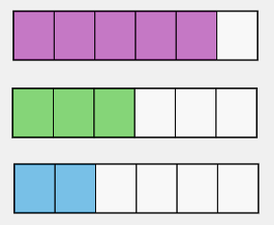
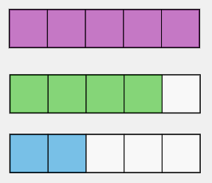
Discuss: How to discuss (your own or another’s) reasoning
What was changing in each set?
What stayed the same?
What thoughts or ideas were you starting to have as you compared what was changing and remaining?
5/6
3/6
2/6
5/5
4/5
2/5
2/3
3/6
3/9
2/6 < 3/6 < 5/6
2/5 < 4/5 < 5/5
2/3 > 3/6 > 3/9
What was one thing you guessed about how the fractions would compare?
What led you to make that guess?
What was different about the last fraction set? How was it like the first two?
How did these differences change or add to your perspective or your ideas?
Did this experiment agree or disagree with your original hypothesis?
Discuss your thoughts
Notes:
Invite the group[s] of students working with the second fraction set to share their experience in the same fashion.

Slide 14
Learn: We can compare fractions using reasoning
NEW CONCLUSION:
When comparing two fractions with the same denominator, the fraction with the higher numerator is the larger fraction.
REVIEW GAME
Take notes, practice with class
Notes:
Present the new conclusion to the class and use the Review game to test its efficacy.
The link leads to Mathplayground.com. Project the game for everyone, choose to play with only “same denominator” option selected. During the game play, have students say which symbol to pick. Game is untimed, allowing students to discuss and debate which option to choose.

Slide 15
Discuss: How to critique (your own or another’s) reasoning
Initial hunch:
Reasons for thinking this:
Supporting evidence from experiment:
Opposing evidence from experiment:
Factor[s] not initially considered:
State the Rule: When comparing fractions, ___________________________.
A fraction is smaller than another if its denominator is larger.
When modeling unit fractions, fractional units got smaller as the number of parts increased.
The results of the first two sets of fractions supported my guess.
The results of the last set opposed my guess.
The value of the fractions’ numerators being the same. I hadn’t considered how the numerator would make a difference in the size of the fraction.
Discuss evidence and reasons
Notes:
Note: Every click in click sequence reveals one answer in yellow.
Invite students to reflect on and critique your reasoning as you experimented with :
“What did I first suppose was going to happen when I compared fraction sets? In other words, what hunch did I have?” (That all fractions would be smaller if their denominator was larger)
“What made me think that this was going to be the case?” (When modeling u.f.s, I saw the fractions were getting smaller as the denominator was getting larger)
“So, as I’m conducting my experiment (comparing fractions in each set), what supporting and opposing evidence am I now getting?” (Supporting: first two sets of fractions supported this statement, opposing: last set opposed my hunch)
“What other information did I fail to consider?” (That we only looked at unit fractions, or fractions with numerators of 1; fractions could have different numerator values that change the amount…)
Summarize, “When I developed my original hypothesis about fraction comparisons, I saw that the bigger a fraction’s denominator got, the smaller the fraction was. I assumed that the reason for this pattern was due to the denominator alone. However, I failed to consider other factors, especially the face that I was only comparing unit fractions, which always have the same numerator. I didn’t think about how the numerator affected the overall size of the number that I was comparing, so I incorrectly extended my assumption to all fractions. I now see that, while I was right about the fractional unit getting smaller, I was wrong in thinking that a smaller unit makes every fraction smaller.”
Ask “How can we combine all of this data we’ve gathered and patterns we’ve observed to restate our observations as a rule?”

Slide 16
Paired Task: Studying fraction sets
How does Fraction Set 3 compare?
Use modeling tools to prove or disprove your theory:
2/3 , 4/6 , 6/9
1/2 , 2/4 , ???
???, ???, ???
MLC
Work with buddy[ies] to find patterns in fraction sets
Notes:
Buddy students up (2 or 3) to model the third set. Provide digital or tangible tools for students to model and compare their fractions. Challenge students to continue the pattern by creating a third fraction for the second trio and then a third trio.

Slide 17
Group work: We can compare fractions
Group work: We may find equivalent fractions
equivalent fraction
a fraction that expresses the same value as another, written in different fractional notation
What did you notice about these fractions?
2/3
4/6
6/9
Take notes + discuss
Notes:
Invite students share what they first noticed about this fraction set. Students may point out the numerators and denominators were all different and express that it was hard to compare at face value.
Ask students how they compared the sizes of these fractions once they modeled them. Students should start to see that they would make an equality statement. Some may describe equality.
Click once to swap slide titles, and introduce the concept of equivalent fractions.

Slide 18
OBJECTIVES:
#1: Students will be able to compare fractions, using reasoning and equivalent fractions.
#1: Students will be able to compare fractions, using reasoning and equivalent fractions.
“I-Can…” StatementS:
I can compare fractions.
I can substitute equivalent fractions.
Focus on objectives, ask questions
Notes:
Expand the first objective to now include finding and using equivalent fractions. Click to reveal highlight.

Slide 19
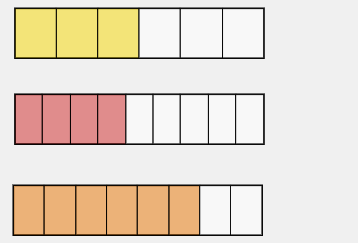
Paired task: Substituting equivalent fractions
Equivalent fractions:
3/6
4/9
6/8
2/3
4/6
6/9
How might you use equivalent fractions to compare two fractions?
3/6
<
2/3
4/6
6/8
>
2/3
6/9
4/9
<
2/3
4/6
6/9
Work with a partner to compare fractions
Notes:
Ask students how they could substitute equivalent fractions of 2/3 to compare against these other numbers. Make sure students are aware that only the right-hand column contains equivalent fractions.
Walk class through the first comparison statement.
Direct students to work with a partner for the second and third.
Click once to swap 2/3 for each inequality statement: 4/6, 6/9, and both 4/6 & 6/9 for the last one. Click between swaps to reveal inequality symbols for first two and after both swaps for the third.

Slide 20
OBJECTIVES:
#3: Students will be able to recognize equivalent fractions of simple fractions.
#1: Students will be able to compare fractions, using equivalent fractions.
“I-Can…” Statement:
I can find, create, and use equivalent fractions.
Focus on objectives, ask questions
Notes:
Explain to students that equivalent fractions are not always listed. Sometimes they will have to find or create them themselves. They’ve already started accomplishing this objective by exploring the modeling software. Now they will work with number lines and tiles to find and create equivalent fractions.

Slide 21
find/Create task: Create equivalent fractions
Group 1 SLIDE
Group 2 Slide
Group 3 Slide
Group 4 Slide
Understand the task, ask questions
Notes:
Divide students into four task-groups of 2-4 students each (split bigger groups into subgroups if needed), according to minimal supports/working conditions that students need for finding fractions on number lines:
Group 1 will find multiple equivalent fractions using virtual tiles and number lines in halves, fourths, and eighths.
Group 2 will use similar reasoning and tools but with all fractions up to sixteenths
Group 3 will work with a double number line up to tenths and find multiple equivalent fractions in given fractional units
Group 4 will work with the fraction number line from MathsIsFun site to find multiple equivalent fractions in given units
While Group 4 can complete their bonus task/question during this time, review that task with the whole class at the end for discussion.

Slide 22
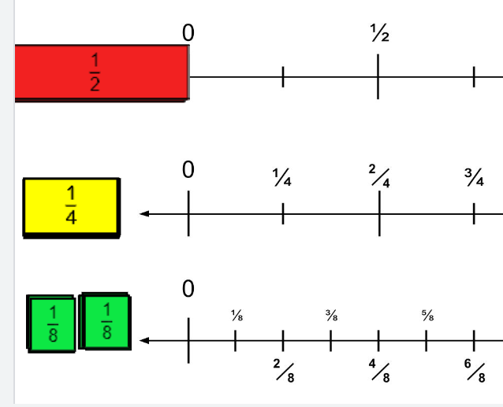
Group 1 task: Create equivalent fractions
Back to list Slide
INTERACTIVE:
Jamboard [place link for class JB]
Make equivalents for:
1/2
8/8
1/4
Explore fraction tools
Notes:
Task: Students in this group will find multiple equivalents for three different fractions. They can create EFs by placing smaller units on a number line until they reach a partition line and record their results.
Display the number line Jamboard. Show students how the number lines show the same values in different units, the tiles are given in three different fractional units and they line up with the partition lines on their corresponding number lines (note: one-fourth lines are added unlabeled to the first number line to help students see where the smaller units would fall).
Explain however, the values will have different fractional notation; in other words, the numerator and denominator will be different.”

Slide 23
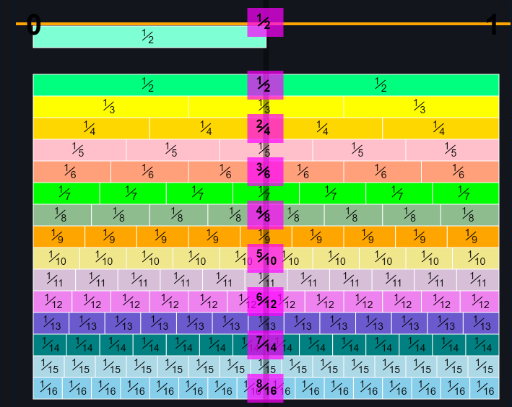
Group 2 task: Create equivalent fractions
Back to list Slide
DISPLAY:
MathsisFun Number Line
Make equivalents for:
1/2
6/8
2/3
Explore fraction tools
Notes:
Task: Students in this group will find multiple equivalents for three different fractions. They will make equivalent fractions by finding the partition lines that line up.
Show students how to scroll through the number line and note when equivalent fractions come up (in purple boxes). They should notice that the partitions line up at various points with some fractional units.

Slide 24
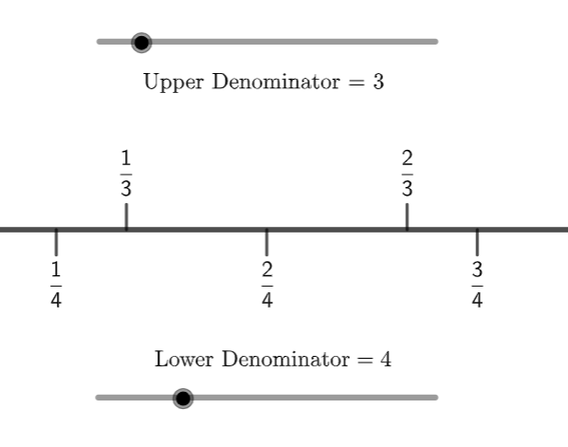
Group 3 task: Create equivalent fractions
Back to list Slide
USE:
Geogebra Two-sided number Line
Make equivalents between:
Halves + fourths
Thirds + sixths
Fifths + tenths
Two fractional units of your choice
Explore fraction tools
Notes:
Task: Students in this group will find multiple equivalents in the same two units. They will then use their own reasoning to find a fourth group of equivalent fractions.
Show students how to change the parts and notice that the unit correlates to how many parts there (four parts = fourths, etc.)

Slide 25
Group 4 task: Create equivalent fractions
Back to list Slide
DISPLAY:
MathsisFun Number Line
Make equivalents among:
Halves + fourths + eighths
Fourths + eighths + sixteenths
Thirds + sixths
BONUS: Which fraction can you make the most equivalents for?
Explore fraction tools
Notes:
Task: Students in this group will find multiple equivalents in the same two or three units. If they have time, they will also find the fraction with the most equivalents. They will use their reasoning to think of fractions that have many equivalents, and choose the one that has the most.
Show students how to scroll through the number line and note when equivalent fractions come up (in purple boxes). They should notice that the partitions line up at various points with some fractional units.
Open up the bonus task to the rest of the class. The answer will be 1 (or 1/1, 2/2, … etc.), but students may see the one-half and notice all of its EFs. Explain that knowing how to find EFs for both one-half and one will be good as they continue comparing fractions.

Slide 26
OBJECTIVES:
#3: Students will be able to recognize equivalent fractions of simple fractions (using …. pattern reasoning).
“I-Can…” Statement:
I can find and create equivalent fractions using what I know about
Focus on objectives, ask questions
Notes:
Check in with students. Ask if they feel like they can use tools to find and even create equivalent fractions.
Explain to students that they may have started to intuitively notice a pattern in the equivalent fractions from this lesson even if they’ve been unable to articulate that pattern. Using intuition with number patterns is actually one way we see ourselves develop number sense. The next couple slides may help those students whose number senses are emerging through this lesson. However, whether or not the connection is apparent yet, students should feel comfortable falling back on their modeling skills and what they know about fractional unit sizes for now when comparing fractions.

Slide 27
Learn: We can create equivalent fractions
Fractional Notation
a fraction expressed as a numerator and a denominator with a fraction line between the numbers (written as “a/b”)
How do the partitions differ from one fraction to the next?
2/3
4/6
6/9
What kind of relationship do we see in their their numbers (how a number is written)?
simplify = to substitute an expression with the equivalent expression that is the easiest to understand
Take notes + discuss
Notes:
Ask what they notice about specific features of the fraction models (partitions and the number of total parts, shaded vs. unshaded parts).
Ask students to describe how they created their third group of fractions that were shaded equally, and what they noticed when creating their own fractions.
Explain that we can create equivalent fractions by further partitioning parts of the simplified fraction. The models and number lines help us to find and create our own fractions if we can find partitions in the number line/shapes that line up. Point out where the 1/3 is partitioned on the top model. Ask students to give an equivalent fraction to 1/3 using what they see here.
Ask what connections they see between the numerators and between the denominators. Click to reveal definition. Explain that when finding equivalent fractions, they will notice that the fractional notation changes (both numbers change) even though the amount shaded stays the same. However, the changes are not random. “If a third is equal to two-sixths, then one-third plus one-third is the same as two-sixths plus two-sixths, etc.”
Say “You may have noticed that you added two to the numerator and three to the denominator to get an equivalent fraction. That pattern continued for the 6/9. Can anyone continue this pattern and think of another equivalent fraction? Why might this be happening?”

Slide 28
Think: How is this value being expressed?
We see the fraction model change. Where do we see change?
What stays the same?
What do you think about the operations we see at the end?
Observe + discuss
Notes:
Play video, asking students to focus on what stays the same and what changes.
After watching once, generate discussion. Possible questions:
What are the fractional notations being represented here?
Does the first fraction change? How so?
How can we summarize the changes we’re seeing?
How does this relate to what we have been learning?
Note for differentiation: Some students will notice the relationship that the num. and den. are doubling for each new fraction, and some won’t. Level 3 students will be developing this understanding. At level 2, students should see that these fractions are equal when they’re modeled and describe changes in the numerators and denominators.

Slide 29
OBJECTIVES:
Students will be able to…
1. Compare fractions, finding and using equivalent fractions if necessary.
2. Order fractions on a number line to compare values, finding and using equivalent fractions if necessary.
3. Find/Create equivalent fractions of simple fractions (using virtual modeling tools, hands-on manipulatives, number lines, or pattern reasoning)
4. Explain my own understanding of a fraction’s size using these terms: equivalent fraction, equal, fractional notation, simplify, simplified fraction, compare, like fractions, same numerator, same denominator
Focus on objectives, ask questions
Notes:
Explain that for the final class activities (and subsequent independent activities), students will have to demonstrate wide mastery of the lesson’s objectives in order to be successful.

Slide 30
Activity: I Have / Who Has?
Creating a human number line
The card with a star in its upper left corner begins the call sequence.
First caller hangs their card on the number line and says “I have _______; who has _________?” filling in the blanks with what is on their card.
The person who is called will then say “I have ____.” But, before placing their card on the line, the class must discuss and guess where that fraction will go on the line.
After class discusses and some guesses have been made, the student with the called card can reveal their card.
The class works together to help that student place the card on the number line.
That player then calls for the next card in the sequence.
Steps 3-6 repeat until all cards have been called.
Work with the class to place fractions correctly
Notes:
Place a physical number line (using rope, clothesline, painters tape, etc.) in classroom, marking 0, ½, and 1.
Hand every student at least one fraction card, according to directions.
Facilitate activity according to directions.
OPTIONAL:
Allow students to use tools at their desks in order to support their reasoning for placing the fraction, such as pre-measured number lines in various fractional units (halves to eighths), fraction tiles, white boards, lesson notes etc.

Slide 31
Connect the lesson: Reading a measuring tape
Notes:
Provide rulers or measuring tape for this discussion, preferably in multiple units. Play Tik-Tok clip.
After watching, generate discussion with the students:
Assess understanding: “What did this person’s wife write (on the paper)? Why does she record her measurement in this way? Do you see on your ruler/tape something that looks like what she’s talking about?”
Connect to learning: “What parts of using a measuring tape are similar to what we’ve been doing? How might we use what we’ve learned about fractions to read a ruler or measuring tape? How does knowing about equivalent fractions make real-life tasks like this easier to do or understand?”
Note: Playing video at .70-.80 speed is recommended, to give students time to read the note at the end and to think about what they’re seeing.

Slide 32
Post-Lesson Learning Checks
How to do it: Choose an activity to complete by yourself, with a classmate, or with a group of classmates.
ACTIVITY TYPE AND SETTING | ACTIVITY NAME + DIRECTIONS
DISCUSSION Medium- to large-sized group (5+ people) | Which One Doesn’t Belong? Look at the fractions and choose the one you think doesn’t belong. How would you argue that you’re right?
LEARNING CHECKS Individual or with a buddy | Monster Fractions (many variations) Ordering four fractions (w/ different denominators + numerators) Finding equivalent fractions
GAMES Small group (2-4 people) | SHOW OR TELL - Vocabulary game CONNECT FRACTIONS (LEVEL 2) - Adding-fractions game
INDEPENDENT ACTIVITIES | Decode a measuring tape Create your own number line
Notes:
Discussion Slide can be projected by clicking link.
“Learning checks” links to QR codes for students who want to complete the activities on their phones
Games are found in Google Docs handout entitled “Independent Games”
Independent Activities are provided in Google Slide deck entitled “Independent Activities”

Slide 33
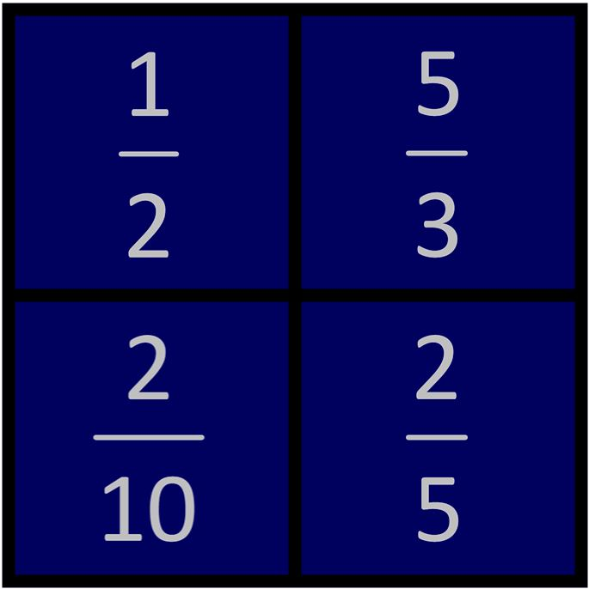
Discussion: Which one doesn’t belong?

Slide 34
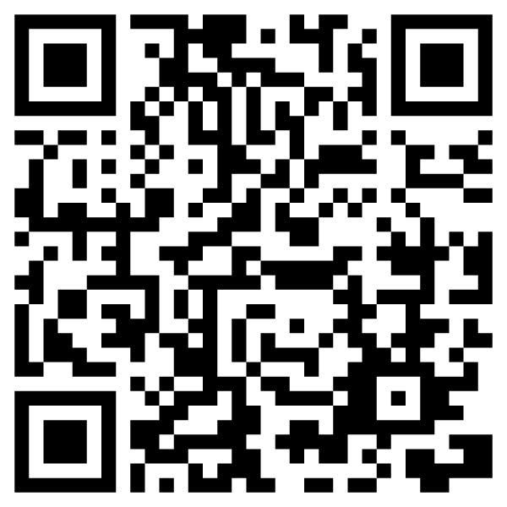
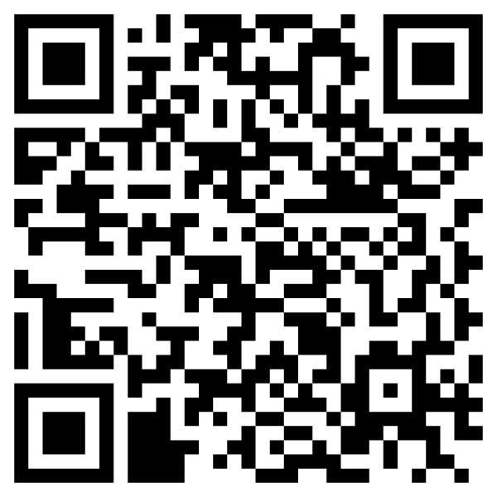
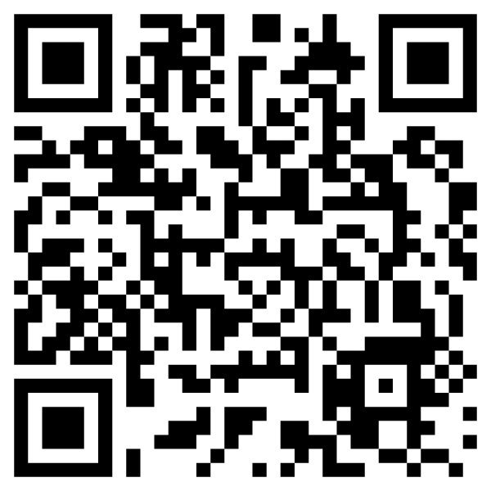
LEARNING CHECKS
Monster Fractions
(many focuses)
Ordering 4 fractions
(different denominators + numerators)
Equivalent fractions
(on a number line)

Slide 35
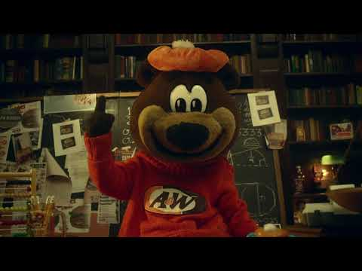
The Reveal: How A&W came back from marketing flop using math

